Slide 1
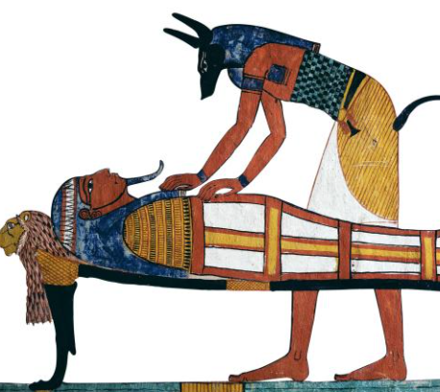
Monday 7th December 2020
L.O: To write the opening.
C: Explanation Text
We are going to start writing an explanation text of how to make a mummy!

Slide 2
Let’s recap the key features of an opening….
Try your best to remember the features because we are going to try and spot them in a minute!

Slide 3
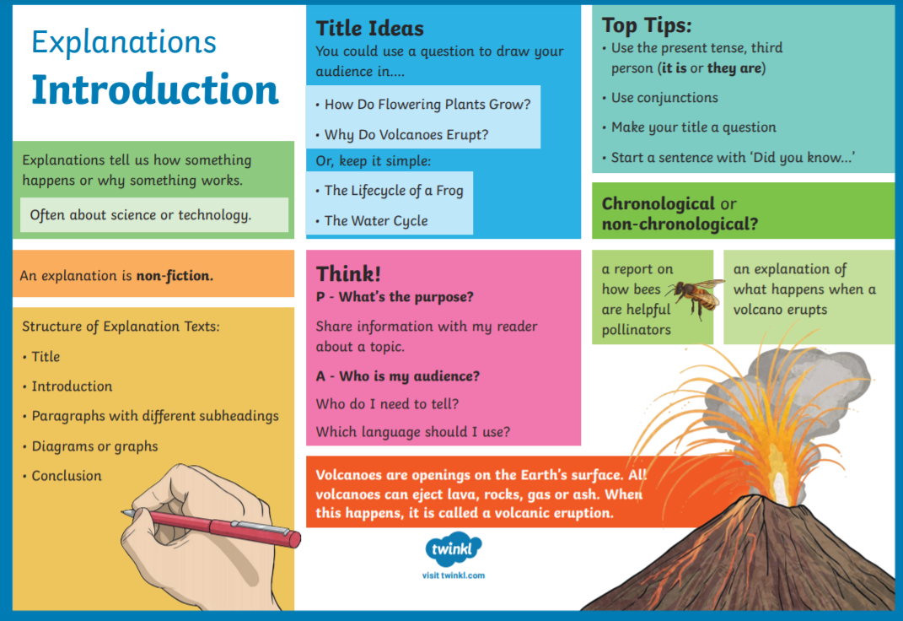
Introduction

Slide 4
Let’s look at our model text!
The Journey to the Afterlife.
The Egyptians believed that when they died, their souls left their bodies. After they were buried, their soul would return and together with the body, would live forever in the afterlife. Unless their body was preserved, it would be no good in the afterlife. But not everybody could afford this, it was a very expensive process that took around 70 days to complete.

Slide 5
First we need a title!
It’s a great idea to start your title with How or Why as it will make the purpose of your explanation text really clear.
Can you work with your partner to come up some title ideas?

Slide 6
Now we need an opening paragraph!
This paragraph should:
- Introduce what you are explaining in a detailed yet clear way.
Let’s mind map a few points we want to include:
Remember your 5 w’s!

Slide 7
Live Modelling of Opening Paragraph

Slide 8
Now it is your turn!
Can you write your own title and opening?
We will pause to hear a few in a few minutes so try your best to impress everyone and move your name up!

