Slide 1
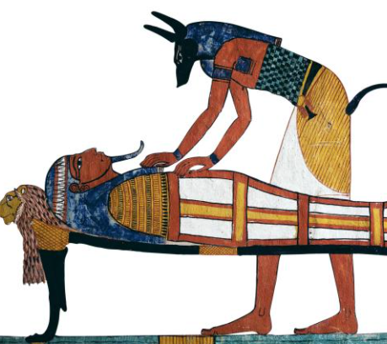
Monday 7th December 2020
L.O: To apply prepositions of place.
C: Explanation Text
We are going to learn all about prepositions!

Slide 2
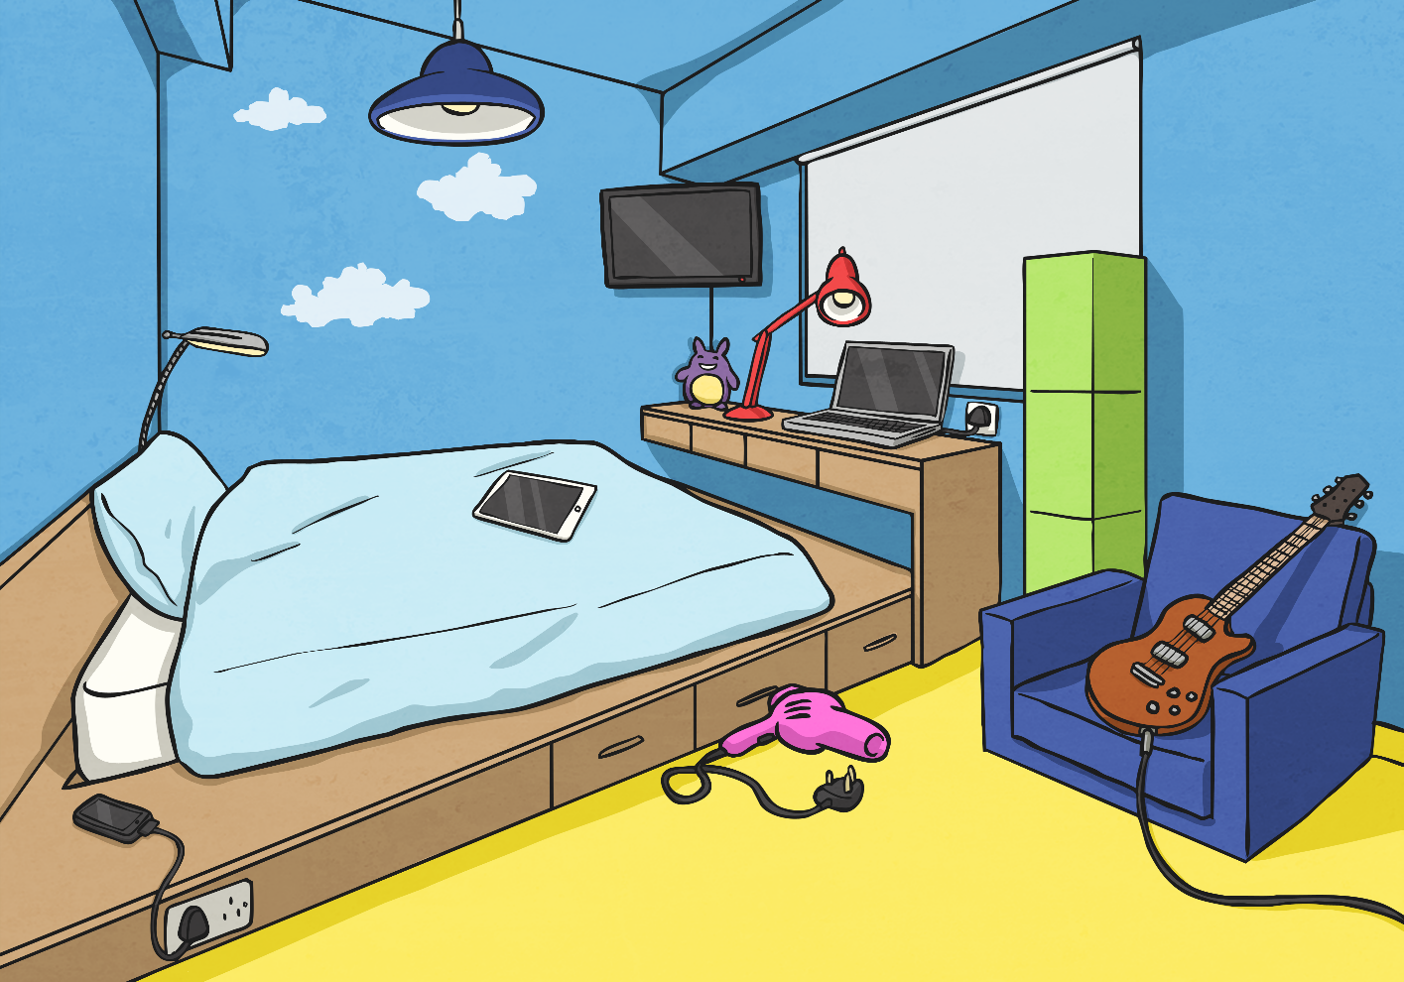
Where Is Everything?
Starter
Look at this bedroom scene. Talk to your partner and describe
where everything is.

Slide 3
Where Is Everything?
Starter
Look at this bedroom scene. Talk to your partner and describe
where everything is.
×
The lamp is in front of the window
×
The desk is under the window
×
×
The guitar is on the chair
The phone is next to the bed.

Slide 4
How many prepositions can you think of?

Slide 5

How many prepositions can you think of?
across
under
below
toward
on
through
Prepositions
in
above
beside
above
with

Slide 6
Preposition Mind Map
How many different words or phrases (prepositions) can you think of to describe time, place or movement?
across
under
before
below
at six o’clock
through
after
Prepositions
toward
on
in
above
beside
off
above
during
with

Slide 7
Preposition Mind Map
How many different words or phrases (prepositions) can you think of to describe time, place or movement?
across
under
before
below
at six o’clock
through
after
Prepositions
toward
on
Add some to your pot of prepositions!
in
above
beside
off
above
during
with

Slide 8
Preposition Or Not?
Keeping in mind that ‘a preposition is a word or phrase used to describe a place, time or movement’ sort the following words into the correct circles:
Prepositions
Not
Prepositions
angry
before lunch
after school
and
under
through
threw
beside
decide
in

Slide 9
Now it’s your turn!
Paddlers: Fill in the blanks and write sentences using the picture prompts.
Snorkellers: Fill in the blanks and write sentences using the picture prompts.
Divers: Write sentences using the picture prompts and highlight the propositions of place.

