Slide 1




11.12.20
LO: Add and subtract
C: Add two 3-digit numbers - crossing 10 or 100

Slide 2




Challenge 1
Always, Sometimes, Never
When 7 and 5 are added together in the ones column, the digit in the ones column of the answer will always be 2
What other digits would always give a 2 in the ones column? Prove it.

Slide 3
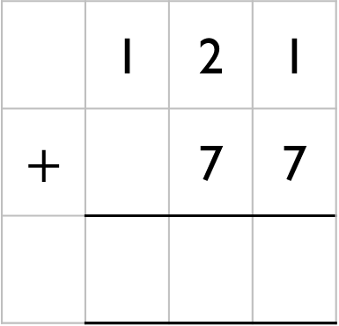
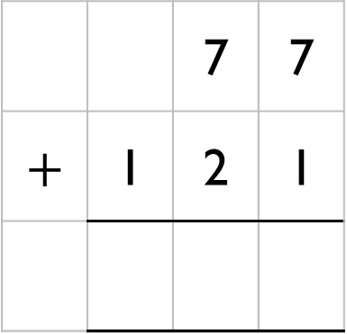
Challenge 2
Rosie has 77 sweets.
Mo has 121 sweets.
Which addition will find how many sweets they have altogether?
Explain your answer.
 |  | 7 | 7
$$+$$ | 1 | 2 | 1
 | 1 | 2 | 1
$$+$$ |  | 7 | 7

Slide 4

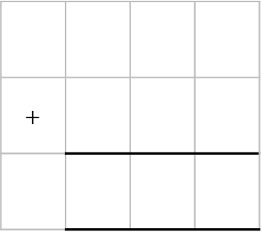
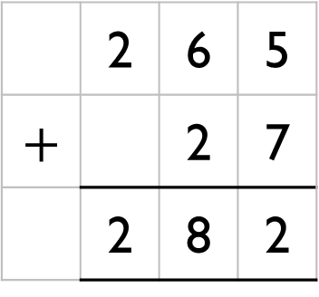

Challenge 3
Eva
Here is her working out:
Is she correct? Explain why.
265 $+$ 27 $=$ 282
 | 2 | 6 | 5
$$+$$ |  | 2 | 7
 | 2 | 8 | 2
$$+$$

Slide 5
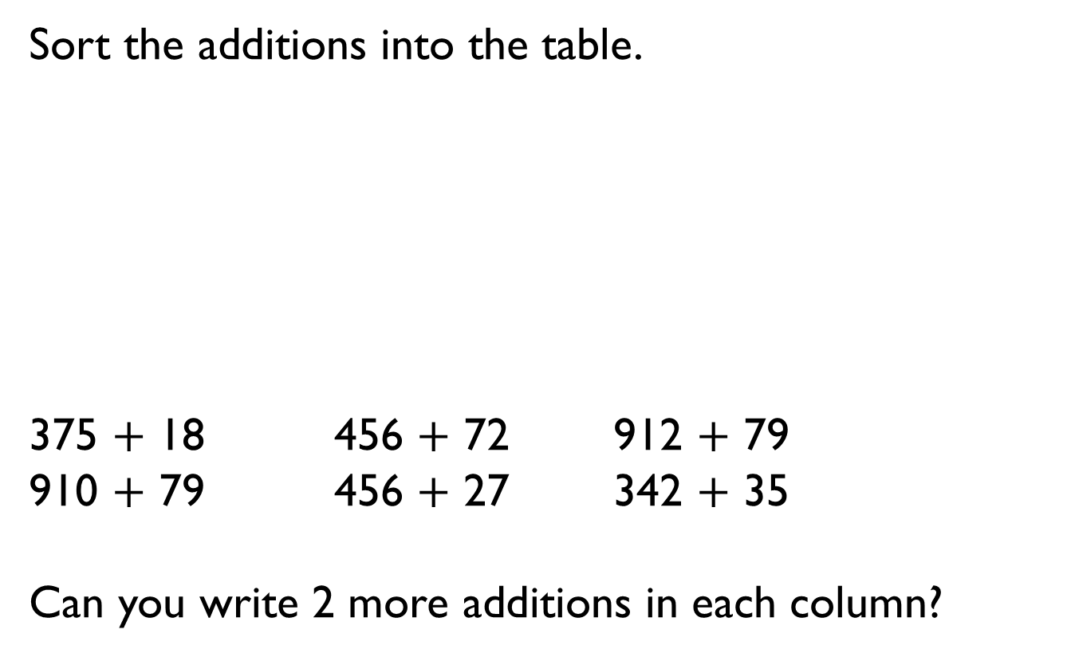
Challenge 4
Sort the additions into the table.
375 $+$ 18 456 $+$ 72 912 $+$ 79
910 $+$ 79 456 $+$ 27 342 $+$ 35
Can you write 2 more additions in each column?
No exchange | Exchange 10 ones | Exchange 10 tens

Slide 6
Challenge 5
Choose one 2-digit and one 3-digit number.
Write additions that have an exchange in the ones and the tens columns.
23
35
756
767
81
56
487
619

