Slide 1
10.12.20
LO: To add and subtract
C: Add two 3-digit numbers –
crossing 10 or 100

Slide 3
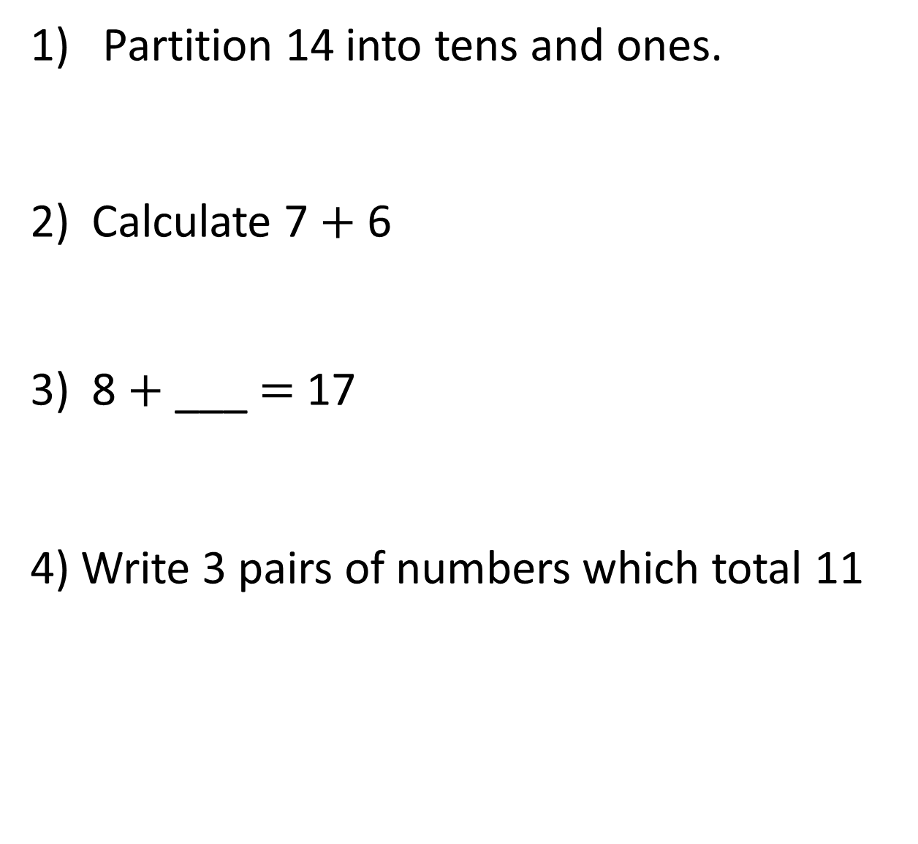
1) Partition 14 into tens and ones.
2) Calculate 7 $+$ 6
8 $+$ ___ $=$ 17
4) Write 3 pairs of numbers which total 11

Slide 4
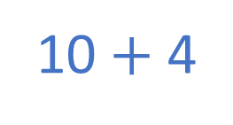

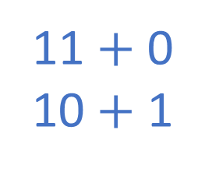
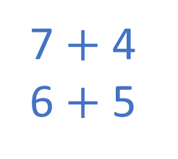
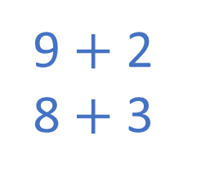
1) Partition 14 into tens and ones.
2) Calculate 7 $+$ 6
8 $+$ ___ $=$ 17
4) Write 3 pairs of numbers which total 11
10 $+$ 4
1 ten $+$ 4 ones
13
9
11 $+$ 0
10 $+$ 1
9 $+$ 2
8 $+$ 3
7 $+$ 4
6 $+$ 5

Slide 6
Mr Rose earns £124 on Monday.
He earns £138 on Tuesday.
How much does he earn in total?
£262
 | Hundreds | Tens | Ones
H | T | O
1 | 3 | 8
1 | 2 | 4
+
2
6
2
2
6
2
12
1

Slide 7





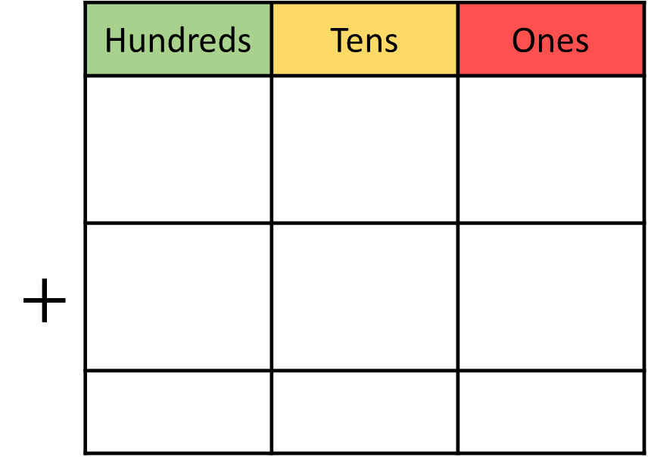
Dexter scores 351 points in a game.
Rosie scores 263 points.
How much do they score altogether?
614
 | Hundreds | Tens | Ones
$$+$$
H | T | O
3 | 5 | 1
2 | 6 | 3
6
1
4
6
1
4
1
Notes:
Can we simplify?
Discuss reduction structure – take away

Slide 8
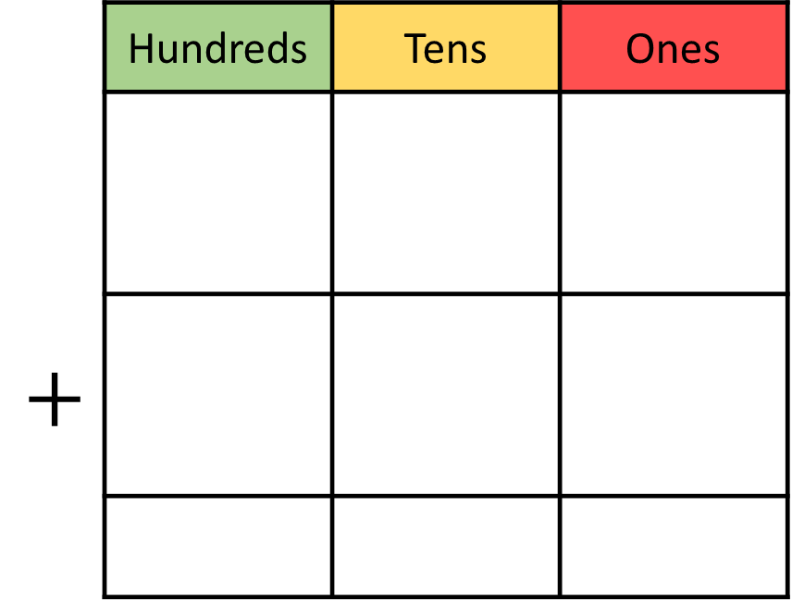
238 + 365 =
603
 | Hundreds | Tens | Ones
$$+$$
H | T | O
3 | 6 | 5
2 | 3 | 8
6
0
3
1
1
6
0
3

Slide 9
695
422 + 273 =
693
+
=
178 + 154 =
2
The answer will have a _____ in the ones place.
+
=

Slide 10

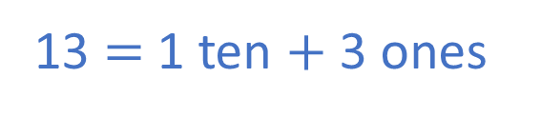
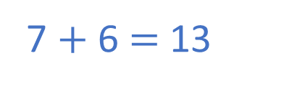
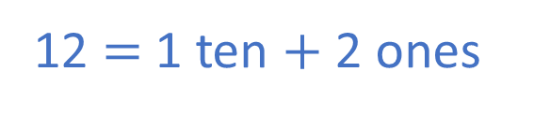
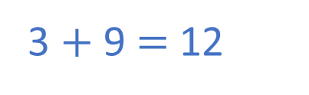
Have a think
1) 407 + 266 =
3
The answer will have a _____ in the ones place.
7 $+$ 6 $=$ 13
13 $=$ 1 ten $+$ 3 ones
2) 813 + 139 =
2
The answer will have a _____ in the ones place.
3 $+$ 9 $=$ 12
12 $=$ 1 ten $+$ 2 ones

Slide 11
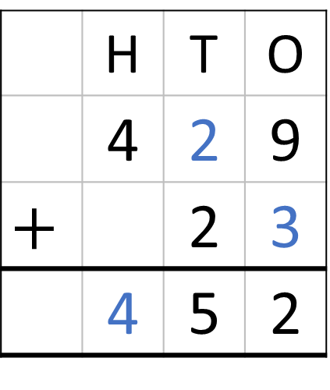
Challenge
 | Hundreds | Tens | Ones
 | H | T | O
 | 4 | 2 | 9
$$+$$ |  | 2 | 3
 | 4 | 5 | 2
1
5
2

