Slide 1
09.12.20
LO: To add and subtract
C: Add two 3-digit numbers –
not crossing 10 or 100

Slide 3
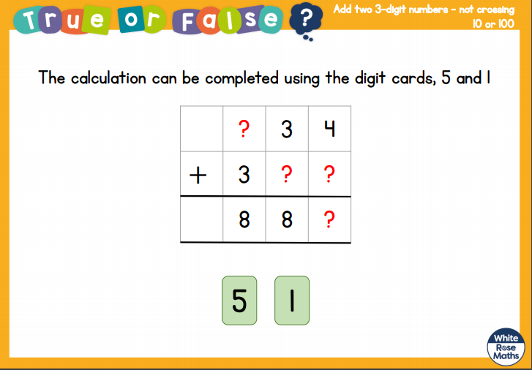

Slide 4
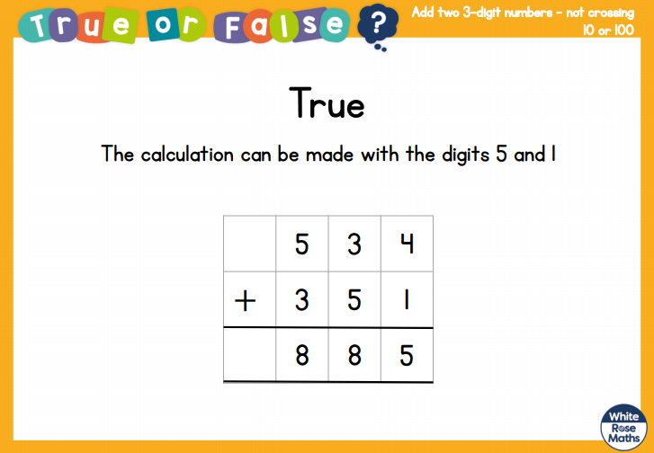

Slide 5
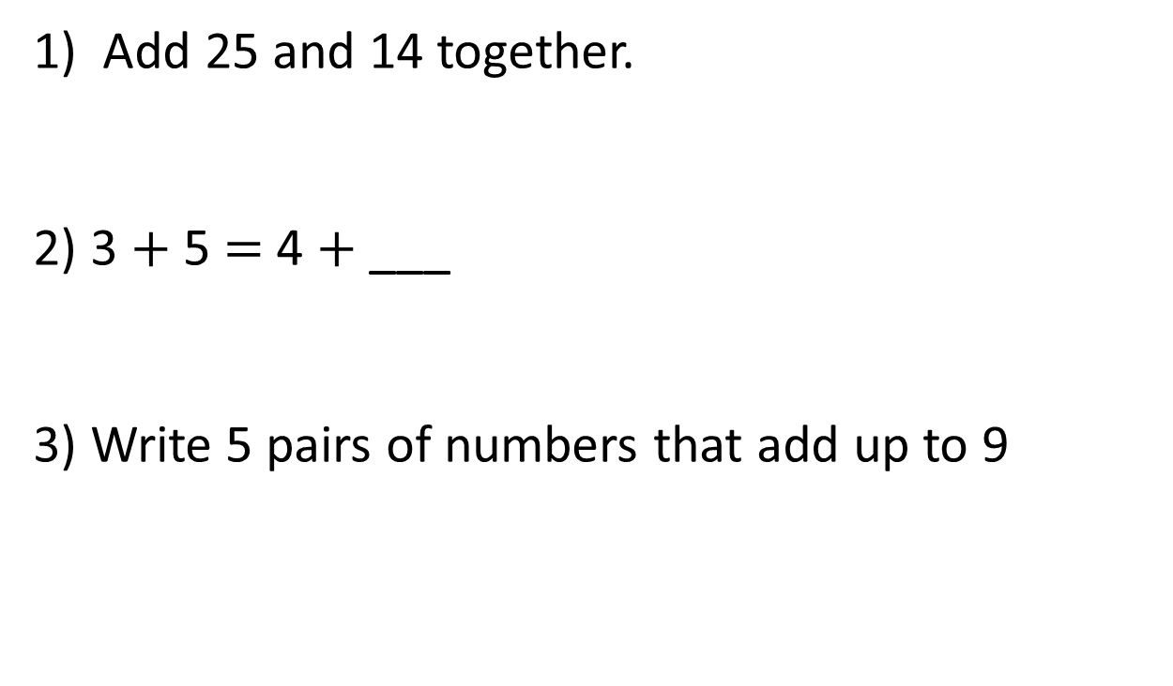
1) Add 25 and 14 together.
2) 3 $+$ 5 $=$ 4 $+$ ___
3) Write 5 pairs of numbers that add up to 9

Slide 6
1) Add 25 and 14 together.
2) 3 $+$ 5 $=$ 4 $+$ ___
3) Write 5 pairs of numbers that add up to 9
39
4
0 and 9
1 and 8
2 and 7
3 and 6
4 and 5

Slide 8
Hundreds | Tens | Ones
+
H | T | O
2 | 1 | 2
1 | 4 | 7
+
3
5
9

Slide 9
Hundreds | Tens | Ones
+
H | T | O
5 | 0 | 2
3 | 1 | 4
+
8
1
6
Notes:
Can we simplify?
Discuss reduction structure – take away

Slide 10
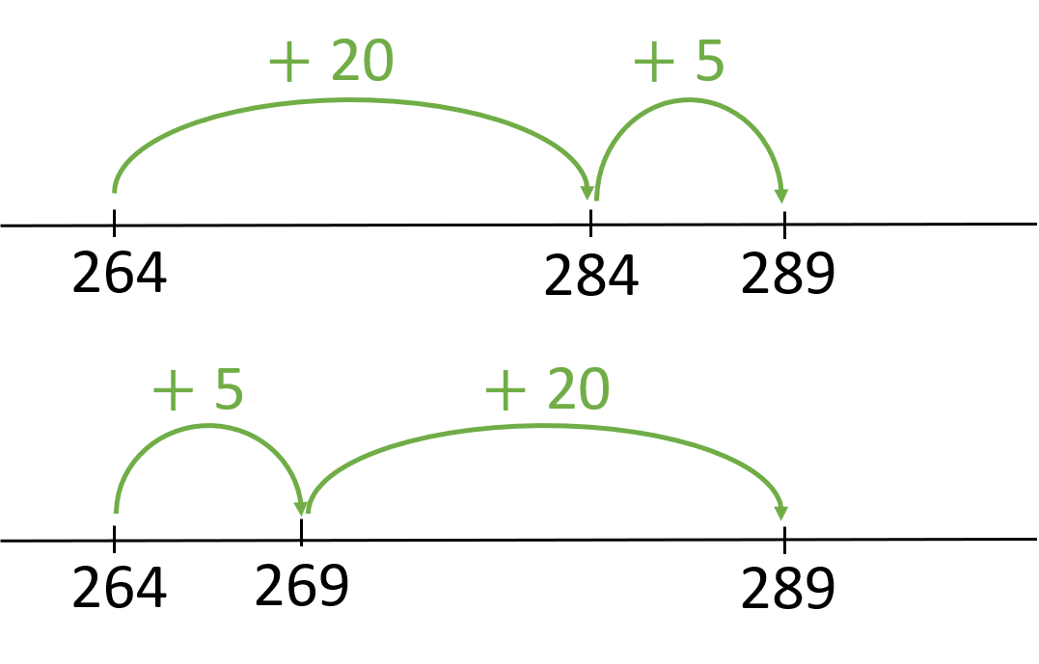
613 + 325 =
938
+ 300
+ 20
+ 5
613
913
933
938
325
300
5
20

Slide 11
976
?
435
541
314
121
420
H | T | O
3 | 1 | 4
1 | 2 | 1
H | T | O
5 | 4 | 1
4 | 3 | 5
H | T | O
4 | 2 | 0
1 | 2 | 1
+
+
+
4
3
5
9
7
6
4
1
5

Slide 12


679
?
Have a think
353
326
231
122
204
H | T | O
2 | 3 | 1
1 | 2 | 2
3 | 5 | 3
H | T | O
3 | 5 | 3
3 | 2 | 6
6 | 7 | 9
H | T | O
2 | 0 | 4
1 | 2 | 2
3 | 2 | 6
+
+
+

