Slide 1
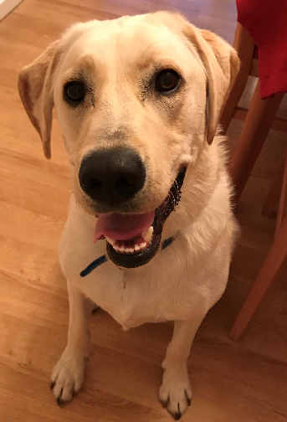
Buddy’s Morning Task:
Please can you draw a final Coronavirus Picture inspired by Banksy for the School Entrance!
Please be really neat and colour in one direction.
Don’t rush we will finish them tomorrow afternoon.
GOOD MORNING!

Slide 2

Wednesday 9th September 2020
10:30-11:20
L.O: To understand place value in 3 digit numbers.
C: Place Value
Today, Miss Watton is looking for amazing MATHS LANGUAGE!

Slide 3


Varied Fluency 1
Write the number represented by each image.
H | T | O
100
100
100
100
100
100
© Classroom Secrets Limited 2018

Slide 4
Varied Fluency 1
Write the number represented by each image.
H | T | O
200
100
100
100
100
600
100
100
© Classroom Secrets Limited 2018

Slide 5
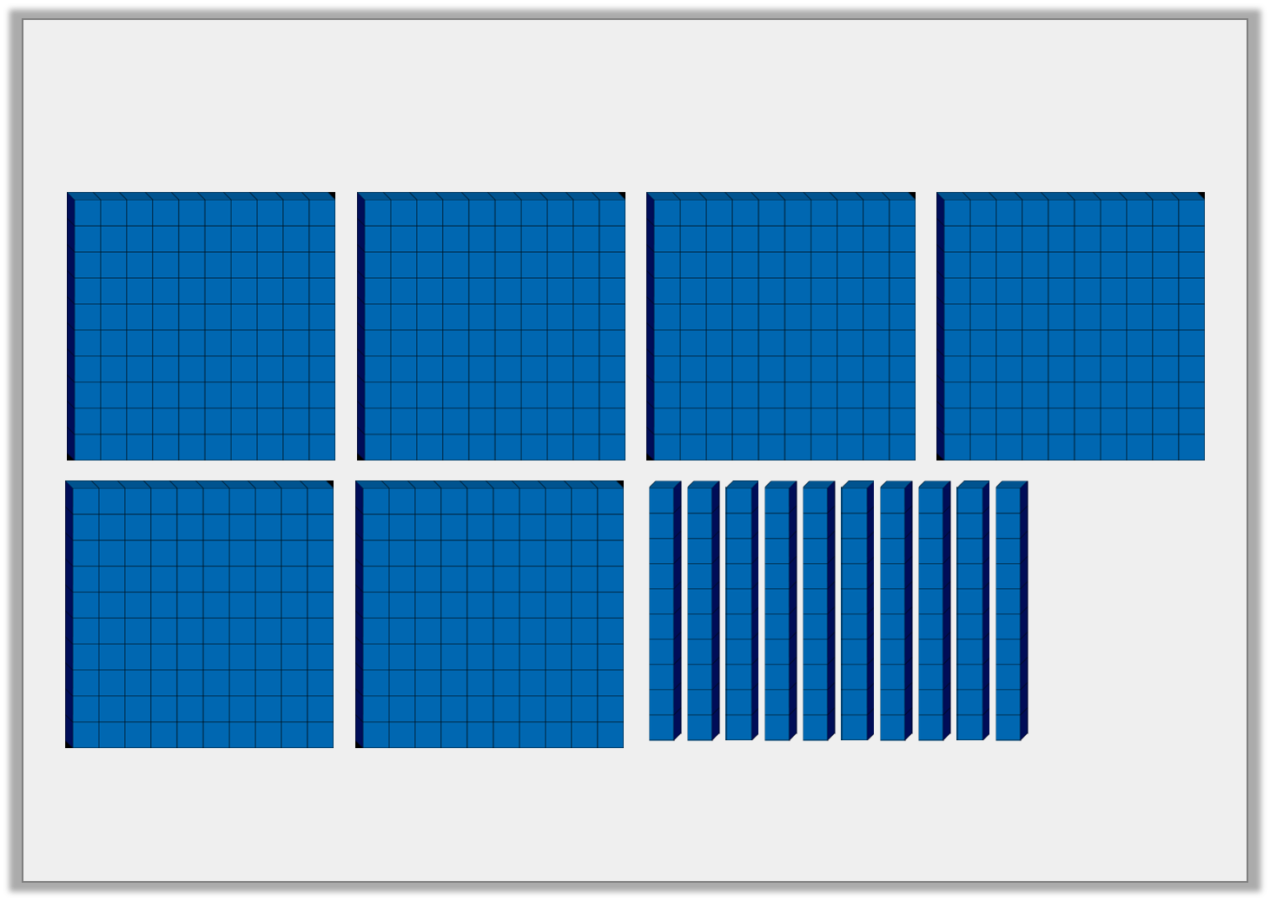
Varied Fluency 2
True or false? The image below represents 700.
© Classroom Secrets Limited 2018

Slide 6
Varied Fluency 2
True or false? The image below represents 700.
True
© Classroom Secrets Limited 2018

Slide 7

Problem Solving 1
Use the cards below to complete the inequality statements.
100
100
H | T | O
100
100
100
100
 |  | <
 |  | >
© Classroom Secrets Limited 2018

Slide 8
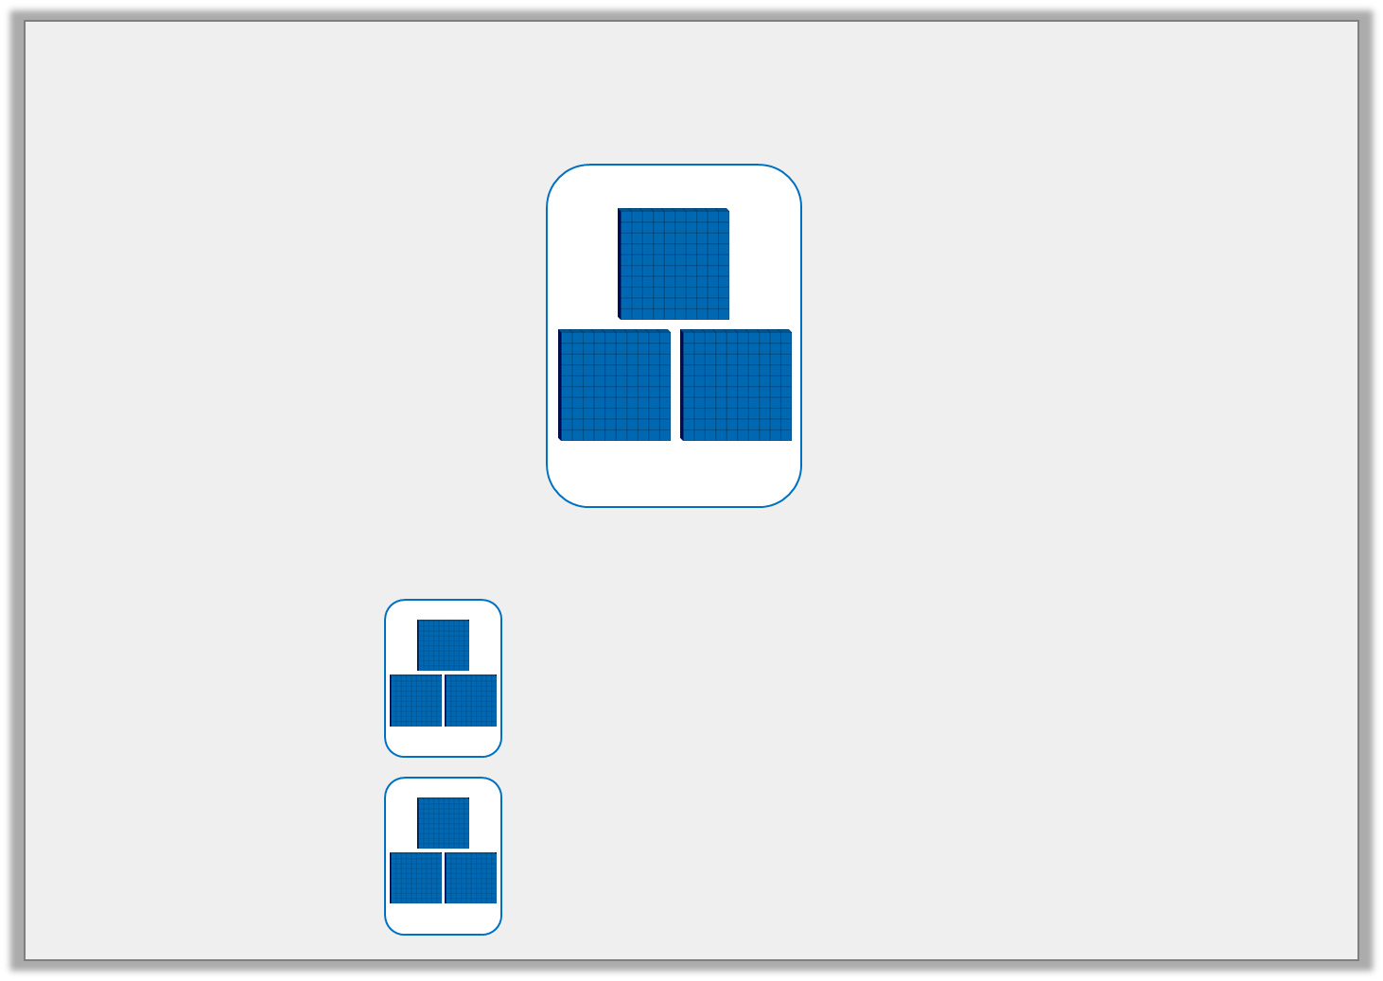
Problem Solving 1
Use the cards below to complete the inequality statements.
Various answers, for example:
100
100
H | T | O
100
100
100
100
100
100
 |  | <
 |  | >
100
100
100
100
H | T | O
© Classroom Secrets Limited 2018

Slide 9
Problem Solving 1
Use the cards below to complete the inequality statements.
Various answers, for example:
100
100
H | T | O
100
100
100
100
100
100
 |  | <
 |  | >
100
100
100
100
H | T | O
© Classroom Secrets Limited 2018

Slide 10
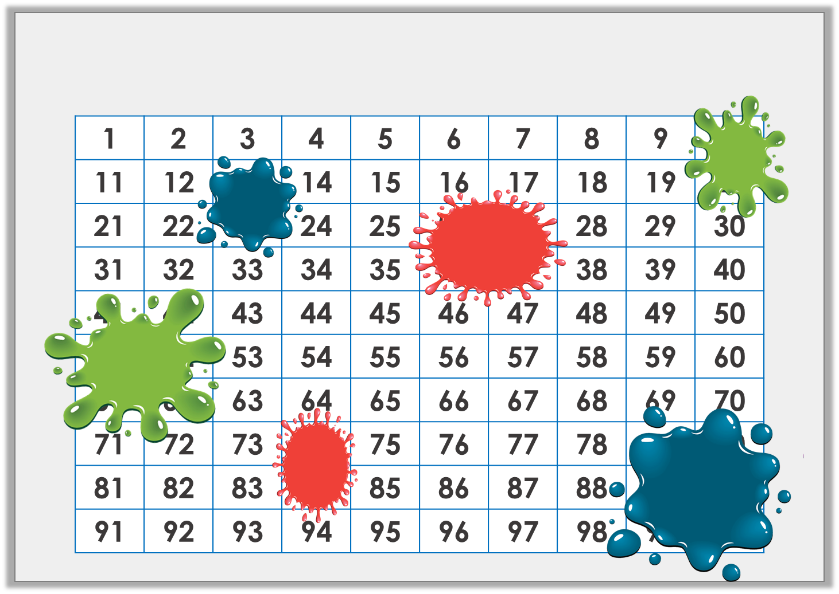
Plenary
Identify the numbers hidden by the splats of paint.
© Classroom Secrets Limited 2018

Slide 11
Plenary
Identify the numbers hidden by the splats of paint.
1 | 2 | 3 | 4 | 5 | 6 | 7 | 8 | 9 | 10
11 | 12 | 13 | 14 | 15 | 16 | 17 | 18 | 19 | 20
21 | 22 | 23 | 24 | 25 | 26 | 27 | 28 | 29 | 30
31 | 32 | 33 | 34 | 35 | 36 | 37 | 38 | 39 | 40
41 | 42 | 43 | 44 | 45 | 46 | 47 | 48 | 49 | 50
51 | 52 | 53 | 54 | 55 | 56 | 57 | 58 | 59 | 60
61 | 62 | 63 | 64 | 65 | 66 | 67 | 68 | 69 | 70
71 | 72 | 73 | 74 | 75 | 76 | 77 | 78 | 79 | 80
81 | 82 | 83 | 84 | 85 | 86 | 87 | 88 | 89 | 90
91 | 92 | 93 | 94 | 95 | 96 | 97 | 98 | 99 | 100
© Classroom Secrets Limited 2018

