Slide 1

Tuesday 8th September 2020
L.O: To understand place value in 2 digit numbers.
C: Place Value
Today, Miss Watton is looking for amazing MATHS LANGUAGE!

Slide 2

L.O: To understand place value in a two digit number.
Think Pair Share!
What does Place Value mean?

Slide 3
L.O: To understand place value in a two digit number.
T
O
So what do these columns mean?

Slide 4
L.O: To understand place value in a two digit number.
Tens
Ones
3
7
What number is this?

Slide 5
L.O: To understand place value in a two digit number.
23
45
63
53
65
94
13
5
Bingo!

Slide 6
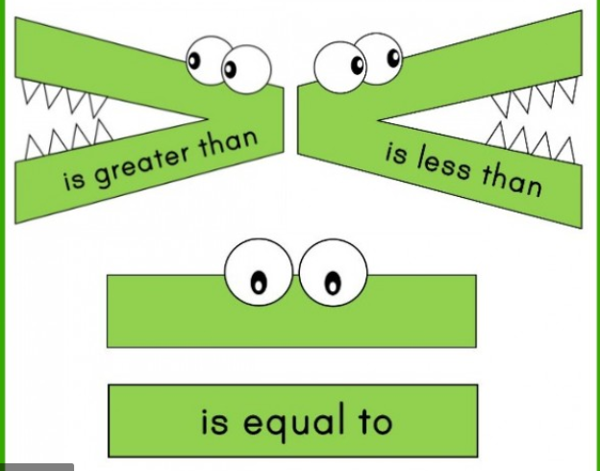
L.O: To understand place value in a two digit number.

