Slide 1
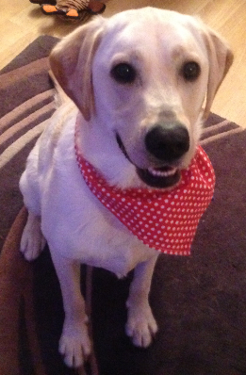
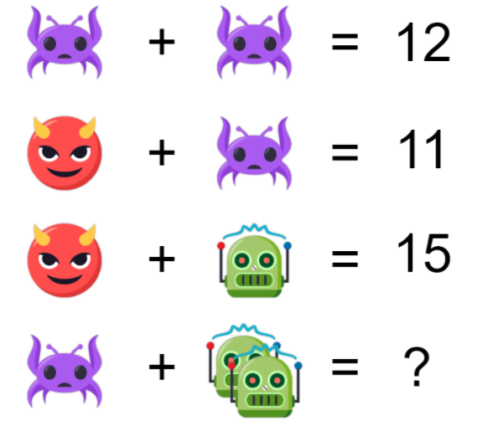
Buddy’s Morning Challenge:
GOOD MORNING!
B

Slide 2
Read Write Inc https://www.oxfordowl.co.uk/for-school/read-write-inc-spelling?sort_field=order&sort_dir=asc&toggle=header-block-information-closed&query=&year_group=year+2%2F+primary+3&unit=&resource_type=#
9:00-10:00

Slide 3
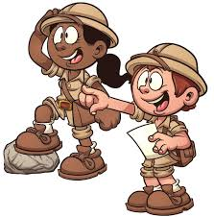
Bole Time!
10:00-10:30
We are going to… go on a spelling scavenger hunt!

Slide 4

Monday 7th September 2020
L.O: To know and use numbers.
C: Number 5
Please write the date and L.O neatly in your book and underline it with a pencil and ruler.

Slide 5
L.O: To know and use numbers.
.
Use your body
Use things on your table
Show me…
Use your whiteboards

Slide 6
L.O: To investigate different ways to represent a number.
L.O: To know and use numbers.
.
Use your body
Use things on your table
Show me…
5
Use your whiteboards

Slide 7
L.O: To investigate different ways to represent a number.
L.O: To know and use numbers.
.
Look around!
How many different ways of making 5 in this classroom?
5

Slide 8
L.O: To investigate different ways to represent a number.
L.O: To know and use numbers.
.
Think Pair Share
Can you come up with a really creative way of making 5 between you?
5

Slide 9

L.O: To investigate different ways to represent a number.
L.O: To know and use numbers.
.
We are going to think about the number 5 in the real world!
Number 5 Scavenger Hunt sheet!

Slide 10
L.O: To investigate different ways to represent a number.
L.O: To know and use numbers.
.
Number 5 Scavenger Hunt!
Work in learning partners.
Record where you can find the number 5
Try to find as many as you can in 10 minutes!

Slide 11
L.O: To investigate different ways to represent a number.
L.O: To know and use numbers.
.
Let’s explore 5 some more!
Can you…
Make it?
Draw it?
Explain it?

Slide 12

L.O: To investigate different ways to represent a number.
L.O: To know and use numbers.
.
The Final Challenge!

Slide 13
11:20-11:35
Break Time

Slide 14
11:35-12:25
English

Slide 15

12:20-12:40
Lunch Outside & Prayer

Slide 16
12:40-13:10
Lunch Inside

Slide 17
13:10-14:20
Jigsaw
What makes a good friend?

Slide 18
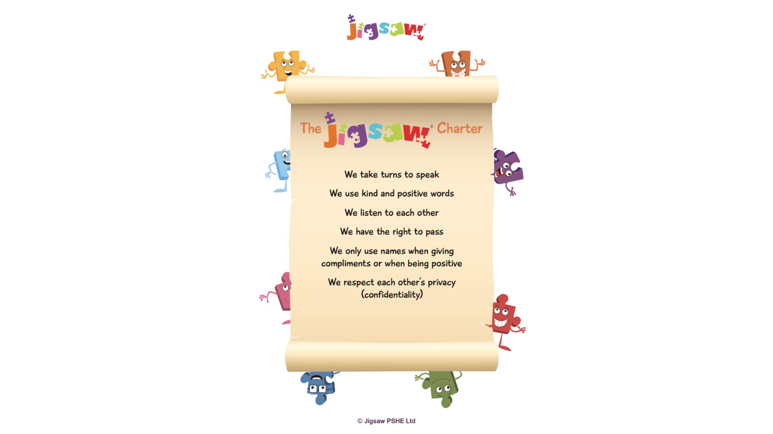

Slide 19
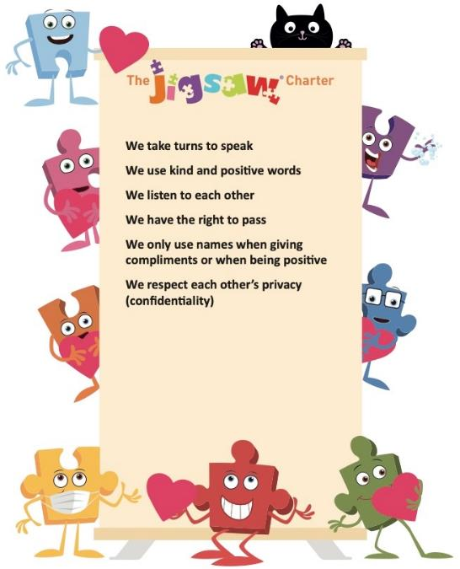
Covid safety rule 01
Covid safety rule 02
Covid safety rule 03

Slide 20
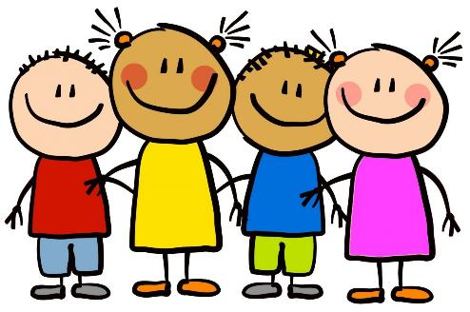
Let’s Connect Us!
Lap, Lap, Clap, Tap Game!

Slide 21

Calm Me Time

Slide 22
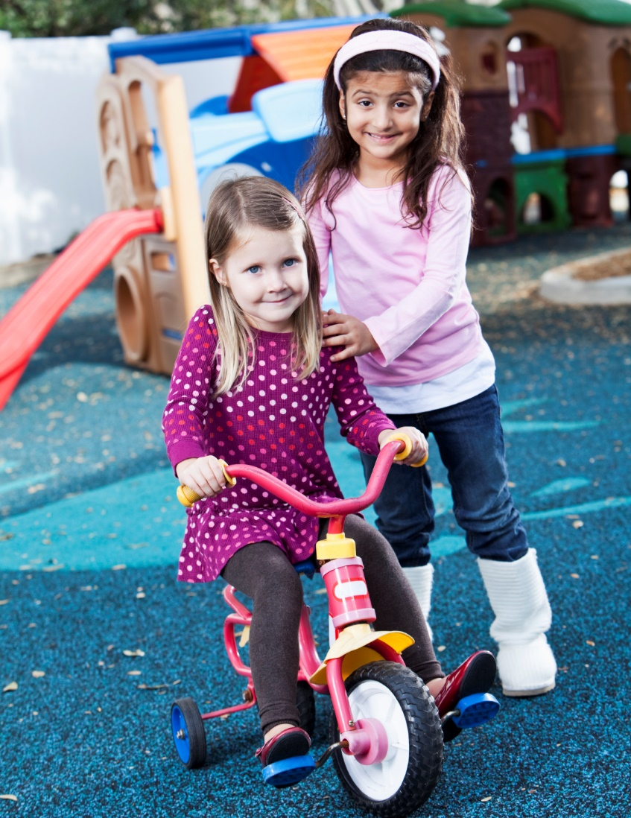
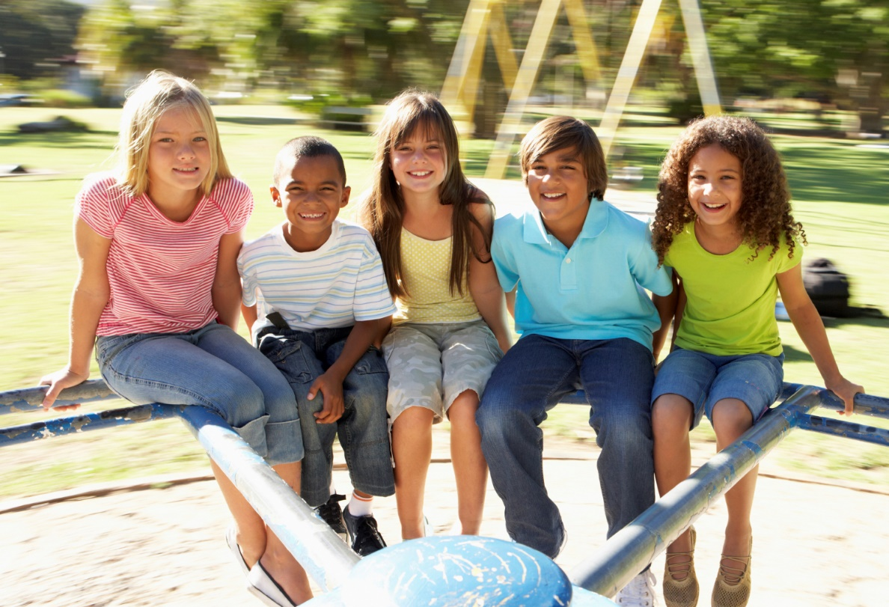
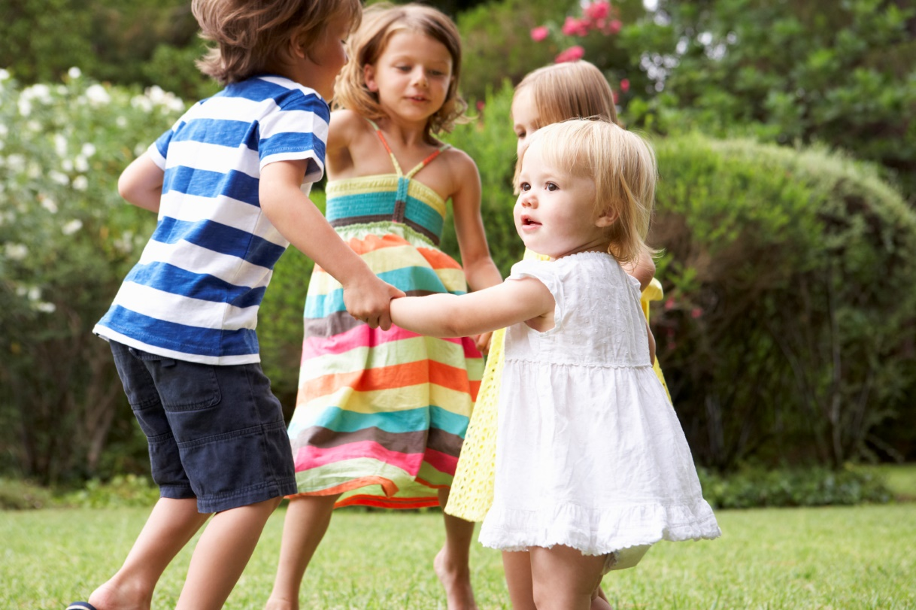
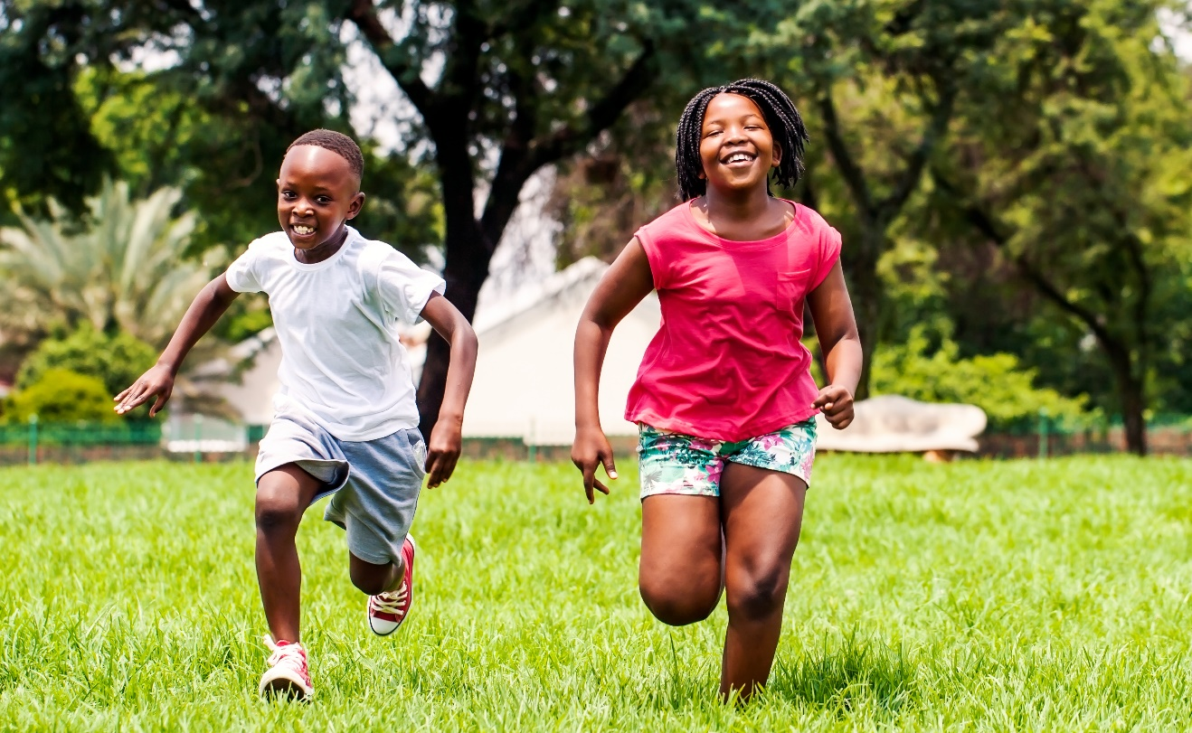
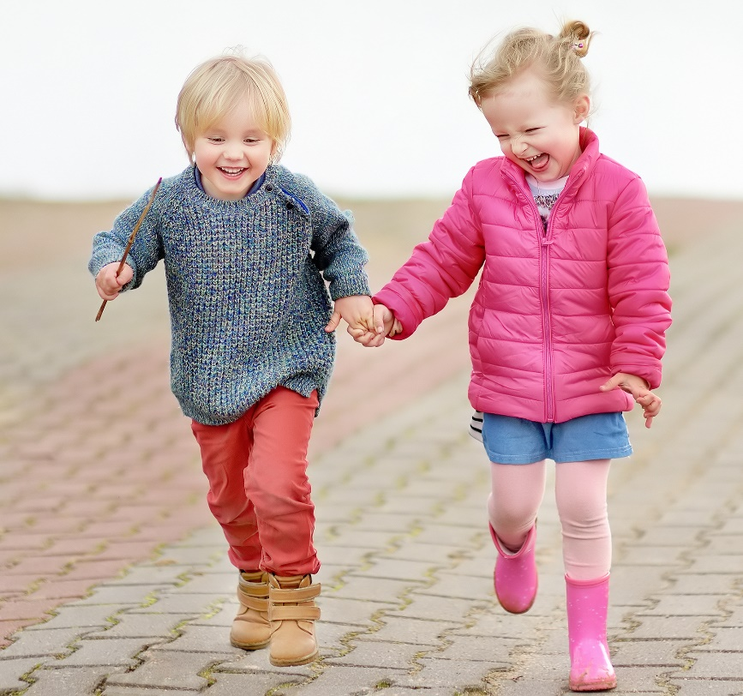
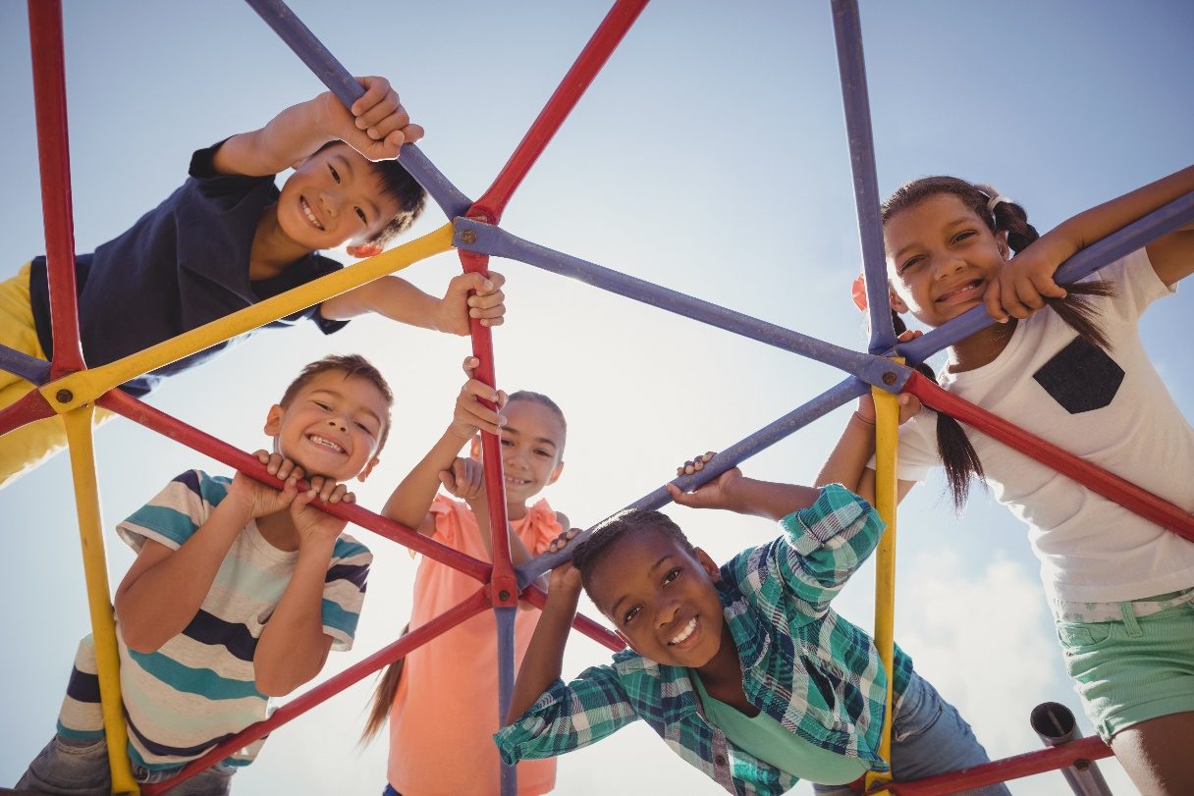

Slide 23
What makes a good friend?

Slide 24
https://www.bbc.co.uk/news/av/uk-england-hereford-worcester-50898386

Slide 25
Let’s write an acrostic poem about friendship during Covid!

Slide 26
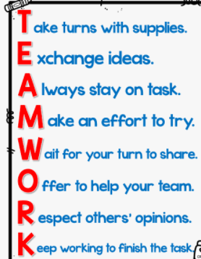
What’s an acrostic poem?

Slide 27
Let’s write an acrostic poem about friendship during Covid!

Slide 28
14:20-14:40
Collective Worship
Luke 11: 33 (Mt 5:15;6:22-23)

Slide 29
14:20-15:10
Handwriting, Spelling and Reading

Slide 30
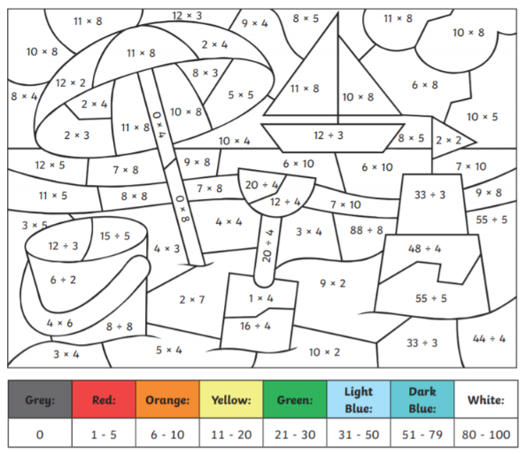
10:30-11:20
Number Skills

Slide 31
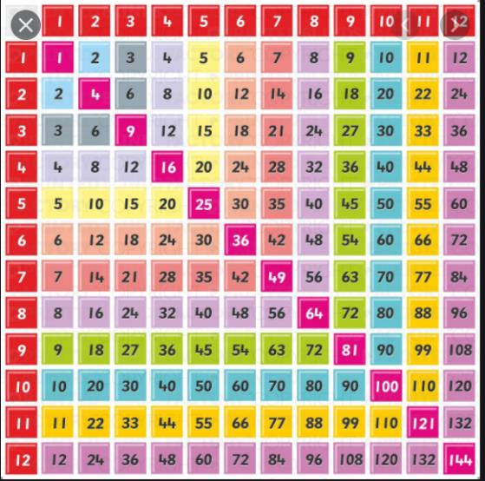
10:30-11:20
Number Skills

Slide 32
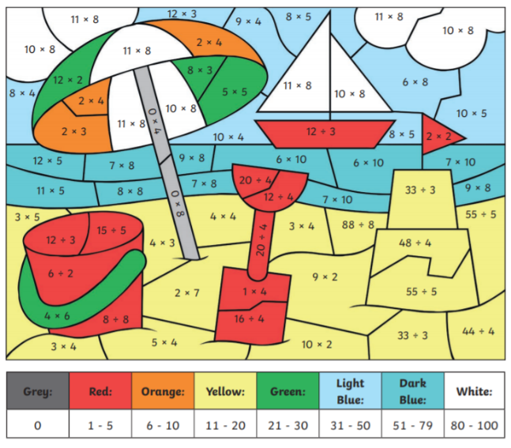
10:30-11:20
Number Skills

