Slide 1
Hope where are you?
Tuesday 8th September 2020
LO: To analyse and present writing
C: Hope where are you?

Slide 2
Let’s Recap
Which continents have we explored so far?
Where the emotions these children felt just sad/unhappy ones?

Slide 3
Your Turn
Listen to your teacher reading a section of the text about one of the continents.
What made it enjoyable?

Slide 4
In your pairs, you have been given a continent which we have not yet explored.
In pairs, you need to take it in turns to read a paragraph each helping each other to improve each time.

Slide 5
Would anyone like to read a paragraph of their continent to the class with expression?

Slide 6
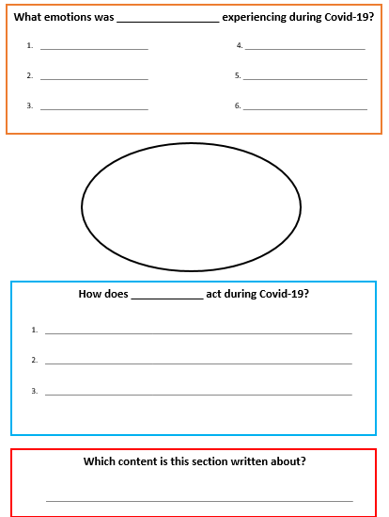

Slide 7

On a post-it note, write down you feelings during lockdown.
Plenary

