Slide 1
LO: To describe position, direction and movement.
C: To describe movement and turns.
Stem Sentences:
Useful words:
Clockwise anti clockwise half turn
quarter turn three quarters turn whole

Slide 2
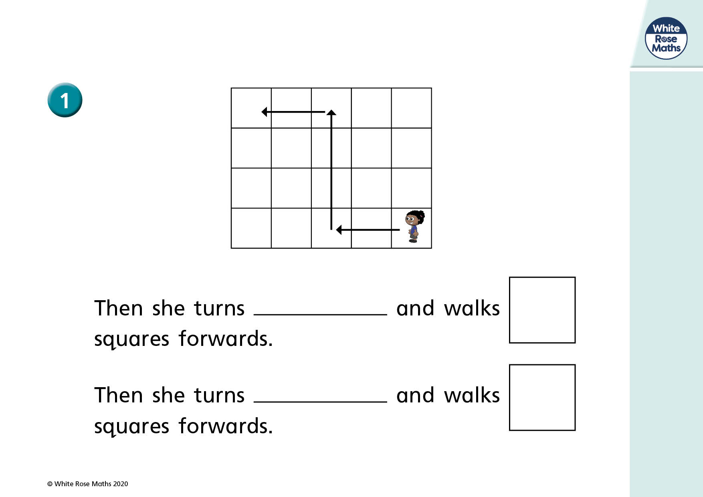
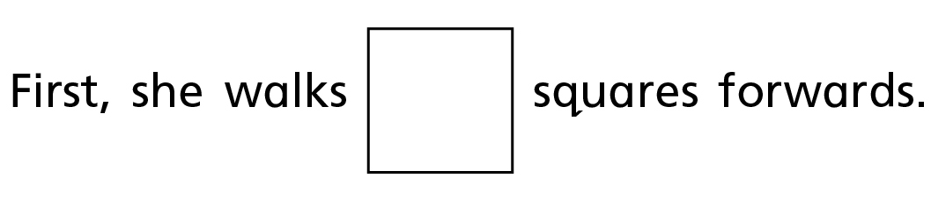

Slide 3
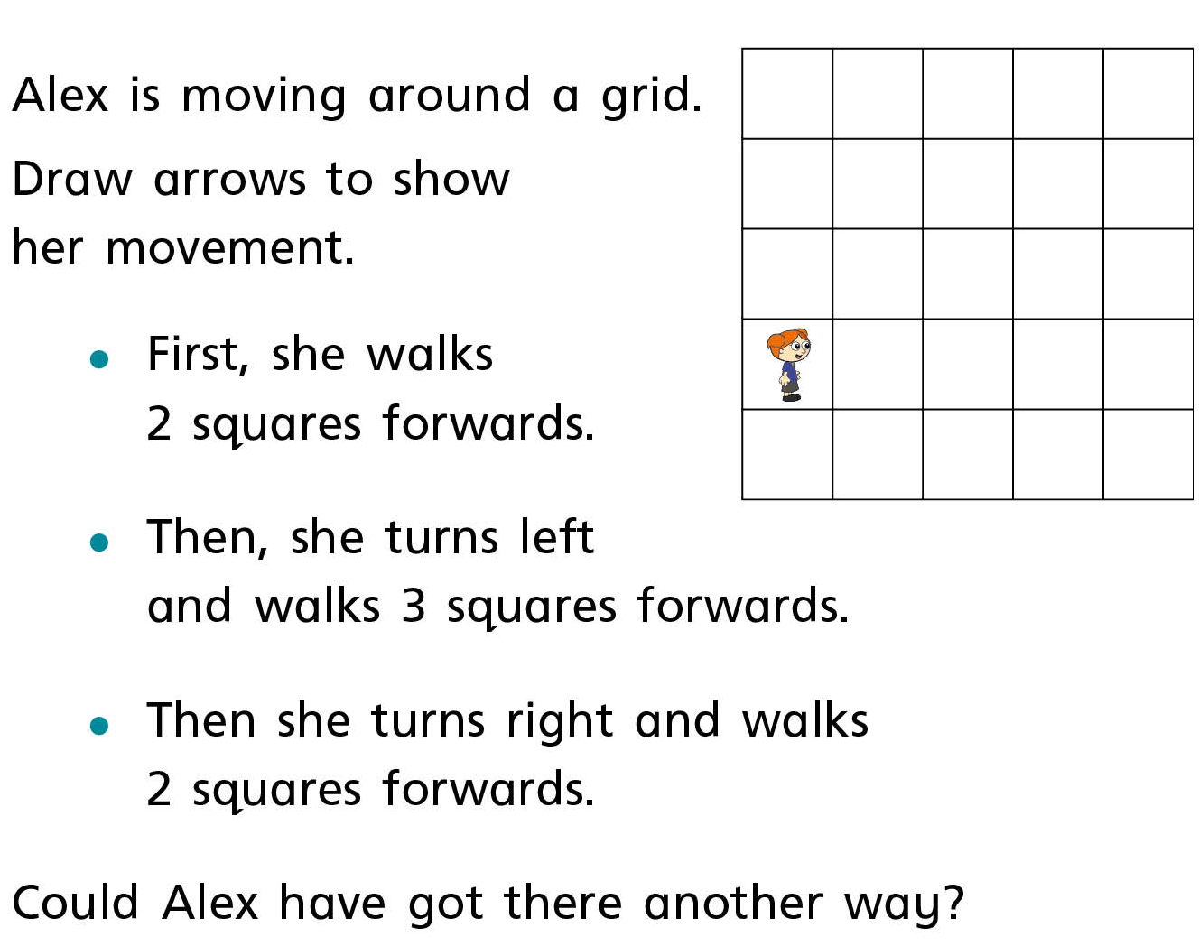
Partner Practise

Slide 4
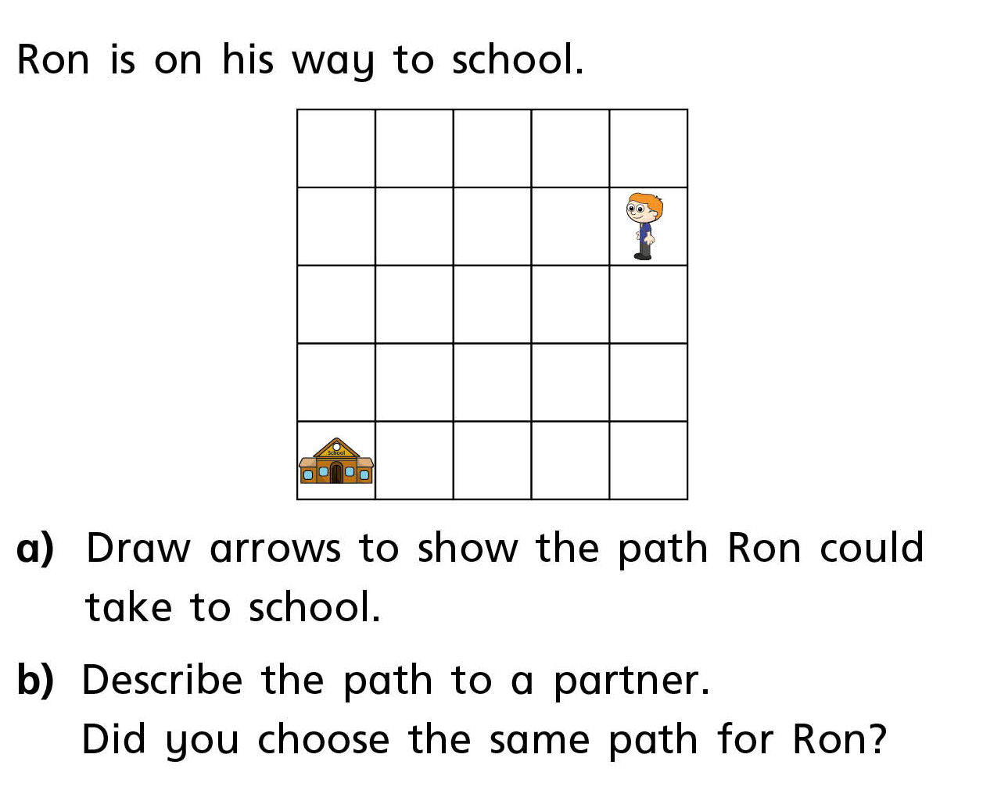
Independent Work

Slide 5
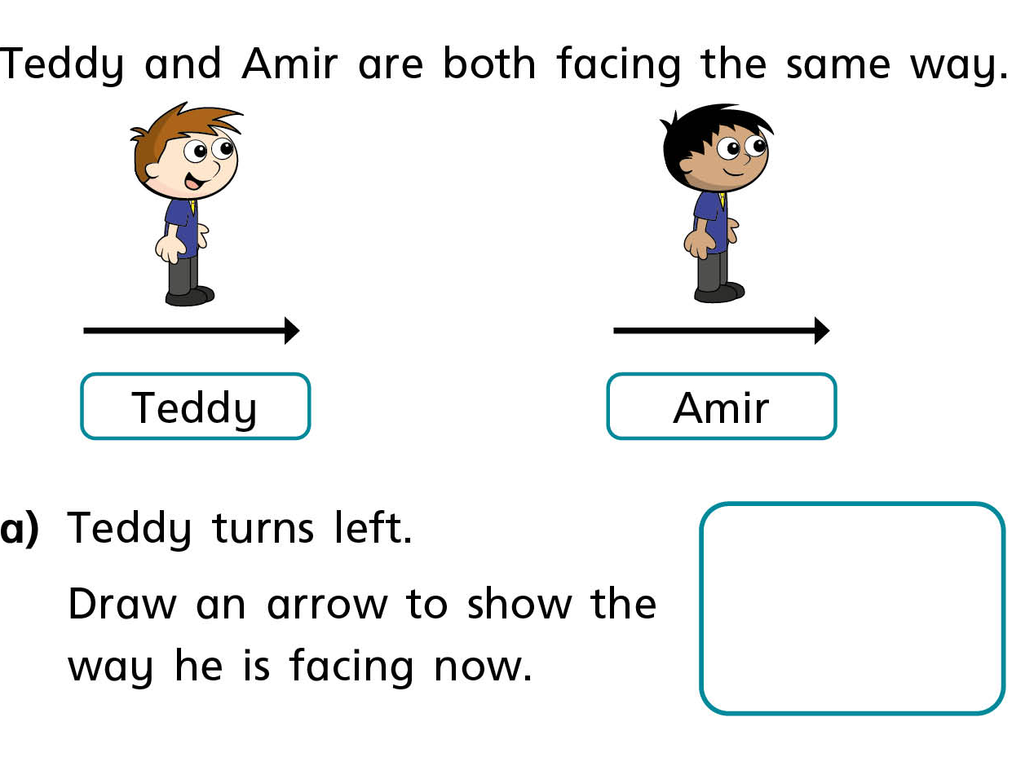

Slide 6
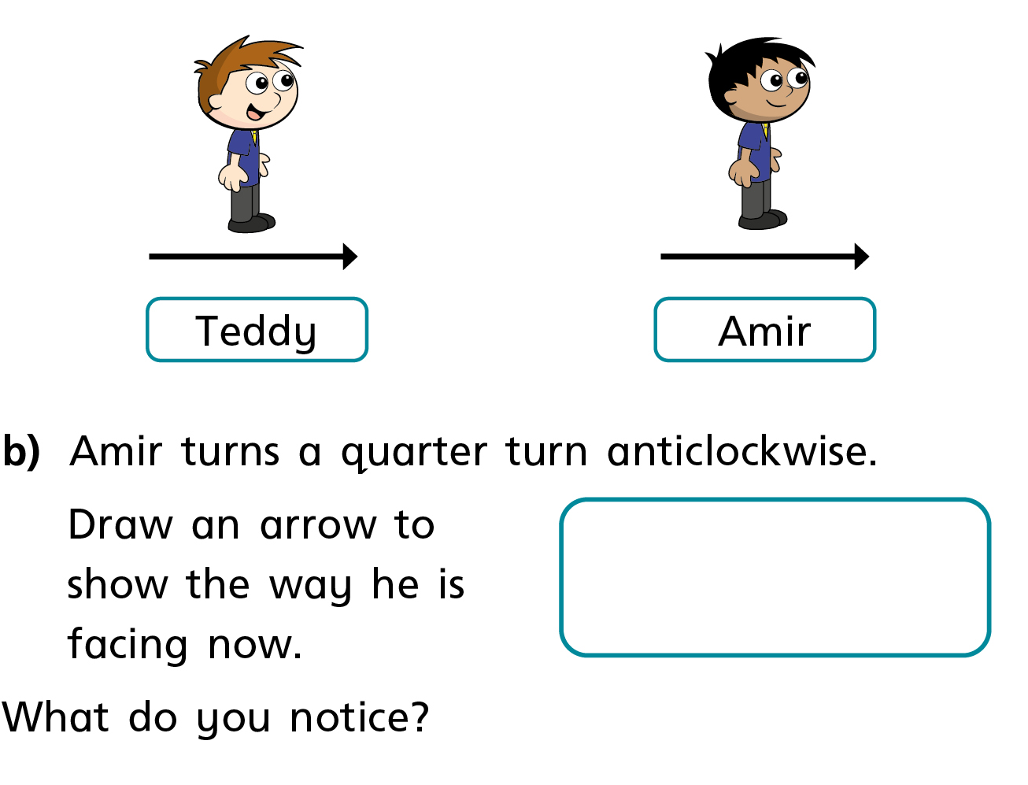

Slide 7
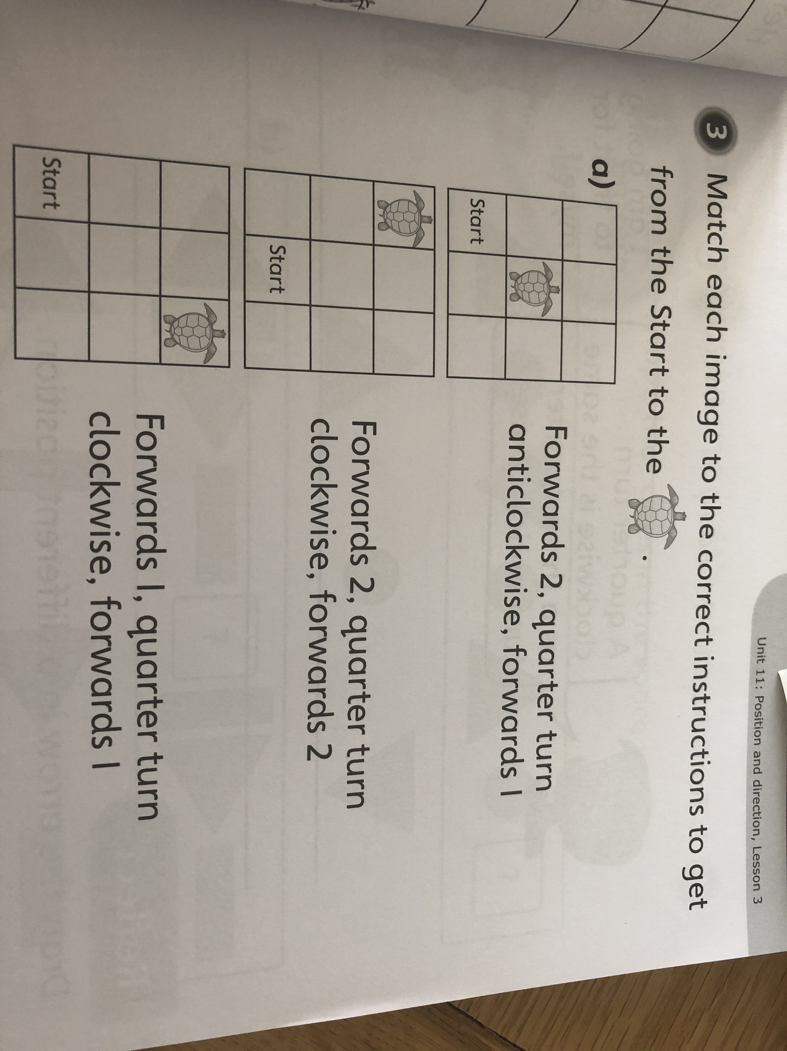
Independent Work

Slide 8
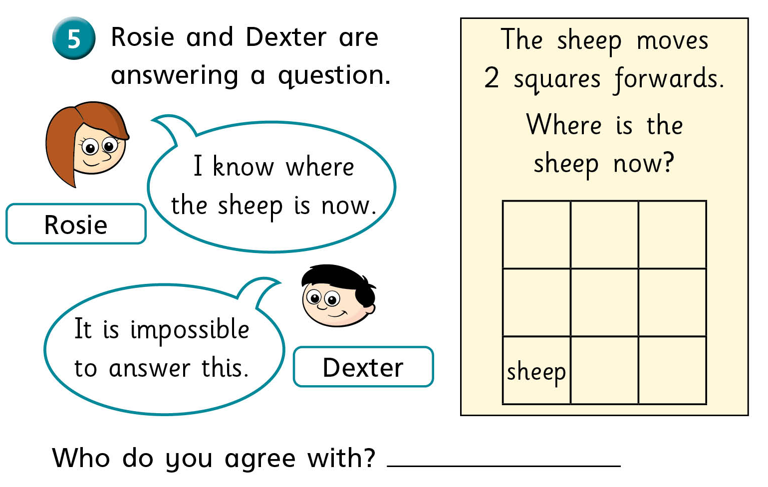
Challenge

Slide 9
LO: To order and arrange combinations of mathematical objects in patterns and sequences.
C: To make patterns with shape.
Stem Sentences:
The ____ turns a _____ turn ______.
The ‘triangle’ turns a ‘quarter’ turn ‘clockwise’.
Useful words:
Clockwise anti clockwise half turn
quarter turn three quarters turn whole

Slide 10
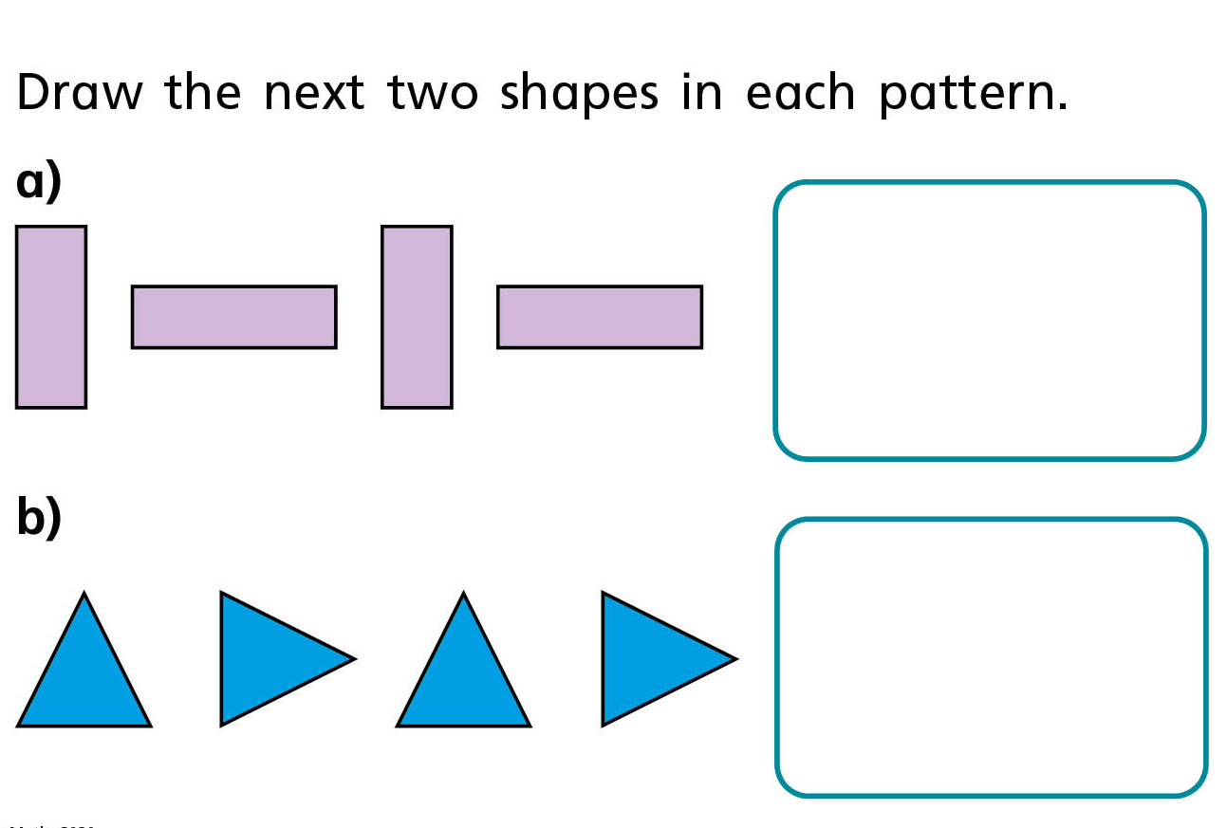

Slide 11
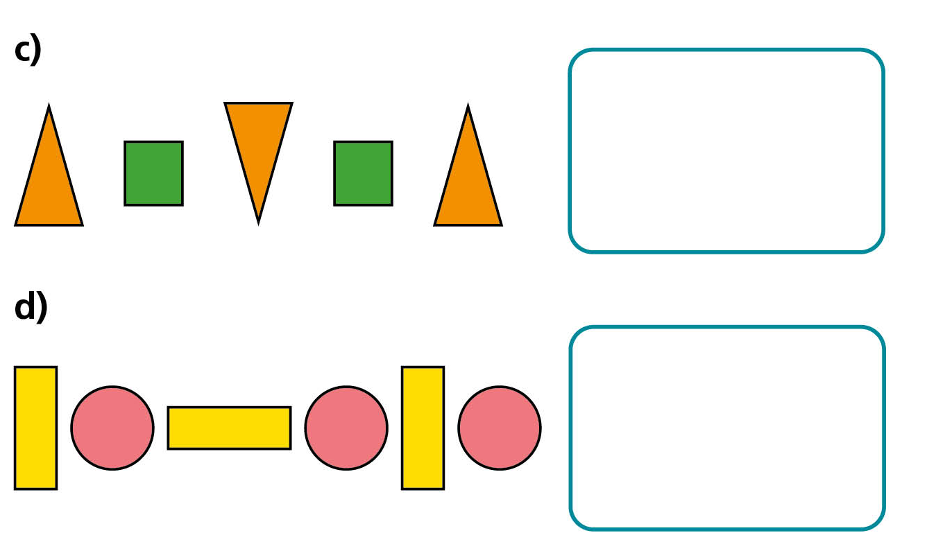

Slide 12
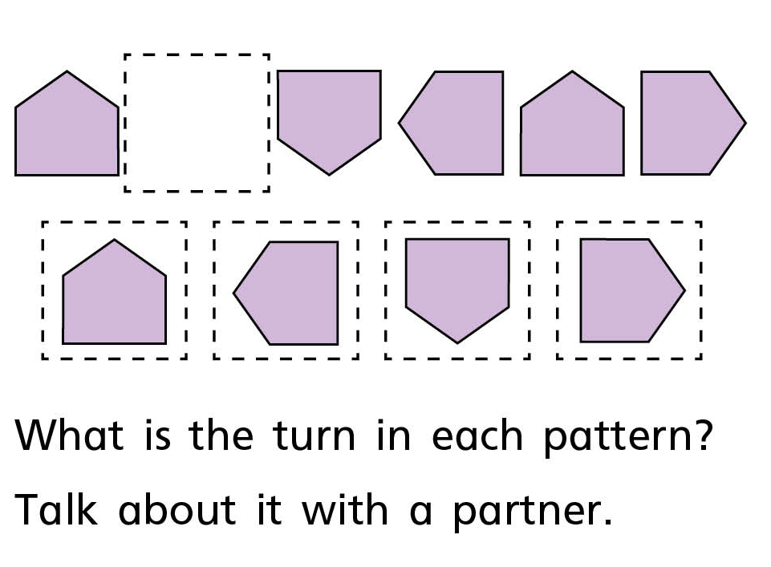

Slide 13
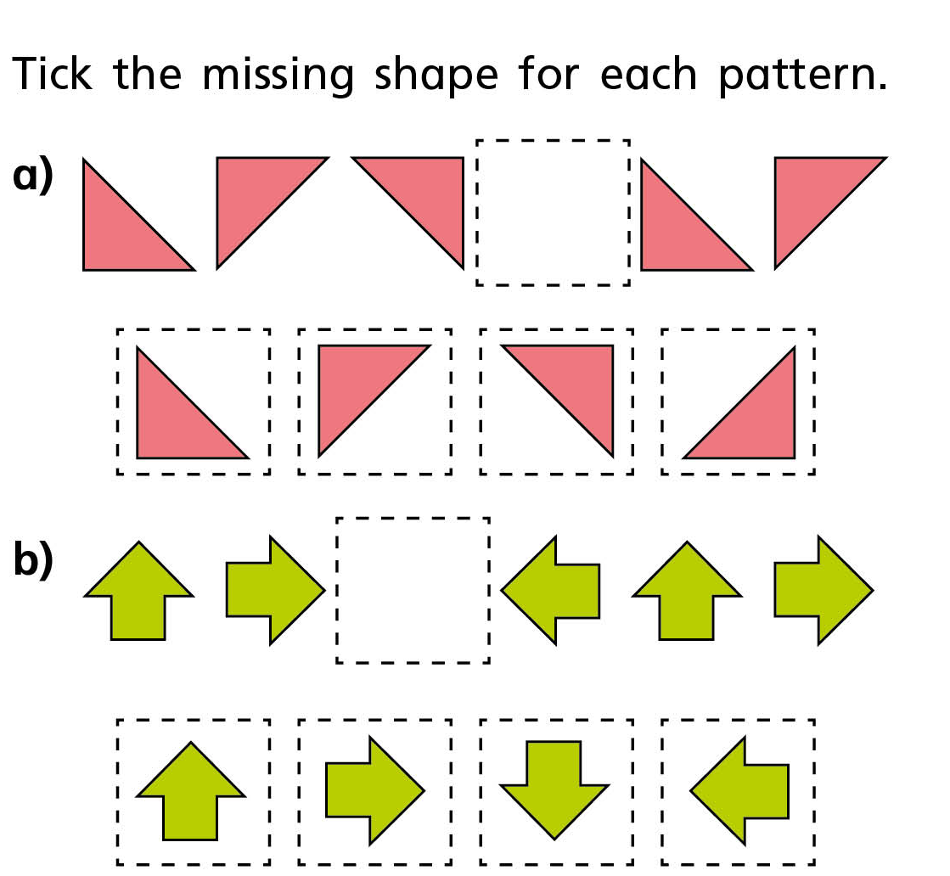
Partner Practise

Slide 14
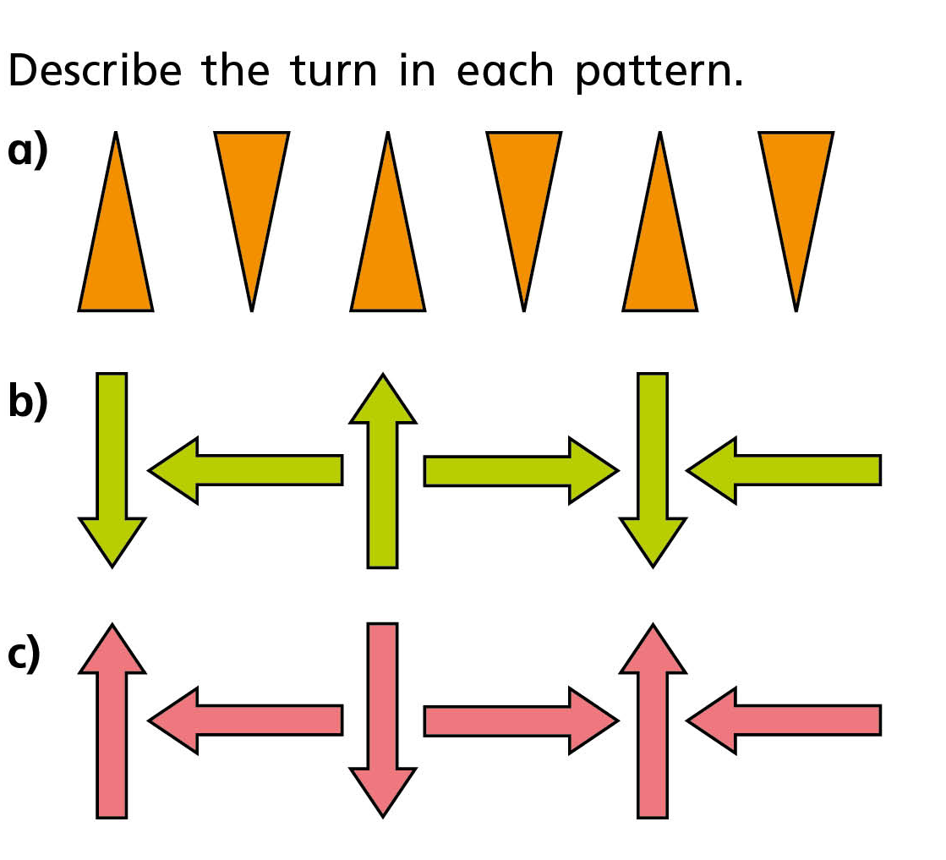
Partner Practise

Slide 15
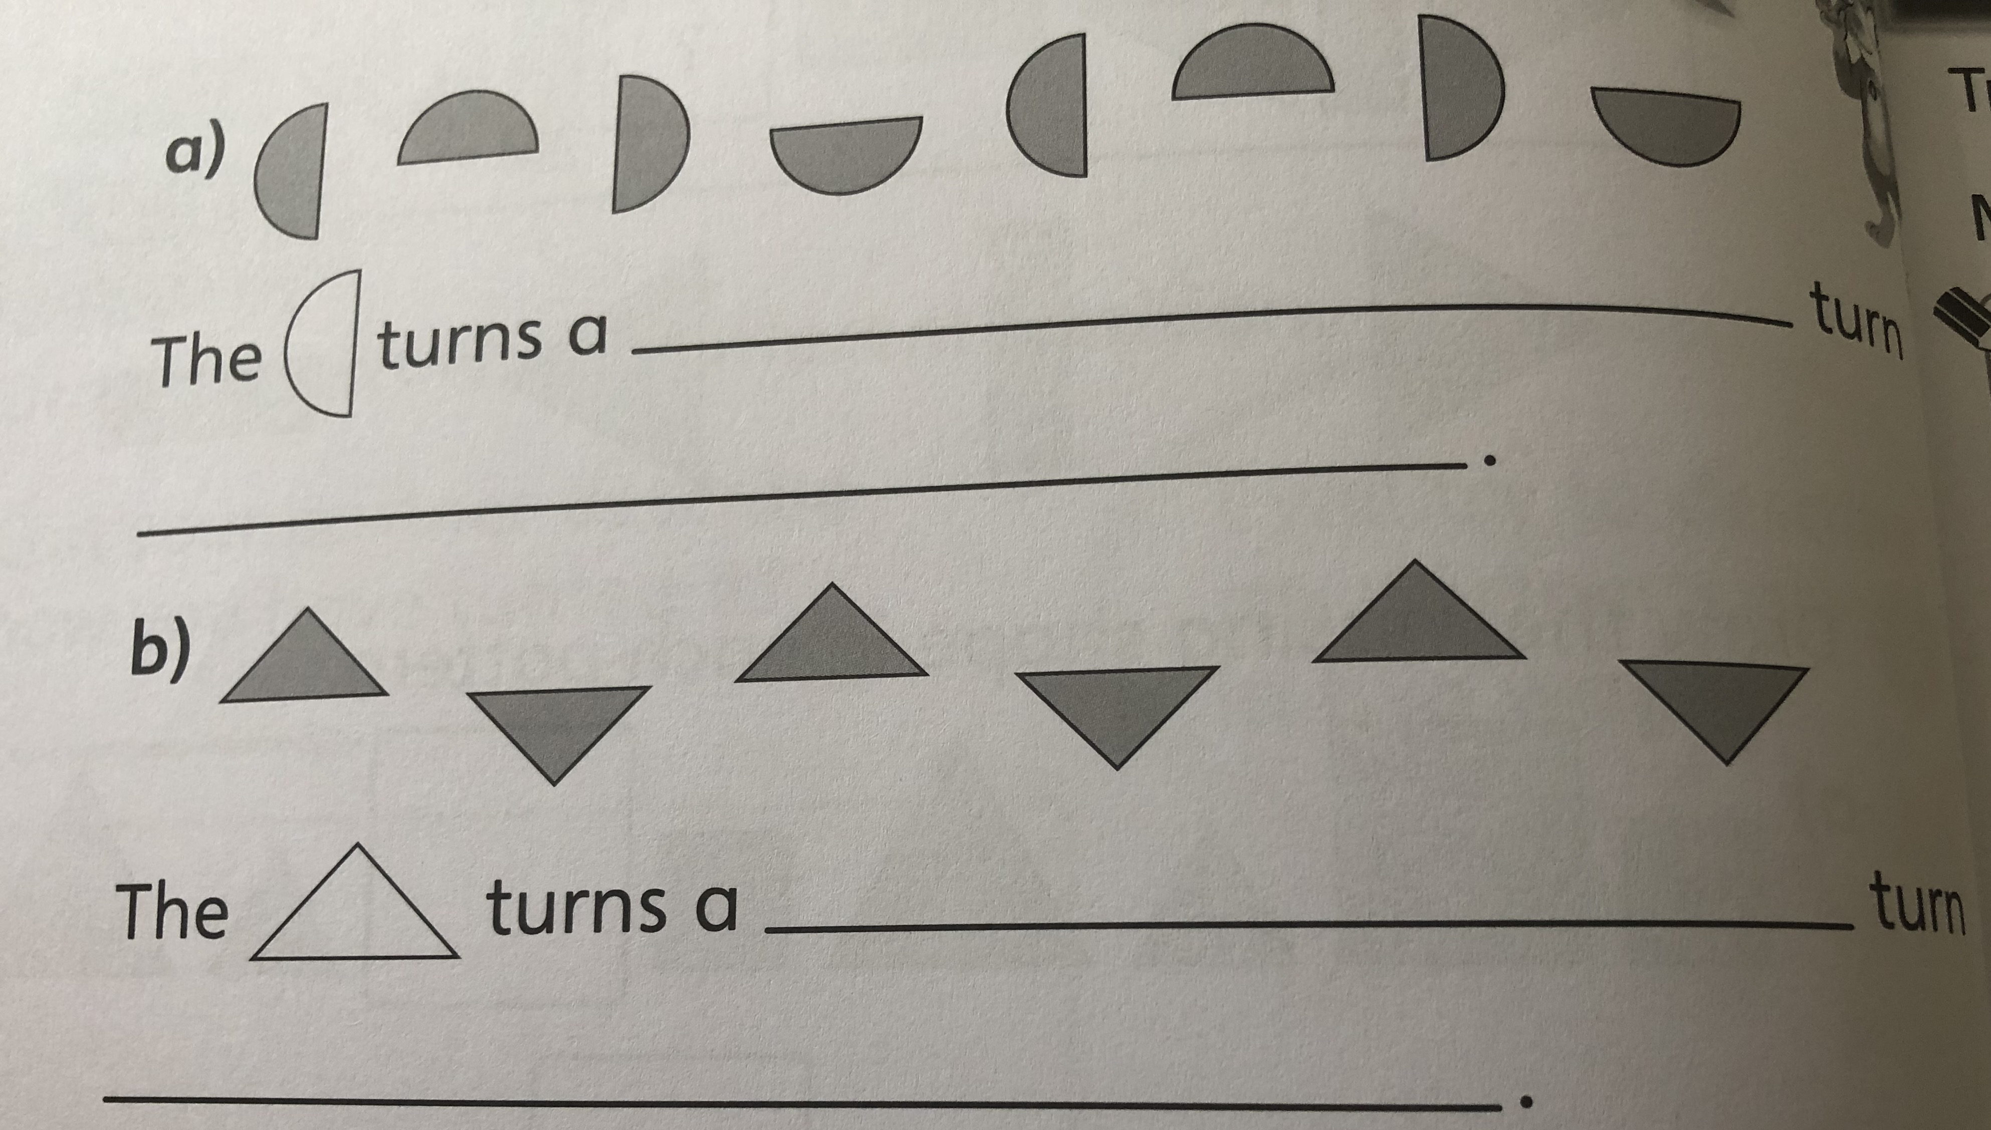

Slide 16
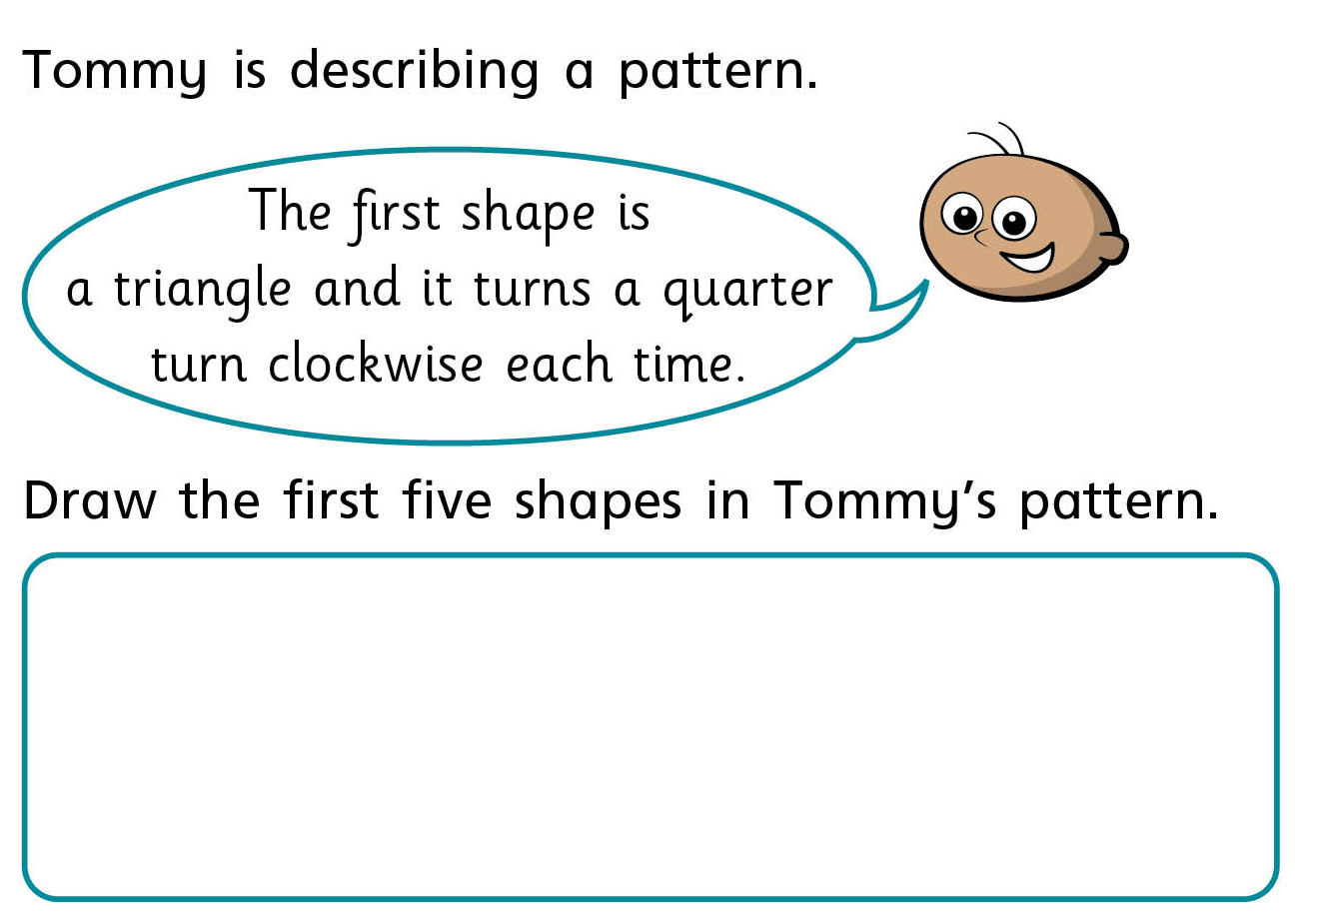
Independent Work

Slide 17
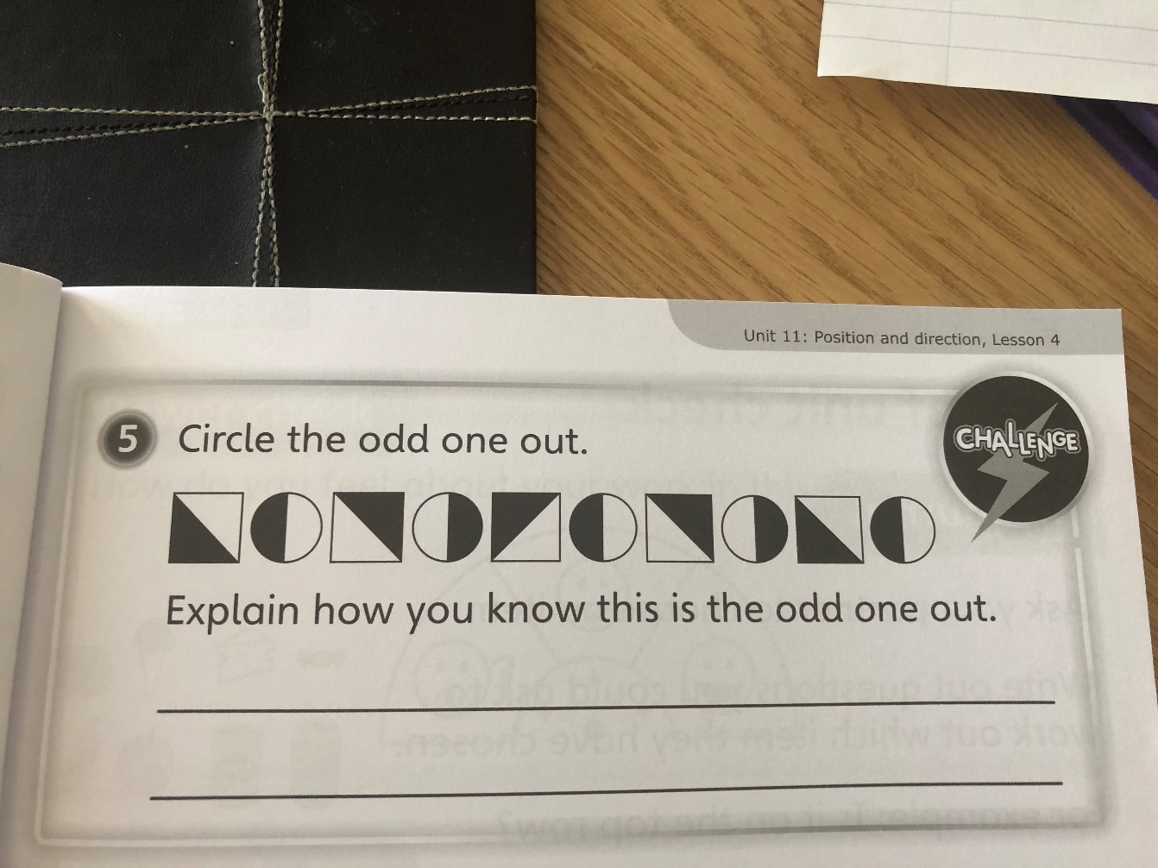
Independent Work

Slide 18
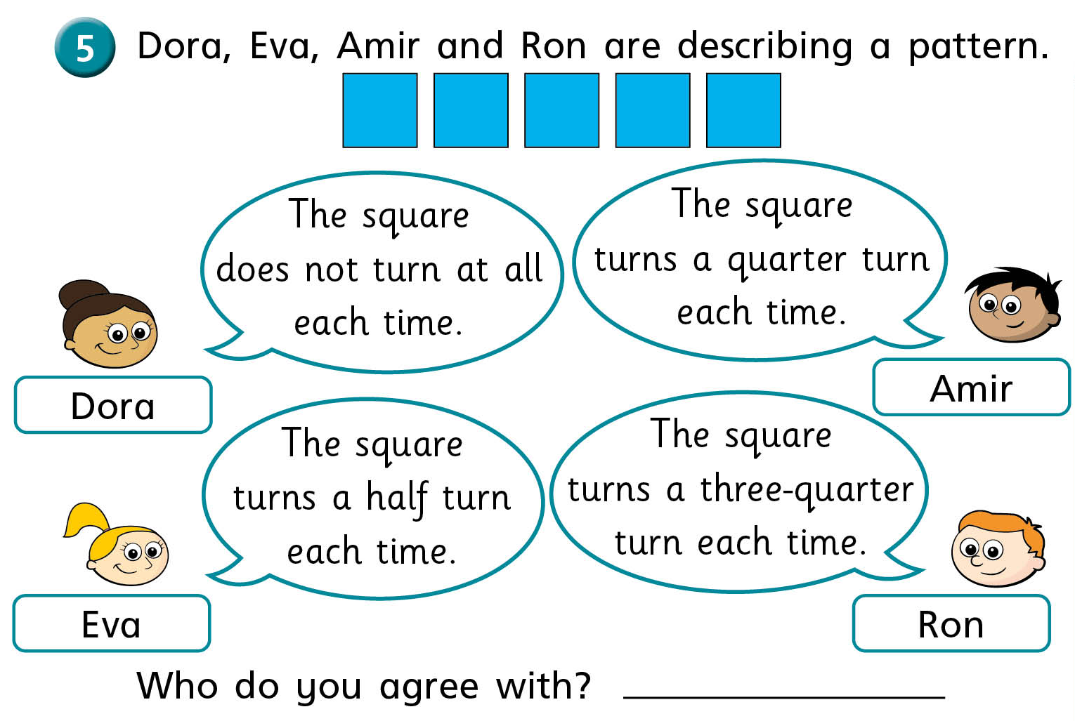
Challenge

