Slide 1
LO: To describe position, direction and movement.
C: To describe movement and turns.
Stem Sentences:
Useful words:
Clockwise anti clockwise half turn
quarter turn three quarters turn whole

Slide 2
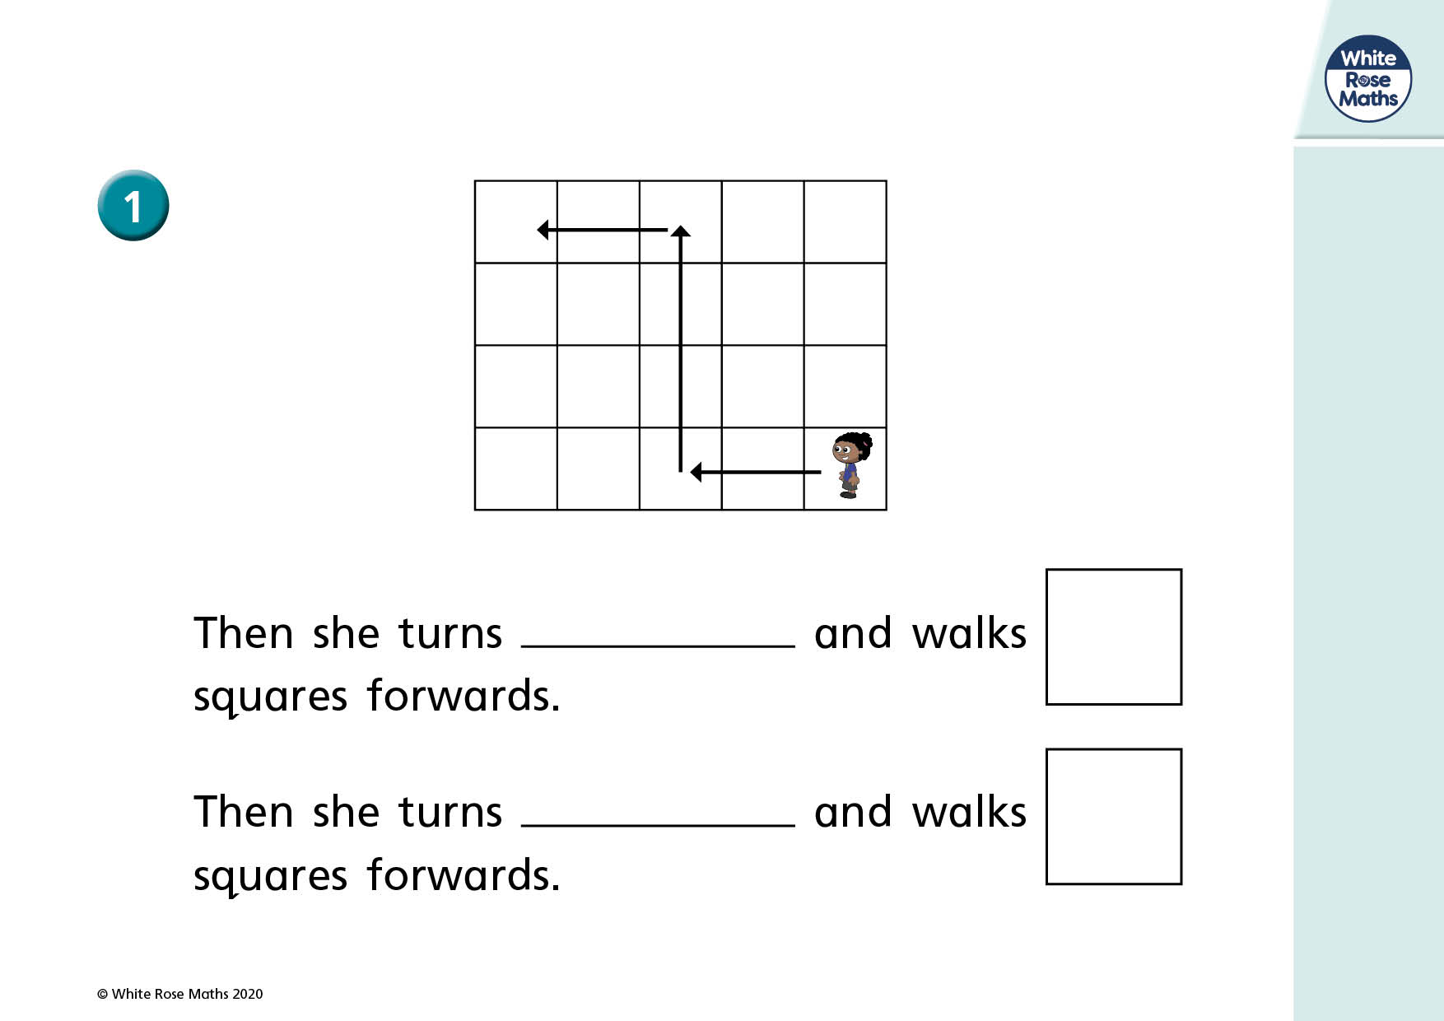
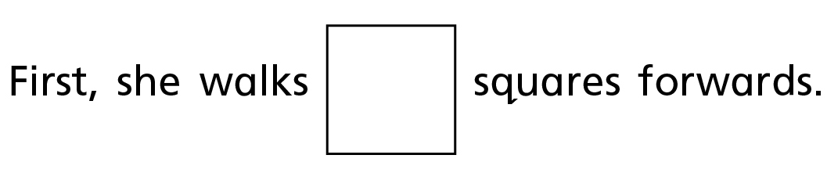

Slide 3
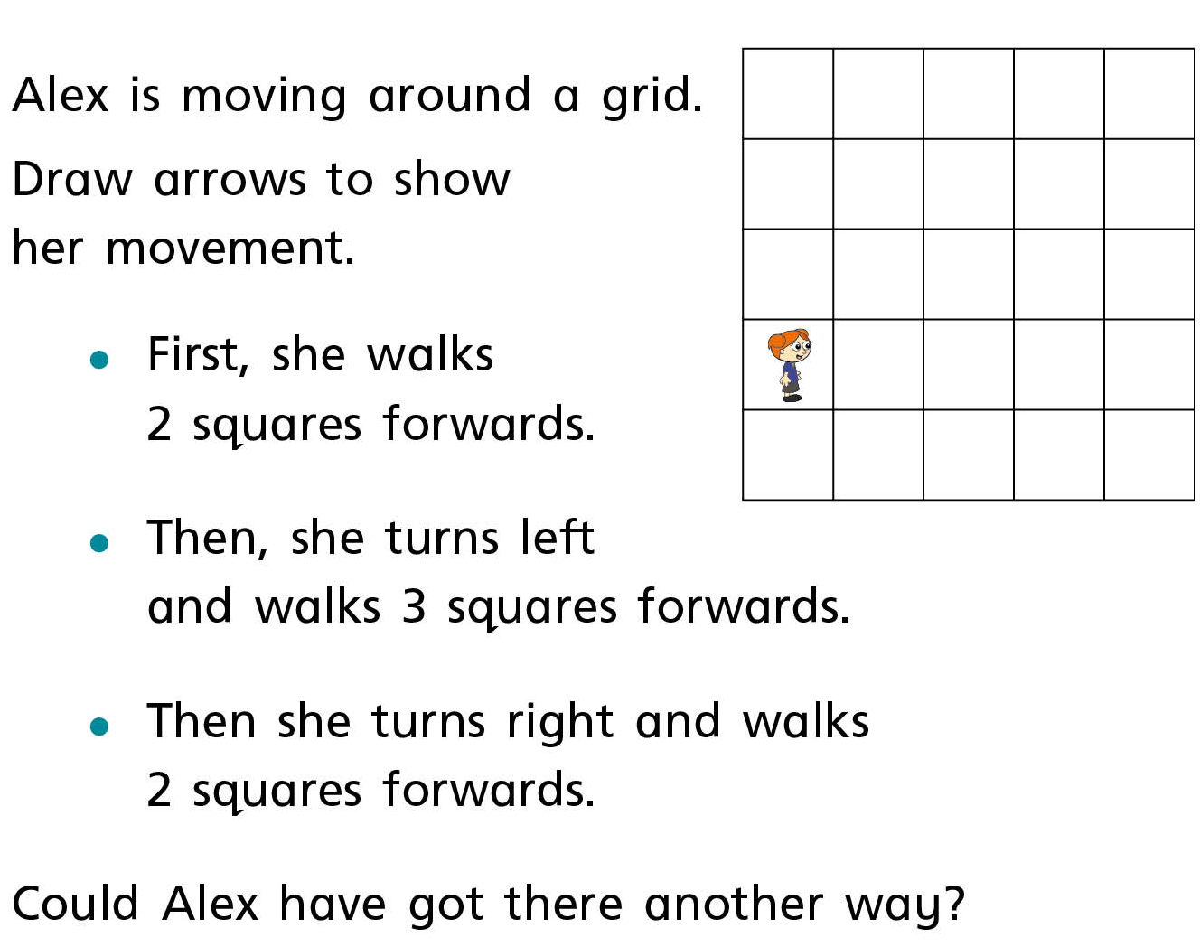
Partner Practise

Slide 4
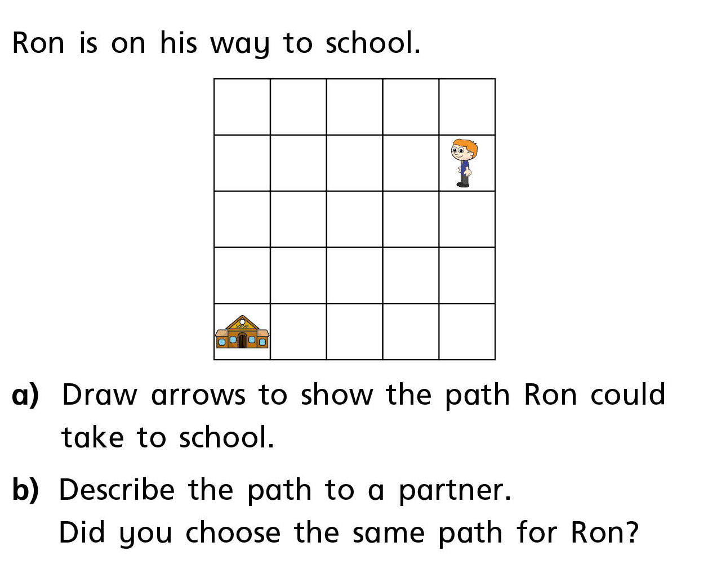
Independent Work

Slide 5
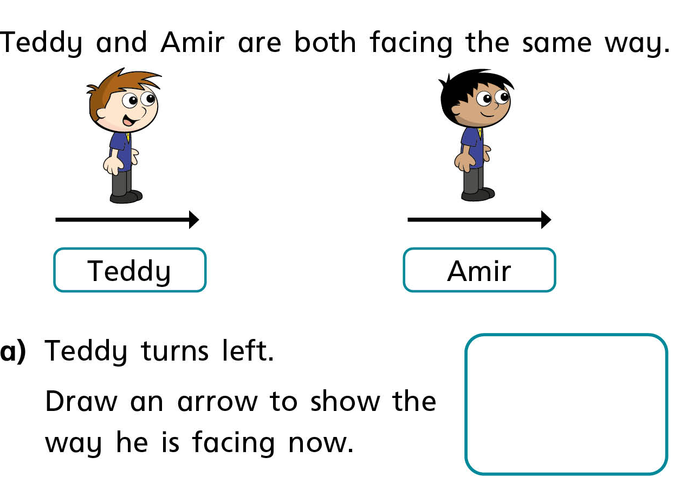

Slide 6
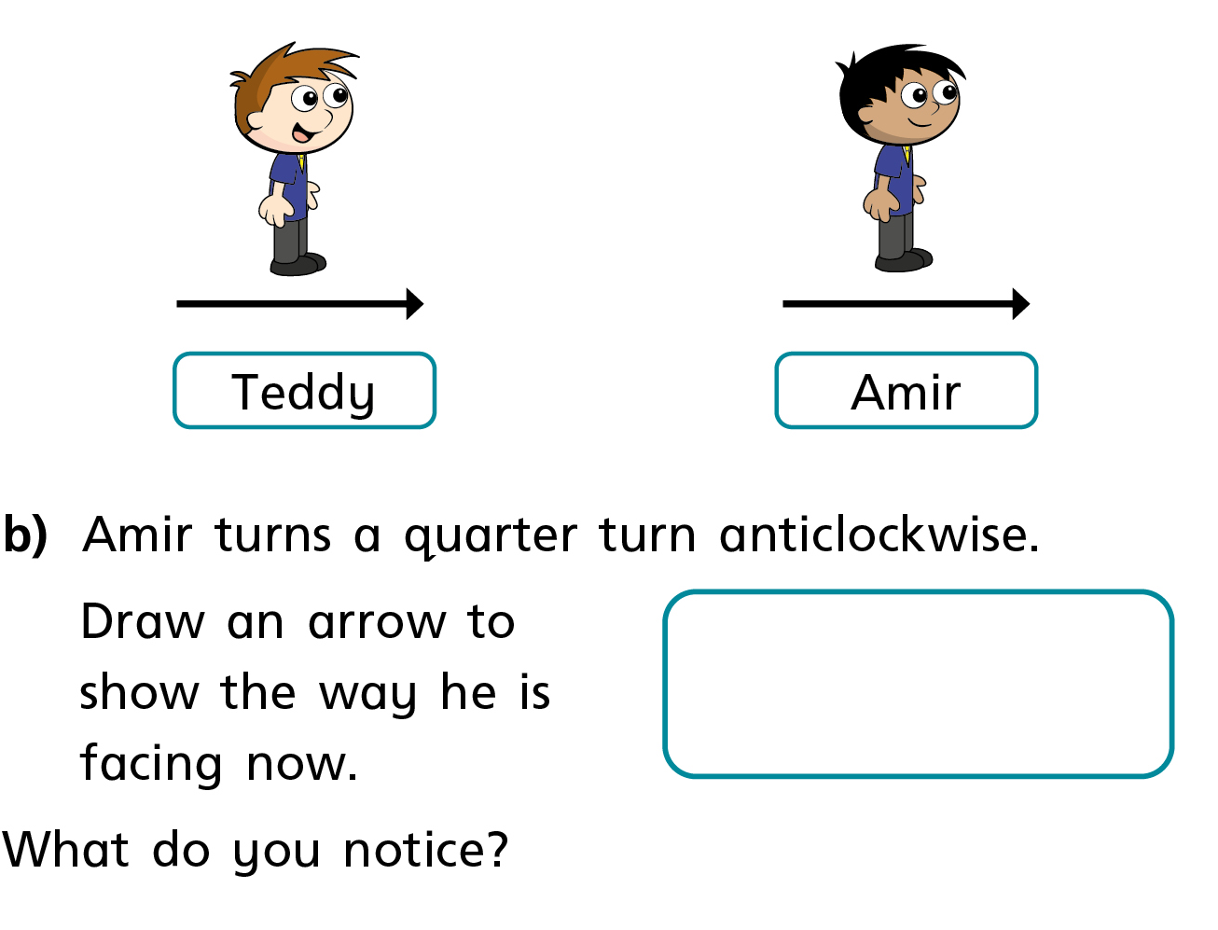

Slide 7
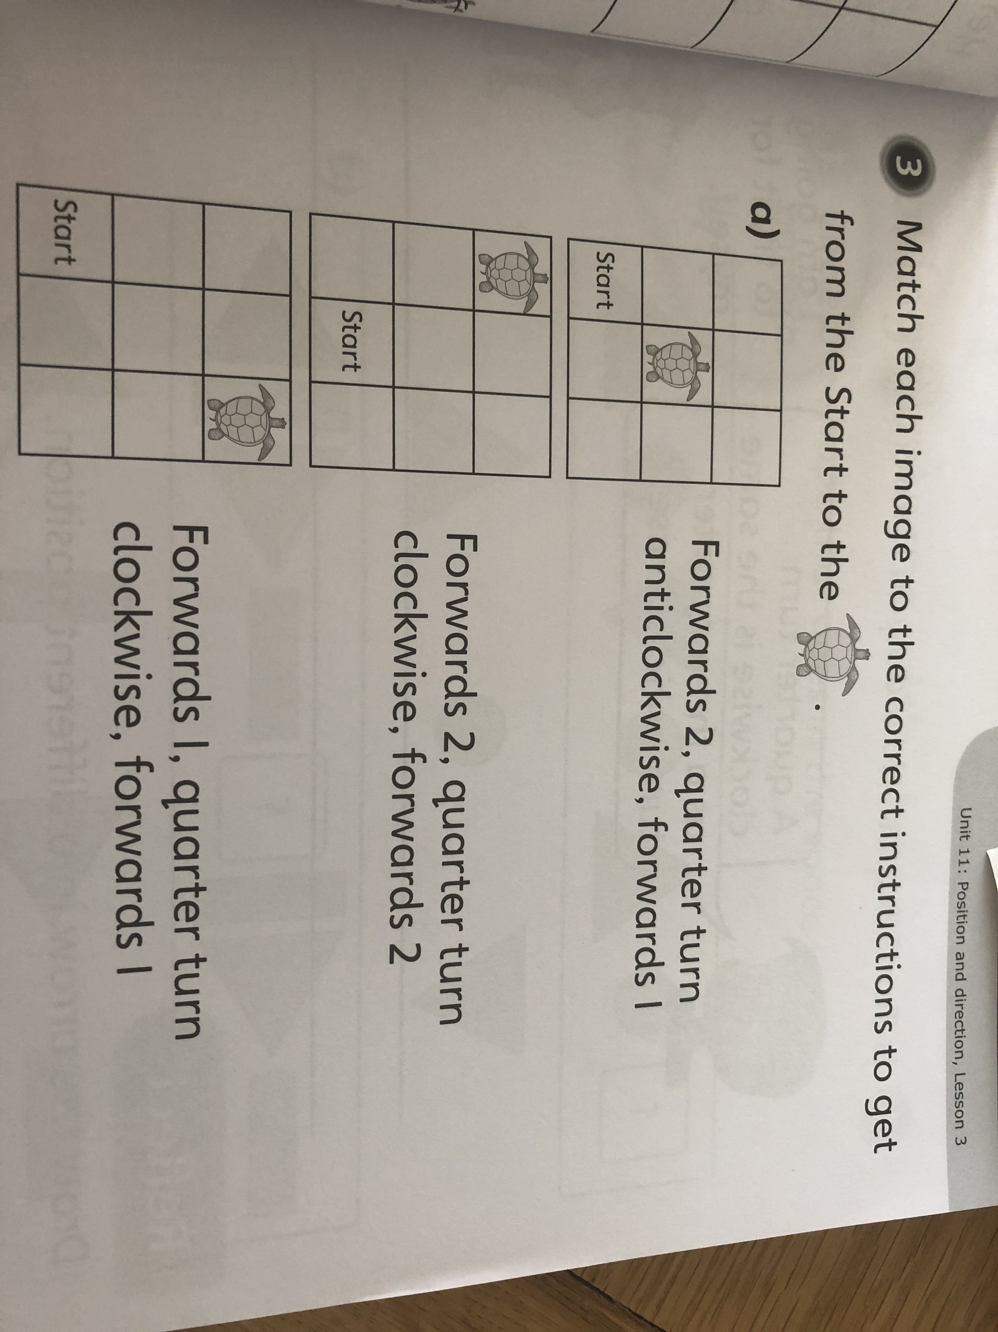
Independent Work

Slide 8
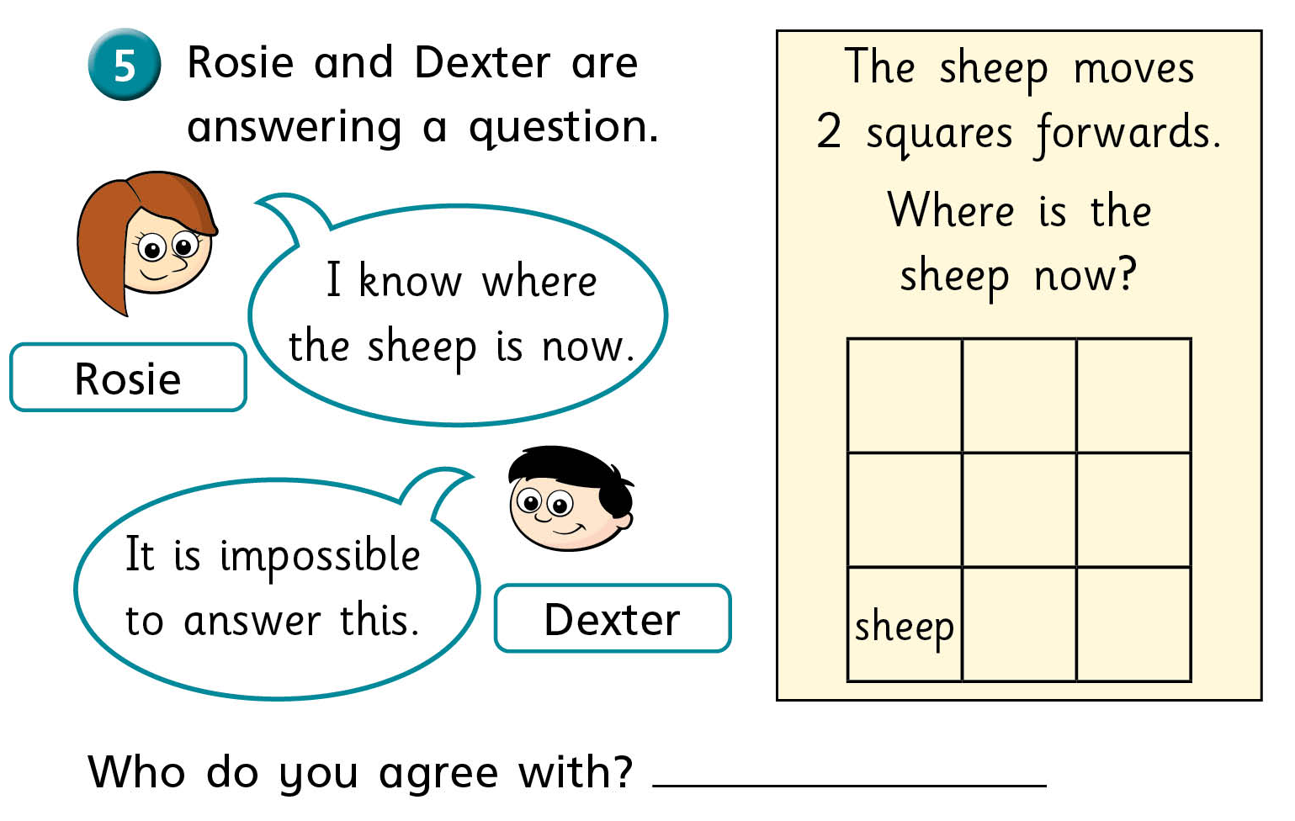
Challenge

