Slide 1
LO: To describe position, direction and movement.
C: To describe turns.
Stem Sentences:
The ‘apple’ has turned a _____ turn ______.
Useful words:
Clockwise anti clockwise half turn
quarter turn three quarters turn whole

Slide 2
LO: To describe position, direction and movement.
C: To describe turns.
Lets move!
Whole turn
Half turn
Quarter turn
Three quarters turn

Slide 3
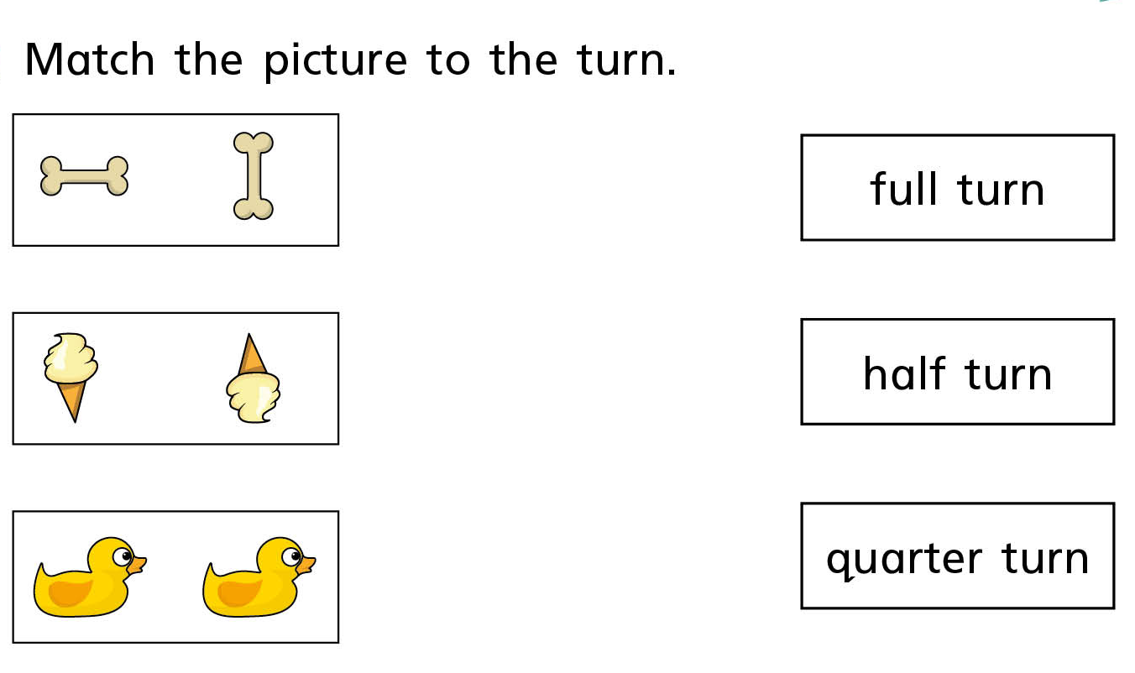

Slide 4


