Slide 1
Monday
LO: To describe position, direction and movement.
C: To describe movement.
Stem Sentences:
The ______ is moving ___ squares ______.
Useful words:
Left right between
Forwards backwards

Slide 2
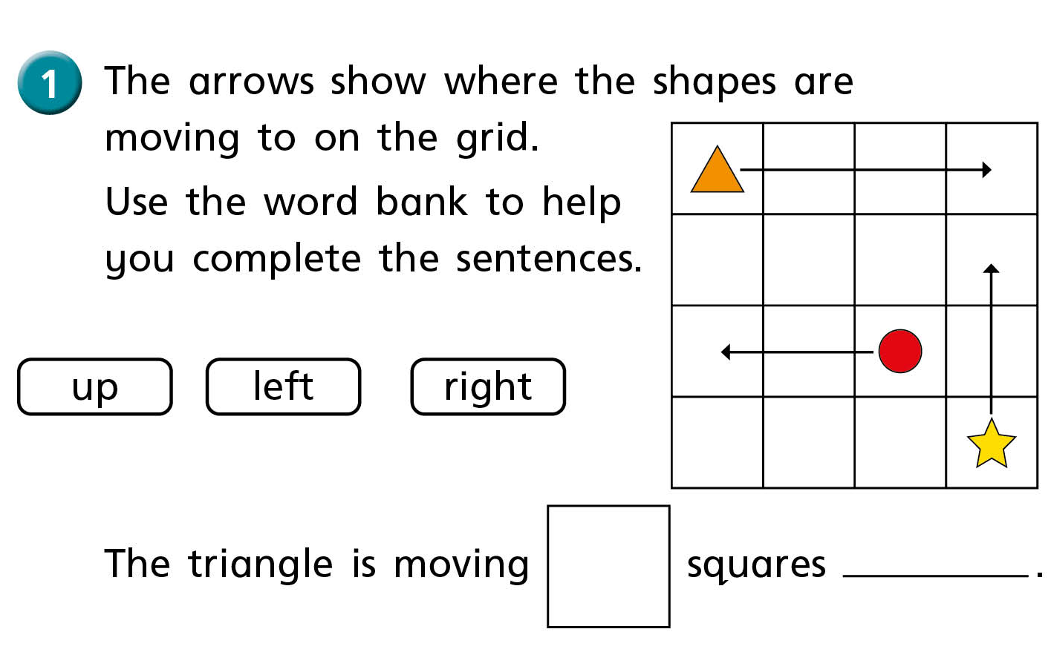

Slide 3
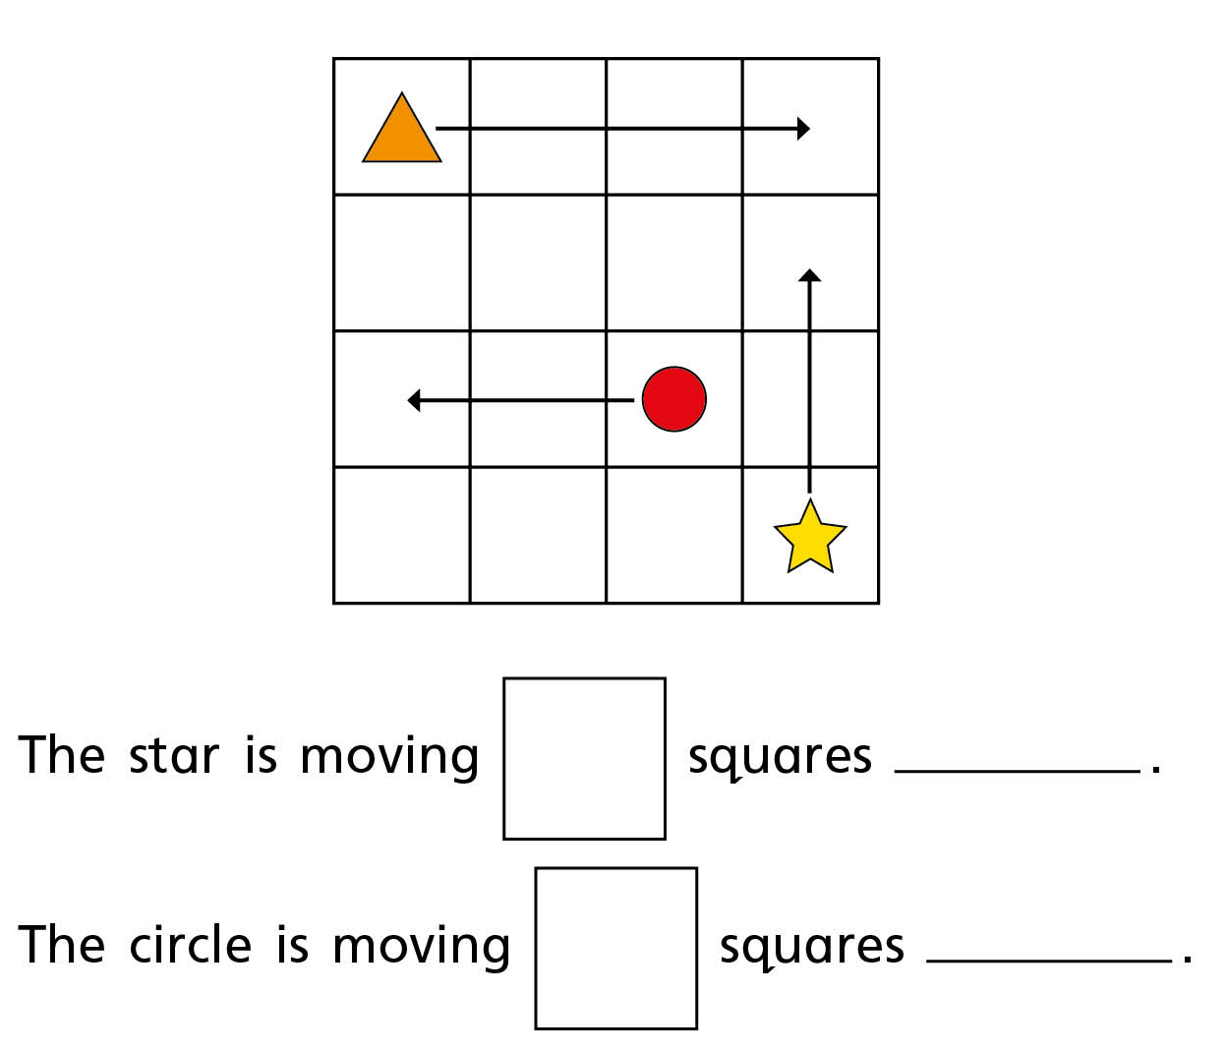
Partner Practise

Slide 4
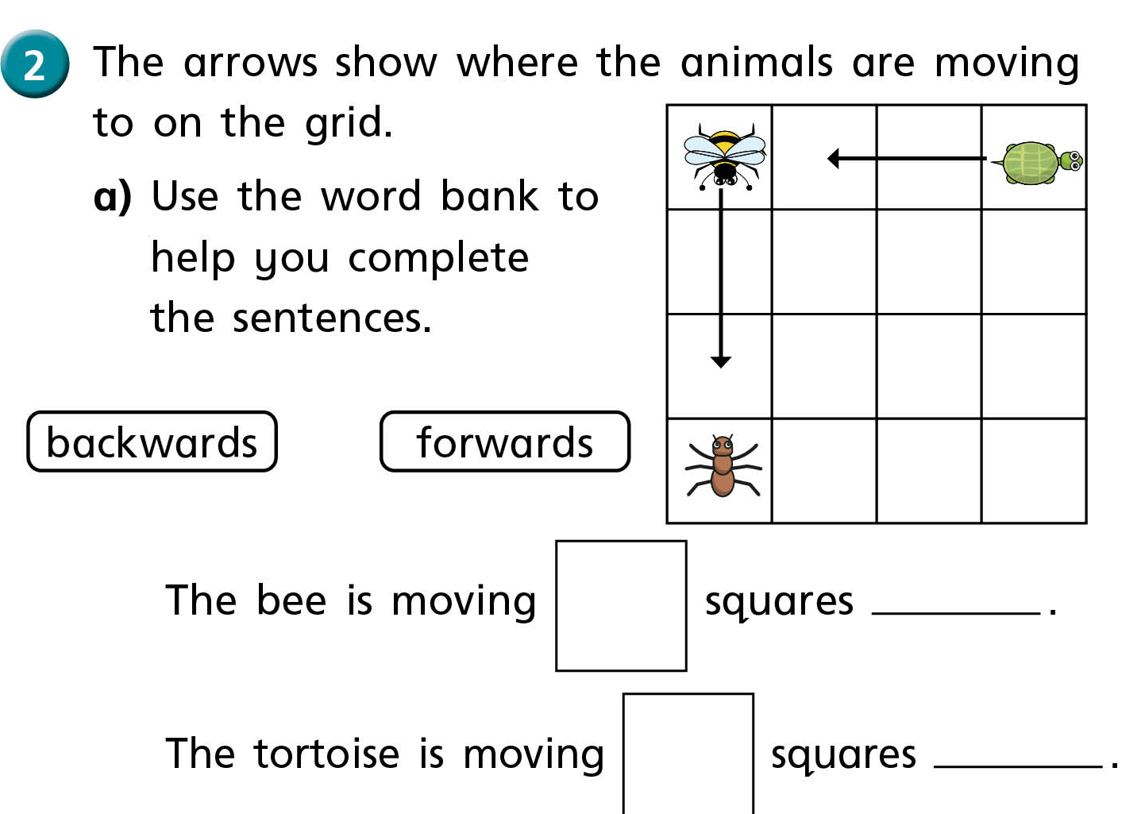

Slide 5
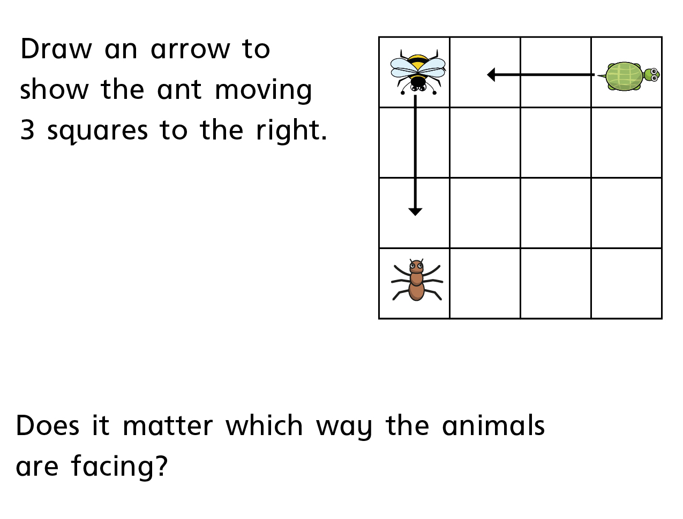
Partner Practise

Slide 6
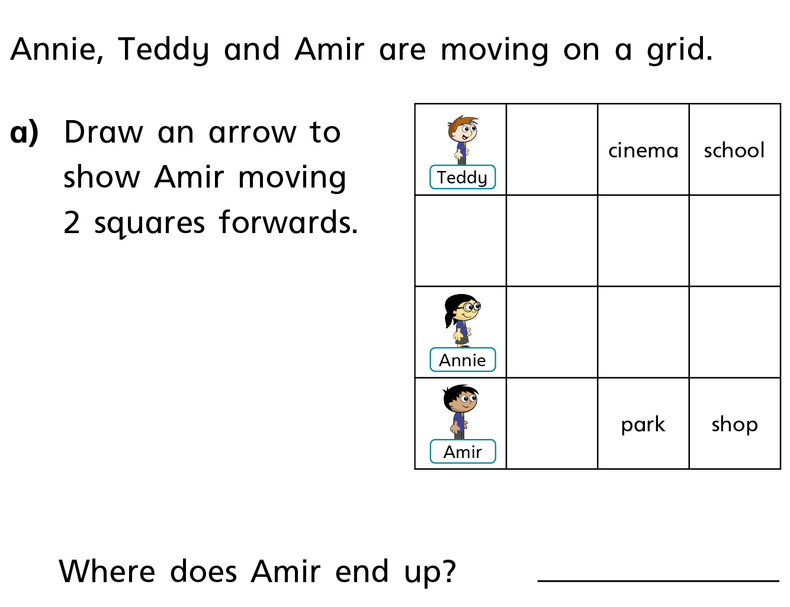
Partner Practise

Slide 7
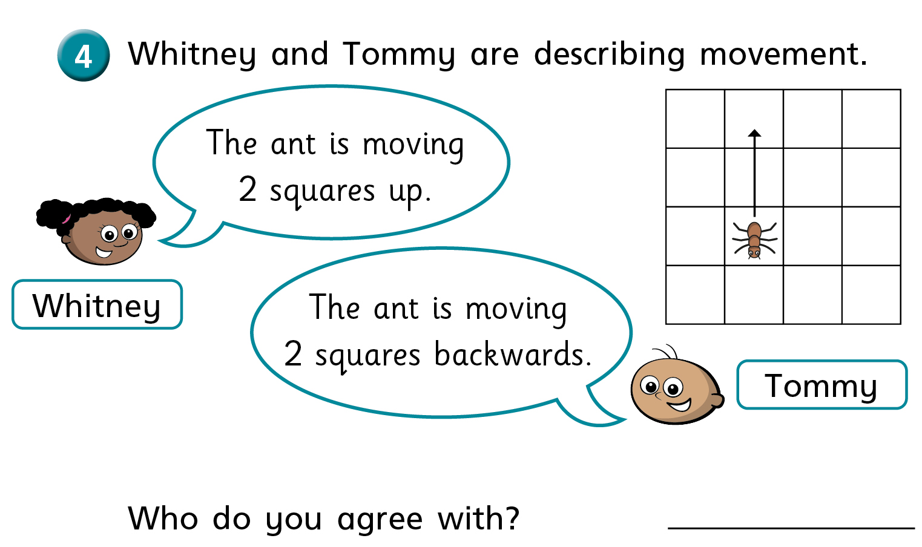

Slide 8
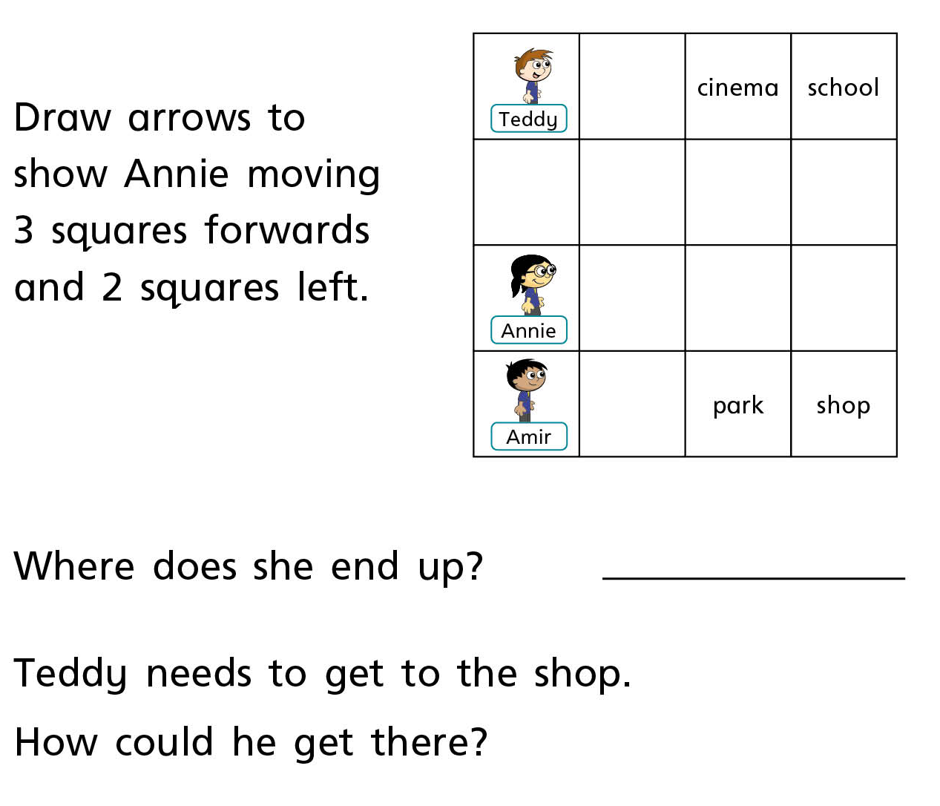
Independent Work

Slide 9
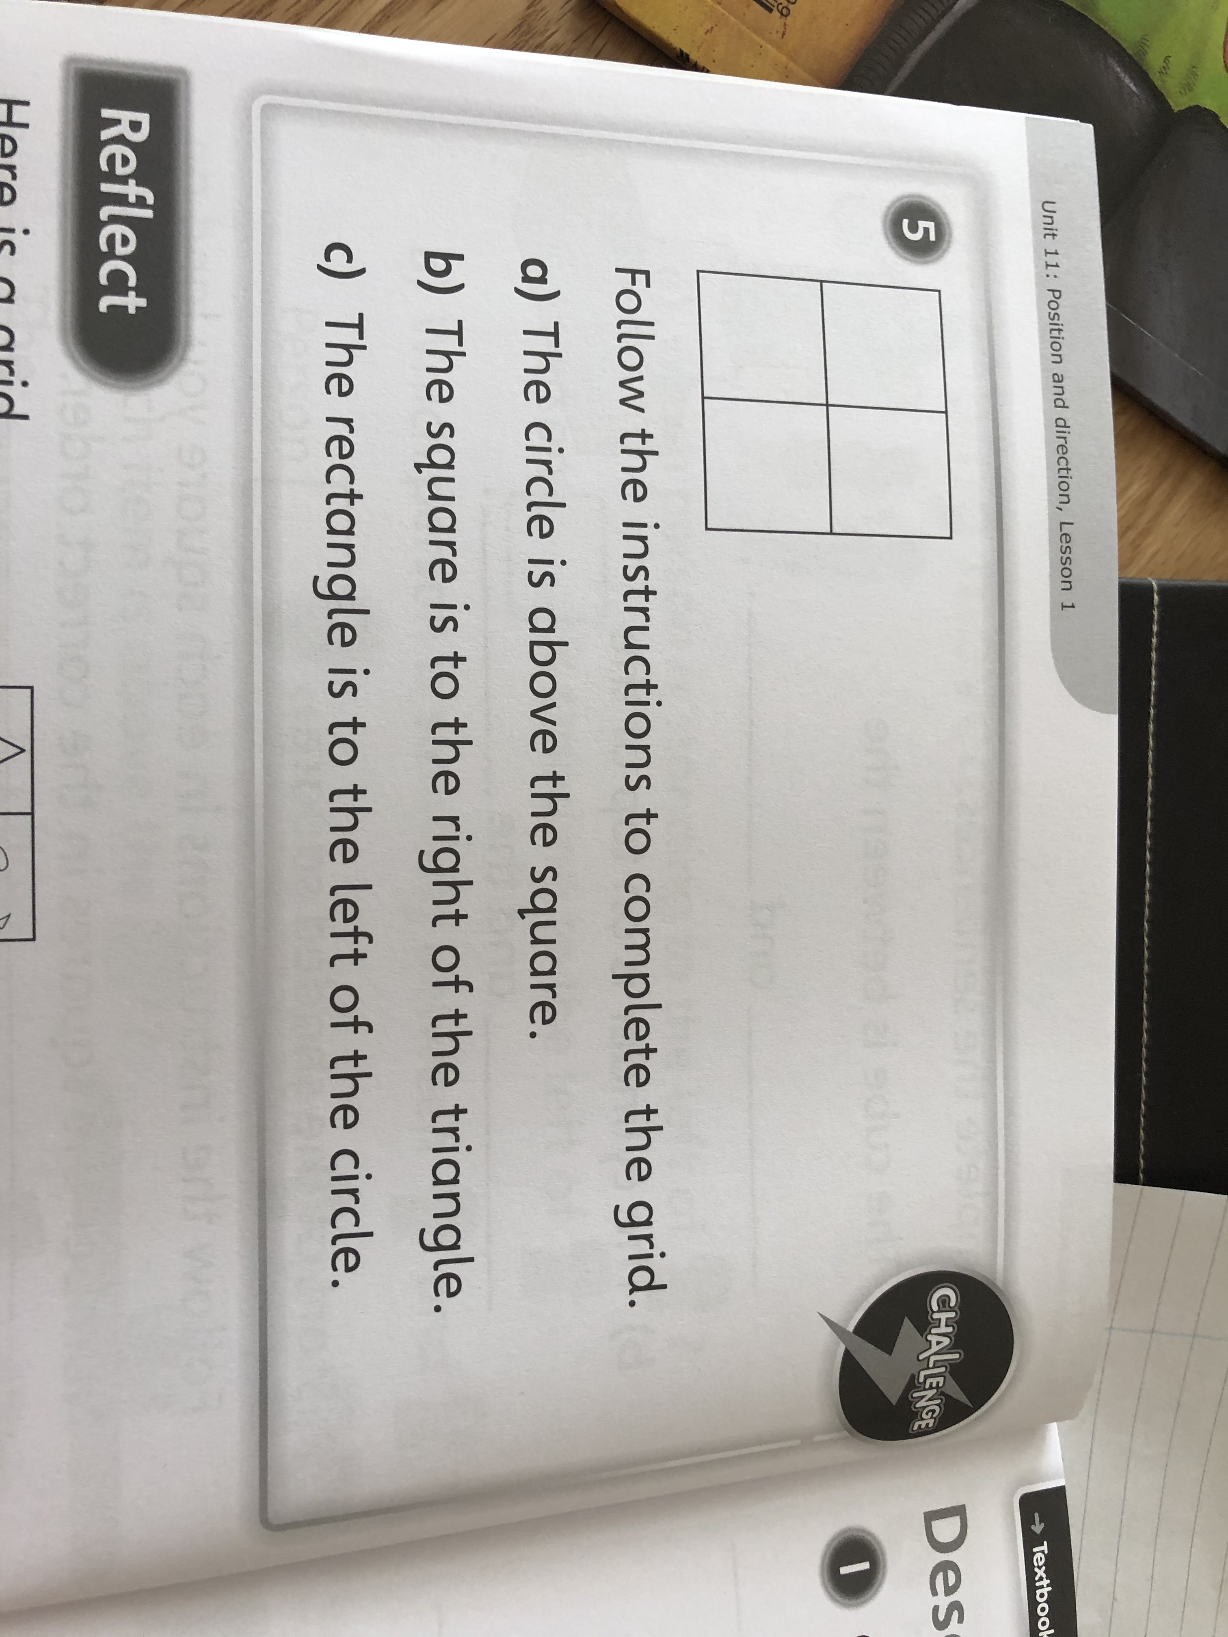
Challenge
Create your own grid and write the instructions.

