Slide 1
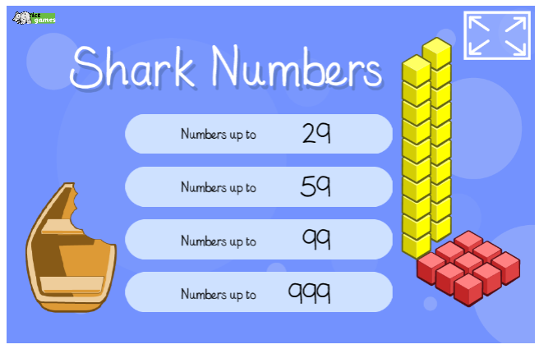
Starter

Slide 2
How many different ways
can we partition 7?
7
6
1

Slide 3


Slide 5
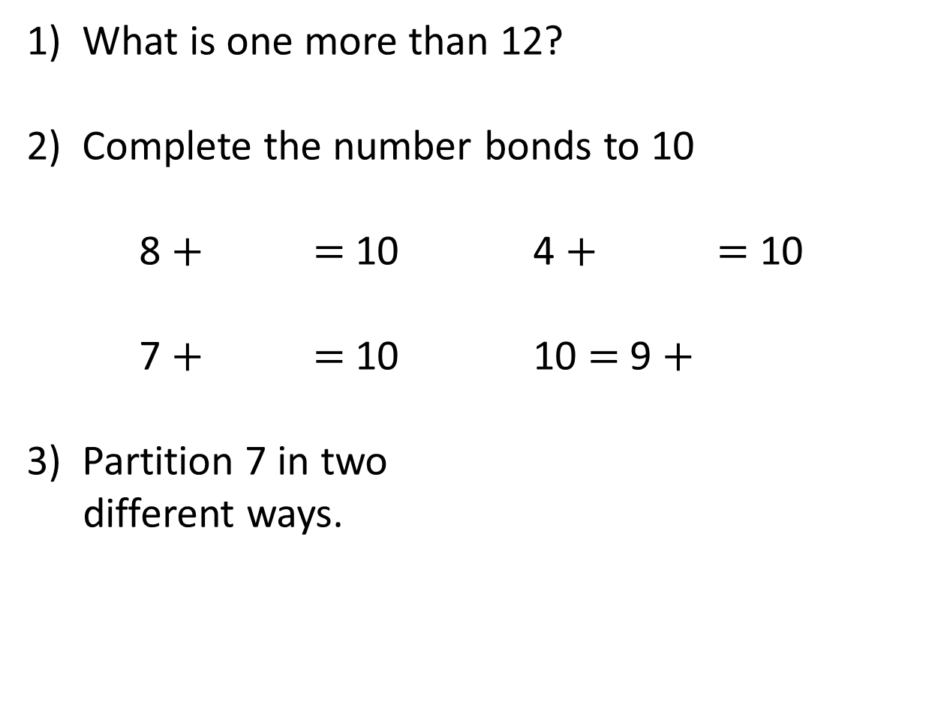
1) What is one more than 12?
2) Complete the number bonds to 10
8 $+$ $=$ 10 4 $+$ $=$ 10
7 $+$ $=$ 10 10 $=$ 9 $+$
3) Partition 7 in two
different ways.
7
7

Slide 6
1) What is one more than 12?
2) Complete the number bonds to 10
8 $+$ $=$ 10 4 $+$ $=$ 10
7 $+$ $=$ 10 10 $=$ 9 $+$
3) Partition 7 in two
different ways.
13
2
6
3
1
7
7
1
0
7
3
2
5
6
4

Slide 8

We can use number bonds to help us add!
6
6 $+$ 4 $=$ 10

Slide 9

3
3 $+$ 7 $=$ 10

Slide 10

5
5 $+$ 5 $=$ 10

Slide 11

1
1 $+$ 9 $=$ 10

Slide 12

8
8 $+$ 2 $=$ 10

Slide 13
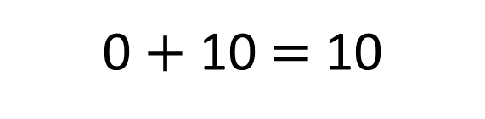
0
0 $+$ 10 $=$ 10

Slide 14

7
7 $+$ 3 $=$ 10

Slide 15
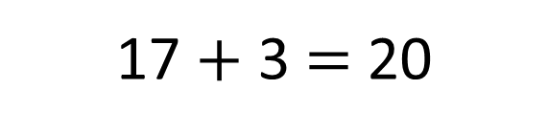
17
17 $+$ 3 $=$ 20

Slide 16
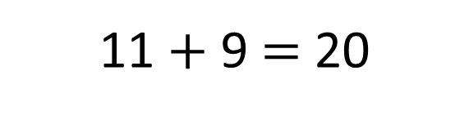
11
11 $+$ 9 $=$ 20

Slide 17
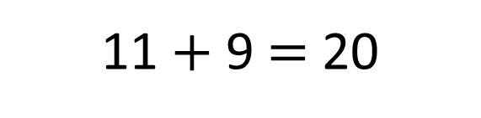

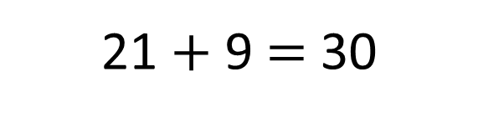
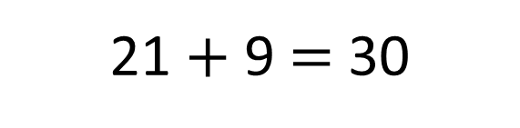
1 $+$ 9 $=$ 10
11 $+$ 9 $=$ 20
21
21 $+$ 9 $=$ 30
21 $+$ 9 $=$ 30

Slide 18
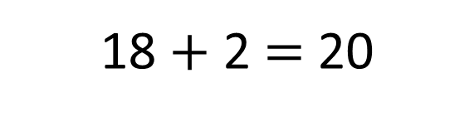
18
18 $+$ 2 $=$ 20

Slide 19
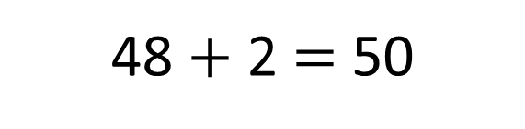
48
48 $+$ 2 $=$ 50

Slide 20

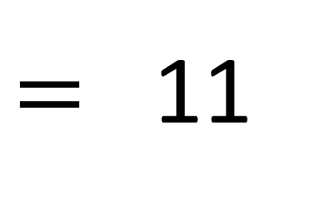
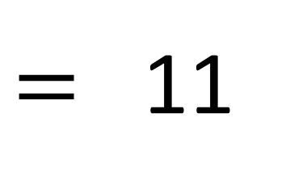
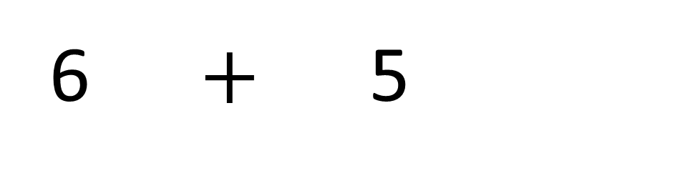
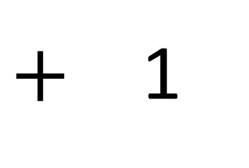
+ 4
+ 1
6
7
8
9
10
11
12
13
$=$ 11
6 $+$ 5
4
1
$+$ 1
10
$=$ 11

Slide 21
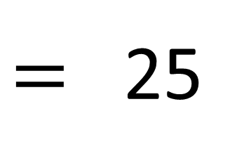
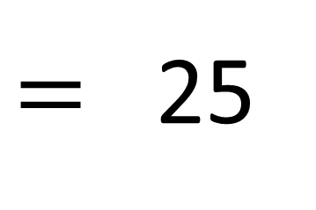
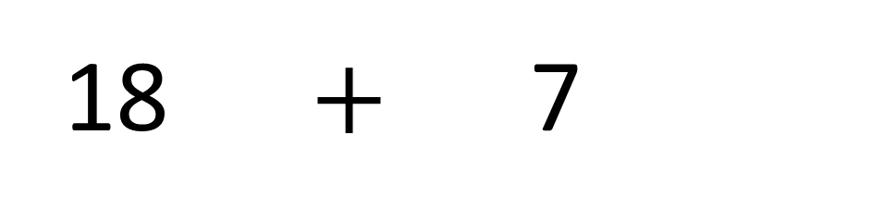
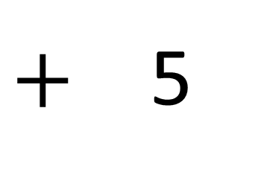
+ 2
+ 5
18
19
20
21
22
23
24
25
$=$ 25
18 $+$ 7
2
5
$+$ 5
20
$=$ 25

Slide 22

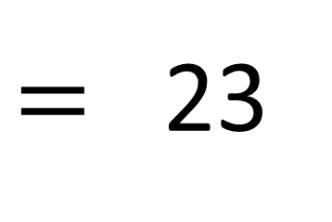
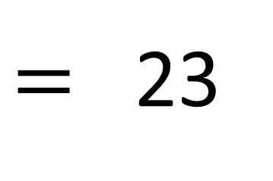
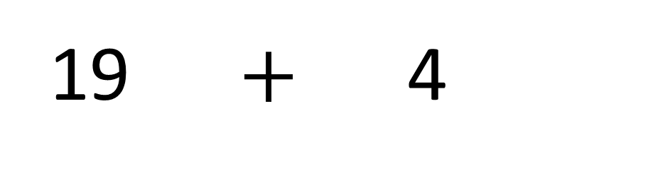
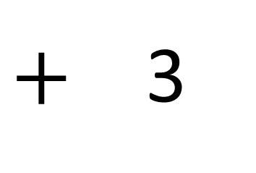
+ 1
+ 3
Have a think
19
20
21
22
23
24
25
26
$=$ 23
19 $+$ 4
1
3
$+$ 3
20
$=$ 23

Slide 23
Have a go at your tasks

