Slide 1
21.10.2020
L.O: Add and Subtract
C: Add and subtract 3-digit and 1-digit numbers – not crossing 10.

Slide 2
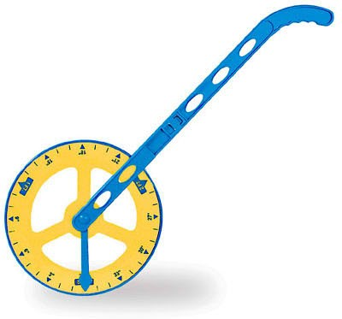
B.O.L.E
You are going to use trundle wheels to measure areas of the BOLE.
We are going to set you some challenges!
For example: Can you find 6cm longer than the gate to the compost heap?

Slide 3
I do we do you do
Column Addition

Slide 4
I do
143+4

Slide 5
We do
495+3

Slide 6
You do
302+7

Slide 7
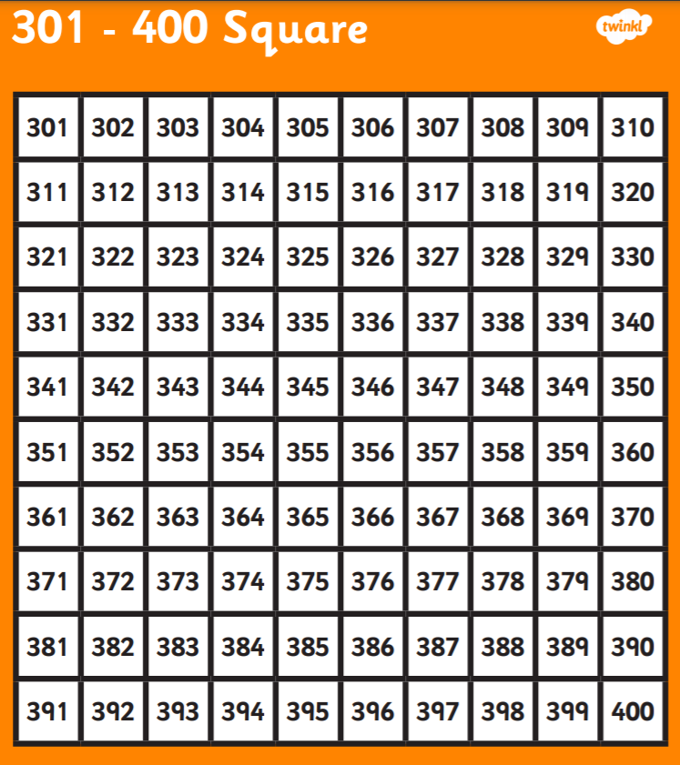
Let’s check
You do
302+7

Slide 8

It’s your turn!

Slide 9
Plenary
Let’s self-assess our number snakes.

