Slide 1

Paddlers:
Maisy’s sunflower is 394cm tall. Sam’s is 396cm tall. What is the difference between their sunflowers?

Slide 2

Snorkellers:
Gregg has 328 lego bricks. Oscar has 320 lego bricks.
How many more does Gregg have?
Can you draw a diagram to explain your answer?

Slide 3
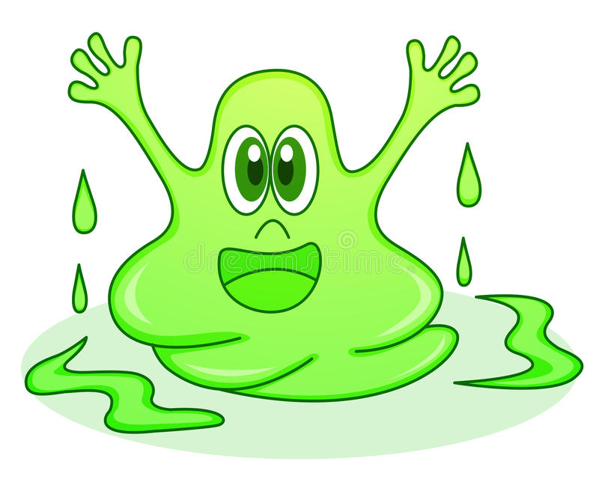
Divers:
The slime monster is 314cm tall. The yeti is 319cm tall. What is the difference between their heights?
Can you draw a diagram to show your methods and explain your answer using a sentence.

