Slide 1
20.10.2020
L.O: Add and Subtract
C: Add and subtract 3-digit and 1-digit numbers – not crossing 10.

Slide 2
Starter Bingo!
Draw this grid on your whiteboard.
Choose six numbers:
35, 670, 15, 234, 6, 62, 702, 105

Slide 3
I do we do you do

Slide 4
I do
145+4
https://mathsbot.com/manipulatives/placeValueCounters

Slide 5
We do
834+6
https://mathsbot.com/manipulatives/placeValueCounters

Slide 6
You do
403+5
https://mathsbot.com/manipulatives/placeValueCounters

Slide 7
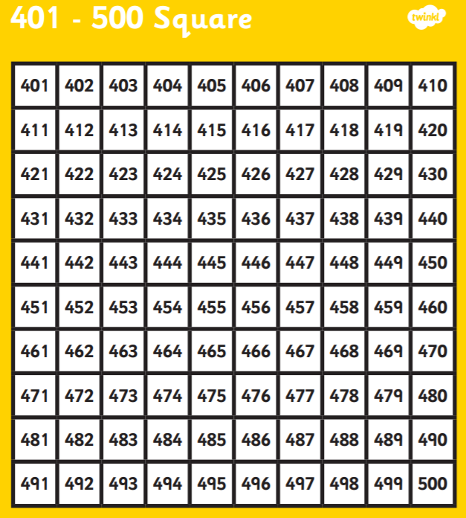
Let’s check
You do
403+5
https://mathsbot.com/manipulatives/placeValueCounters

Slide 8

It’s your turn!

Slide 9
Plenary
Choose one question on your sheet. Explain to your talk partner what you did to solve it and why using STEM sentences.

