Slide 1


Paddlers
Jake has 8 fish and he buys 3 more. How many does he have all together?
Copy and complete the number line to help you.

Slide 2
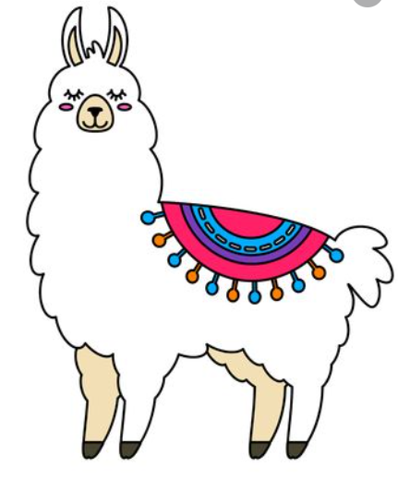
Paddlers
Abby has 52 llamas in her field. She gets 3 new baby llamas. How many does she have now?
Draw a part-whole model to show your sum.

Slide 3
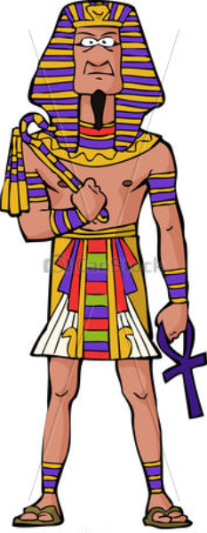
Paddlers
The Pharaoh has 38 treasures.
6 are stolen.
How many treasures are left?

Slide 4
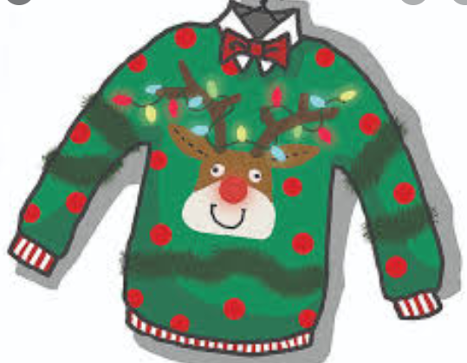
Snorkellers
Max has knitted 37 jumpers for charity. He donates 6 to the homeless. He gives the rest to the elderly. How many does he give to the elderly?
Draw a number line to show your working out.

Slide 5

Snorkellers
There are 234 cars in the car park.
There are 5 spaces left.
How big is the car park?

Slide 6
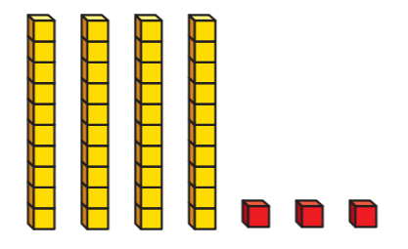
Snorkellers
Bob has made this number using dienes.
Ava’s number is 9 bigger.
What is Ava’s number?

Slide 7
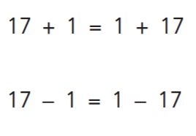
Divers
Are these number sentences true or false?
Write a sentence to explain your answers.

Slide 8
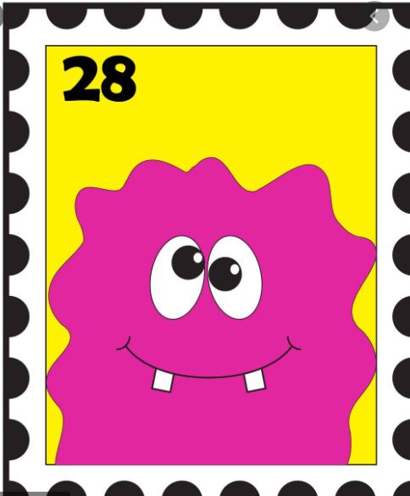
Divers
Sophie has collected 403 stamps. She gives 5 to her little brother.
How many does she have left?
Draw a number line to help you.

Slide 9

Divers
Follow the instructions:
234 + 4
-6 from your answer
+9 to your answer
+5 to your answer
-3 from your answer
What do you end up with?

