Slide 1
19.10.2020
L.O: Add and Subtract
C: Add and Subtract 1s

Slide 2

Starter
? + ? = 20
What could the missing numbers be?

Slide 3
Starter
? + ? = 20
How many did you find?
Which methods did you use?

Slide 4


Let’s Recap
Copy and complete the part-whole models in your books.
2)
3) 4)
2
9
6
4
4
1
2
4
3
8

Slide 5
Complete the part-whole models
2)
3) 4)
10
2
9
6
4
7
9
3
4
1
2
4
3
8

Slide 6


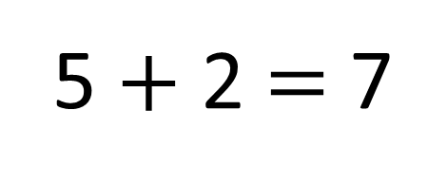
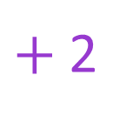
How many cakes has Ron baked in total?
5 $+$ 2 $=$ 7
$+$2
0
1
2
3
4
5
6
7
8
9
10

Slide 7
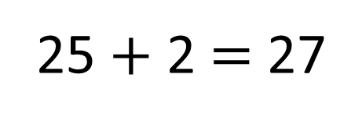

How many cakes has Ron baked in total?
25 $+$ 2 $=$ 27
$+$2
20
21
22
23
24
25
26
27
28
29
30

Slide 8



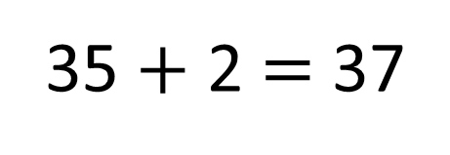
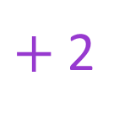
How many cakes has Ron baked in total?
Have a think
35 $+$ 2 $=$ 37
$+$2
\
30
31
32
33
34
35
36
37
38
39
40

Slide 9
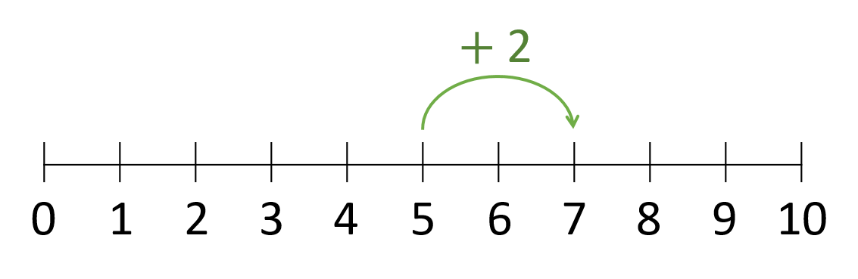
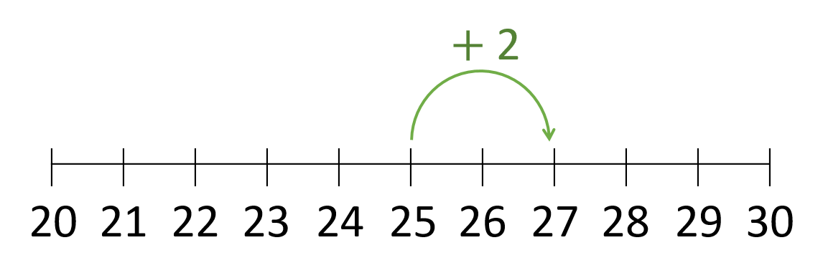
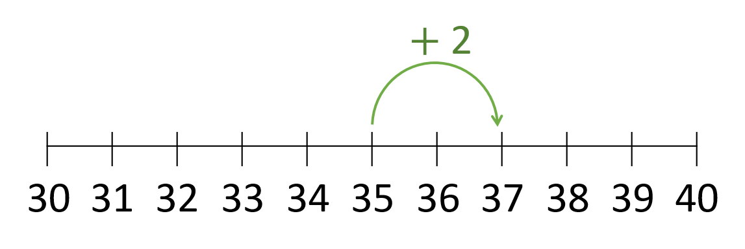
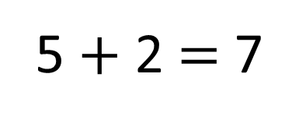
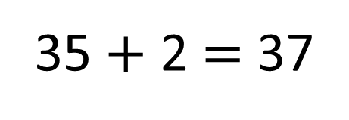
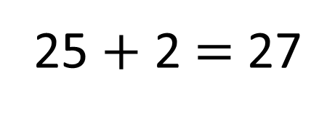
5 $+$ 2 $=$ 7
25 $+$ 2 $=$ 27
35 $+$ 2 $=$ 37

Slide 10
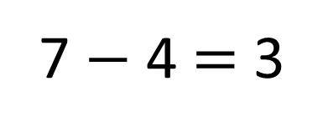
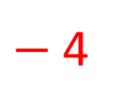
Ron has baked 7 cakes.
He gives 4 to his family.
How many cakes does he have left?
$−$4
0
1
2
3
4
5
6
7
8
9
10
7 $−$ 4 $=$ 3

Slide 11

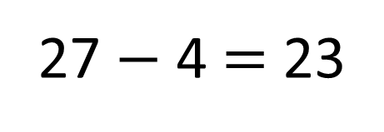
27 $−$ 4 $=$ 23
$−$4
20
21
22
23
24
25
26
27
28
29
30

Slide 12
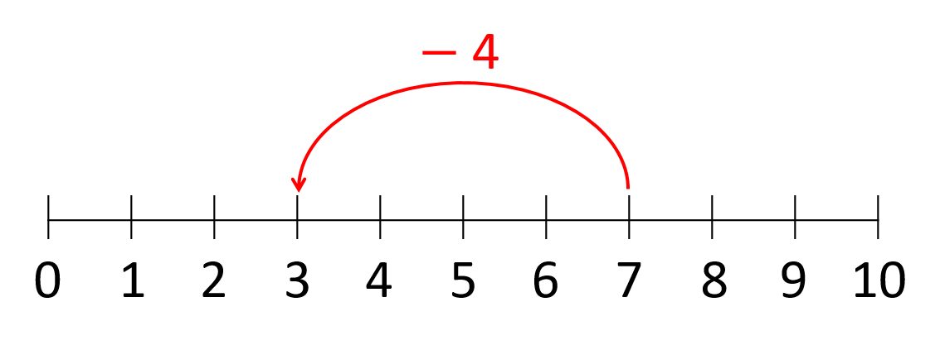
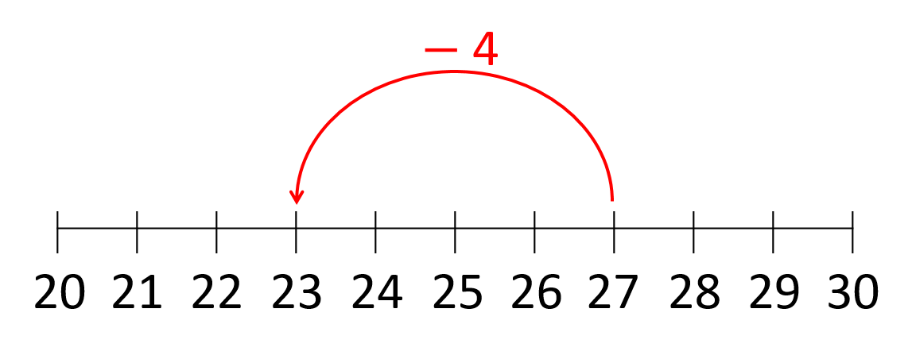

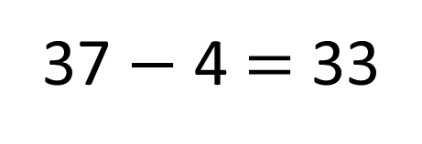
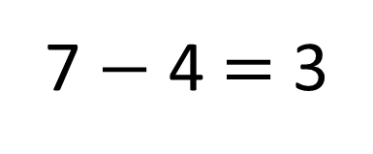
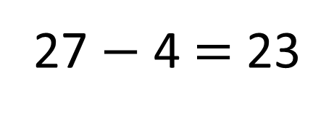
7 $−$ 4 $=$ 3
27 $−$ 4 $=$ 23
37 $−$ 4 $=$ 33

Slide 13
Your turn!
Work through the problems one by one.
Stick it in then solve using a picture.
Divers: Write a STEM sentence to explain your methods.

Slide 14

Plenary
I’m thinking of a number

