Slide 1
Friday 23rd October 2020
LO: To present writing
C:Finding Something Tale

Slide 2
Let’s Share…
KS1 need some new stories to share with their children. The teacher’s have asked if they can borrow our stories.

Slide 3
Aim
To know how to read aloud confidently.

Slide 4

How Do I Read Aloud Well?
Am I using a clear voice?
Try it…
She did a beautiful painting.
Did you read this clearly?

Slide 5
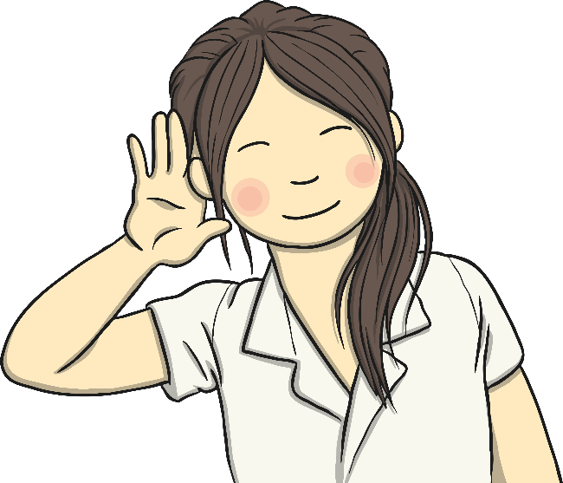
How Do I Read Aloud Well?
Am I being heard by my audience?
Try it…
The lions roared!
Did your audience hear you?

Slide 6
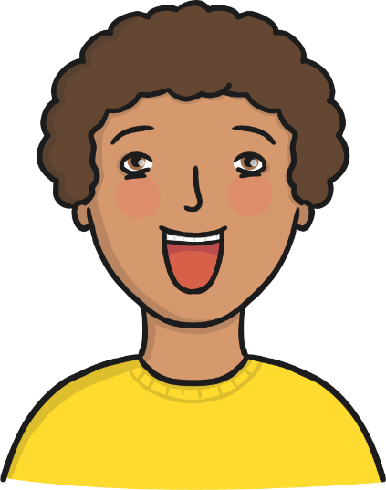
How Do I Read Aloud Well?
Am I using feeling and expression?
Try it…
I really want to go outside!
Did you read this in an excited voice? Did you emphasise the word really by making it sound a little louder and more powerful than the other words?
Try it…
“Are we nearly there yet?” he moaned.
Did you read this question in a moany voice?

Slide 7
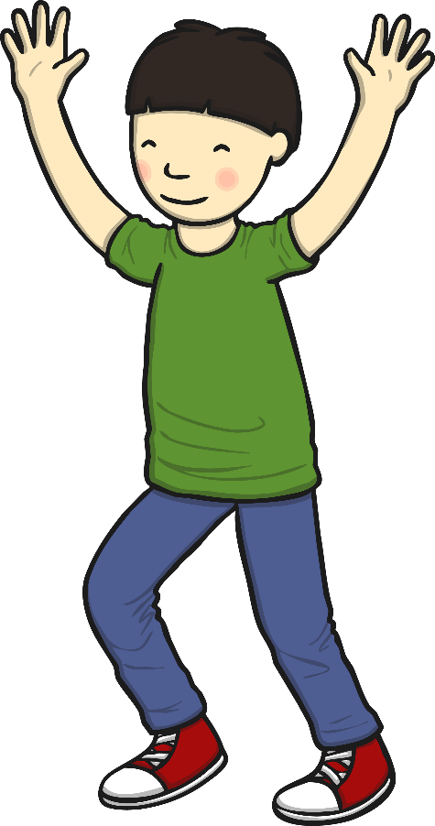
How Do I Read Aloud Well?
Am I moving or gesturing?
Try it…
He’s jumping around everywhere.
Did you gesture out to the room to mean
everywhere?

Slide 8

How Do I Read Aloud Well?
Am I reading at the right speed?
Try it…
He tiptoed quietly down the stairs… then ever so slowly opened the door…
Did you read this slowly, pausing at the ellipsis?
Try it…
She rushed into the room, popped the balloon and then ran out!
Did you read this quickly?

Slide 9
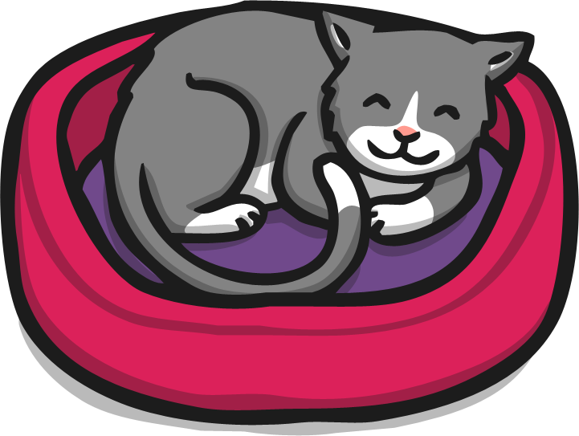
How Do I Read Aloud Well?
Am I reading with the correct tone in my voice?
Try it…
“I said be quiet!” she snapped.
Did you read the speech in a snappy voice?
Try it…
“This is lovely,” purred the cat.
Did you read this in a happy (maybe purry) voice?

Slide 10
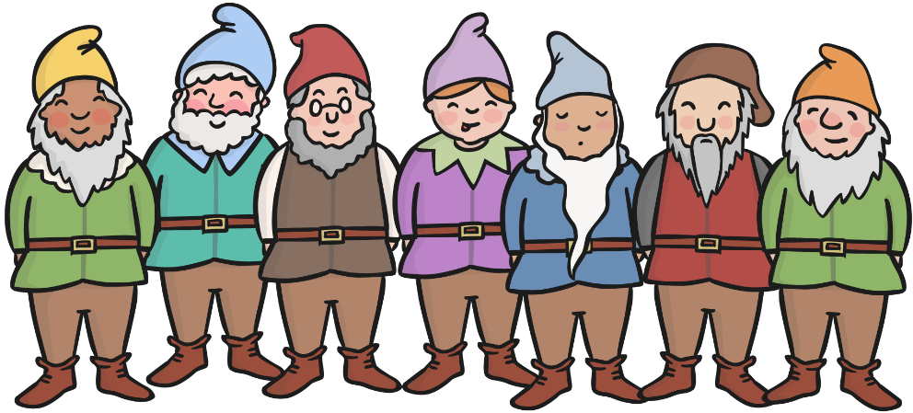
How Do I Read Aloud Well?
Am I following the rhythm?
Try it…
Hi ho, hi ho, it’s off to work we go.

Slide 11
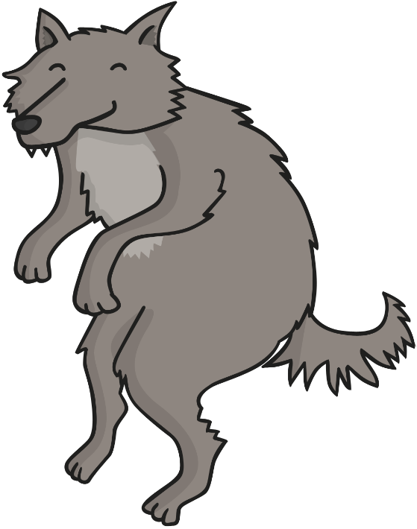
How Do I Read Aloud Well?
Am I using different voices for different characters?
Try it…
The big bad wolf followed the little pig to the house made of sticks. “Little pig, little pig, let me in,” he snarled.
“Not by the hair on my chinny, chin, chin, I will not let you in!” cried the second little pig.
“Then I’ll huff and I’ll puff and I’ll blow your house down!” growled the big bad wolf.
Did you use a growly voice for the big bad wolf and a squeaky voice for the little pig?

Slide 12
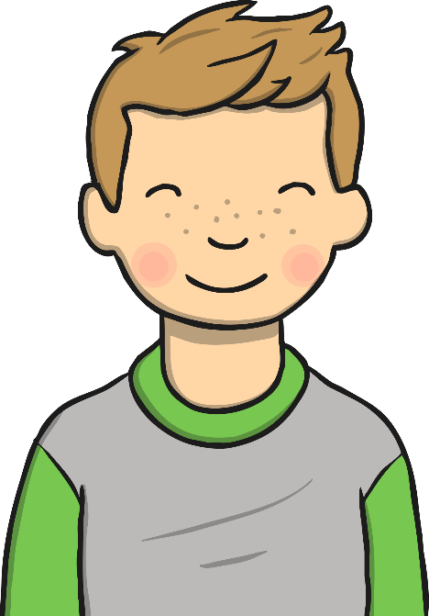
How Do I Read Aloud Well?
Am I speaking confidently?
Try it…
Welcome to our class assembly.
Did you sound proud?

Slide 13
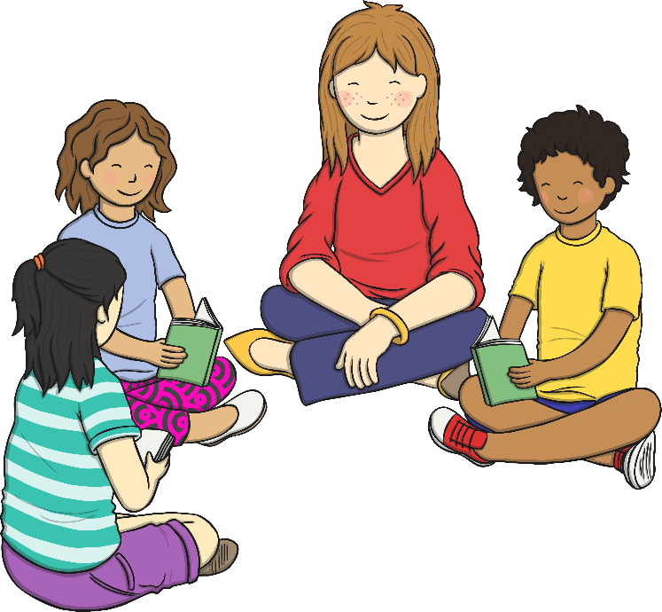
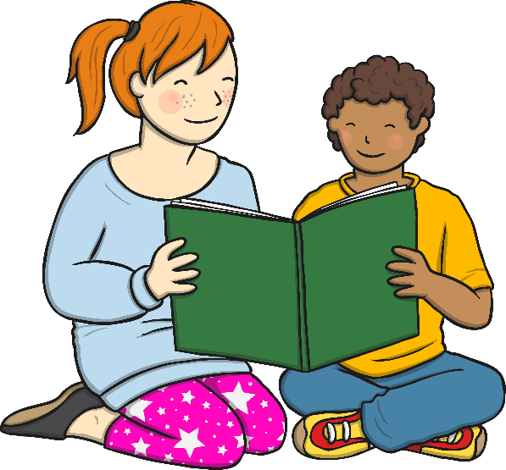
Top Tips
Practise, practise, practise!
Practising a favourite story or page over and over to become more familiar with it builds up your confidence.

Slide 14
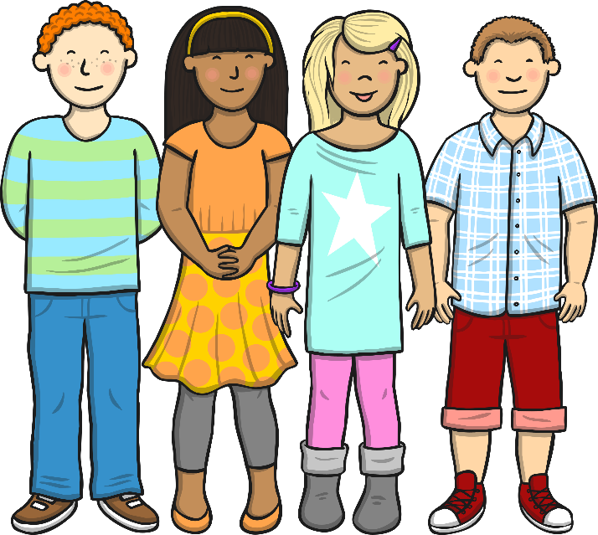
Top Tips
Read aloud on your own.
Try it on your own first when you can be as silly or loud as you like!
Read aloud to an audience.
Start with your family or a good friend.

Slide 15
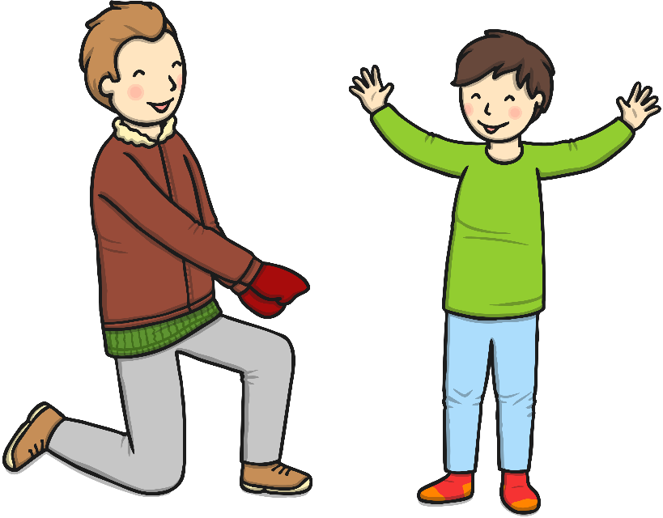
Top Tips
Copy cat!
Copy a friend or someone in your family, mimic the way they talk with expression.

Slide 16
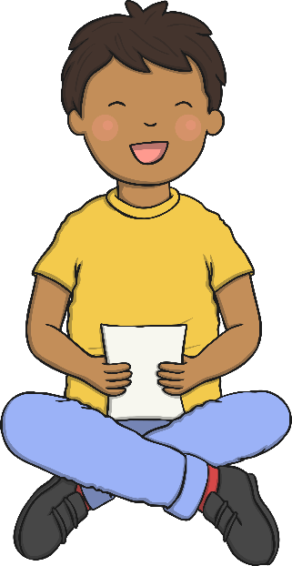
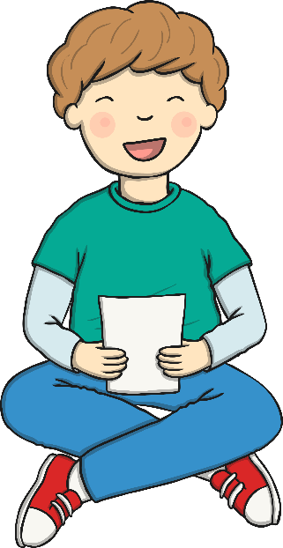
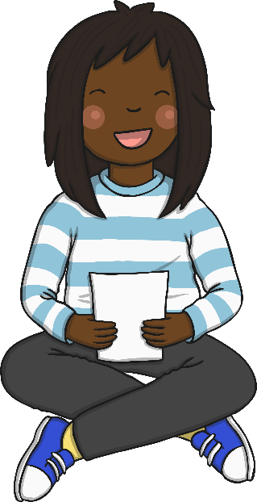
Top Tips
Have fun!
Try some of our fun reading activities to help practise reading in different voices…

Slide 17
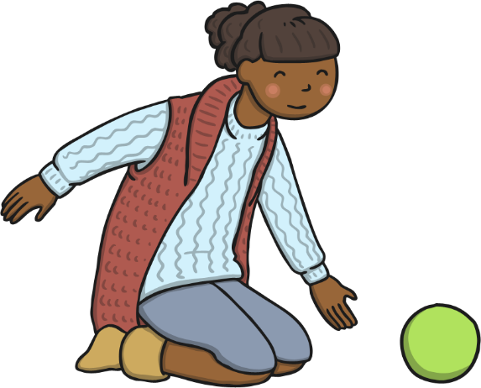
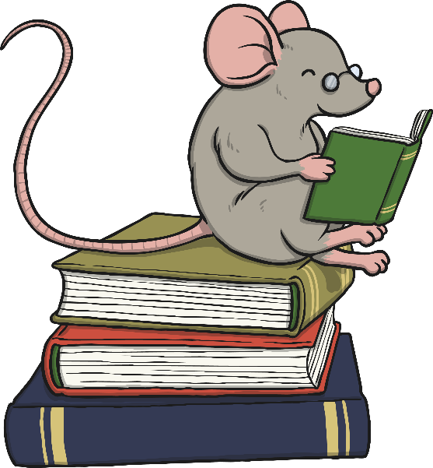
Fun Reading Aloud Activities
Game on!
Shoot, swing, catch and throw as you read each word.
There’s a mouse in the house! Read in a tiny squeaky
mouse voice.

Slide 18
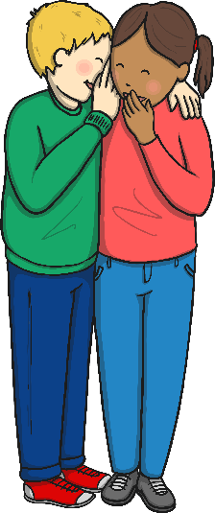
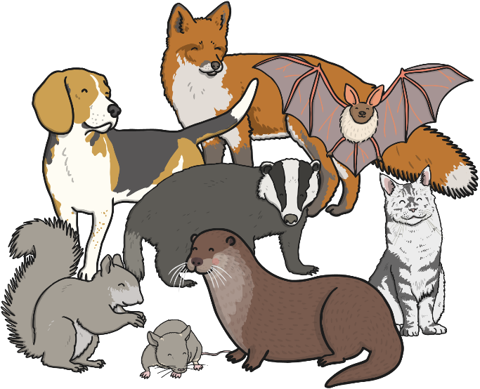
Fun Reading Aloud Activities
Crescendo!
Start each line with a whisper, getting louder until you reach the end of the line.
Talk like an animal! Read (and act) like you imagine your favourite animal would.

Slide 19
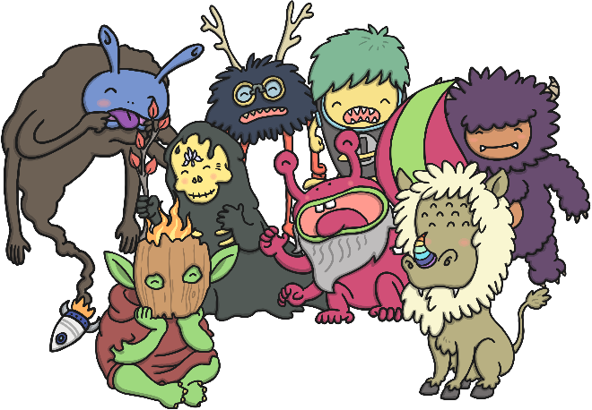
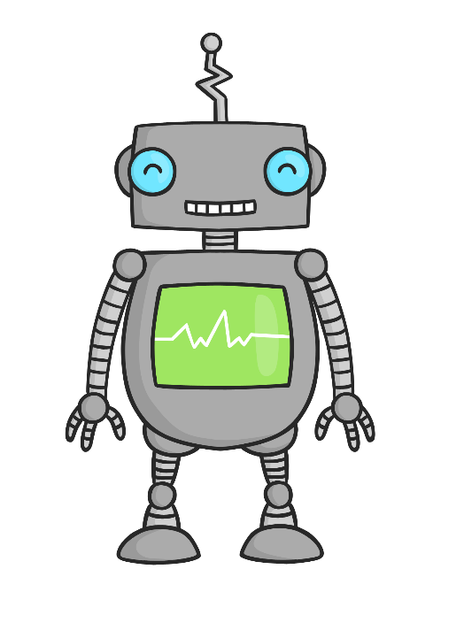
Fun Reading Aloud Activities
Monsters! Read in your silliest monster voice.
Robots! Read like the computerised voice of a robot.

Slide 20
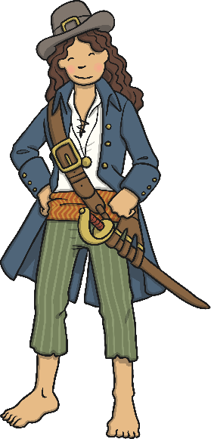
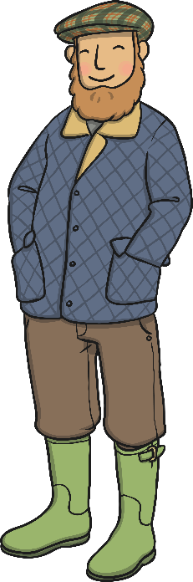
Fun Reading Aloud Activities
Arrrr! Read like a pirate and say ‘Arrrr!’ at the end of every sentence or phrase.
Farmer Giles! Read in a Somerset accent.

Slide 21
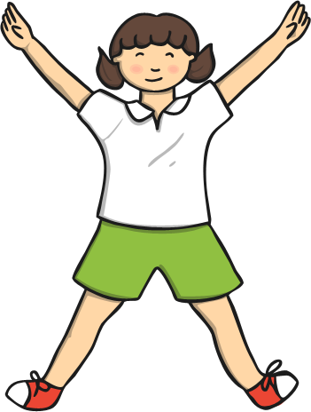
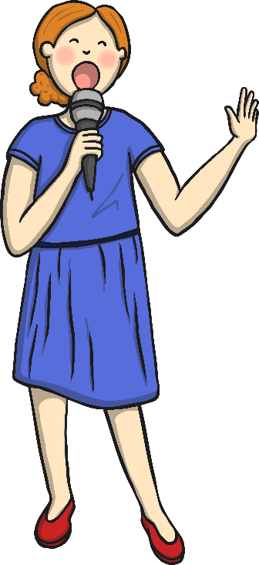
Fun Reading Aloud Activities
Star jumps! Do a star jump for each word.
A night at the Opera! Read like an opera singer.

Slide 22
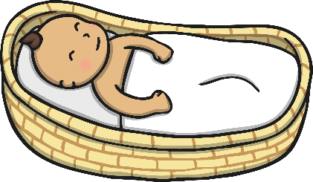
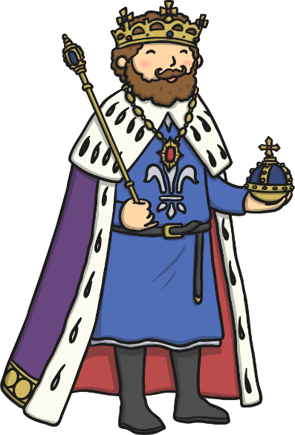
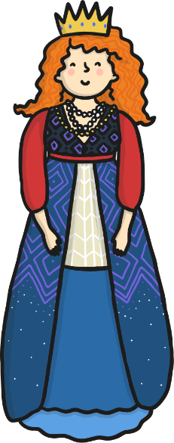
Fun Reading Aloud Activities
Baby face! Read like a little baby.
Royalty! Read like a king or queen.

Slide 23
Now let’s hear from an expert…
https://www.youtube.com/watch?v=RvV23xoZRkI

Slide 24
Practise and Perform
With your partner, practise reading your story out loud.
Once you are happy with how you sound, record it for KS1!

Slide 25


