Slide 1
Tuesday 20th September 2020
LO: To publish a story
C:Finding Something Tale

Slide 2
Jeremy Strong
If you have any Jeremy Strong books at home, then have a flick through and see how the book has been set out. If not look at the pages on the next slide.

Slide 3
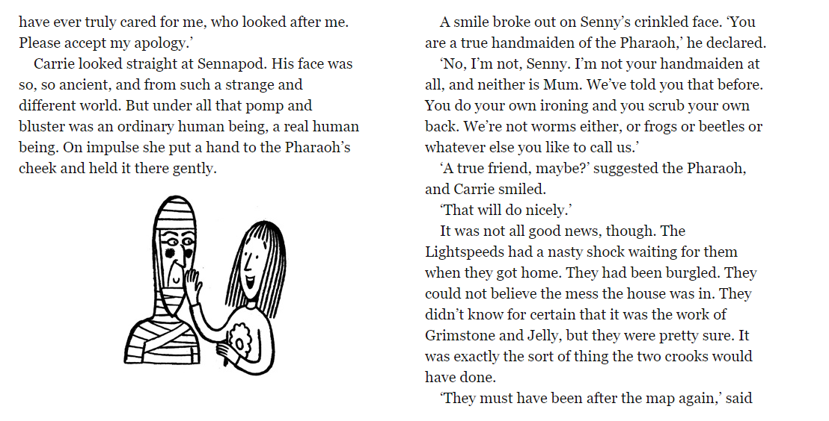

Slide 4
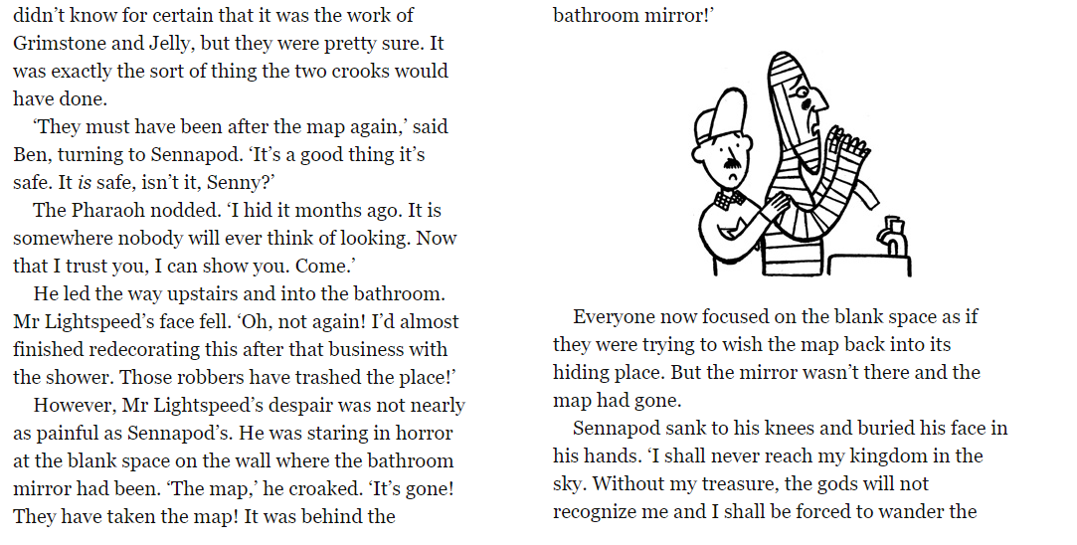

Slide 5
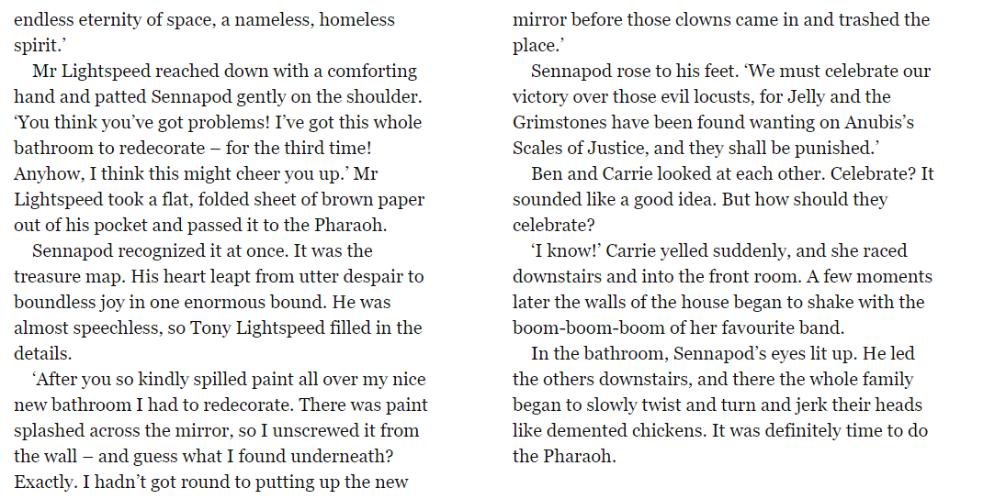

Slide 6
Think about….
Does every page have a picture?
What are the pictures like?
How could you achieve the same effect?

Slide 7
Have a go at publishing the first section!

