Slide 1
Tuesday 22nd September 2020
L.O: To master techniques.
C: To practice sewing

Slide 2
We are going to look at some Ancient Egyptian baskets!
We will learn about them and how they are made and practice some stitches!

Slide 3
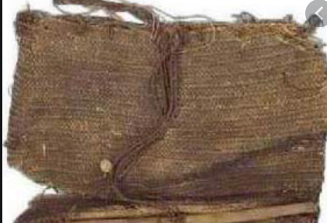
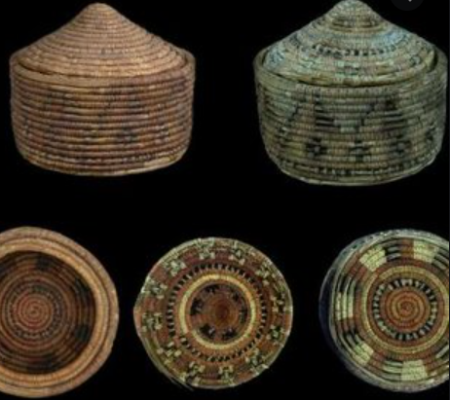
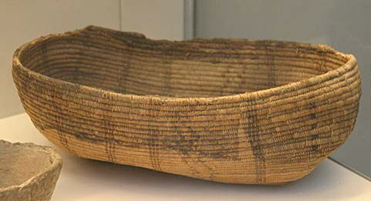
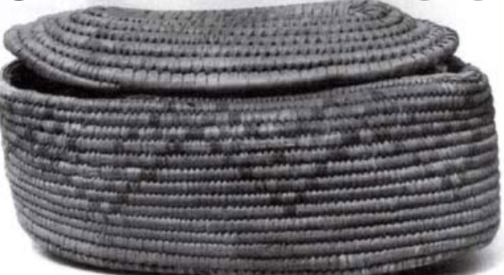
What do you think the Egyptians might have used these baskets for?

Slide 4
Baskets were lightweight so they were used to store and transport food and goods. They were also used to transport soil and materials when constructing pyramids.

Slide 5
The Egyptians made three types of baskets! Coiled, Twined and Plaited.

Slide 6
This video shows how they would have made a coiled basket!
https://www.youtube.com/watch?v=poAtIVYdTfI&t=581s
(watch at double speed/skip through)

Slide 7
We are going to learn a range of stitches
Straight
Running
Zigzag
Blanket

Slide 8
Our top tips!
What do you remember:
1.
2.
3.
4.
5.

