Slide 1
10 more than my number is the same as 100 less than 320.
What is my number?
Explain how you know.

Slide 2
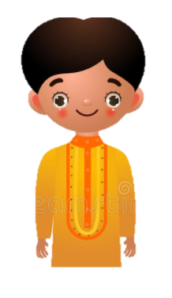
Ahmed says 10 less than 304 is 294.
Is Ahmed correct?
Explain how you know.

Slide 3
Zoe has split her drink on her work! Can you work out the missing digits?
Write the complete number sentence
4 56 – 100 = 356

Slide 4
100 more than my number is the same as 10 more than 738.
What is my number?
Explain how you know.

Slide 5
Which number is bigger?
10 more than 264
or
100 less than 372
Explain how you know.

Slide 6

Can you write a sentence to explain to Alien Alan how to find 100 less than 304?

Slide 7
Timmy says “10 more than 284 is 348”.
Is Timmy right?
Explain how you know.

Slide 8
Can you write a sentence explain to Alien Alan how to find 1 more than 230?

Slide 9
Molly has split her drink on her work! Can you work out the missing digits?
Write the complete number sentence
2 20 – 100 = 220

