Slide 1
Monday 7th June 2021
LO: to write with purpose
C: Biographies

Slide 2

What is a biography?

Slide 3

Biographies
Biographical writing is about someone else’s life. It is about a real person, but written by someone else.
A biography highlights the key events that have happened in their life, sometimes talking about their childhood.
A biography can be written about someone who is dead or alive.

Slide 4

Read through the examples and think about what the features of biographies are.
Create a bubble map of the features you have found!
Can you find an example of the features in the texts?

Slide 5
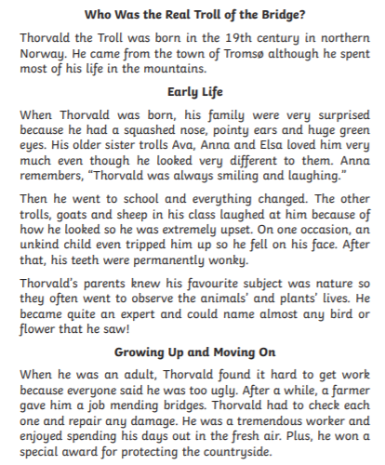
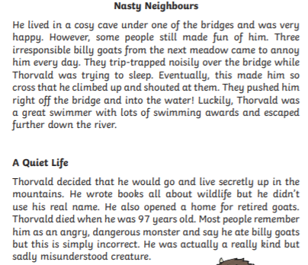

Slide 6
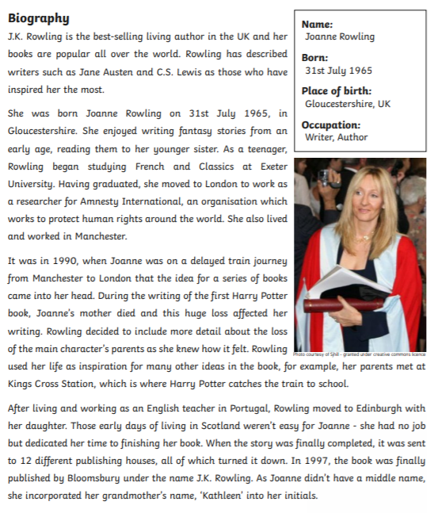
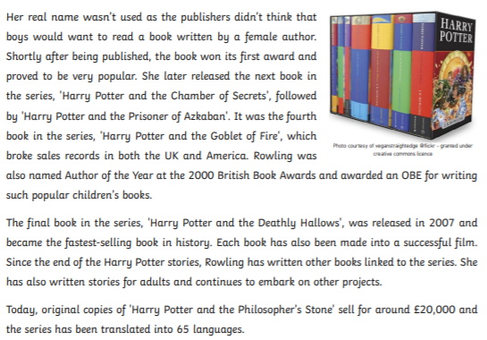

Slide 7
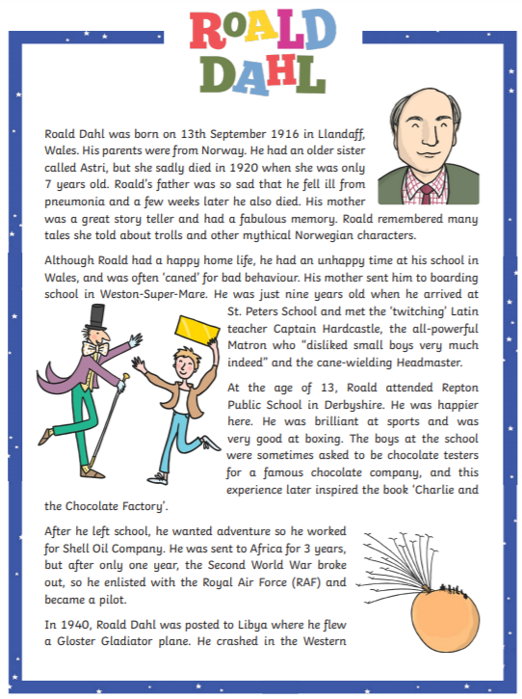
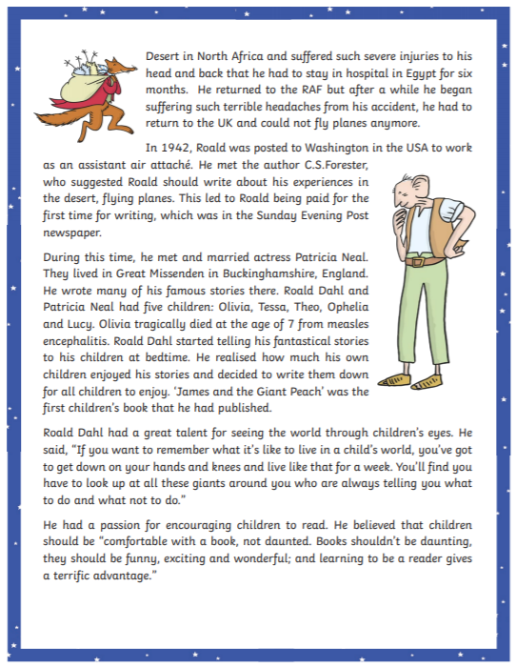

Slide 8
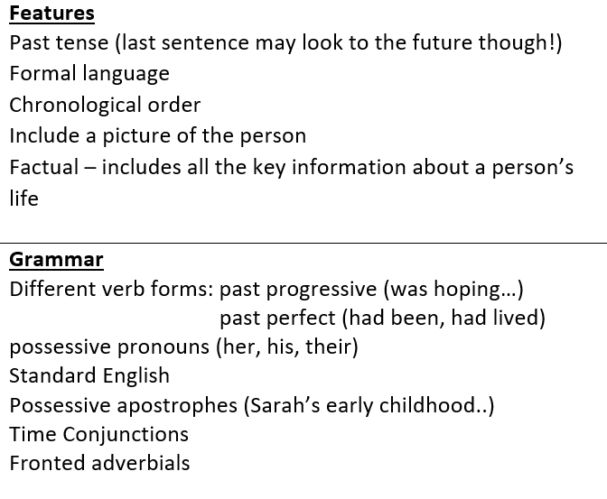

Slide 9
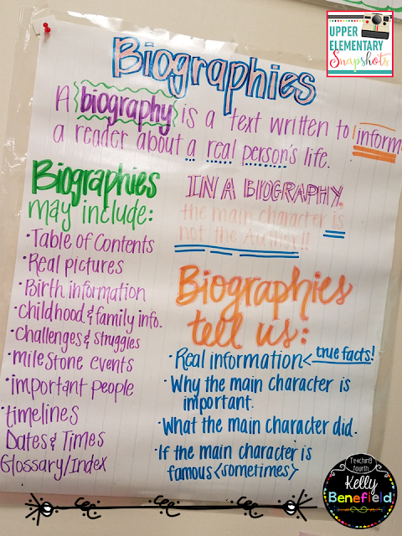
Activity
You are going to create your own biography poster today!
You should include a definition of biographies, the purpose of biographies/what biographies tell us and the different features of biographies.
Red Pen: look at these the books in your house. Do you have any biographies? Can you explain why it is a biography?

Slide 10
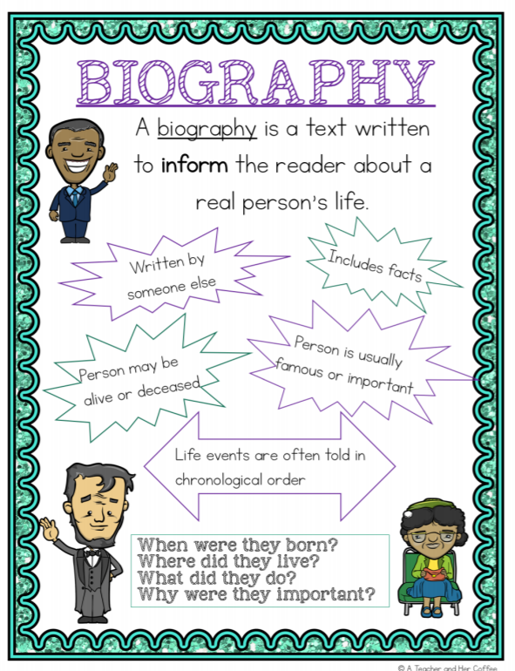
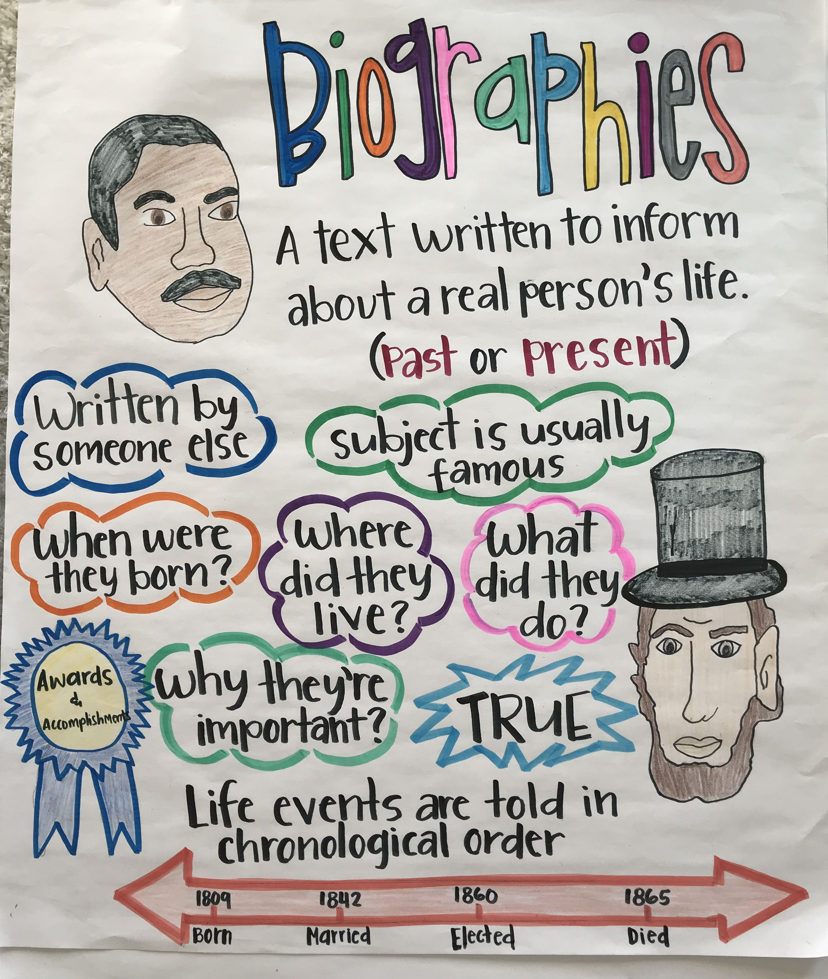

Slide 11
Tuesday 8th June 2021
LO: to write with purpose
to organise writing appropriately
to use paragraphs
C: Biographies

Slide 12
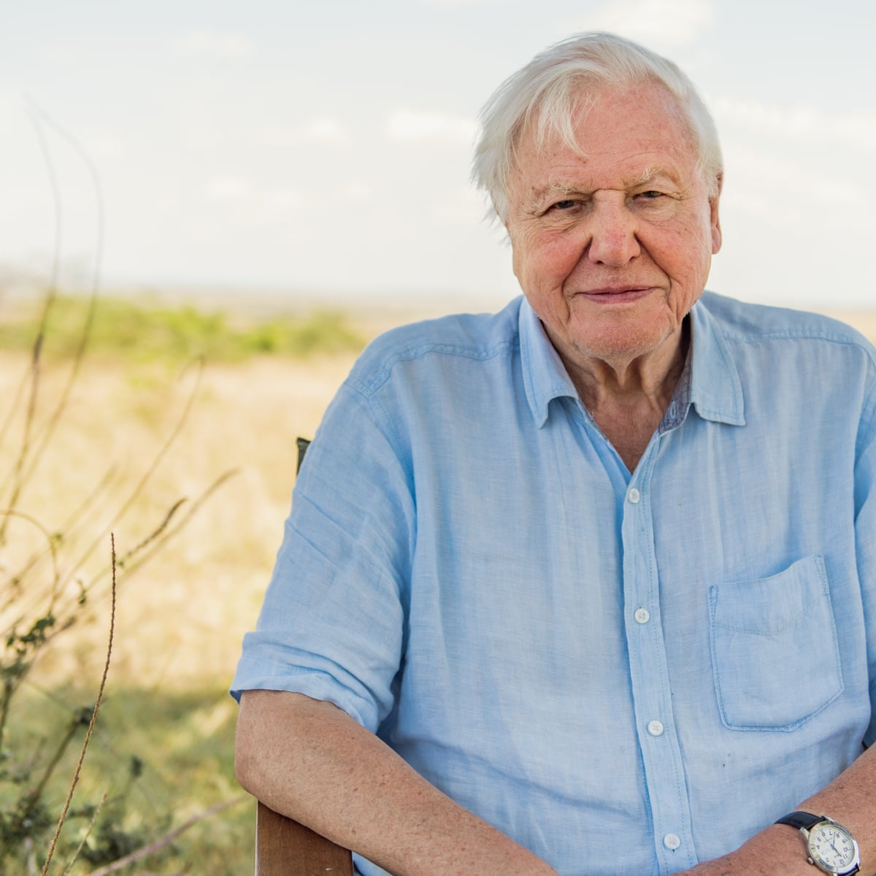
Starter
Do you know who this man is?

Slide 13
David Attenborough
This is David Attenborough and he is an English broadcaster, writer and naturalist known for his innovative educational television programmes.

Slide 14
What questions do you have about David Attenborough?
What would you like to find out about him?
Create a bubble map of your questions!

Slide 15
As biographies are about people’s lives, they need to be written in a particular order.
What order do you think this might be?

Slide 16
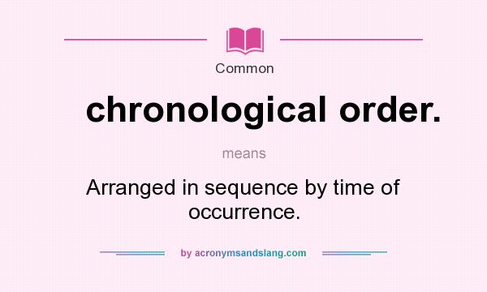

Slide 17
What sub-headings might be used in biographies?

Slide 18
Over the next week, you are going to be writing David Attenborough's biography!
Before we start writing his biography, what might we need to do?

Slide 19

We need to do some research first!
Read the information about David Attenborough and write down any important information you find and want to include in your biographies.

Slide 20
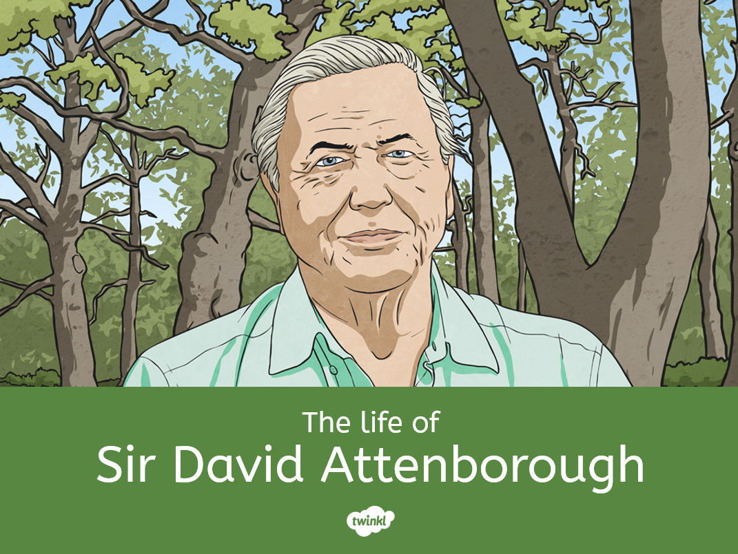
https://kids.kiddle.co/David_Attenborough
https://www.activityvillage.co.uk/david-attenborough
https://kids.britannica.com/students/article/David-Attenborough/316711

Slide 21
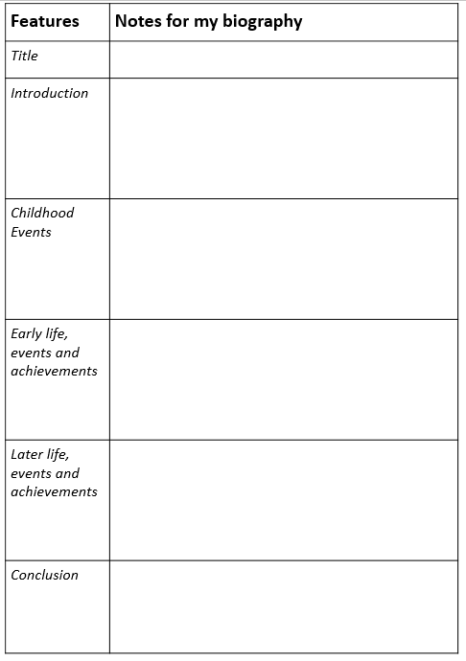
You will be filling this template in.
Remember: you need to be writing facts under the correct sub-heading!

Slide 22
Activity
Read the information sheets about David Attenborough and fill in the template with facts you think are important and you would like to include in your own work next week.
Make sure you record your facts under the relevant sub-heading.
Red Pen: David Attenborough reflection!
One interesting thing I read was…
The hardest part of David’s life was…
The best part of his life was…
One thing that surprised me was…

Slide 23
Wednesday 9th June 2021
LO: to write with purpose
to use sentence appropriately
to punctuate accurately
to analyse writing
C: Biographies

Slide 24

Starter
Can you remember what this word means?
Can you give some examples?

Slide 25
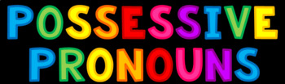
What do you think these might be?

Slide 26
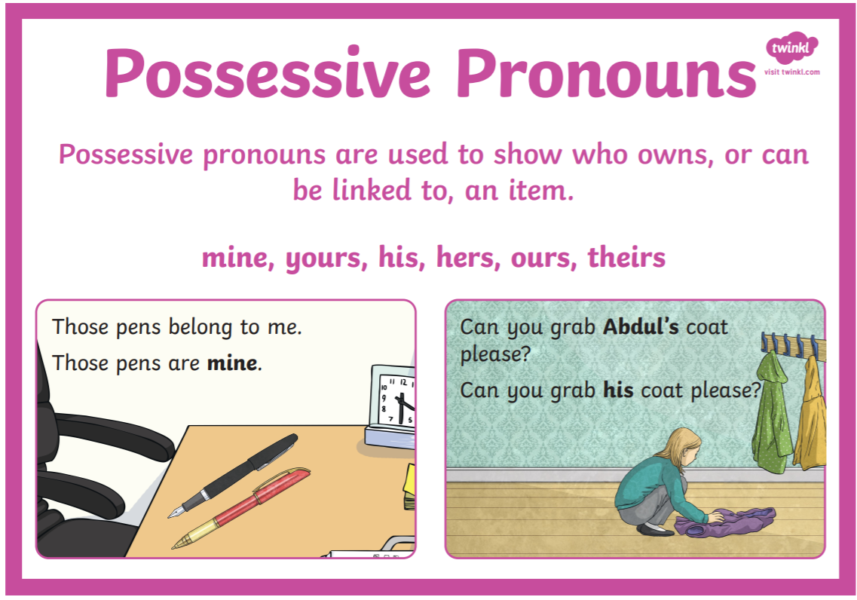

Slide 27
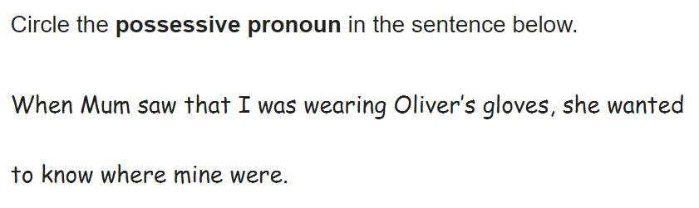

Slide 28
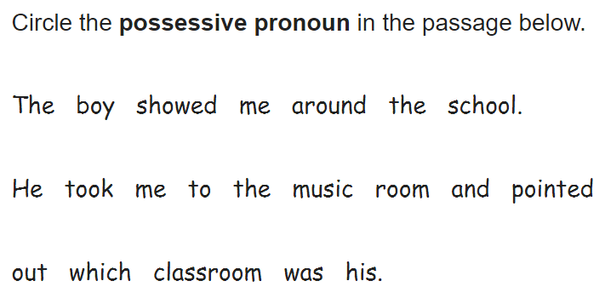

Slide 29
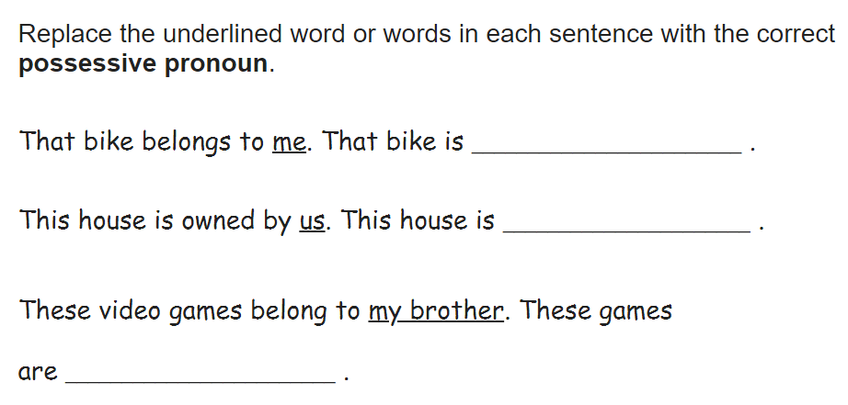
These video games belong to me and my brother. These games are _________________.

Slide 30
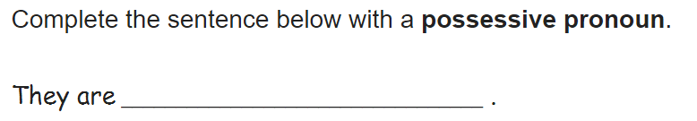

Slide 31
NFERs
We found this question hard on our NFERs!
Can you answer it correctly now?
Replace each underlined group of words below with a
possessive pronoun.
The meaning must stay the same.
Jill and I raced our paper boats across the pond.
In the end, Jill’s paper boat won, because my paper boat sank.

Slide 32

We are going to practise writing some sentences for our biographies over the next two days.
The focus today will be on: writing simple, compound and complex sentences about David Attenborough using possessive pronouns.

Slide 33
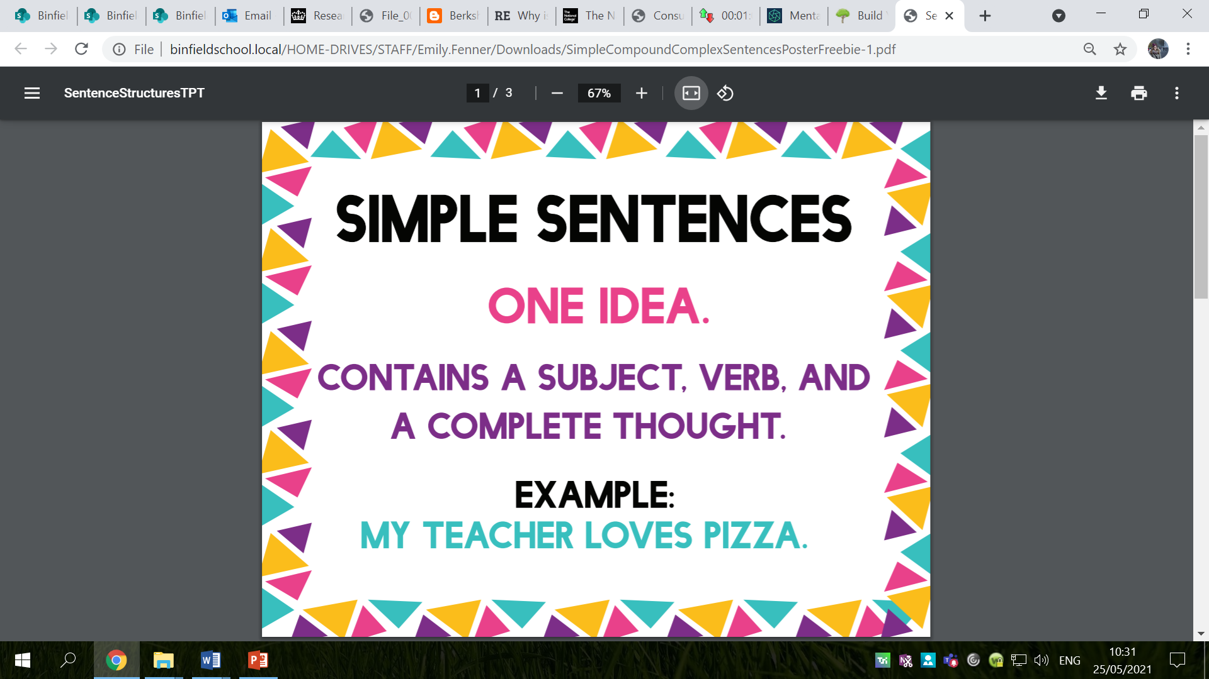

Slide 34
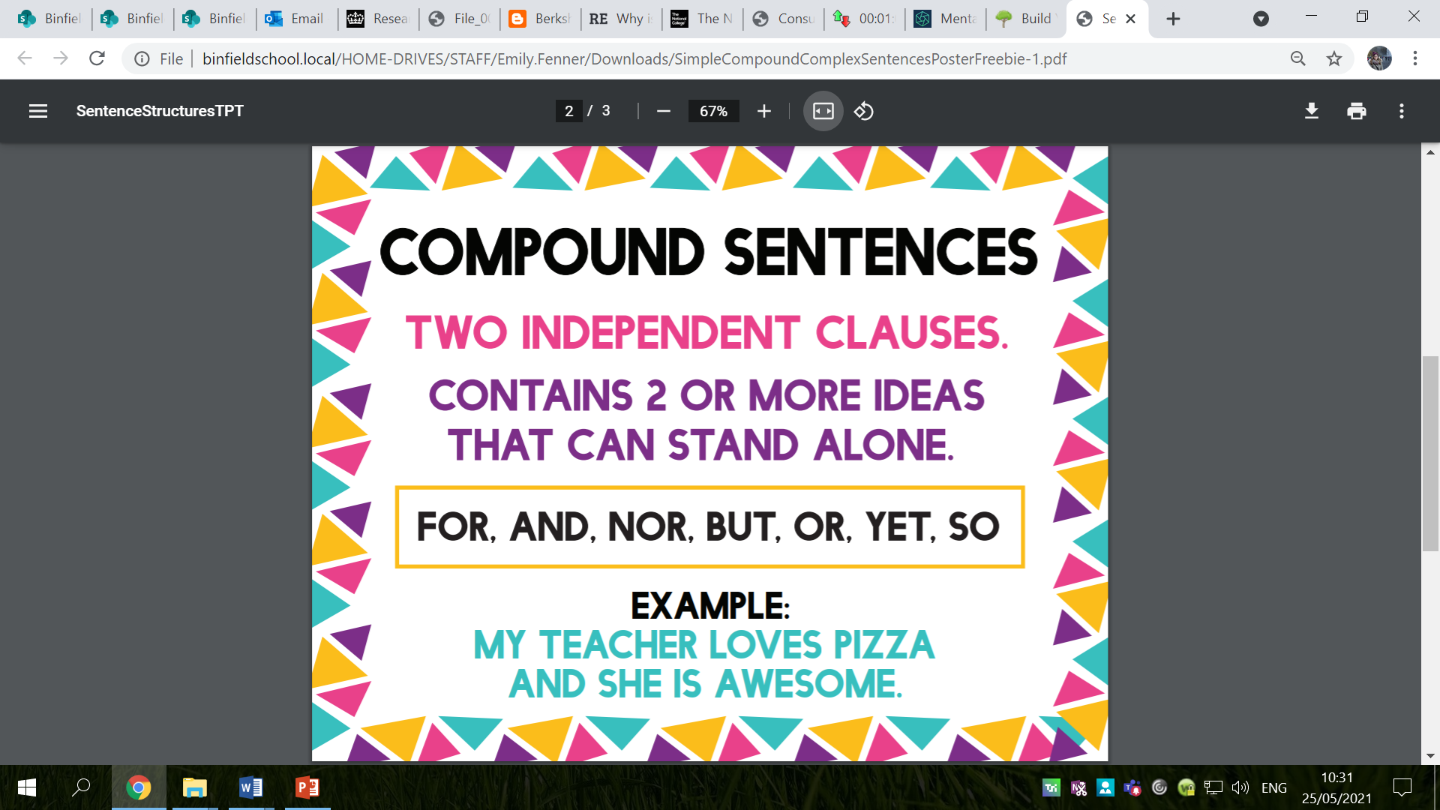

Slide 35
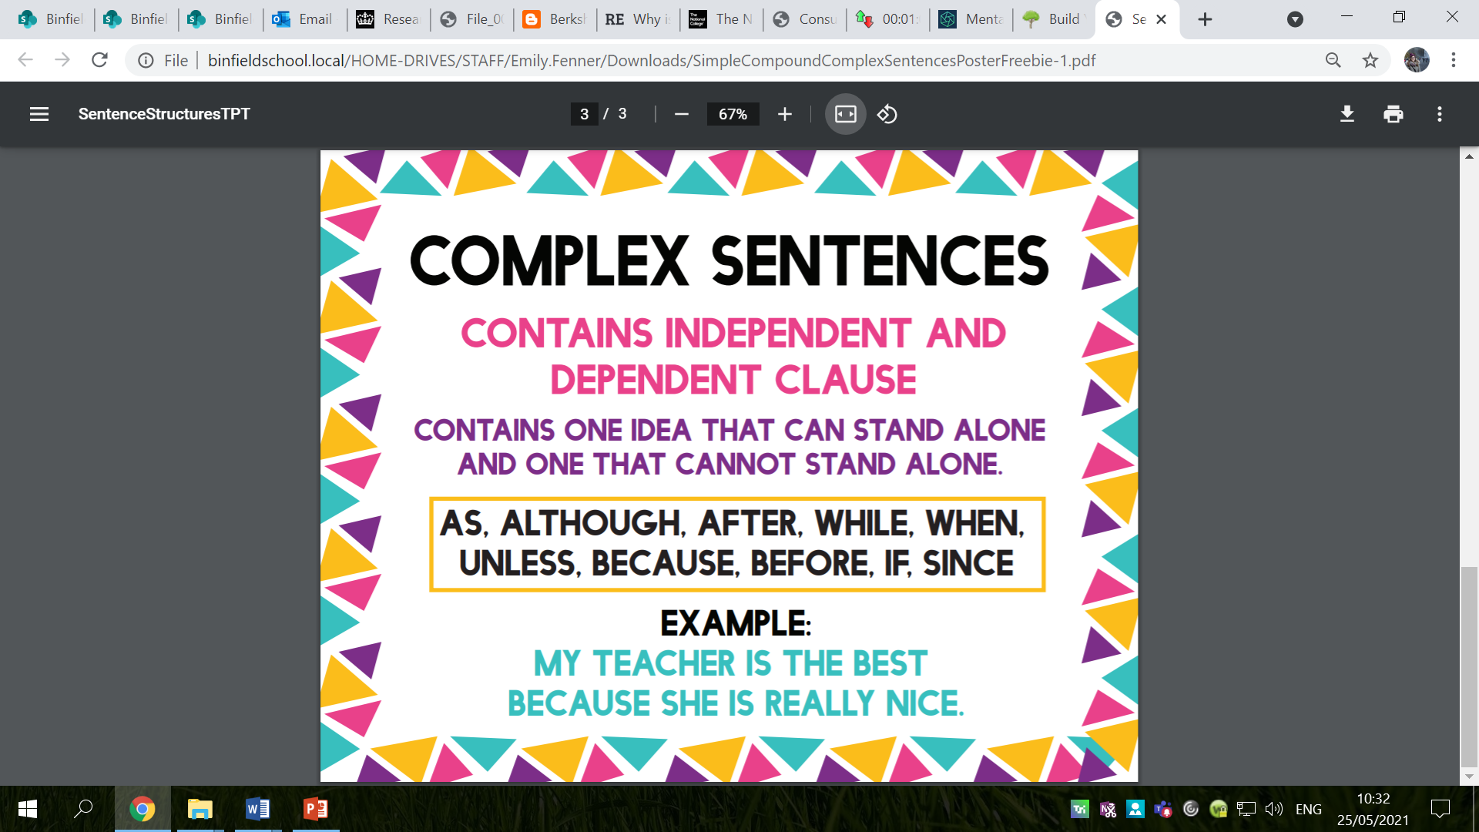

Slide 36
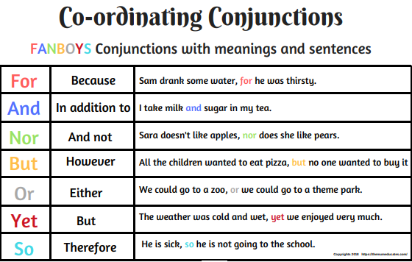

Slide 37
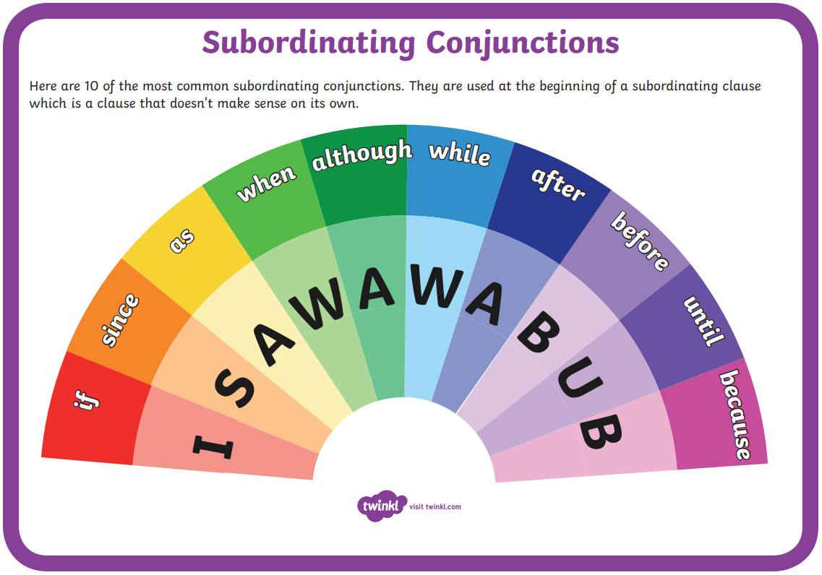

Slide 38
Create some different types of sentences about David Attenborough with possessive pronouns.
Remember to use the facts from last lesson to help you!
Make sure your facts are correct!
Have you used a possessive pronoun in your sentence?
Can you improve your sentences, for example with expanded noun phrases?

Slide 39
Activity
Write simple, compound and complex sentences about David Attenborough using possessive pronouns.
Use the facts from last lesson to help you.
Red Pen: Biographies should be written in formal language. Check your sentences – have you used formal language? How could you make your writing more formal?

Slide 40
Thursday 10th June 2021
LO: to write with purpose
to spell correctly
to punctuate accurately
C: Biographies

Slide 41


Starter
Do you know what this punctuation mark is?
What is it used for?

Slide 42
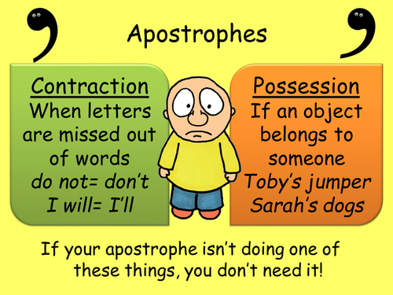

Slide 43
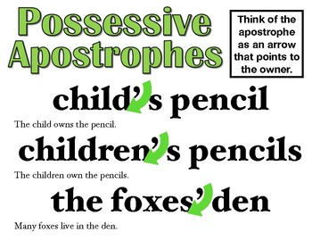
https://www.bbc.co.uk/bitesize/topics/zvwwxnb/articles/zx9ydxs

Slide 44
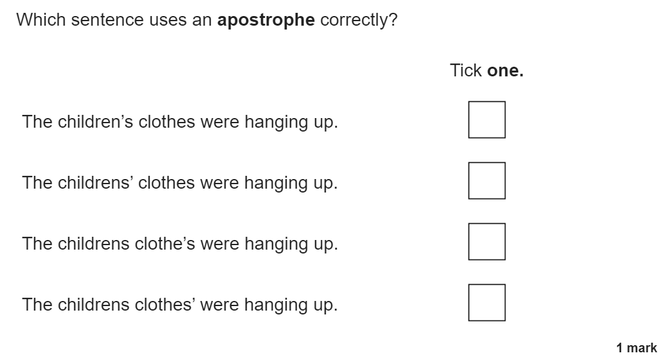

Slide 45
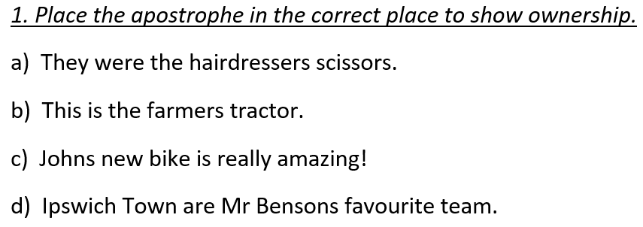

Slide 46
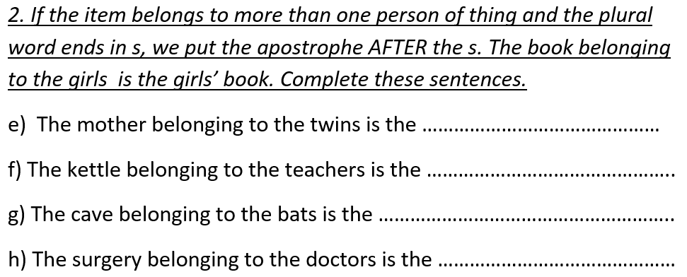

Slide 47
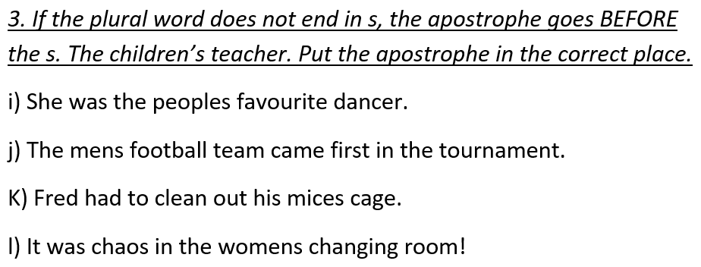

Slide 48
We are going to continue practising writing some sentences for our biographies.
Our focus today will be on: writing sentences about David Attenborough using biography sentence starters and possessive apostrophes.

Slide 49
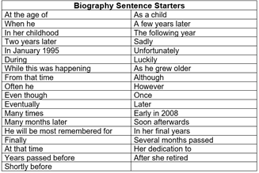
Not all of these sentence starters will need a comma straight after!
Think carefully about where commas should go in your sentence, e.g. after a subordinate clause, after a fronted adverbial/time connective etc.

Slide 50
Create sentences about David Attenborough with possessive apostrophes and biography sentence starters.
Use your facts from Tuesday’s lesson to help you!
https://wordwall.net/resource/16697787/biography-sentence-starters
Can you create a sentence about David Attenborough using the given sentence starter?
Make sure your facts are correct!
Have you used a possessive apostrophe in your sentence?
Where should the possessive apostrophe go?
Can you improve your sentences, for example with expanded noun phrases or conjunctions?

Slide 51
Activity
Write sentences about David Attenborough using possessive apostrophes and biography sentence starters.
Red Pen: look carefully at the commas in your writing. Have you used commas correctly? Have you used commas after fronted adverbials? After time connectives? Etc.
Correct any missing or incorrectly placed commas.

