Slide 1
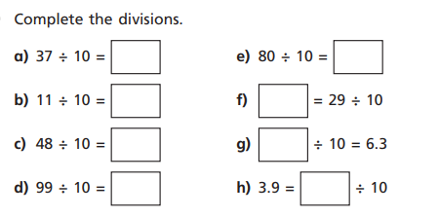
Monday – make sure you put your answers on Showbie

Slide 2
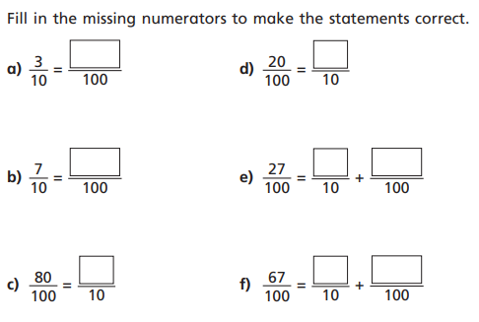
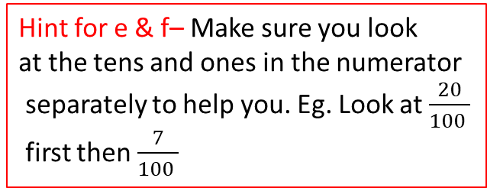
Tuesday – make sure you put your answers on Showbie
Hint for e & f– Make sure you look
at the tens and ones in the numerator
separately to help you. Eg. Look at $\frac{20}{100 }$
first then $\frac{7}{100 }$

Slide 3
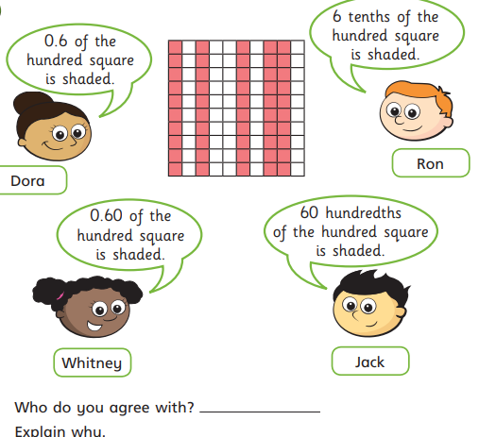
Wednesday – make sure you put your answers on Showbie

Slide 4
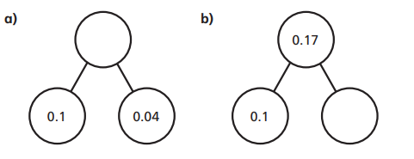
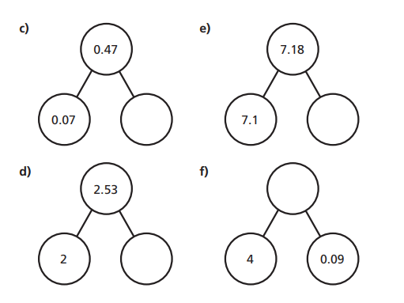
Thursday – make sure you put your answers on Showbie

Slide 5
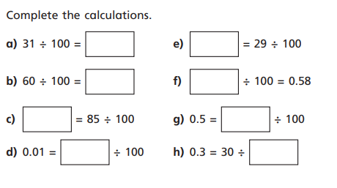
Friday – make sure you put your answers on Showbie

