Slide 1
LO: to identify that humans and some animals have skeletons and muscles for support, protection and movement.
C: Animals including humans

Slide 2
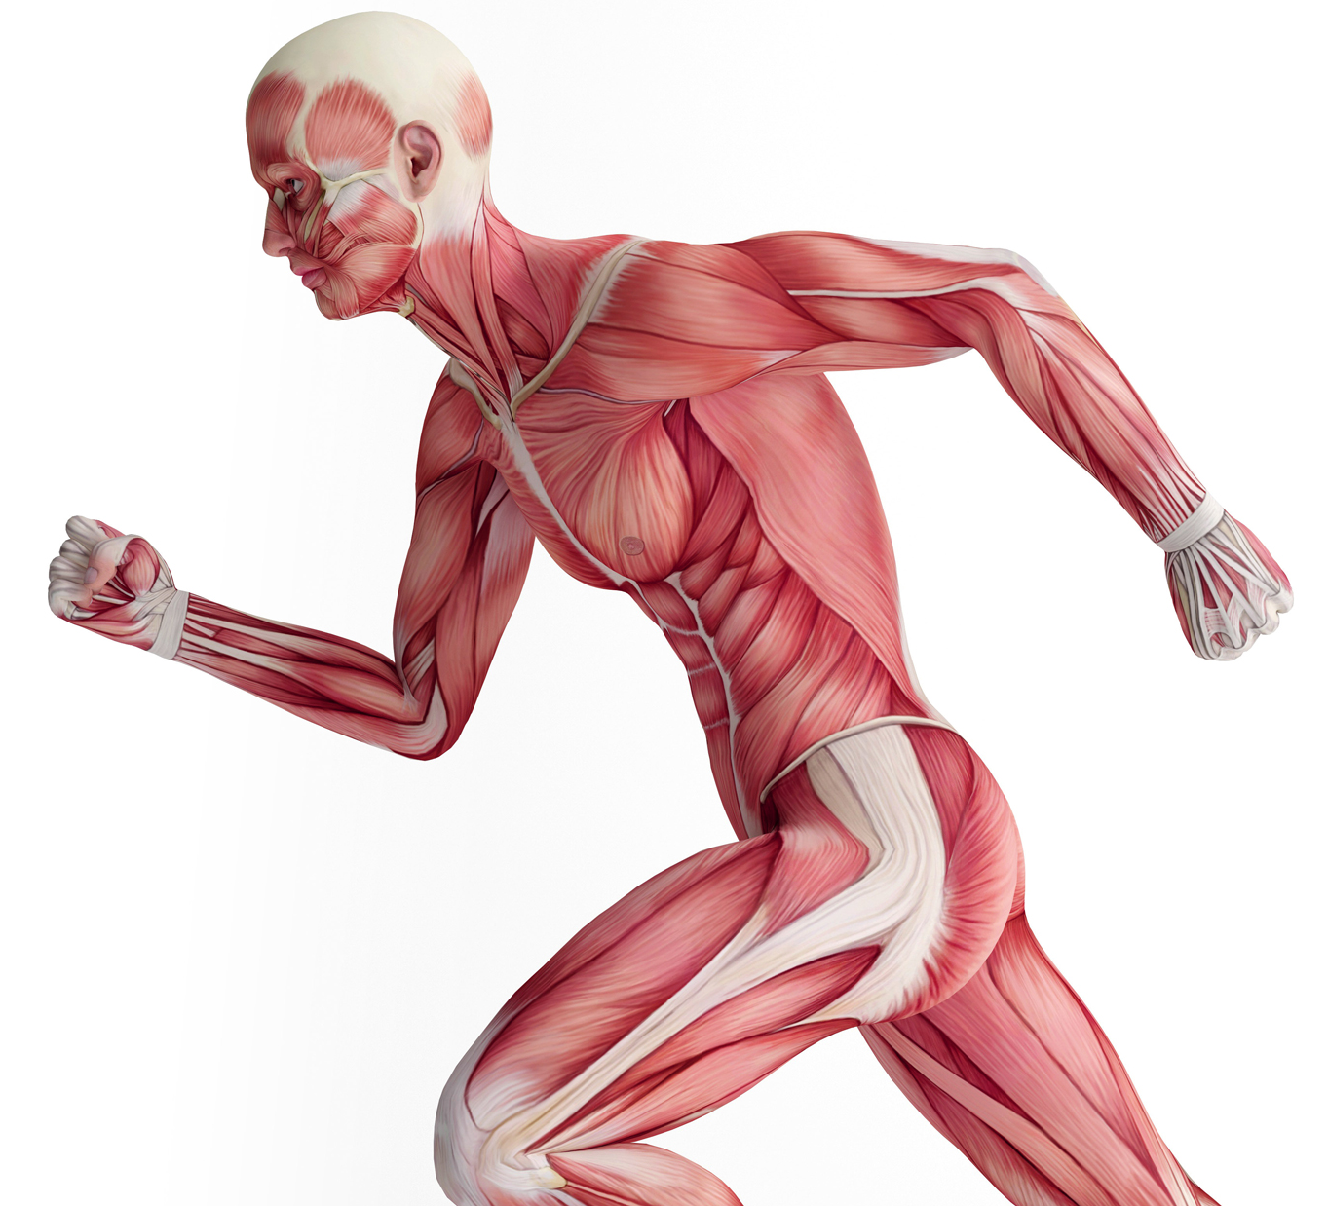
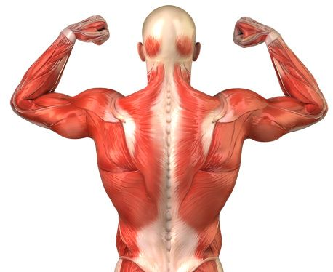
What are muscles?
Muscles are responsible for every movement our bodies make.
https://www.bbc.co.uk/bitesize/clips/zpp6n39
https://www.bbc.co.uk/bitesize/clips/zj2kjxs
How many muscles do we have in our bodies?
Over 600!

Slide 3
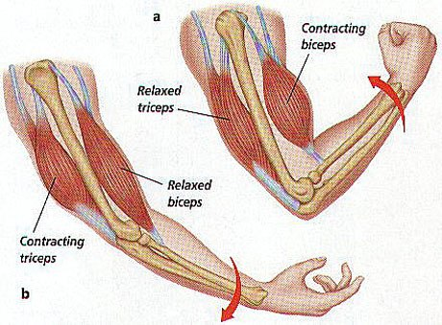
Muscles are made of strong stretchy tissue that can contract and relax.
Muscles enable us to move our bones, because they are attached to the ends of the bones and can shorten or lengthen.
When muscles contract (shorten) they allow us to move – when any part of our body moves, muscles are in action!

Slide 4
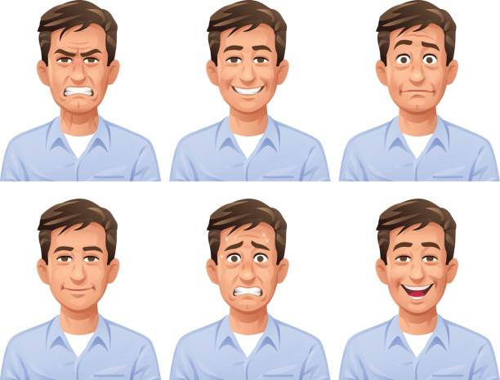
Often many muscles work together to have a single effect, for example, it takes 17 muscles for humans to smile and 43 to frown – so smile, it’s easier!
Can you make different faces? Happy, angry, surprised etc. – feel your face; which muscles are hard (contracted) and which are soft (relaxed)?

Slide 5
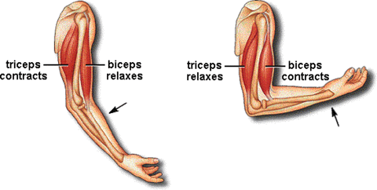
Extend one arm in front of you and raise your first towards your shoulder a few times.
Now place your other hand over your upper arm while you do it.
You should be able to feel the muscle contracting (getting shorter and thicker) under your skin.
This muscle is called your bicep.
If you take off your jumper and roll up long sleeves, you will be able to see the change in shape of the muscle as you do it.
There are muscles opposite your biceps on the lower side of your arm that contract every time you straighten your arm.
These are called your triceps.

Slide 6
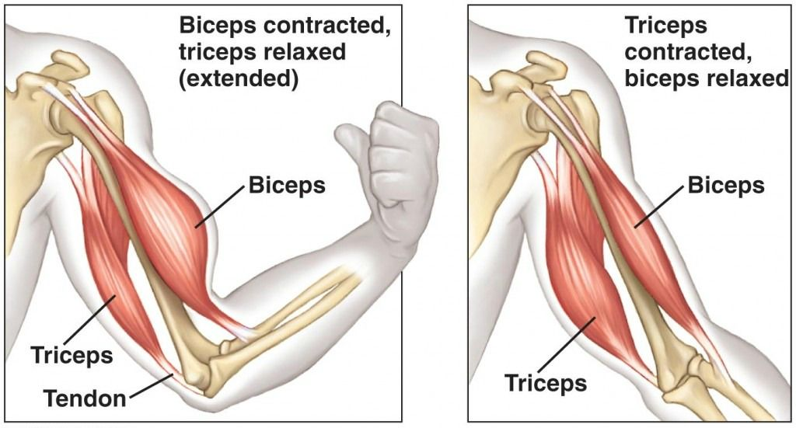
Your biceps and triceps work in pairs to bend and straighten your arms.
Let’s get our muscles doing some work!
Hold your water bottle in one hand out to the side with a straight arm.
1 – gently bring up your arm to touch your ear.
Repeat your actions several times until you felt a slight ache in your muscles.
Now try: 2 – gently bring your arm down and under your armpit.

Slide 7
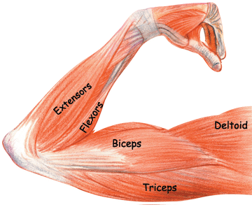
Point to where your arm aches.
Movement 1: your biceps should be aching.
Movement 2: your triceps should be aching.
Why is this?
The muscle that is working the hardest is the one that is lifting the weight of the bottle.
The triceps are lifting the bottle from the armpit out to the side, whilst the biceps are lifting the bottle up from the side to your ears.

Slide 8
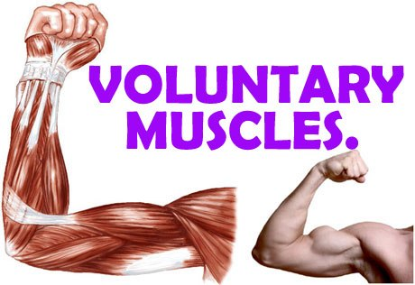
Voluntary Muscles
Some muscles are known as "voluntary" - that is, they only work when you specifically tell them to.
Can you think of some voluntary movements?
Clap you hands, lift your leg and so on.

Slide 9
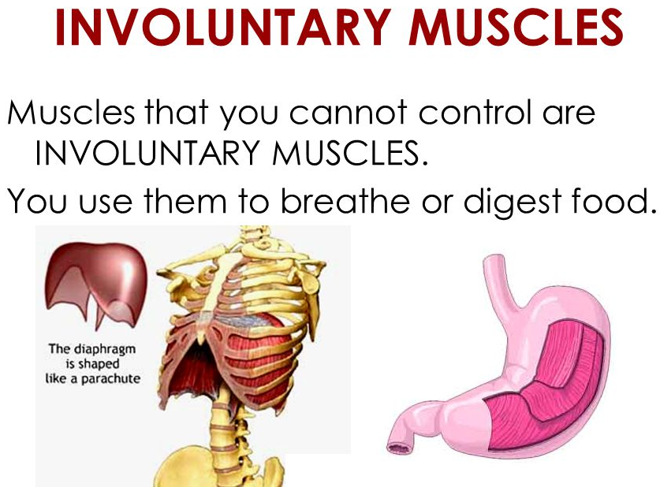
Involuntary Muscles
Other contracting muscles are automatic.
Can you think of any examples?
Contracting of your heart
The movement of your diaphragm so that you can breathe
Blinking your eyes is automatic.

Slide 10

Paddling | Snorkelling | Diving
Draw a labelled picture of your biceps and triceps. Explain what muscles do in your books. Red Pen: which muscle do you use the most? Explain your thinking. | Draw a labelled picture of your biceps and triceps. Explain what muscles do and why they are important in your books. Red Pen: explain the difference between voluntary and involuntary muscles. Give an example of each type. | Draw a labelled picture of your biceps and triceps. Explain what muscles do and why they are important in your books. Red Pen: how and why do muscles move in pairs?

