Slide 1
Friday 4th December 2020
LO:
*identify religious symbolism in literature and the arts
*present the key teachings and beliefs of a religion
C: Christianity

Slide 2
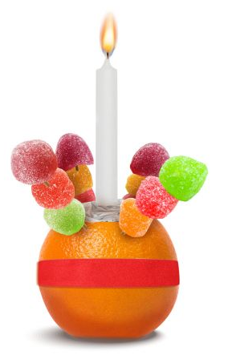
Have you seen this before?
Do you know what it is?
Can you explain its different parts?

Slide 3
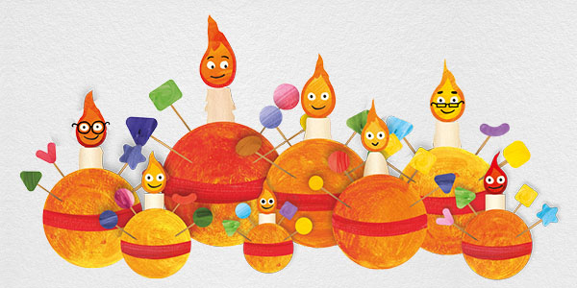
This is a Christingle!
Christians think of Christingle as “Christ’s Light”
It is a symbol of the Christian faith.
Lots of churches hold Christingle services around this time of year.
The Christingle is made up of different parts – each part reminds us of the Christian faith.

Slide 4
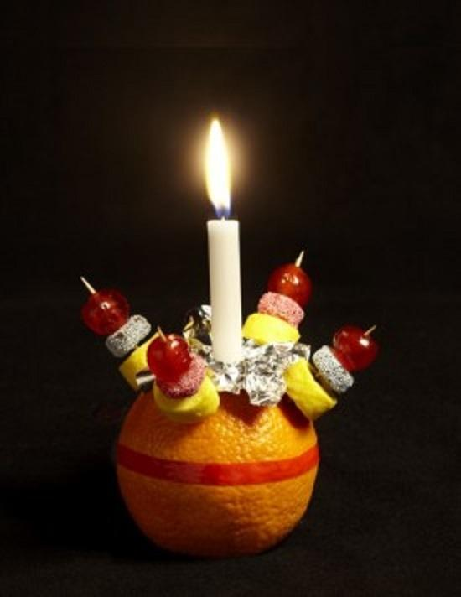
The orange represents the world.
The candle is to remind us of Jesus as Christian believe Jesus is the light of the world.
The red ribbon goes all around the ‘world’ and reminds Christians that Jesus died because it symbolised His blood.
The four cocktail sticks have two meanings; the four seasons or the four corners of the world.
The sweets or dried fruit symbolise God’s gifts to the world including kindness and love.

Slide 5
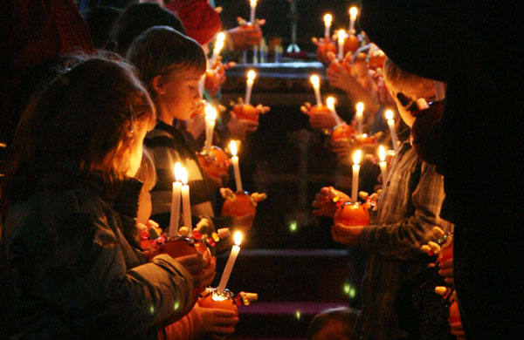
Christingle Service
Christingle services are held in churches, usually between Advent and Candlemas.
It is an excellent opportunity for people of all ages to join in, using oranges to create visible symbols of the Christian message.
For many years churches all over the world have made Christingles to remind them that Christ is the light who came into the world at Christmas.

Slide 6

Paddling | Snorkelling | Diving
Design your own Christingle. Remember to label the parts and what they symbolise. Red Pen: What is your favourite part of the Christingle? Why? | Design your own Christingle. Remember to label the parts and write about what each part symbolised. Why do Christians make Christingles? Red Pen: How does making a Christingle show commitment to God? | Design your own Christingle. Remember to label the parts and write about what each part symbolises. Why is a Christingle service important to Christians? Red Pen: Do you think the Christingle is an effective symbol to help Christians recall some key Christian beliefs?

