Slide 1


Slide 2
Word Classes
https://www.bbc.co.uk/bitesize/articles/zvs2kty
https://www.youtube.com/watch?v=JeognSU6wfU&list=PLEBUp_Z2SsOrU2YhUh445C36FlGiwpgVR&index=10
https://www.youtube.com/watch?v=P69F4S0ZUmI&list=PLEBUp_Z2SsOrU2YhUh445C36FlGiwpgVR&index=13

Slide 3
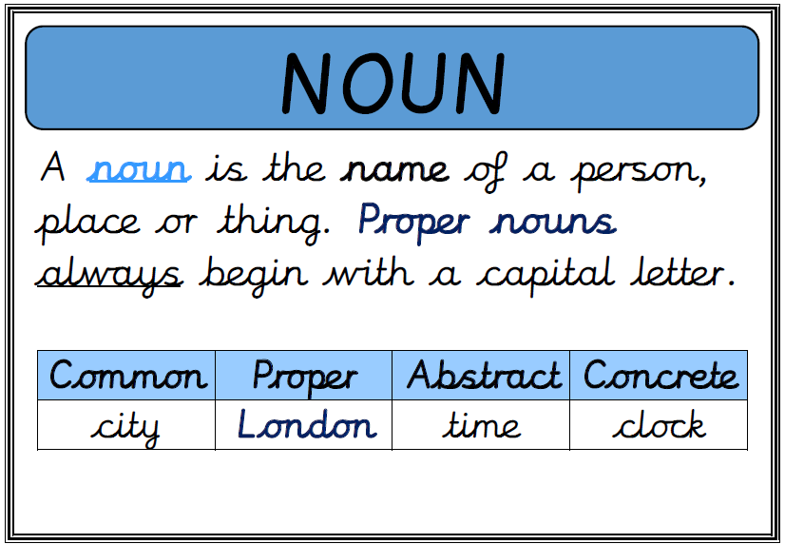

Slide 4
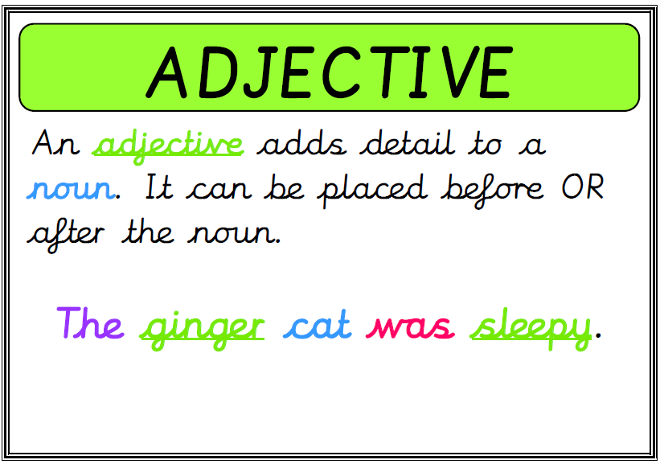

Slide 5
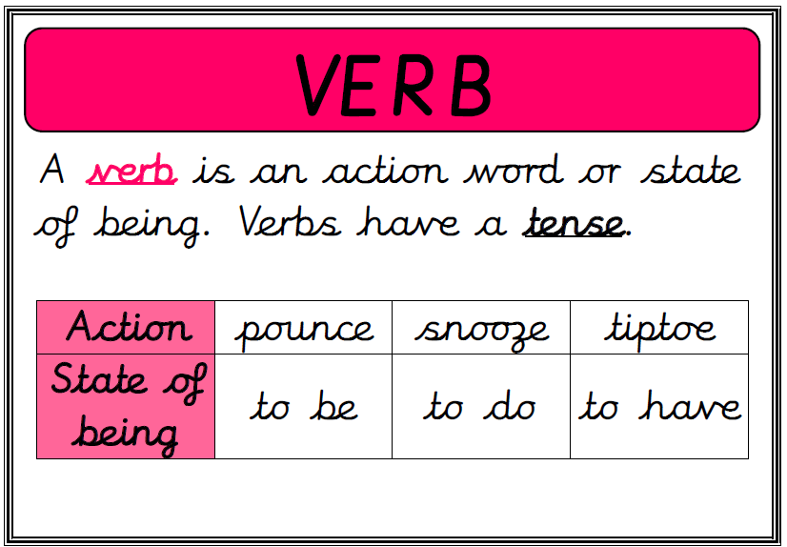

Slide 6
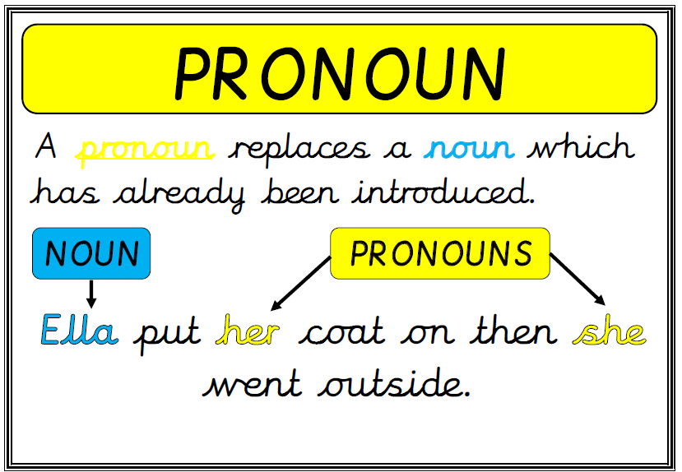

Slide 7
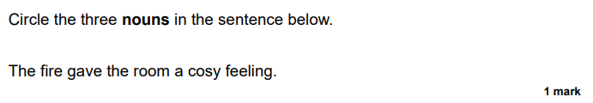

Slide 8
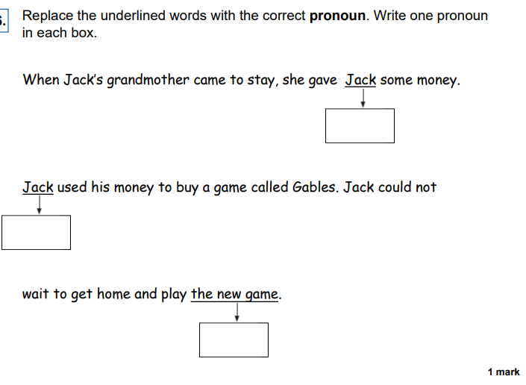

Slide 9
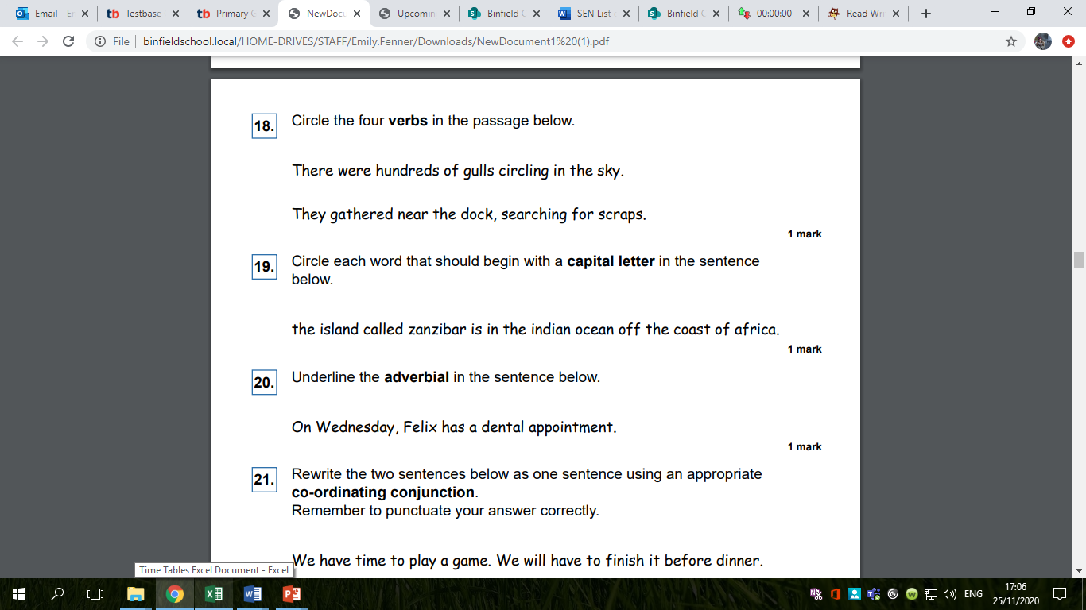

Slide 10
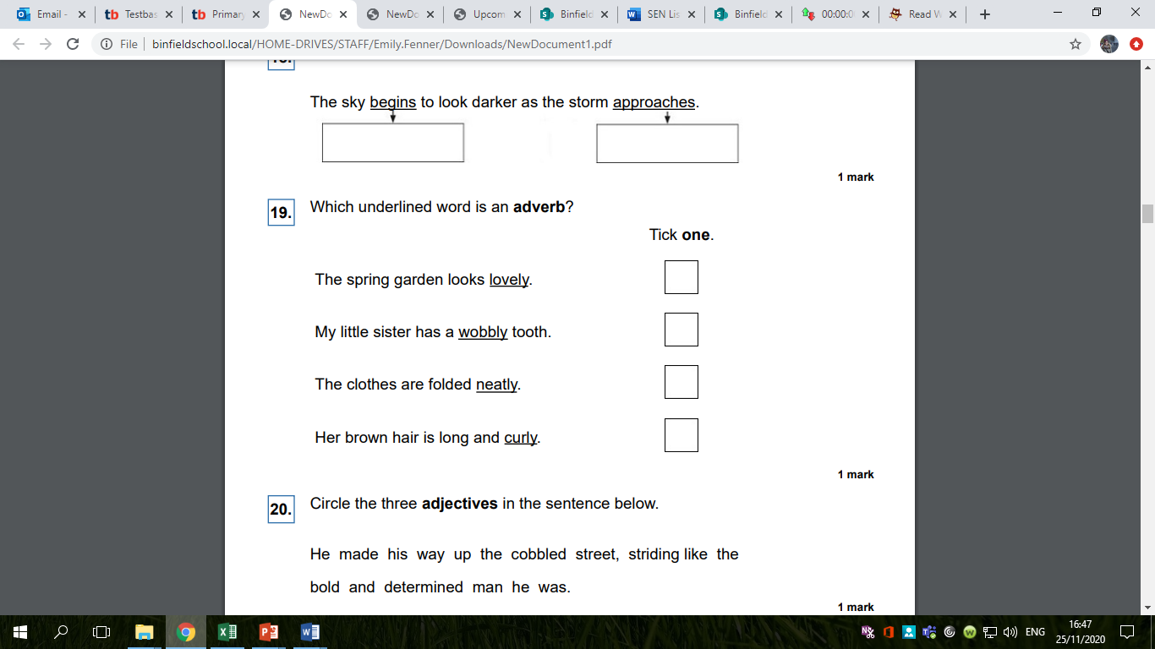

Slide 11
Determiners
https://www.youtube.com/watch?v=B8MnOXgX0Kk&list=PLEBUp_Z2SsOrU2YhUh445C36FlGiwpgVR&index=26

Slide 12
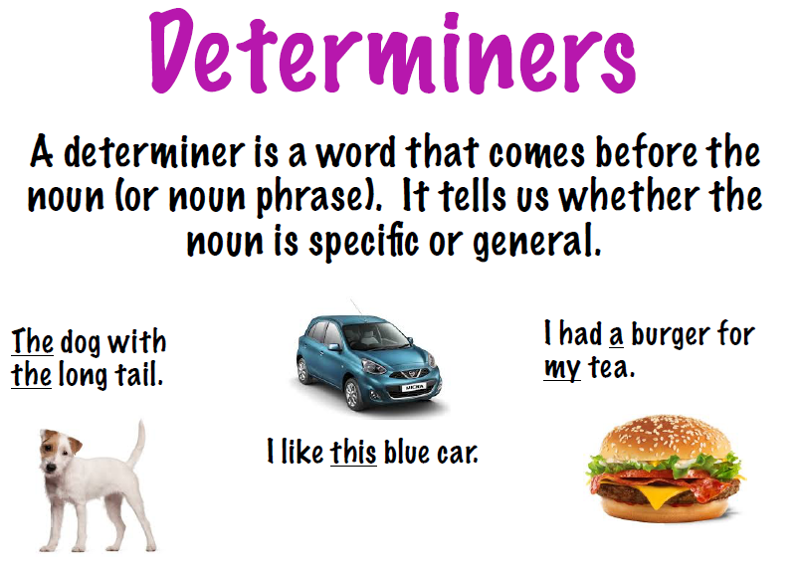

Slide 13
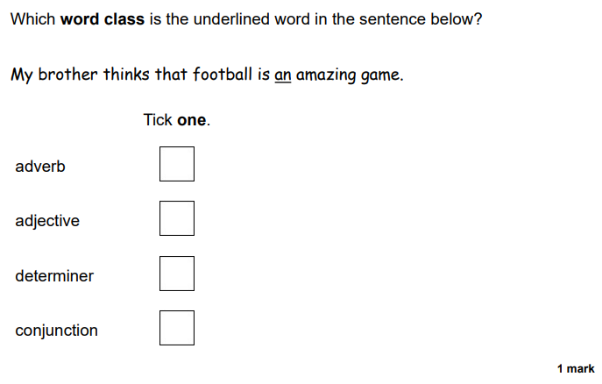

Slide 14
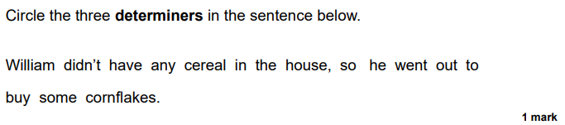

Slide 15
Prepositions
https://www.bbc.co.uk/bitesize/topics/zwwp8mn/articles/zw38srd
https://www.youtube.com/watch?v=d4inYRw6WOI&list=PLEBUp_Z2SsOrU2YhUh445C36FlGiwpgVR&index=32

Slide 16
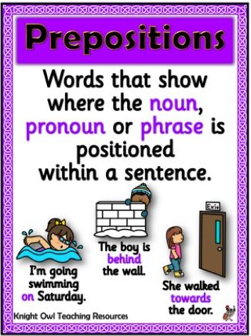
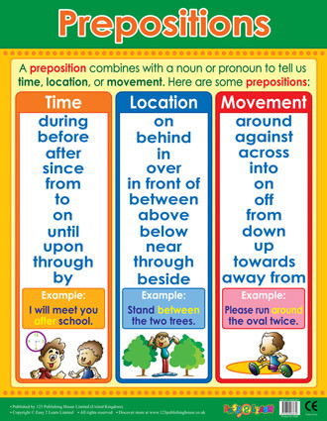

Slide 17
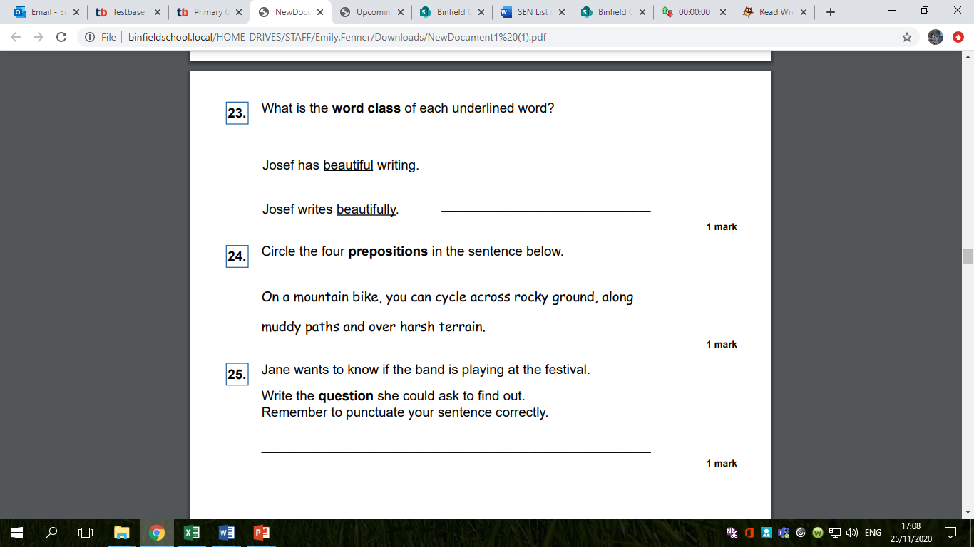

Slide 18
Adverbs and Adverbials
https://www.bbc.co.uk/bitesize/articles/zv73bdm

Slide 19
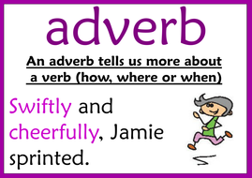
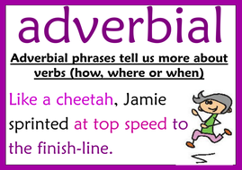

Slide 23
Conjunctions
https://www.bbc.co.uk/bitesize/topics/zwwp8mn/articles/z9wvqhv
https://www.bbc.co.uk/bitesize/topics/zwwp8mn/articles/zqk37p3
https://www.youtube.com/watch?v=3_CQHL90e7k&list=PLEBUp_Z2SsOrU2YhUh445C36FlGiwpgVR&index=5
https://www.youtube.com/watch?v=S-L69zd2RuA&list=PLEBUp_Z2SsOrU2YhUh445C36FlGiwpgVR&index=28

Slide 24
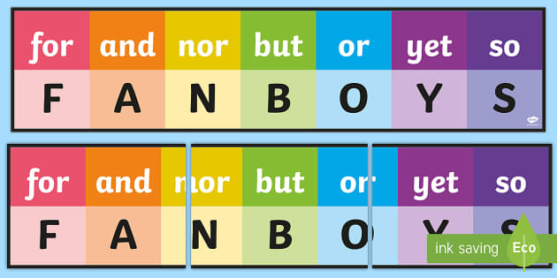
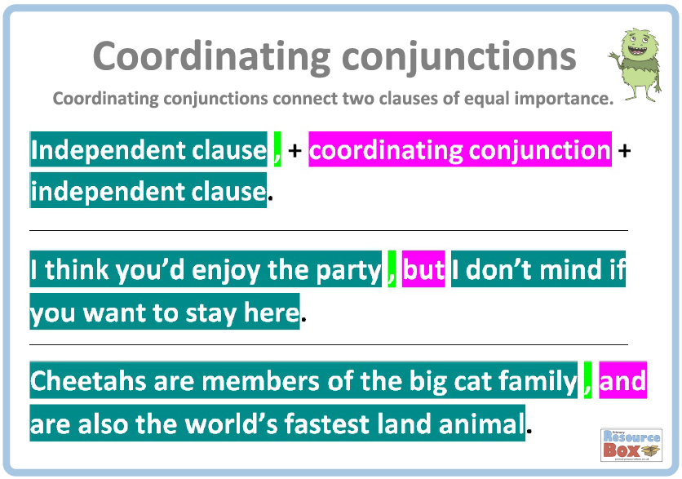

Slide 25
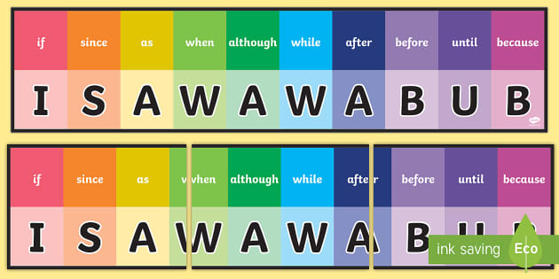
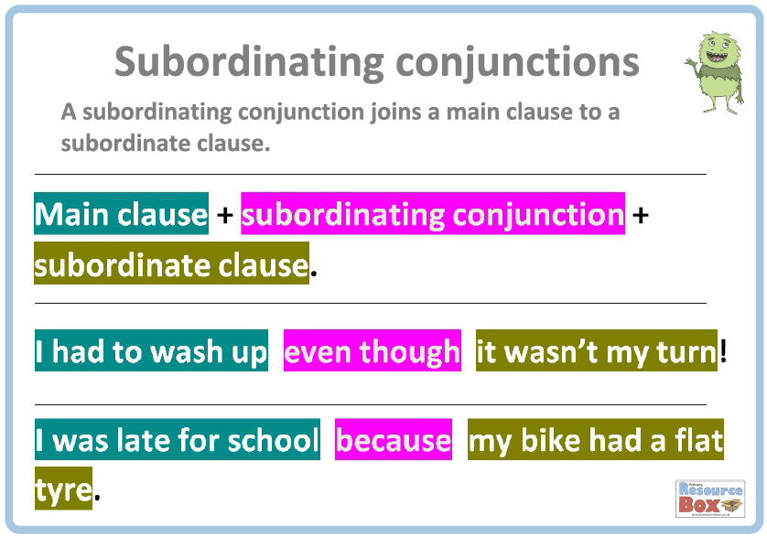

Slide 26
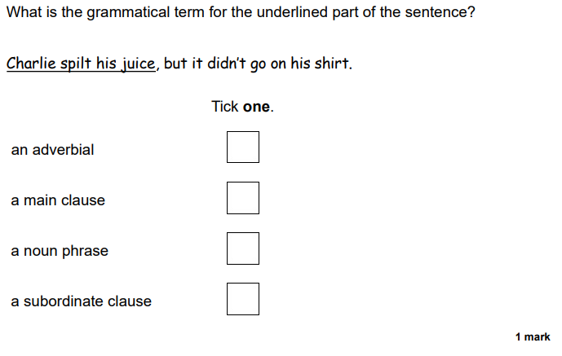

Slide 27
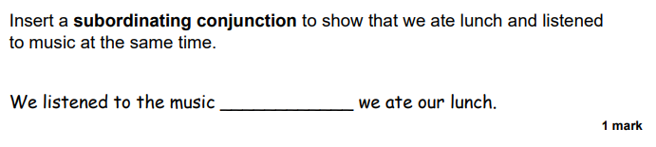

Slide 28
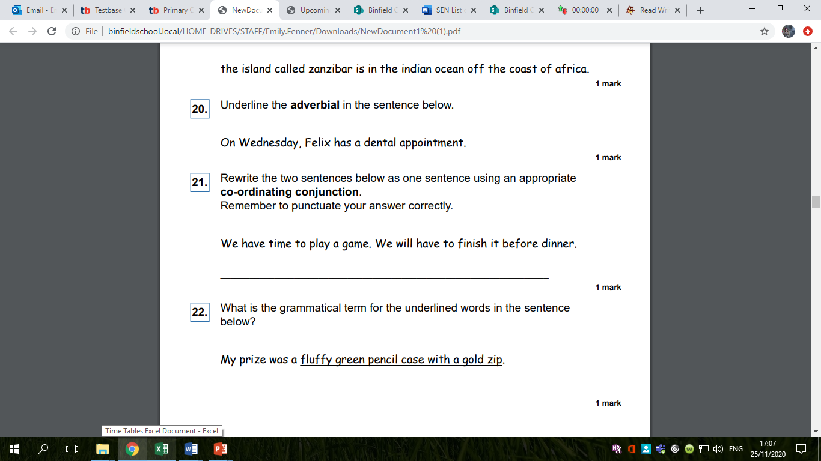

Slide 29
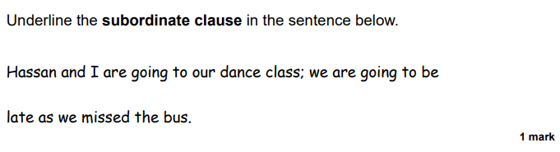

Slide 30
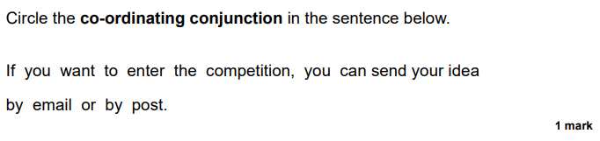

Slide 31
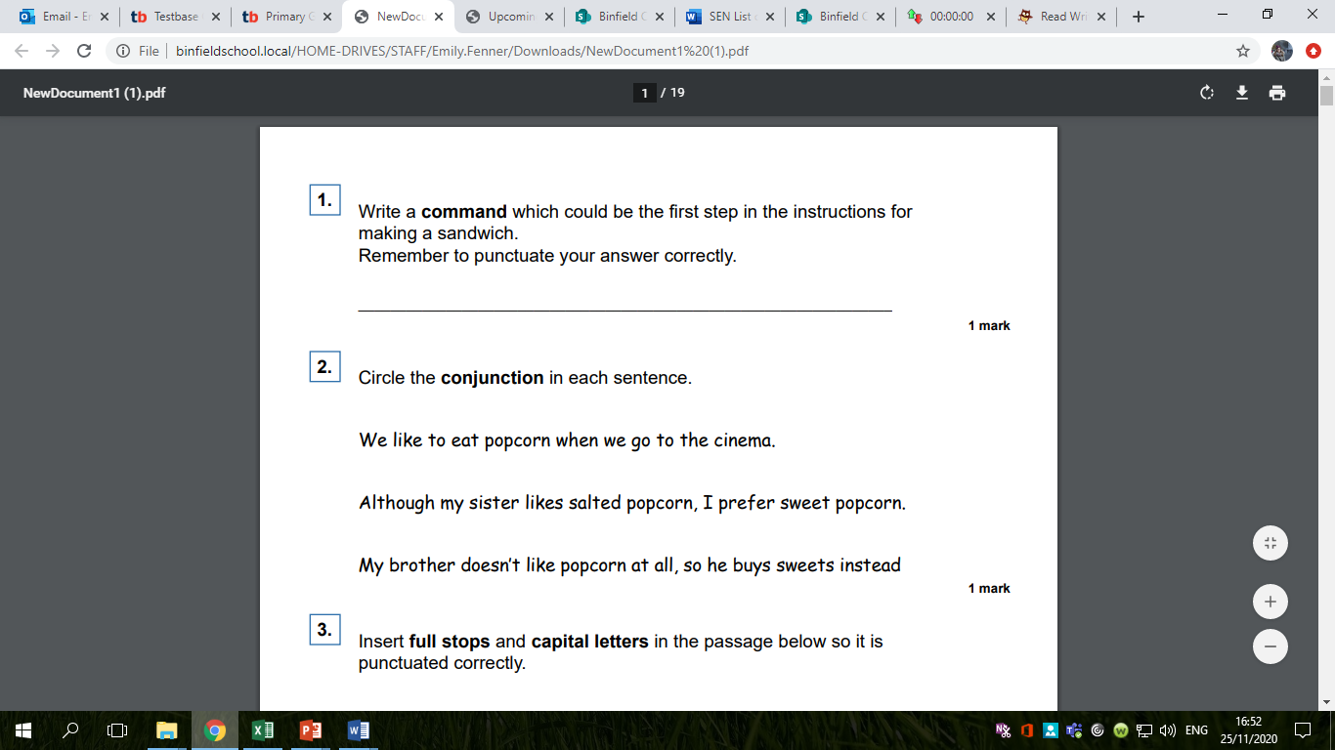

Slide 32
Tenses
https://www.bbc.co.uk/bitesize/topics/zrqqtfr/articles/z3dbg82
https://www.youtube.com/watch?v=DPOm4Z-HpGY&feature=youtu.be

Slide 33
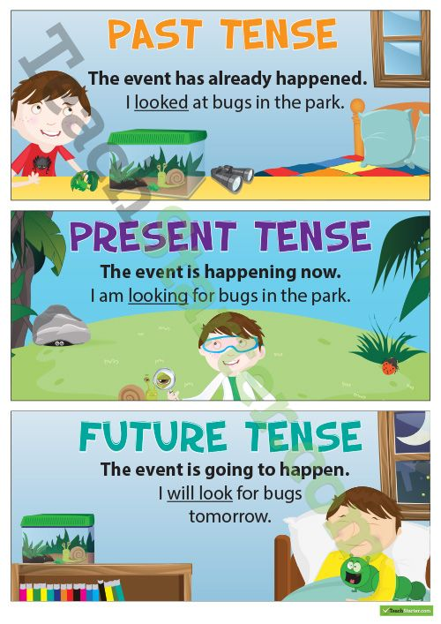

Slide 34
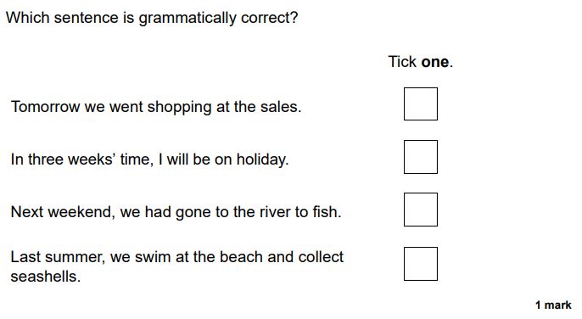

Slide 35
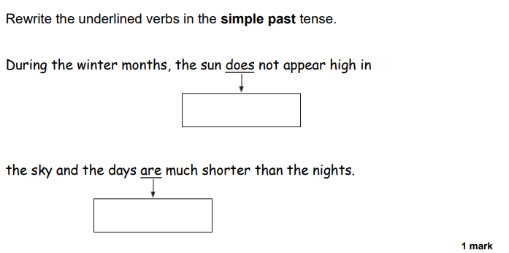

Slide 36
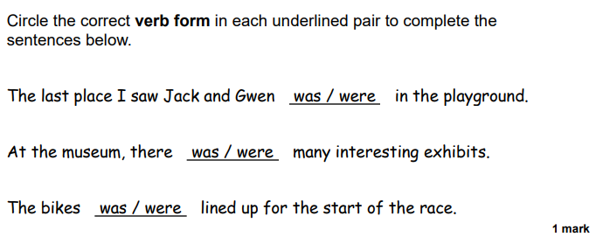

Slide 37
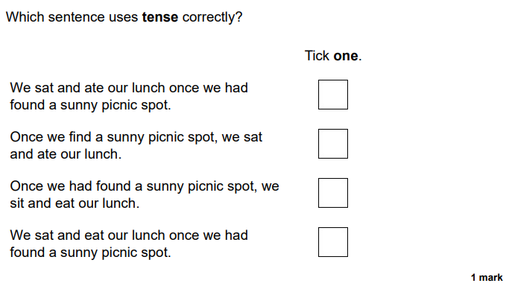

Slide 38
Punctuation
https://www.bbc.co.uk/bitesize/topics/z8x6cj6/articles/zxvcrdm

Slide 39
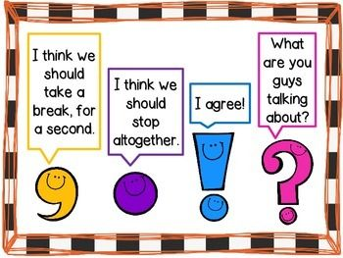

Slide 40
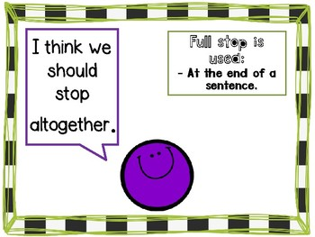
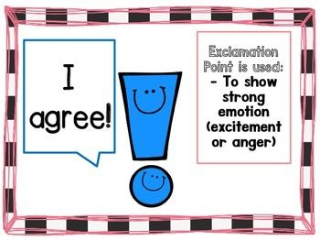

Slide 41
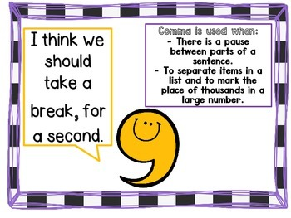
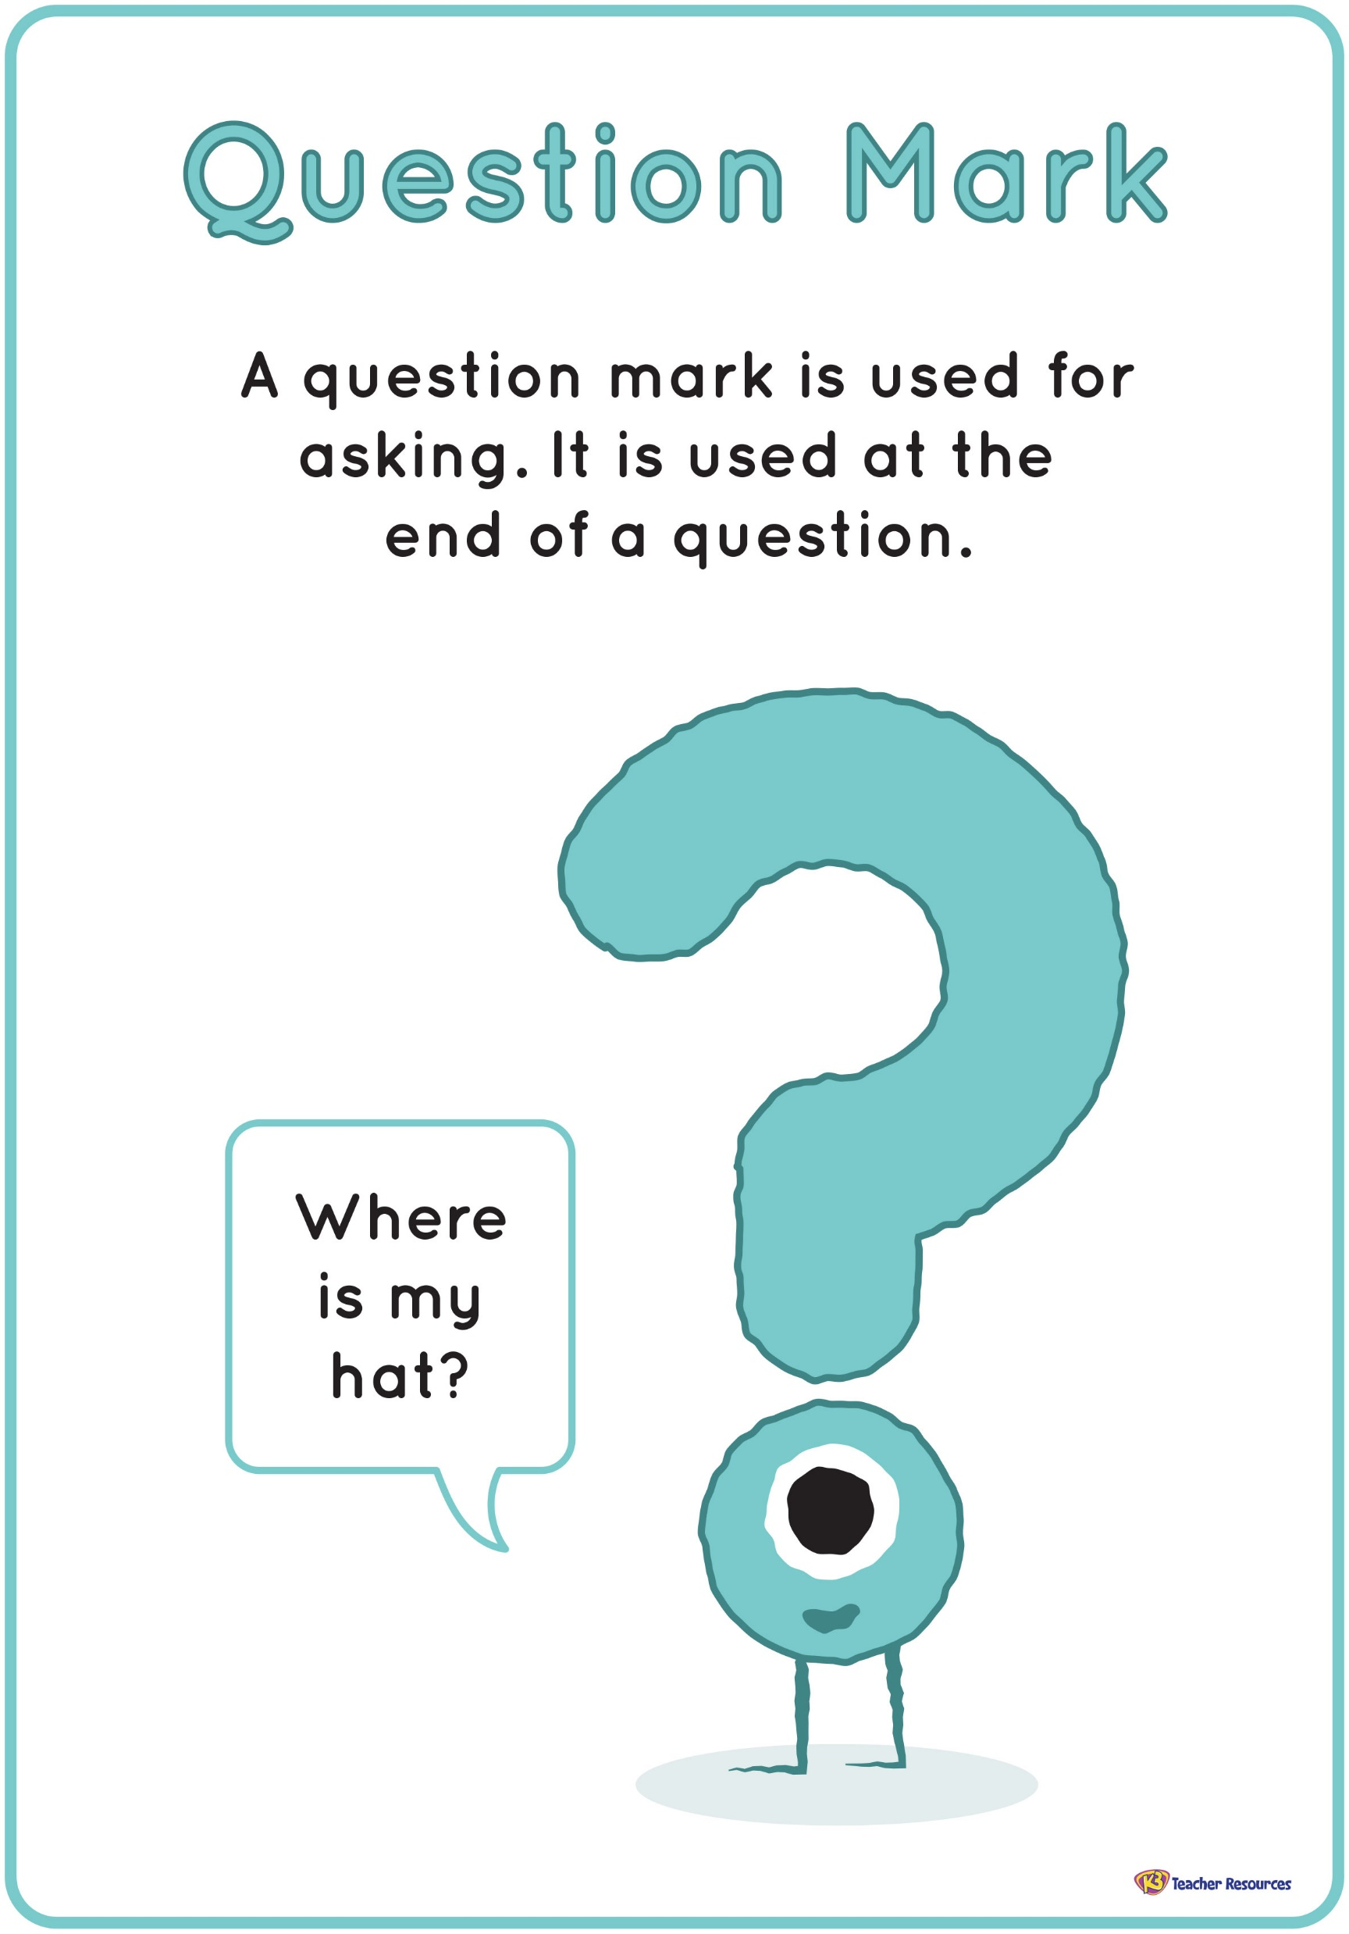

Slide 42
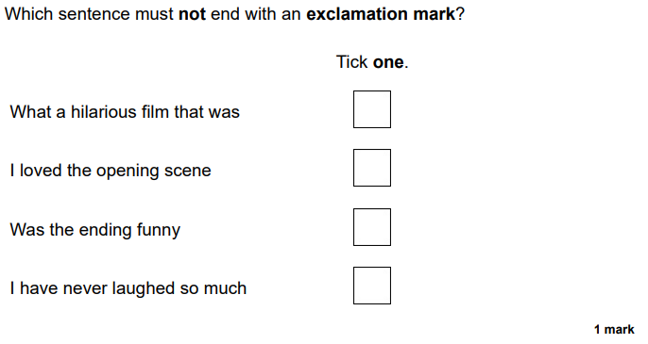

Slide 43
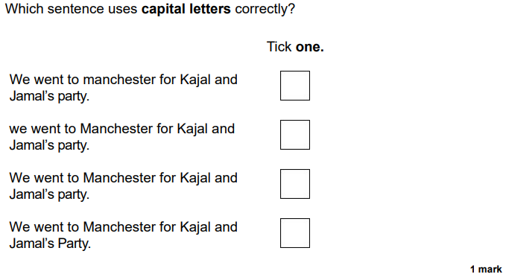

Slide 44
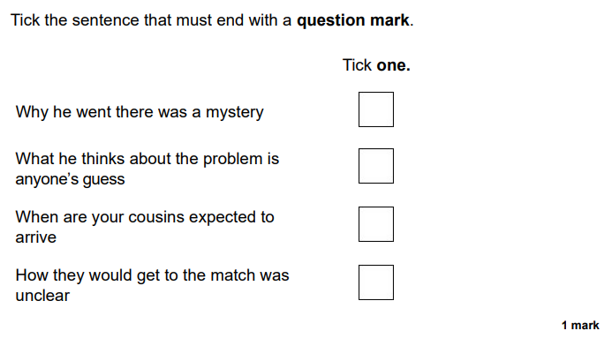

Slide 45
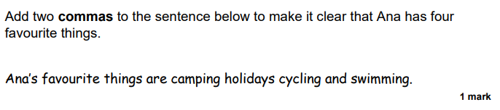

Slide 46
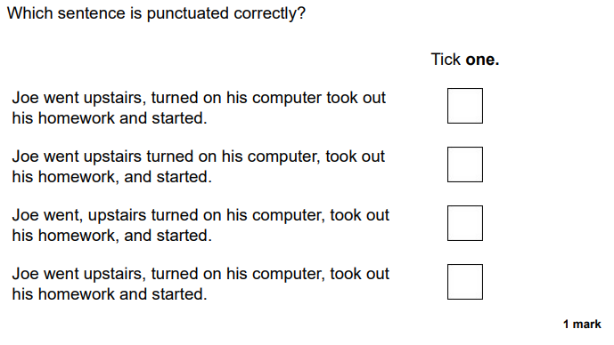

Slide 47
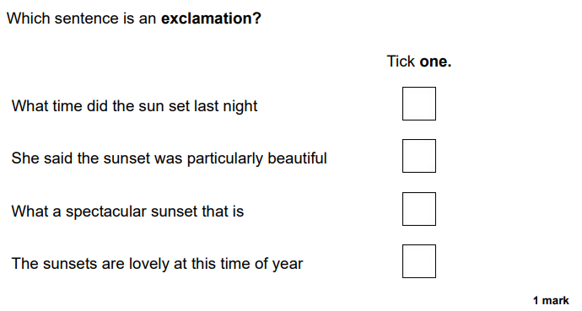

Slide 48
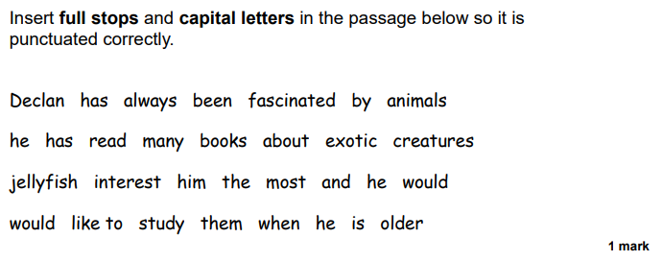

Slide 49
Types of Sentences
https://www.bbc.co.uk/bitesize/articles/zhh6pg8

Slide 50
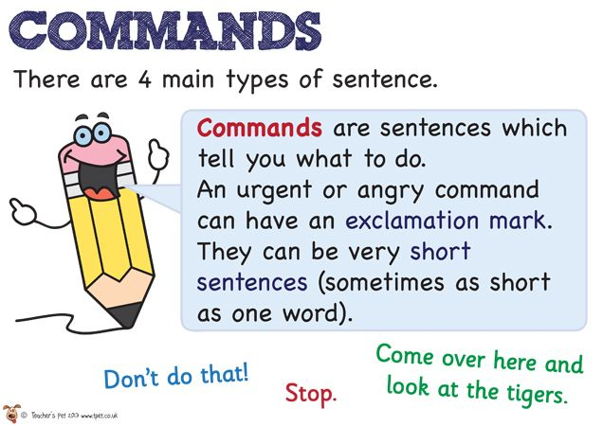
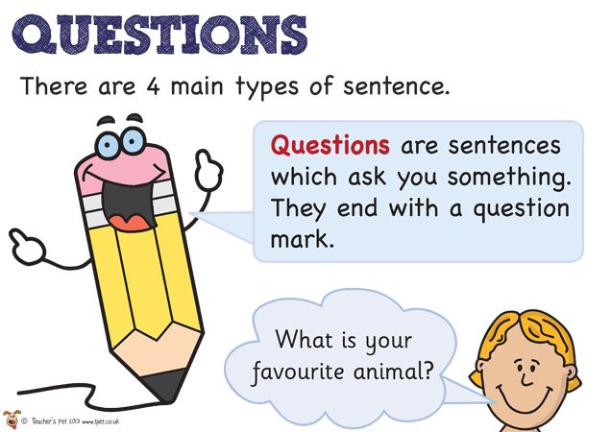

Slide 51
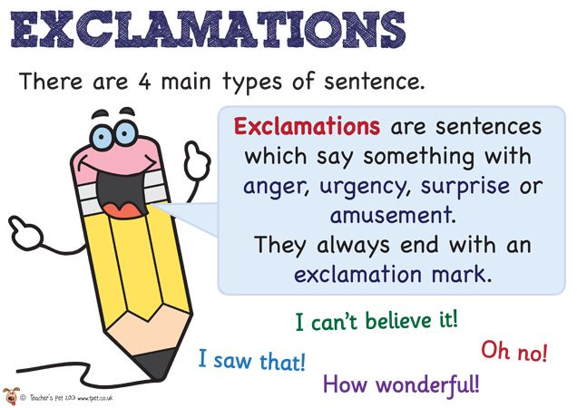
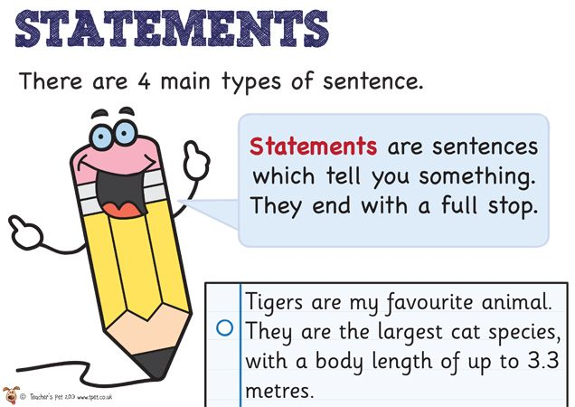

Slide 53
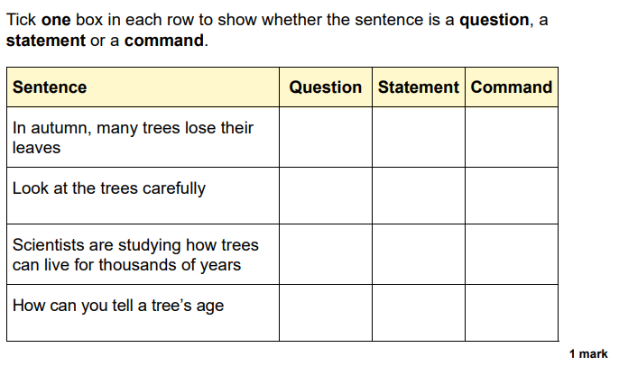

Slide 55
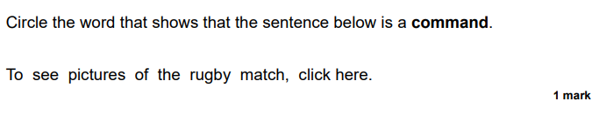

Slide 57
Prefixes and Suffixes
https://www.bbc.co.uk/bitesize/topics/z8mxrwx/articles/z9hjwxs
https://www.bbc.co.uk/bitesize/topics/z8mxrwx/articles/zwgbcwx
https://www.youtube.com/watch?v=Wel9tQmcIQc&list=PLEBUp_Z2SsOrU2YhUh445C36FlGiwpgVR&index=29

Slide 58
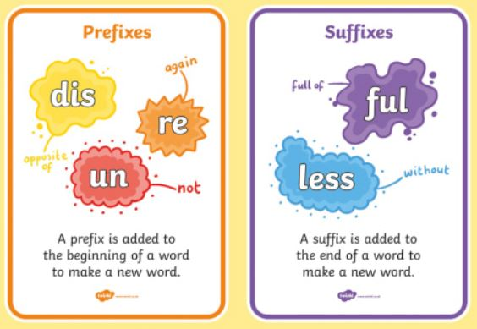

Slide 59


Slide 60


Slide 61


