Slide 1
How to make a Powerpoint Presentation.

Slide 2
Choose a layout and a background
On the toolbar click on FORMAT.
Select slide layout from the list.
On the right hand side a menu should appear with a selection of text and image layouts.
Choose one by double clicking.
On the toolbar click on format.
Select slide design from the list.
On the right hand side a menu should appear with a selection of background designs.
Choose one by double clicking on it.

Slide 3
To add a picture
To add a picture from online.
Click on insert on the toolbar.
Select online pictures.
This should bring up a box. Type in what you want a picture of, select your chosen picture and then click INSERT.
To add a picture from your computer.
Click on insert on the toolbar.
Select picture.
This should bring up a box. Select the folder or picture you want by clicking on it and then clicking INSERT.

Slide 4
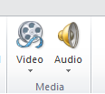
Inserting Sound
To insert a sound onto a page:
Click on the ‘insert’ tab at the top
Click on the arrow below the word ‘audio’
If you’ve saved a sound on the computer:
  Select ‘audio on my PC’
  Find and select the file in your folder and click on ‘insert’
If you would like to record a sound:
  Select ‘record audio’
  Click the red circle to begin recording and then click OK.

Slide 5
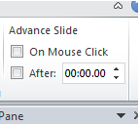
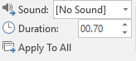
Transitions
Transitions are the way one page fades into the next
Choose a transition from the ‘transitions’ tab
Choose either to change the page ‘on mouse click’
or ‘after..’ A certain amount of time
You can also choose to have a sound as the slide changes. Click the down arrow and choose the sound you want.

Slide 6
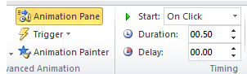
Animations
Animations are the way text/images appear on your page
Select the text/image you want to apply a transition to
Choose an animation from the ‘animations’ tab
Select when you want it to start, and how long it lasts
The ‘animation’ pane shows the order your transitions will happen

Slide 7
To save your work
To view your presentation
Select SLIDESHOW on the toolbar.
Click on view show.
FILE on the toolbar.
Click on save as.
Choose the folder you want to save the file in.
You can now write your file name and click save.

Slide 8
Tips and Suggestions
Put your slides in a logical order
Only include relevant information
Make sure you don’t repeat yourself
Check your slides regularly using ‘Slide Show’
Check your transitions/animations aren’t too slow
Check sounds all work
Save your work regularly so you don’t lose anything

