Slide 1
LO: to describe the simple functions of the digestive system
C: Animals including humans

Slide 2
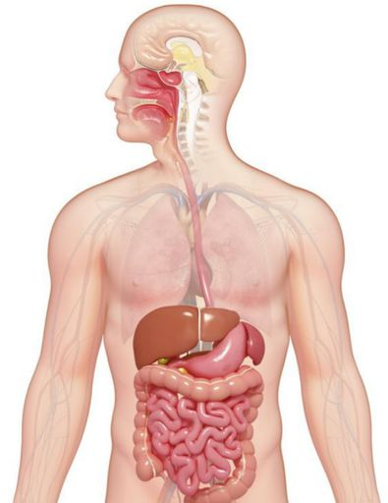
What do we mean by digestion?
The act of softening and changing food so that the body can absorb it to use for energy and growth.

Slide 3

Swallow
Trace down your throat to where you think your stomach is.
What other parts of your digestive system can you name?
Can you locate these parts in your bodies?

Slide 4
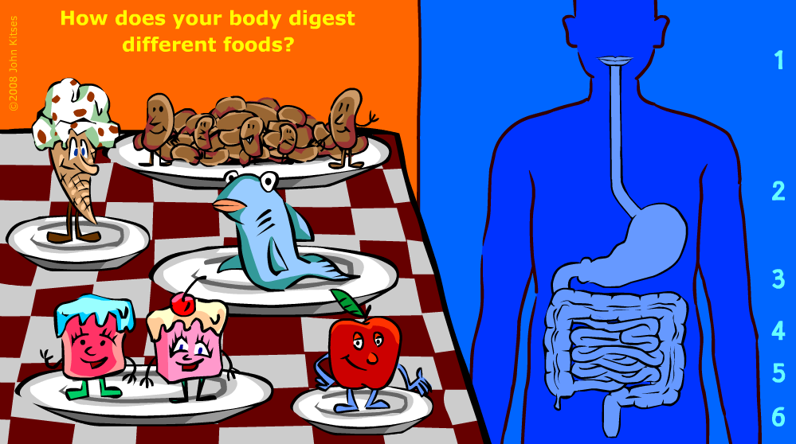
https://www.youtube.com/watch?v=jDDIBG6gnQ0

Slide 5

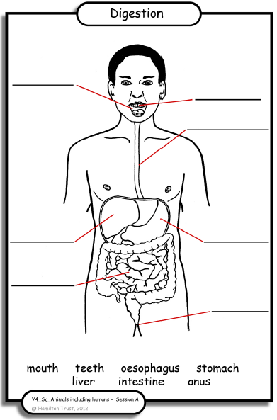
Paddling | Snorkelling | Diving
Label the parts of the digestive system. Red Pen: What can you tell me about the different parts of the digestive system? | 1. Label the parts of the digestive system. 2. Write some facts about the digestive system that you have learned. Red Pen: Why do we need to digest our food? | Label the parts of the digestive system. Write some facts about the digestive system that you have learned. Red Pen: I only need my teeth to digest food. True or False? Explain your reasoning.

