Slide 1
Friday 11th December 2020
LO: to understand how beliefs are conveyed
to understand beliefs and teachings
C: Christianity

Slide 2
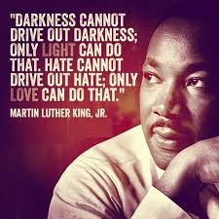
What do you think this quote means?

Slide 3
Can you think of a scenario where there is ‘darkness’ in terms of unhappy or evil situations?
Can you create two contrasting endings?
- one where the problem is ‘solved’ with more darkness
- one where the problem is solved with ‘light’

Slide 4
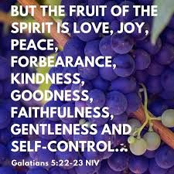
Features of light might include:
Christians believe in the ‘fruits of the spirit.’
These are 9 specific behaviours which are the result of the work of the Holy Spirit in a Christian’s life.
Could any of these features of light have solved the ‘darkness’ problems you created?

Slide 5
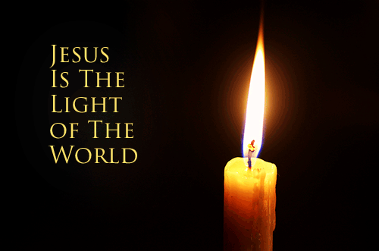
What do Christians believe about Jesus as light of the world?
Christians choose to live their lives as Jesus did.
They aim to make choices every day which bring light, hope and love into the world.
They read their Bibles and pray to know Jesus and understand what God wants them to do.
They are filled with God’s love, so the light can be passed on – just like with the Christingle candle.

Slide 6
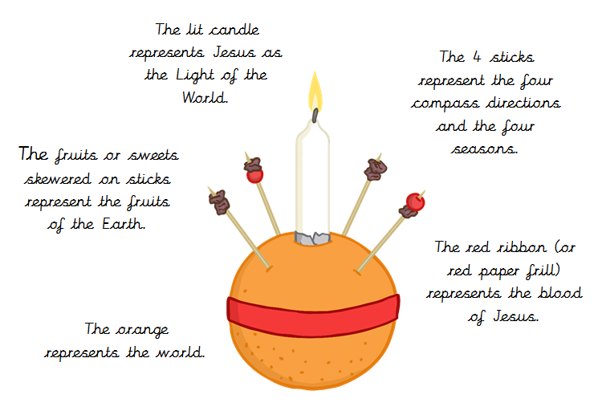

Slide 7
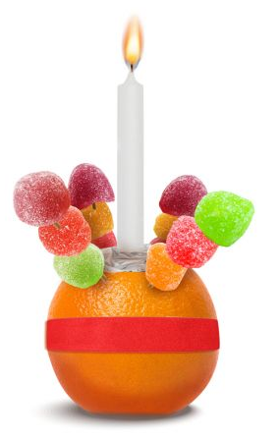
Key beliefs about God’s light:
It is a creative light. ‘
All things came in to being through him.’
The sweets and fruits added to the Christingle are a symbol of creation, and creation owes its existence to the light of the world.

Slide 8
Key beliefs about God’s light:
It is an everlasting light.
‘The darkness did not overcome it.’
The life and light of Christ are stronger than the deepest darkness and can never be extinguished.

Slide 9
Key beliefs about God’s light:
It is a generous light.
God’s love is shared with the world through the light of Christ.
We are called to share the light that can bring everyone to fullness of life.

Slide 10
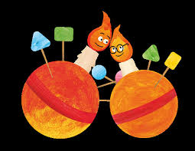
Activity: Sharing the Light
Watch: https://www.youtube.com/watch?v=8r7-RgE1v1I
Using the template, create a ‘Christingle hope’ card.
This transforms a simple drawing into a bright and colourful card to share the light with someone else.
The surprise reveal brings a little burst of light and joy!
Red Pen: Which part of the Christingle do you think has the most important meaning and why?

