Slide 1
Monday 7th December 2020
LO: to write for purpose
C: Newspaper Reports

Slide 2

Paragraphs
What are paragraphs and when do we start a new one?

Slide 3
Paragraphs
Paragraphs are a group of sentences that deal with one main idea or topic.
A long piece of writing, such as a newspaper, is easier to read if it is divided into paragraphs.
We start a new paragraph when we change:
- a place
- a time
- a topic

Slide 4
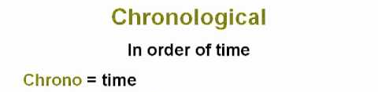
Paragraphs
Often when we write paragraphs are in chronological order.

Slide 5
Chronology
Chronology is the order something happens. When you write your main paragraph, you will have to put the events in order otherwise it will not make sense.
You will have to write in chronological order.

Slide 6
What features have we looked at for newspapers?

Slide 7

Success Criteria
Headline
Paragraphs
Time adverbials
Conjunctions
Quotes
3rd person
Past tense

Slide 8
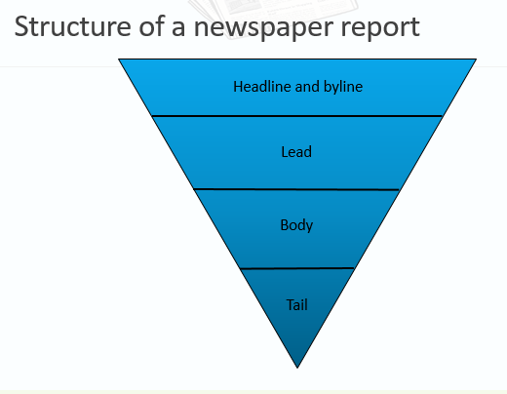
In our newspaper we will have 3 paragraphs under the headline, byline and summary sentence.

Slide 9
Lead Paragraph
Headline and byline
For a good lead paragraph, you need to;
Make the paragraph short and snappy so that it briefly explains what has happened;
Ensure that, even if the reader stopped reading at this point, they would still know roughly what happened;
Use past tense in most cases;
Make sure the first paragraph answers as many of these six questions as you can –
Who? What? Where? Why? When? How?
Lead
Body
Tail

Slide 10
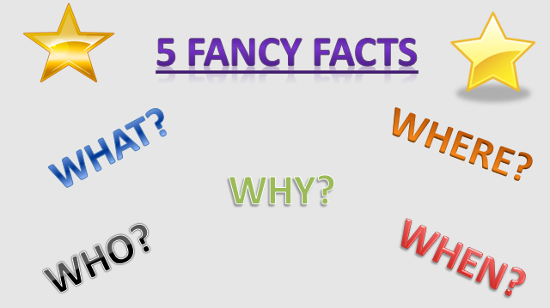
Lead paragraph

Slide 11
Body Paragraph
For a good body section, you need to:
Add more information and detail to your lead paragraph;
Include background information, evidence, facts and quotes from people involved in or connected to the event/story;
Continue to write in order of importance, putting the most important information in the first few paragraphs of the body section.
Headline and byline
Lead
Body
Having quotes from witnesses or experts
will make your report more credible and interesting.
Tail
Be sure to use correct punctuation for quotes!

Slide 12
Tail Paragraph
For a good tail section:
Give the reader the opportunity to gain additional information if they are particularly interested in the topic of the news report;
Include links to previous news reports or useful websites;
Include a final quote from a witness or expert that helps to sum up the story or that could hint at what might happen next.
Headline and byline
Lead
This ‘Tail’ information can be useful but is not always needed. It tends to be the least important information in the report.
Body
Tail

Slide 13
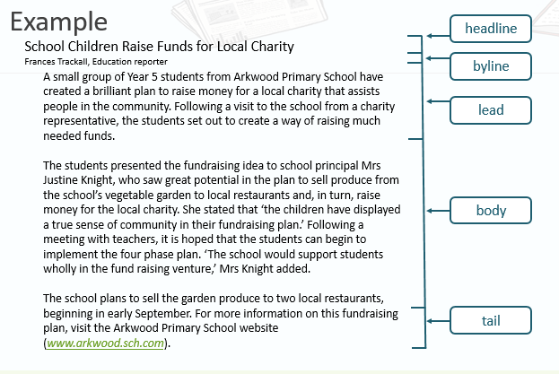

Slide 14
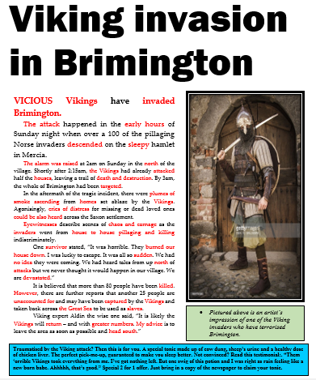

Slide 15
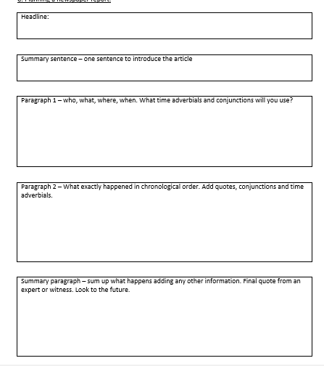
Activity:
Complete the boxed up plan for your newspaper articles about the Roman invasion of Britain.
Red Pen Challenge: try to use impressive vocabulary (e.g. time adverbials)

Slide 16

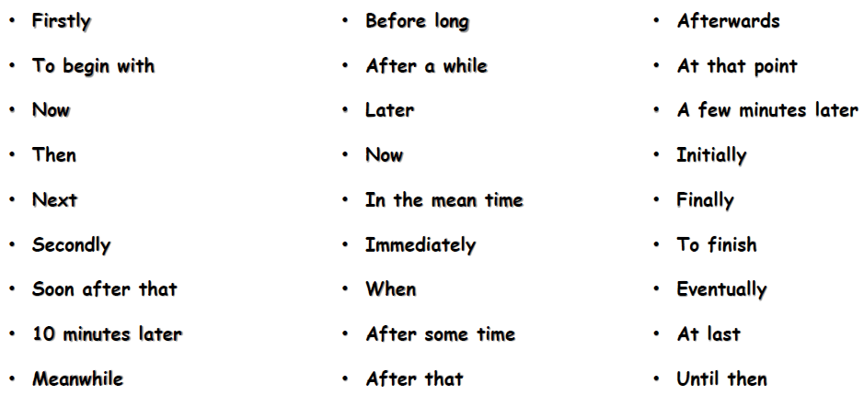
Time Adverbials

Slide 17
Tuesday 8th December 2020
LO: to write for purpose
C: Newspaper Reports

Slide 18

Starter
Look back at your plan from last lesson.

Slide 19
You are going to start writing your newspaper report today.
Remember to use your plan to help you!

Slide 20
Lead Paragraph
Headline and byline
For a good lead paragraph, you need to;
Make the paragraph short and snappy so that it briefly explains what has happened;
Ensure that, even if the reader stopped reading at this point, they would still know roughly what happened;
Use past tense in most cases;
Make sure the first paragraph answers as many of these six questions as you can –
Who? What? Where? Why? When? How?
Lead
Body
Tail

Slide 21
Viking Invasion in Brimington
Vicious Vikings have invaded Brimington!
The attack happened in the early hours of Sunday night when over a 100 of the pillaging Norse invaders descended on the sleepy hamlet in Mercia.

Slide 22

First you need to write a headline at the top of the page.
Now, you are going to fold your page in half and use a ruler to draw a line down the middle to create your columns.
Next, write your summary sentence.
Finally, write your first paragraph – the lead paragraph.
You need to make sure the 5 W’s are covered in this paragraph.
You should use time adverbials, conjunctions, 3rd person and past tense.

Slide 23
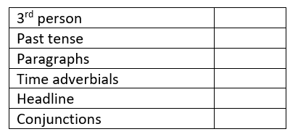
Activity:
Write your headline, summary sentence and lead paragraph.
Take your time with your presentation and handwriting.
Make sure you include all of the information you need in the first paragraph.
Use your plan and the success criteria to help you!

Slide 24
Wednesday 9th December 2020
LO: to write for purpose
C: Newspaper Reports

Slide 25
You are going to carry on writing your newspaper report today.
Remember to use your plan to help you!

Slide 26
Body Paragraph
For a good body section, you need to:
Add more information and detail to your lead paragraph;
Include background information, evidence, facts and quotes from people involved in or connected to the event/story;
Continue to write in order of importance, putting the most important information in the first few paragraphs of the body section.
Headline and byline
Lead
Body
Having quotes from witnesses or experts
will make your report more credible and interesting.
Tail
Be sure to use correct punctuation for quotes!

Slide 27
The alarm was raised at 2am on Sunday in the north of the village. Shortly after 2:15am, the Vikings had already attacked half the houses, leaving a trail of death and destruction. By 3am, the whole of Brimington had been targeted.
In the aftermath of the tragic incident, there were plumes of smoke ascending from homes set ablaze by the Vikings. Agonisingly, cries of distress for missing or dead loved ones could be also heard across the Saxon settlement.
Eyewitnesses describe scenes of chaos and carnage as the invaders went from house to house pillaging and killing indiscriminately.
One survivor stated, “It was horrible. They burned our house down. I was lucky to escape. It was all so sudden. We had no idea they were coming. We had heard tales from up north of attacks but we never thought it would happen in our village. We are devastated.”
It is believed that more than 80 people have been killed. However, there are further reports that another 25 people are unaccounted for and may have been captured by the Vikings and taken back across the Great Sea to be used as slaves.

Slide 28
Write your second paragraph – the body paragraph.
You need to make sure you write in chronological order.
You should use time adverbials, conjunctions and quotes.
You should also remember to write in 3rd person and past tense.

Slide 29
Activity:
Write your body paragraph.
Take your time with your presentation and handwriting.
Make sure you include all of the information you need in the your paragraph.
Use your plan and the success criteria to help you!

Slide 30
Thursday 10th December 2020
LO: to write for purpose
C: Newspaper Reports

Slide 31
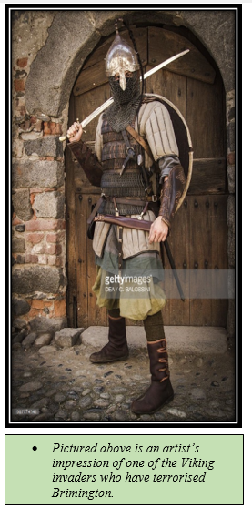
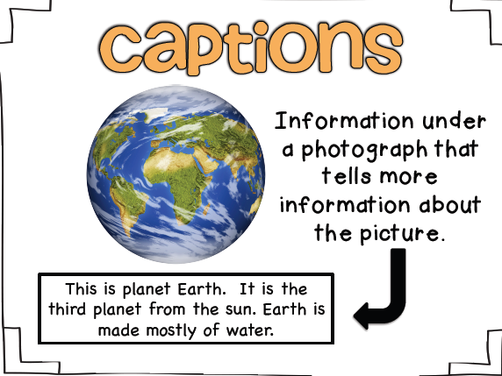
Starter
Add a picture and a caption to your work.

Slide 32
You are going to carry on writing your newspaper report today.
Remember to use your plan to help you!

Slide 33
Tail Paragraph
For a good tail section:
Give the reader the opportunity to gain additional information if they are particularly interested in the topic of the news report;
Include links to previous news reports or useful websites;
Include a final quote from a witness or expert that helps to sum up the story or that could hint at what might happen next.
Headline and byline
Lead
This ‘Tail’ information can be useful but is not always needed. It tends to be the least important information in the report.
Body
Tail

Slide 34
Viking expert Aldin the wise one said, “It is likely the Vikings will return – and with greater numbers. My advice is to leave the area as soon as possible and head south.”
Traumatised by the Viking attack? Then this is for you. A special tonic made up of cow dung, sheep’s urine and a healthy dose of chicken liver. The perfect pick-me-up, guaranteed to make you sleep better. Not convinced?
Read this testimonial:. “Them ‘orrible Vikings took everything from me. I’ve got nothing left. But one swig of this potion and I was right as rain feeling like a new born babe.” Special 2 for 1 offer. Just bring in a copy of the newspaper to claim your tonic.

Slide 35
Write your third paragraph – the tail paragraph.
You need to make sure you summarise the article and look towards the future – what will happen next?
You should use time adverbials and conjunctions.
You should also remember to write in 3rd person and past tense.

Slide 36
Activity:
Write your tail paragraph.
Take your time with your presentation and handwriting.
Make sure you include all of the information you need in the your paragraph.
Use your plan and the success criteria to help you!

