Slide 1
LO: Number line to 10,000
C: To know and use number.
Mon
Watch this video, without pausing where it asks you to, then answer the
questions for Monday that you will find on our webpage.
https://vimeo.com/455474568

Slide 3
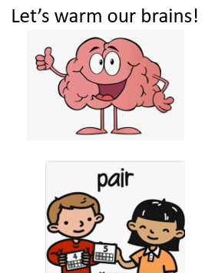
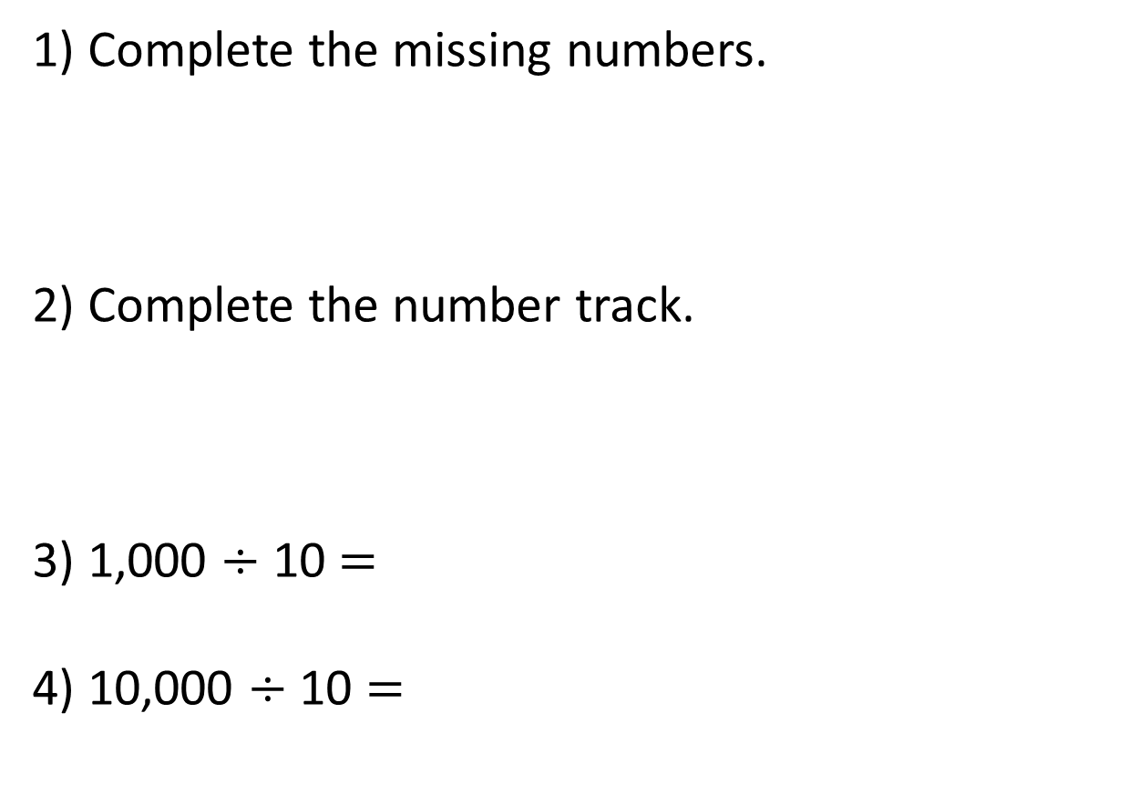
1) Complete the missing numbers.
2) Complete the number track.
3) 1,000 $÷$ 10 $=$
4) 10,000 $÷$ 10 $=$
1,000
2,000
3,000
5,000
2,000
4,000
10,000

Slide 4
1) Complete the missing numbers.
2) Complete the number track.
3) 1,000 $÷$ 10 $=$
4) 10,000 $÷$ 10 $=$
1,000
2,000
3,000
4,000
5,000
6,000
2,000
4,000
6,000
8,000
10,000
100
1,000

Slide 6
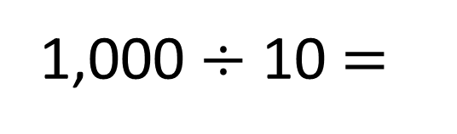
Complete the number line.
1,000
0
100
200
300
400
500
600
700
800
900
1,000
1,000 $÷$ 10 $=$
100

Slide 7
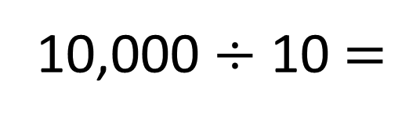
Complete the number line.
10,000
0
1,000
2,000
3,000
4,000
5,000
6,000
7,000
8,000
9,000
10,000
10,000 $÷$ 10 $=$
1,000

Slide 8
Place 2,500 on the number line.
2,500
0
2,000
3,000
10,000
The previous multiple of 1,000 is 2,000
500 is half of 1,000
The next multiple of 1,000 is 3,000
2,500 is halfway between 2,000 and 3,000

Slide 9
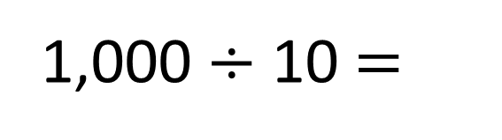
Place 3,620 on the number line.
3,620
1,000
3,000
3,600
3,700
4,000
The previous multiple of 100 is 3,600
3,620 is closer to 3,600 than 3,700
1,000 $÷$ 10 $=$
100
The next multiple of 100 is 3,700

Slide 10
Place 3,620 on the number line.
3,620
1,000
3,000
3,600
3,700
4,000
The previous multiple of 100 is 3,600
3,620 is closer to 3,600 than 3,700
1,000 $÷$ 10 $=$
100
The next multiple of 100 is 3,700

Slide 11
Have a go at the questions on your worksheet.

Slide 12
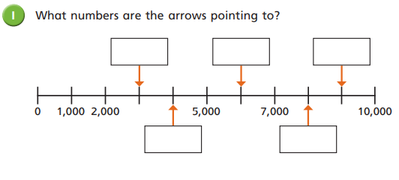
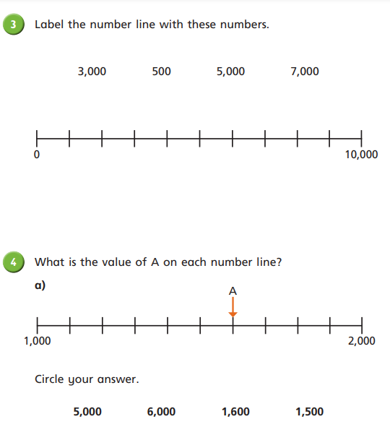
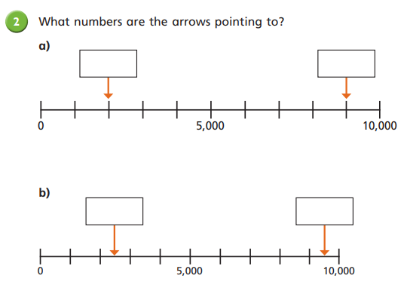
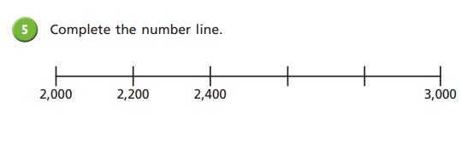

Slide 13
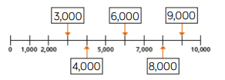


Answers

Slide 14

Answers

Slide 15
LO: Number line to 10,000
C: To know and use number.
Tues
Watch this video again, without pausing where it asks you to, then answer the
questions for Tuesday that you will find on our webpage.
https://vimeo.com/455474568

Slide 16
Place 2,500 on the number line.
2,500
0
2,000
3,000
10,000
The previous multiple of 1,000 is 2,000
500 is half of 1,000
The next multiple of 1,000 is 3,000
2,500 is halfway between 2,000 and 3,000

Slide 17
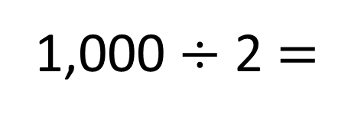
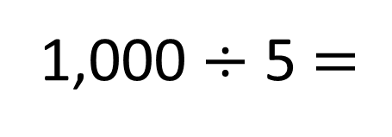
1,000
3,000
3,200
3,400
3,600
3,800
4,000
1,000 $÷$ 5 $=$
200
1,000
3,000
3,500
4,000
1,000 $÷$ 2 $=$
500

Slide 18

Have a think
Estimate the values of A and B.
A
B
0
2,500
5,000
7,500
10,000
A is approximately 2,000
B is approximately 7,520

Slide 19
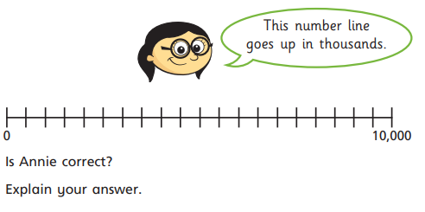
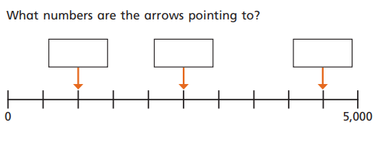
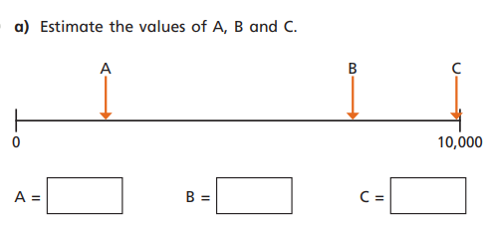
Task Challenge

Slide 20
Task Challenge
Answers
1000
2500
4500
No she is not correct. The number line is 0 to 10,000. There are 20 lines. 10,000 ÷ 20 = 500. This number lines goes up in 500’s
2000
7500
9990

Slide 21
LO: Find 1, 10, 100 more of less.
C: To know and use number.
Wed
Watch this video, without pausing where it asks you to, then answer the
questions for Wednesday that you will find on our webpage.
https://vimeo.com/456123596

Slide 23
Continue the sequences.
17, 18, 19, ___, ___, ___
2) 23, 33, 43, ___, ___, ___
3) 180, 170, 160, ____, ____, ____
4) 180, 280, 380, ____, ____, ____

Slide 24
Continue the sequences.
17, 18, 19, ___, ___, ___
2) 23, 33, 43, ___, ___, ___
3) 180, 170, 160, ____, ____, ____
4) 180, 280, 380, ____, ____, ____
20 21 22
53 63 73
150 140 130
480 580 680

Slide 26

132
100 more
10 more
1 more
232
142
133

Slide 27

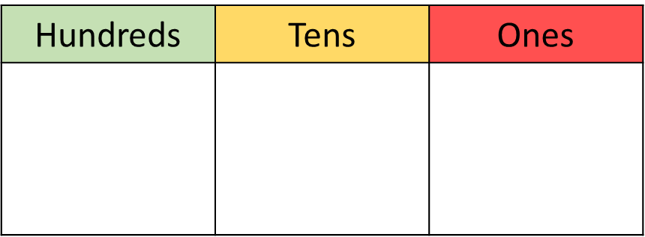
Have a think
354
100 less
10 less
1 less
254
344
353

Slide 28



What is 1 more than 239?
240

Slide 29

292
is 10 less than 302
Impossible! There are no tens to subtract.

Slide 30
Have a think
Dexter adds one more counter.
What new number could he make?
404
314
305

Slide 31

560 is one hundred less than the number I am hiding.
100 less
660
560
100 more

Slide 32
Now it’s your turn…

Slide 33
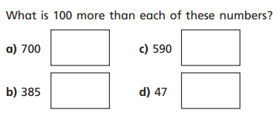
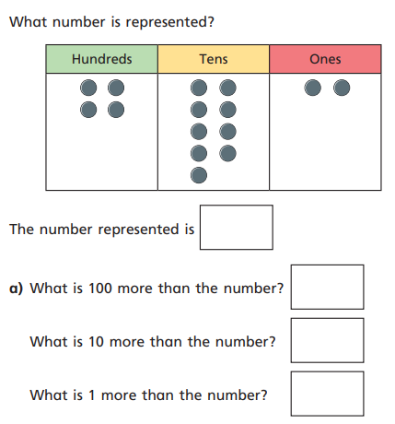
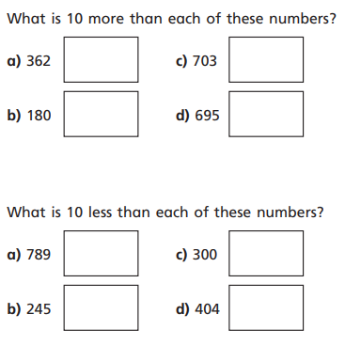
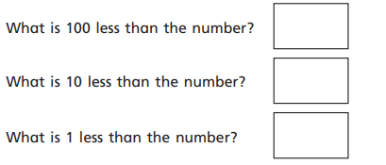
2
1
3
4

Slide 34
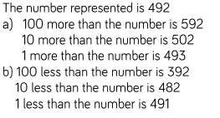



Answers
4
1
2
3

Slide 35
LO: Find 1, 10, 100, 1000 more of less.
C: To know and use number.
Watch this video, without pausing where it asks you to, then answer the
questions for Thursday that you will find on our webpage.
https://vimeo.com/456123805

Slide 37
Complete the sequence.
345, 445, 545, ____ , ____
Complete the number track.
3) What is 10 more than 3,562?
4,000
5,000
6,000

Slide 38
Complete the sequence.
345, 445, 545, ____ , ____
Complete the number track.
3) What is 10 more than 3,562?
645 745
4,000
5,000
6,000
7,000 8,000 9,000
3,572

Slide 40


1,000 m
2,369 m
How far has the blue rocket travelled?

Slide 41
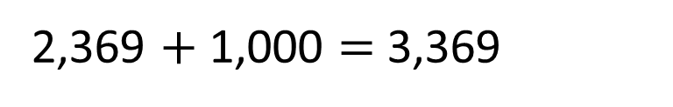
Thousands | Hundreds | Tens | Ones
3,369
1,000 more than 2,369 is
2,369 $+$ 1,000 $=$ 3,369

Slide 42

1,000 m
3,369 m
1,000 m
2,369 m
How far has the yellow rocket travelled?

Slide 43
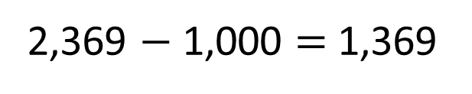
Thousands | Hundreds | Tens | Ones
1,369
1,000 less than 2,369 is
2,369 $−$ 1,000 $=$ 1,369

Slide 44
1,000 m
3,369 m
1,000 m
2,369 m
1,369 m
1,369
2,369
3,369
1,000 less
1,000 more

Slide 45

Thousands | Hundreds | Tens | Ones
4,907
1,000 more
1 more
5,907
100 more
10 more
4,908
5,007
4,917

Slide 46
Have a think
Thousands | Hundreds | Tens | Ones
4,907
1,000 less
1 less
3,907
100 less
10 less
4,906
4,807
4,897

Slide 47
3,562 is 1,000 more than
2,562
I think the missing number is 4,562

Slide 49
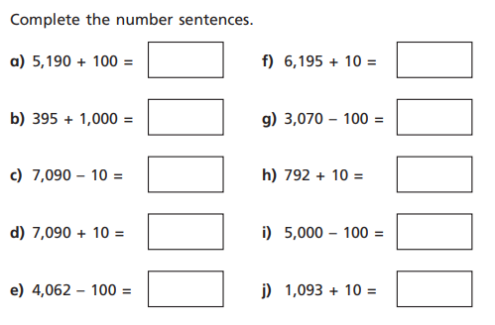
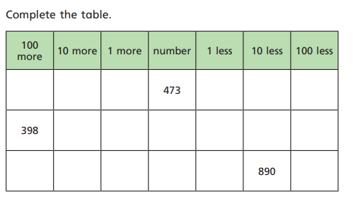
Task

Slide 50
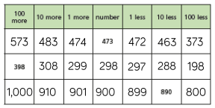
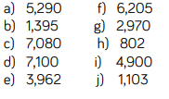
Answers

Slide 51
Friday
Spend today practising your TTRockstars.
Can you beat you last score?

