Slide 1


Slide 2
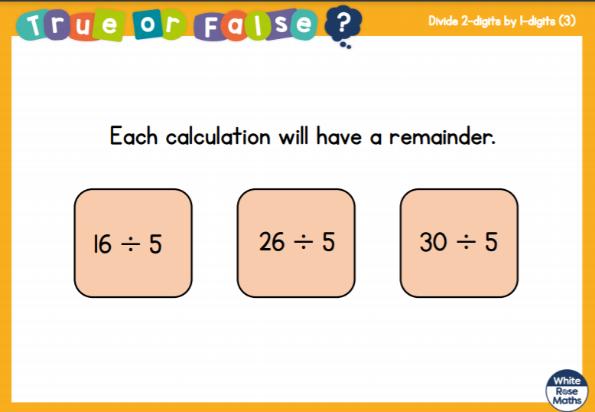

Slide 3
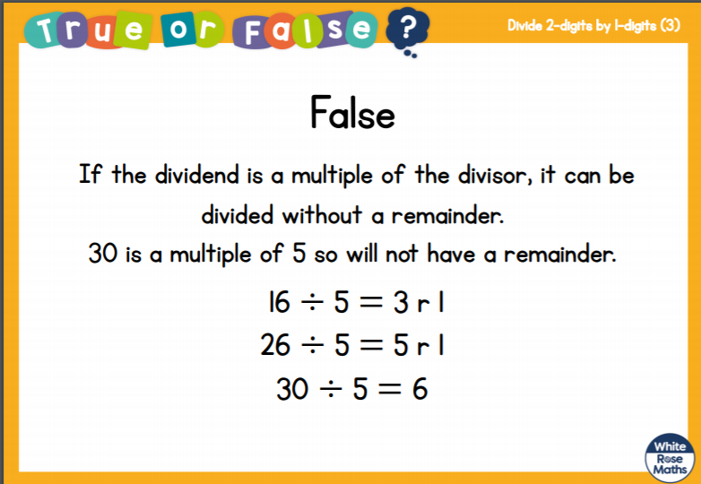

Slide 5
Circle the multiples of 10
120 13 30 80 23 204
2) Here are 20 cubes.
a) How many groups of 4 are there?
b) How many groups of 3 are there?
How many cubes will be remaining?

Slide 6
Circle the multiples of 10
120 13 30 80 23 204
2) Here are 20 cubes.
a) How many groups of 4 are there?
b) How many groups of 3 are there?
How many cubes will be remaining?
5
6
2

Slide 8

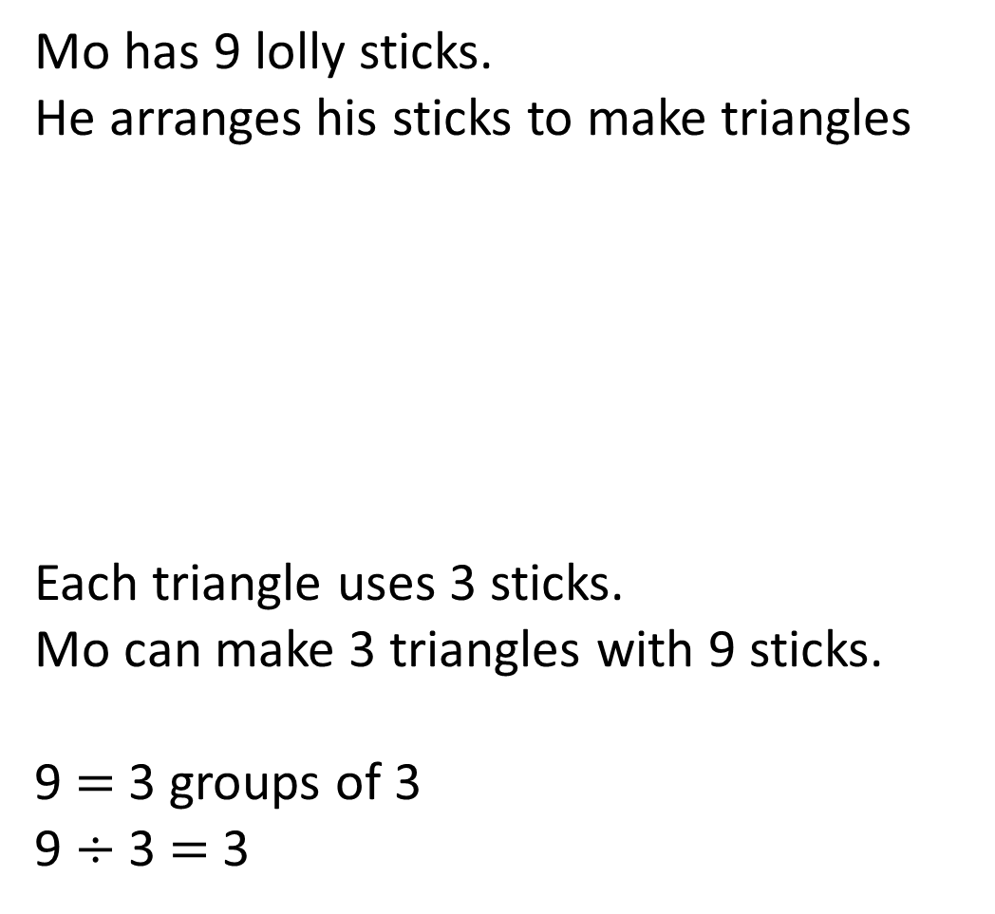
Mo has 9 lolly sticks.
He arranges his sticks to make triangles
Each triangle uses 3 sticks.
Mo can make 3 triangles with 9 sticks.
9 $=$ 3 groups of 3
9 $÷$ 3 $=$ 3

Slide 9
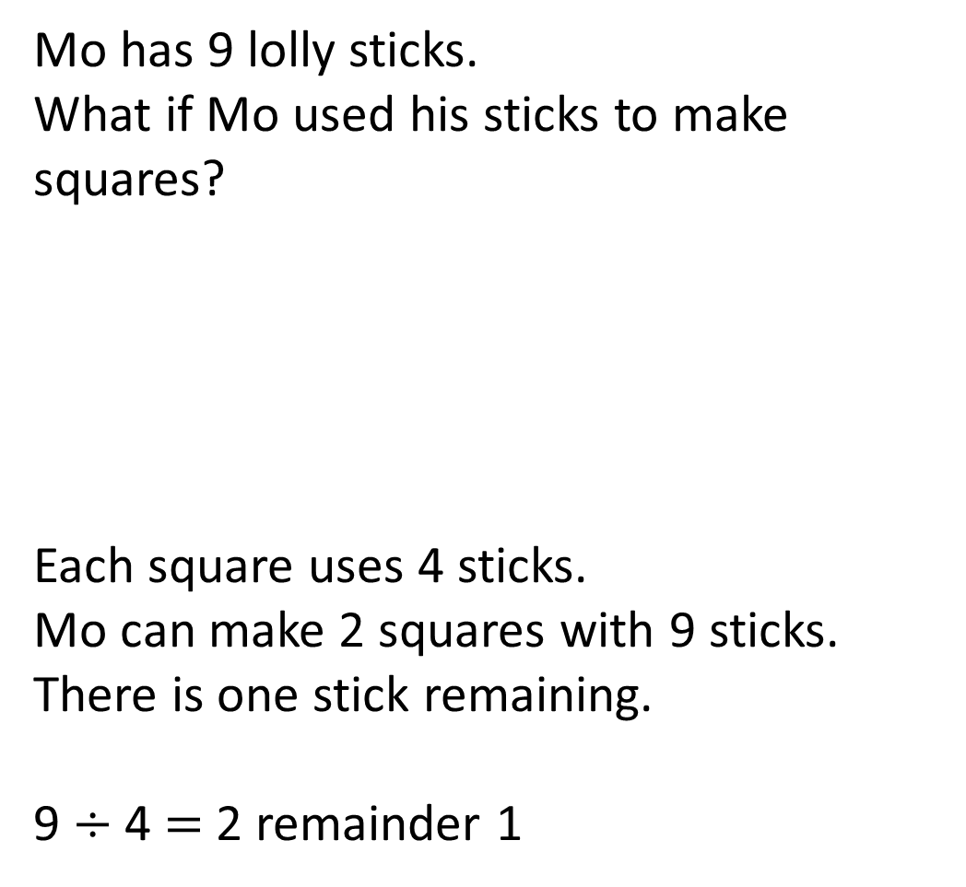
Mo has 9 lolly sticks.
What if Mo used his sticks to make squares?
Each square uses 4 sticks.
Mo can make 2 squares with 9 sticks.
There is one stick remaining.
9 $÷$ 4 $=$ 2 remainder 1

Slide 10

What if Mo has 19 lolly sticks.
How many squares and triangles could he make? How many sticks will be remaining each time?
Have a think
6 triangles and 1 stick remaining. 19 $÷$ 3 $=$ 6 r 1
4 squares and 2 sticks remaining. 19 $÷$ 4 $=$ 4 r 3

Slide 11
Have a go at questions
1 - 3 on the worksheet

