Slide 1
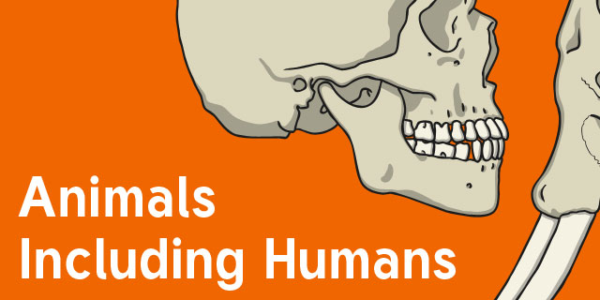
Science

Slide 2
Lesson 2
LO: to recognise the different food groups and understand how they help our bodies
C: Animals including humans

Slide 3

What do humans need to grow and keep healthy?

Slide 4
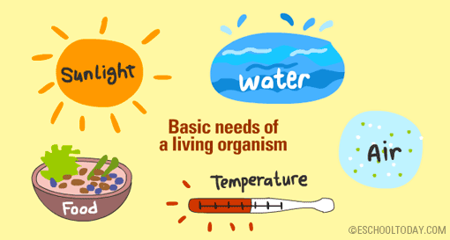
What do humans need to grow and keep healthy?

Slide 5
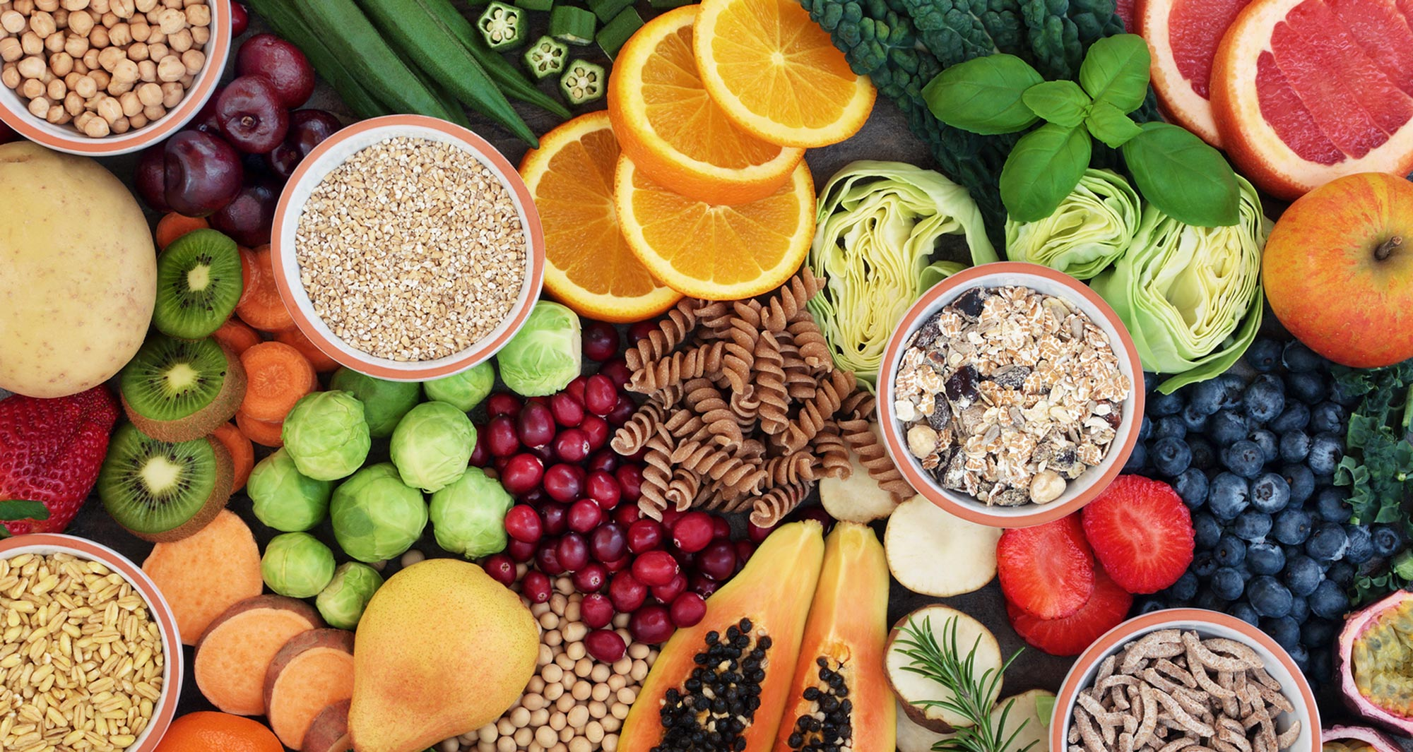
Today we will be focusing on food!
What did you have for dinner last night?

Slide 6
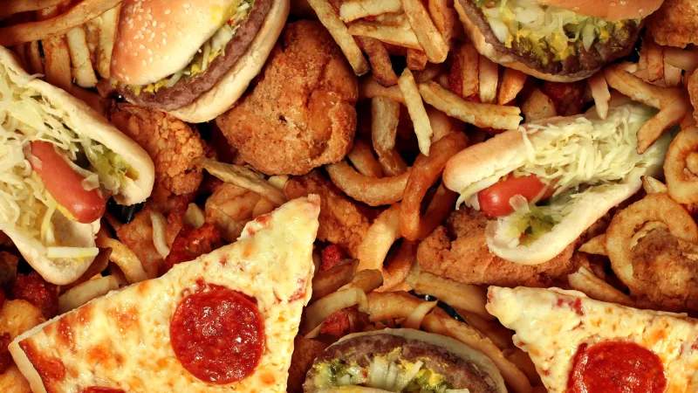

Should we eat whatever we want to?

Slide 7
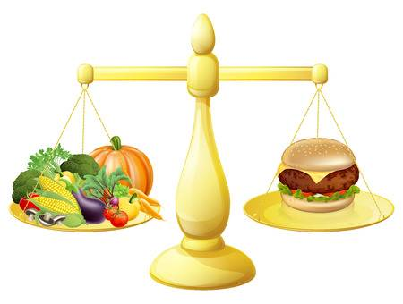
Should we eat whatever we want to?
To keep healthy we need to eat a balanced diet.
What is a balanced diet?

Slide 8
Should we eat whatever we want to?
To keep healthy we need to eat a balanced diet.
What is a balanced diet?
Eating a balanced diet just means that you choose foods in the right amounts from each of the food groups.

Slide 9
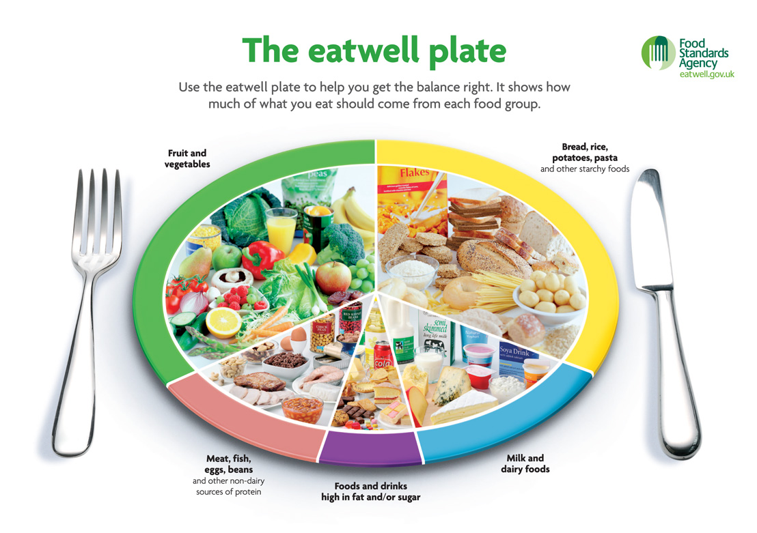
There are 5 different types of food we should eat.
Can you identify them?

Slide 10
Different types of food help our bodies in different ways.
Our bodies need a variety of different foods so that they can keep working properly.
Let’s look at the sort of foods we should be eating and why they are good for us.

Slide 11

Carbohydrates are in starchy and sugary foods.
Carbohydrates give you energy.
These foods contain carbohydrates.
potato
rice
cereal
pasta

Slide 12

Proteins help your body grow and repair itself.
Meat & Fish contain protein.
Here are some good ways of getting protein.
nuts
beef
eggs
fish

Slide 13

Vitamins & Minerals are found in fruit & vegetables
They help your bodies to work properly.
These are really good for us.
carrot
grapes
apple
corn

Slide 14
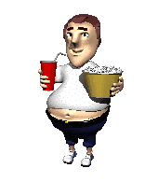



Foods containing fats and oils.
Used as an energy store.
Although they taste good these foods can be bad for you if you eat too many!
Oil
butter
chips
cheese

Slide 15
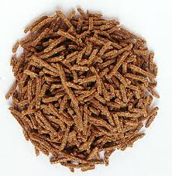
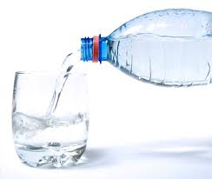
We also need…
Helps to clean your digestive system
Fibre
Needed for chemical reactions in your body
Water

Slide 16
Check your understanding!
Protein
Acts as an energy store
Vitamins & Minerals
Give us energy.
Help our bodies to grow.
Carbohydrates
Help your body to work and grow.
Fats & Oils
Help your body get better.

Slide 17
Think of something you ate last night – can you identify which food group it comes from?

Slide 18
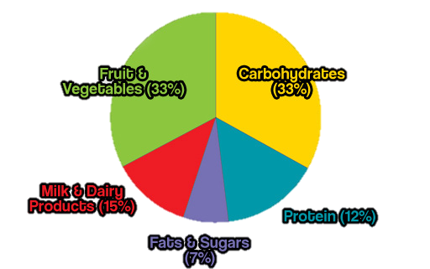
So how much should you eat?
The eatwell plate shows you how much of each food group you should eat each day…

Slide 19
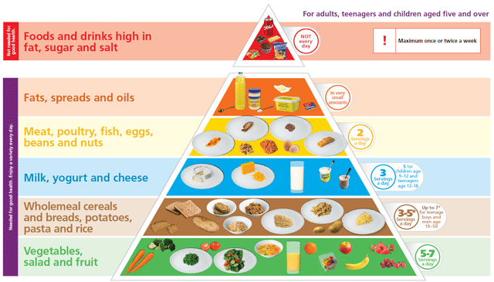

Slide 20
We can use the food pyramid to help us know how much of each food group we should be eating.
Which food group should we be eating the most from?
Why?
How do you know?
Which food group should we be eating the least from?
Why?
How do you know?

Slide 21

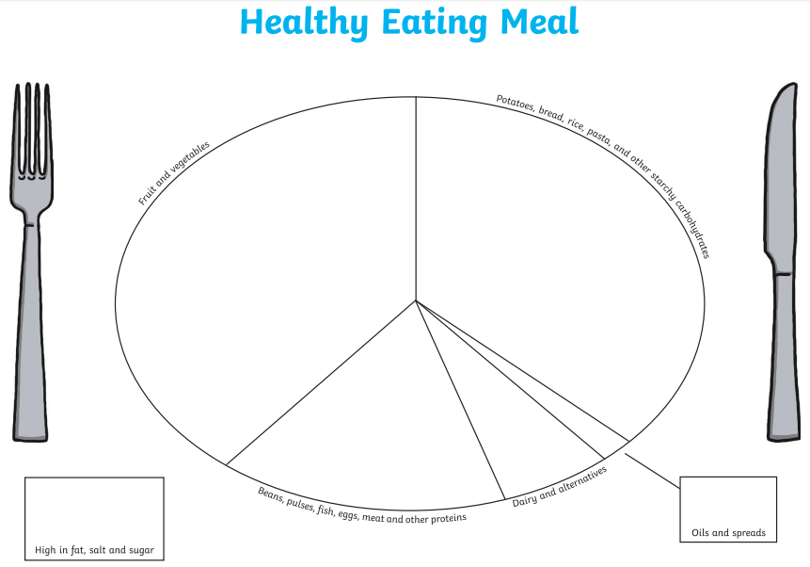
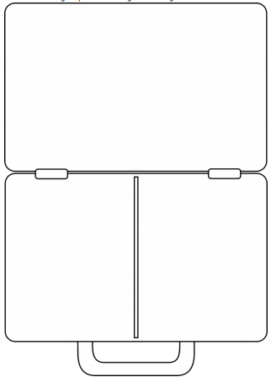
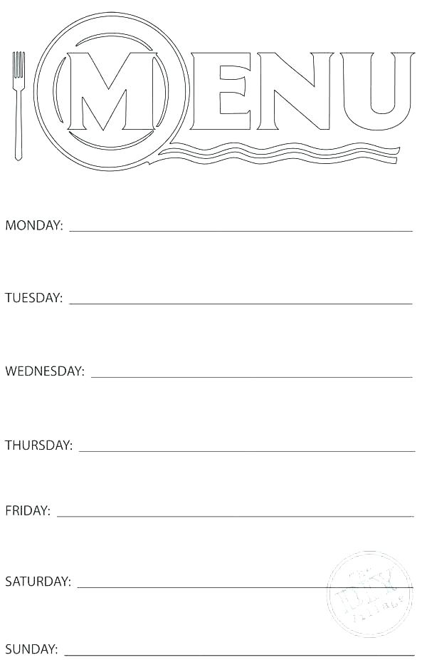
Paddling | Snorkelling | Diving
Sort the pictures of food into the different categories on the healthy eating plate. Red Pen: why do we need to eat different types of food? | Create a healthy packed lunch for Robin Hood – making sure you have created a balanced meal for him! Label the food groups. Red Pen: how do the different food groups help our bodies? | Create a healthy eating menu for Robin Hood and his merry men – making sure you create a balanced diet for them! Label the food groups. Red Pen: how do the different food groups help our bodies? What would happen if we didn’t eat one of the food groups?

