Slide 1
Monday 2nd November 2020
LO: to write with purpose.
C: Roman Gods

Slide 2
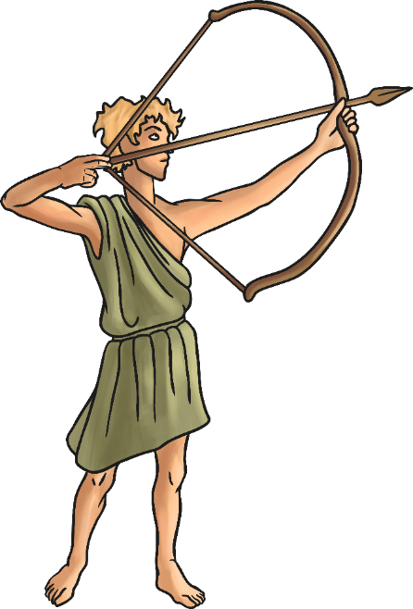
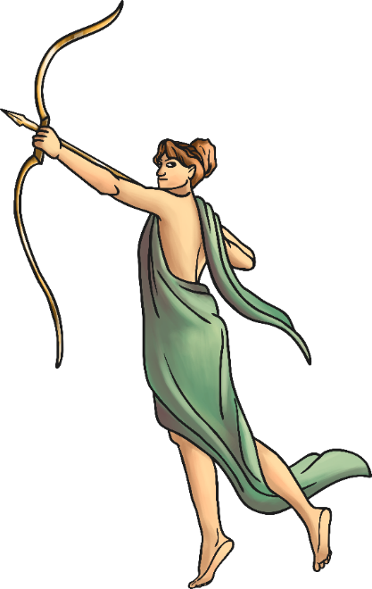
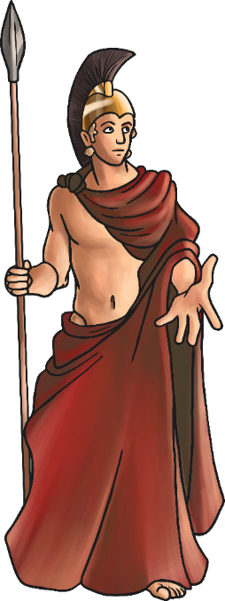
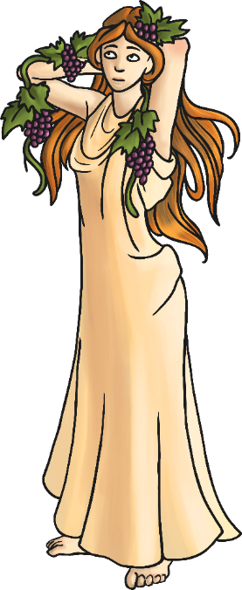
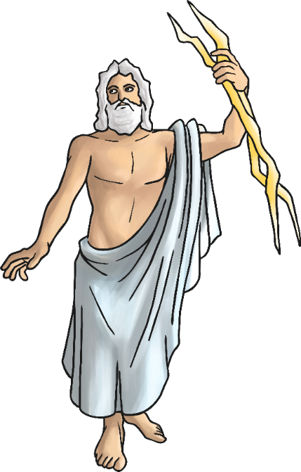
Roman Gods
The Romans believed in many different gods and goddesses.
These gods were like people, but with magical powers.
Each god or goddess looked after different people or things.
There were gods for just about everything.
The Romans even took on many of the gods of the people they conquered.
They especially liked the Greek gods.

Slide 3
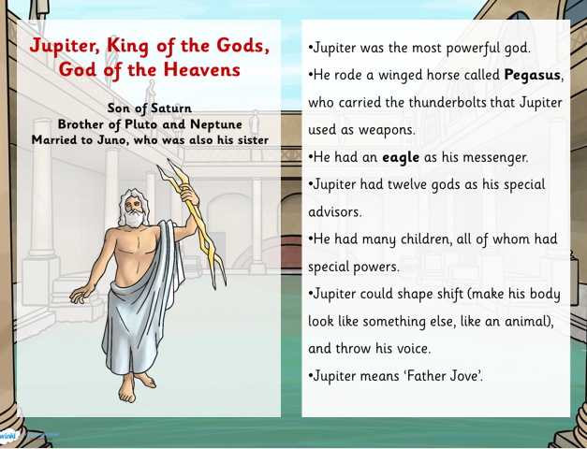
Read the Roman Gods fact sheet.
What have you learned about the different Roman Gods?
Think of some questions you would like to ask about Roman Gods.
What would you like to know or find out about?

Slide 4
Which Roman God is your favourite? Why?
What is the most interesting fact you have learned?

Slide 5
Tuesday 3rd November 2020
LO: to use imaginative description
C: Roman Gods

Slide 6
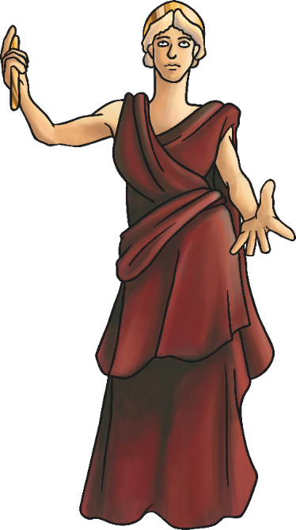
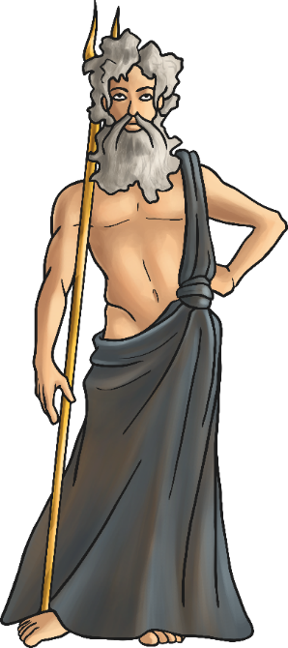
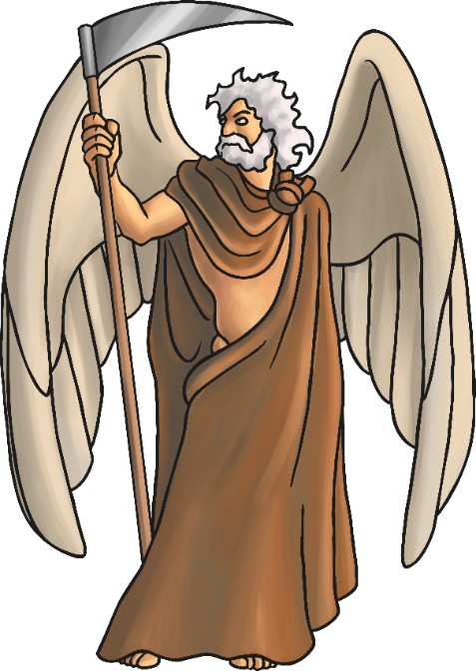
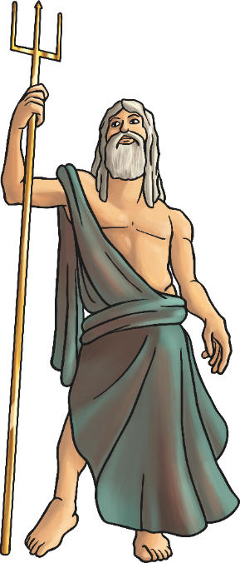
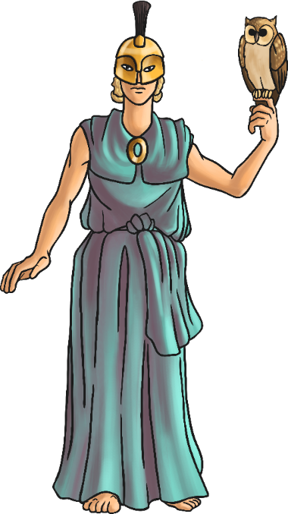
You are going to create your own Roman God today!

Slide 7


What features of the Roman Gods that we have already looked at did you find really interesting?
What features might your own God have?
You could create your own ideas or mix and match features of Roman God’s we
have already looked at.

Slide 8
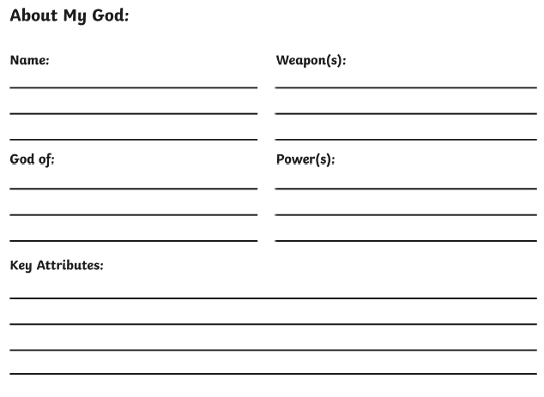
Activity:
Complete the sheet.
Red Pen Challenge: add adjectives to your sheet which describe your God’s weapon/powers/features etc.

Slide 9
Wednesday 4th November 2020
LO: To use imaginative description
C: Roman Gods

Slide 10


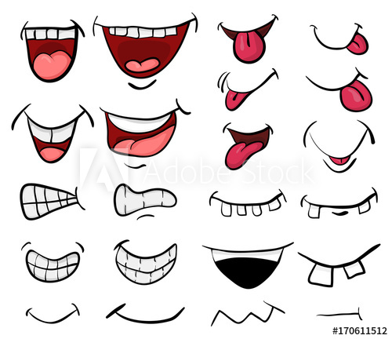
Starter: Character Descriptions
What adjectives could we use to describe:
Eyes
Hands
Mouth

Slide 11
Look back at your plan from last lesson.
What does your Roman God look like?

Slide 12
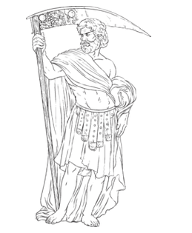
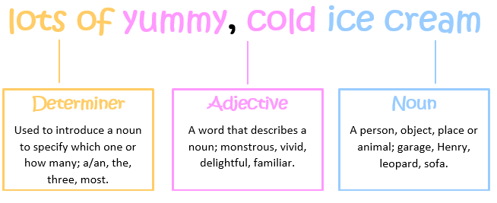
Activity:
Draw a picture of your Roman God and label it with expanded noun phrases.
Remember to:
- set it out as: ‘determiner adjective, adjective noun’
- use commas between the two adjectives.
Red Pen Challenge: use a thesaurus to improve your adjectives.

Slide 13
Thursday 5th November 2020
LO: To use sentences appropriately
To punctuate accurately.
C: Roman Gods

Slide 14
Starter: What a Difference
Here is a simple sentence: All the schools were closed.
Can you extend the sentence using any of the conjunctions below?
Even though | Unless | Because | Until
If | As soon as | Although | While
When | Before | After | As

Slide 15
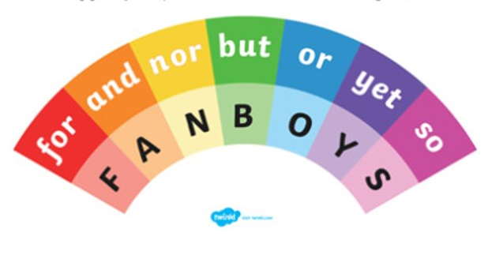
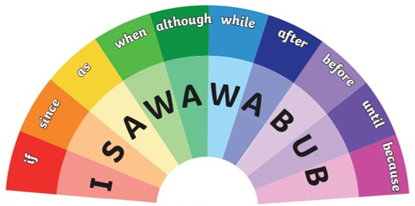
What can you remember about conjunctions?

Slide 16



Eddie – The God of Education
Eddie thoughtfully watches over resilient, hard-working children, as they learn in school. He has a bright, burning lightbulb above his head which lights up, when he has a brilliant idea! His bright, blue eyes glow with excitement, when he notices dedicated, focused children learning. He has large, elephant-like ears which stick out from his face, so he can hear everything. Although he tries to use his knowledge as power, he does carry a towering, sharp pencil which he uses as a deadly, frightening weapon. If anyone unkindly tries to stop children learning, he pokes them angrily with the sharpened, pointed tip. His chosen mode of transport is a comfortable, hovering brain. He likes to ride everywhere on it, since he does his best thinking on it!

Slide 17
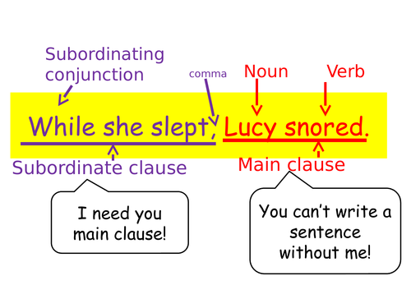
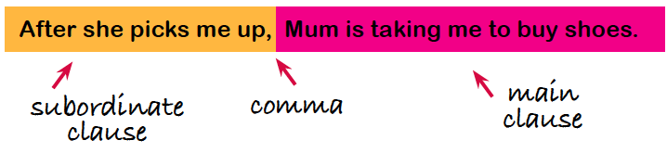
Diving
Can you remember how to use subordinating conjunctions at the start of a sentence?
Where should the comma go?

Slide 18
Activity:
Write a descriptive paragraph about your Roman God using expanded noun phrases and conjunctions.
Red Pen Challenge: start some of your sentences with a sub-ordinating conjunction.
Paddling | Snorkelling | Diving
expanded noun phrases + but, so, when, because, after | expanded noun phrases + but, so, yet, after/before, since, while | expanded noun phrases + so, yet, for, if, although, until

