Slide 1
Monday 21st September 2020
LO: to punctuate accurately

Slide 2

What does this word mean?

Slide 3
Punctuation is the name for marks used in writing. They are to help understanding and correct reading.
What examples of punctuation can you think of?

Slide 4
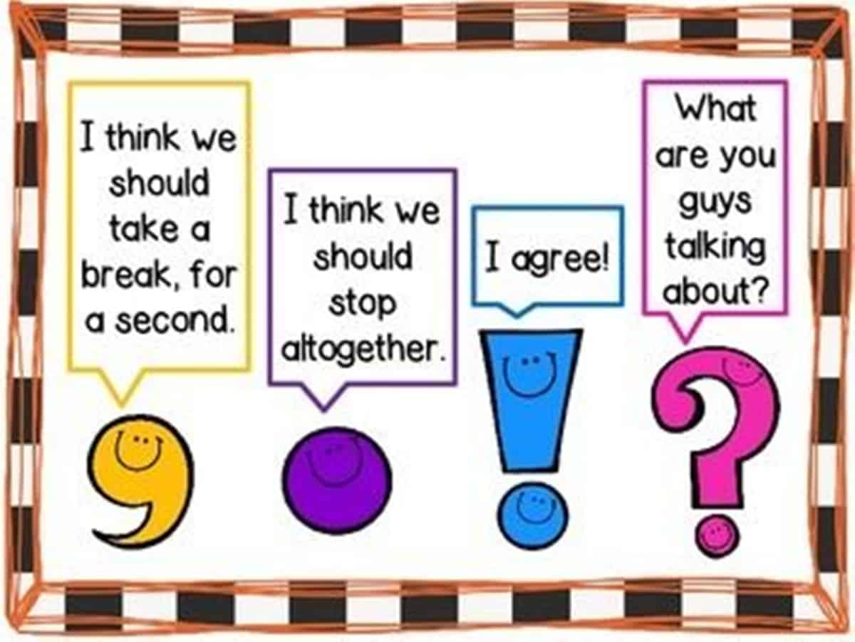

Slide 5
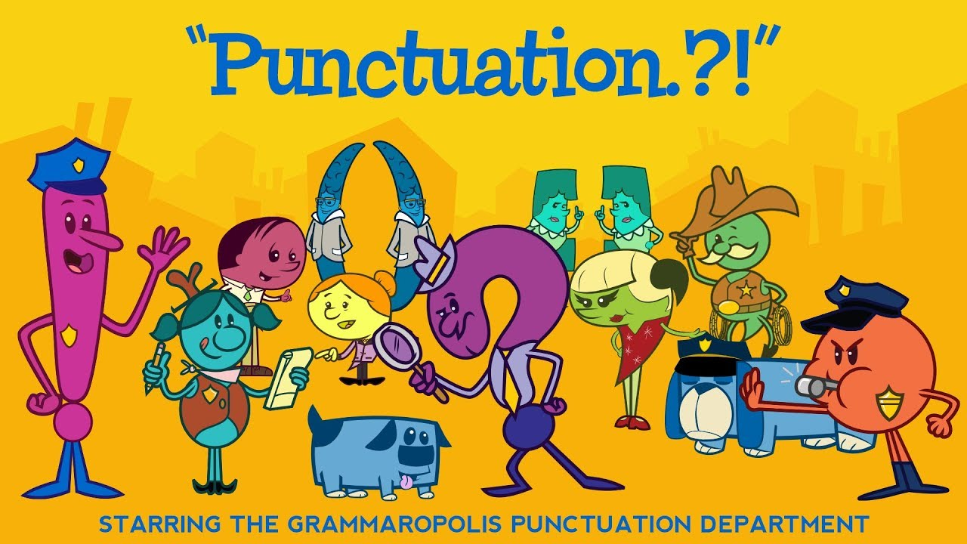
Watch: https://www.youtube.com/watch?v=9In5lUUCzAA

Slide 6
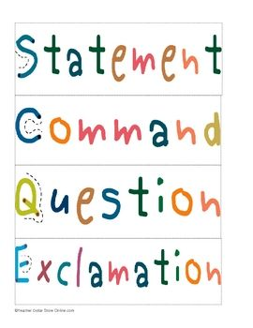
What these words mean?
What punctuation should we use with these sentence types?
Watch: https://www.youtube.com/watch?v=n_foMADqjSc&feature=youtu.be

Slide 7
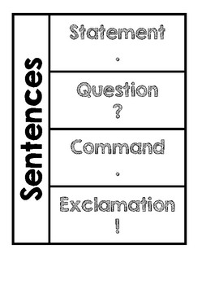

Slide 8
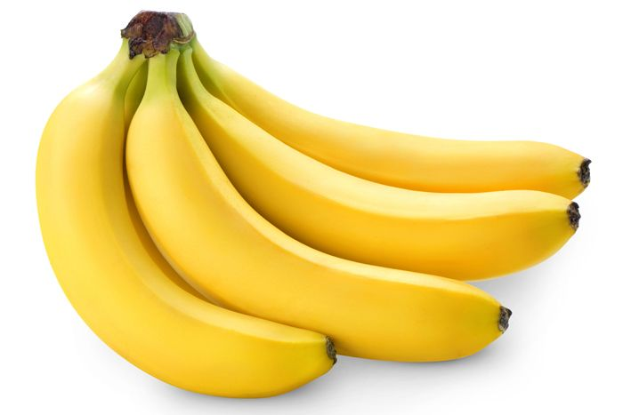
Activity
Select a topic, e.g. bananas.
Write four sentences, one for each type:
Statement – The monkey ate the bananas.
Question – Why do bananas curve like the moon?
Command – Peel the green banana.
Exclamation – The banana exploded!
Choose a topic and write four sentences, one for each type.
If there is time, choose another topic and write four more sentences!
Challenge: use expanded noun phrases in your sentences.
The excited, brown monkey greedily ate the ripe, yellow bananas while hanging upside down from a towering, leafy tree.

Slide 9
Tuesday 22nd September 2020
LO: to use the main features of a type of writing
C: The Heart and the Bottle

Slide 10
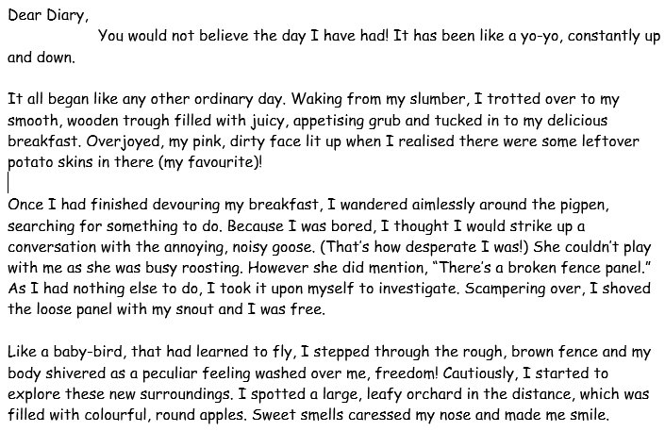

What do you think this piece of writing is?

Slide 11
What are the features of diaries?

Slide 12
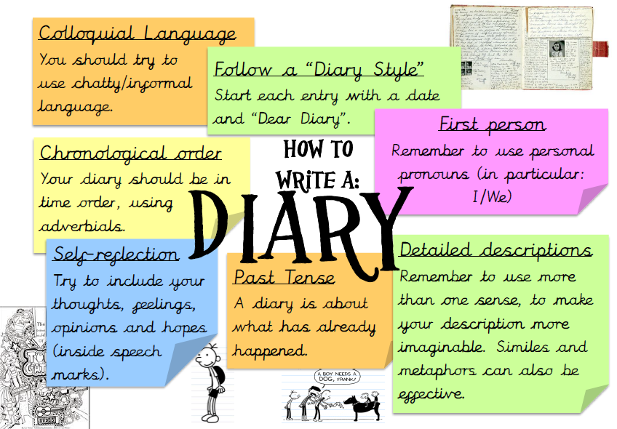

Slide 13
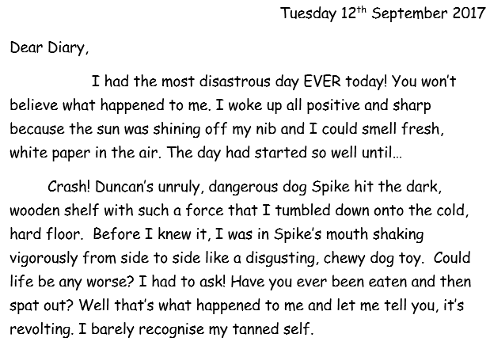

Do all of these diary entries have these features?
Are there any features we have forgotten to add to our list?

Slide 14
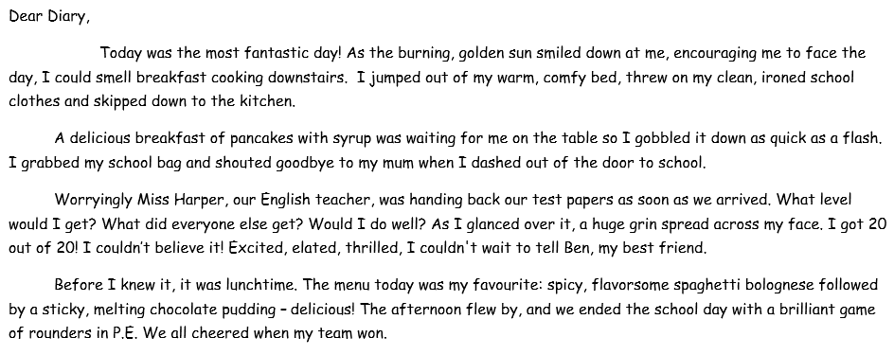

Do all of these diary entries have these features?
Are there any features we have forgotten to add to our list?

Slide 15
Wednesday 23rd September 2020
LO: to write with purpose
C: The Heart and the Bottle

Slide 16

This week we are going to write a diary entry pretending to be the girl or the man from the story The Heart and the Bottle.
Who can remember what happened in the story?
https://www.youtube.com/watch?v=8FSuy-J_Pzk

Slide 17
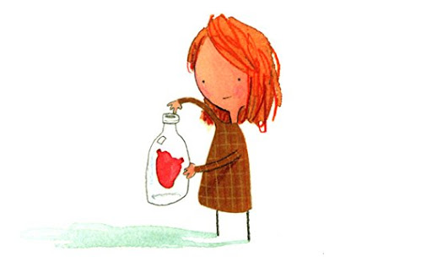
The girl’s point of view
Think about the story from the girl’s point of view:
What has she done/experienced?
What might she be thinking?
How might she be feeling?

Slide 18
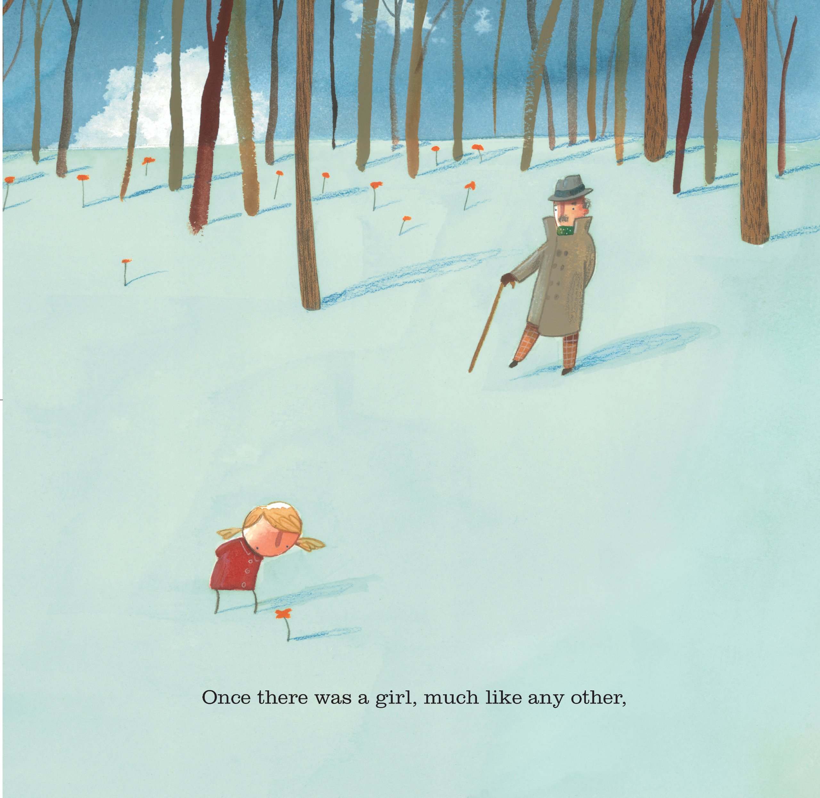
The man’s point of view
Think about the story from the man’s point of view:
What has the man done/experienced?
What might he be thinking?
How might he be feeling?

Slide 19
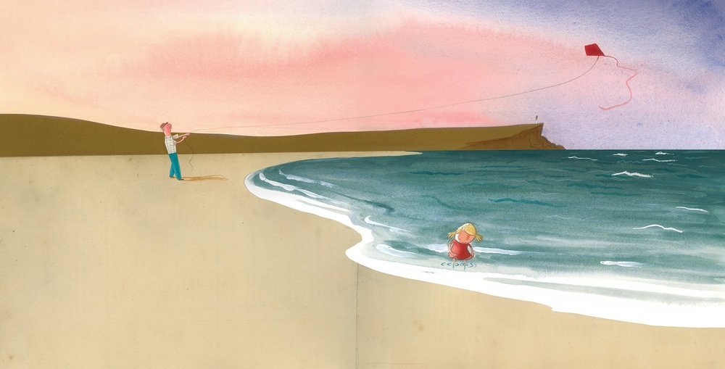
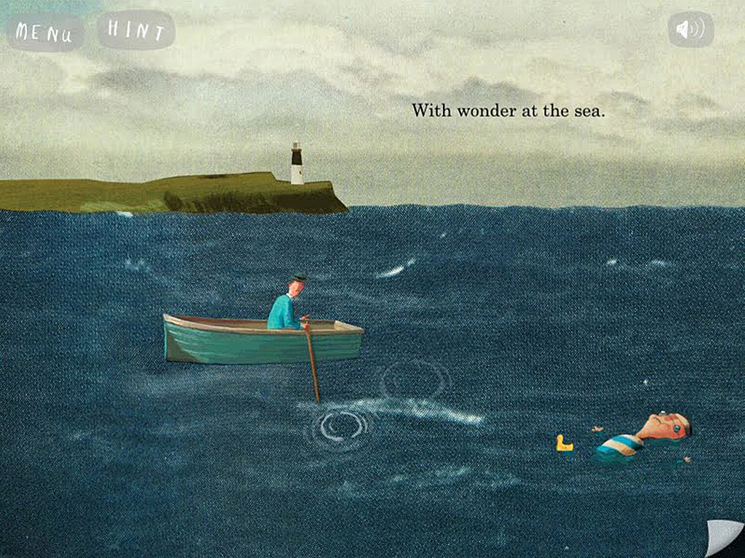
You can either write a diary entry about the whole story or choose a specific part of the story to write about, for example: when they went sailing on the sea/flying a kite on the beach etc.

Slide 20
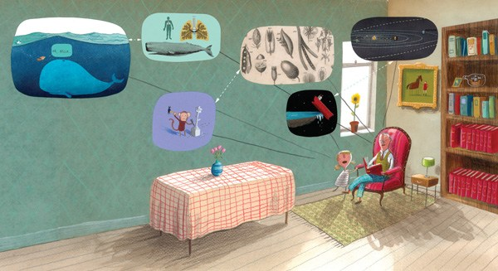
Let’s create a class plan together.
Who are we going to be writing as?
What is going to happen?
Describe the setting.
What is the character thinking?
What is the character feeling?

Slide 21

Activity:
Create your own plan of ideas for your diary entry by answering the questions below.
Who are you going to be writing as?
What is going to happen?
Describe the setting.
What is the character thinking?
What is the character feeling?

Slide 22
Thursday 24th September 2020
LO: to write with purpose
C: The Heart and the Bottle

Slide 23
Today you are going to be writing their diary entry about the story.
Look back at your plan from last lesson.

Slide 24
What features of diary entries can you see in my example?
What would you highlight in pink if you were the teacher marking it?
Dear diary,
I had the most incredible day with my kind, friendly grandad today! We bravely went sailing out to sea in a little, wooden boat. I couldn’t stop grinning broadly because I had never been in a boat before! As we sailed gently across the vast, blue ocean, frothy, white splashes of water hit our boat.
Bravely, I jumped out of the safe, striped boat into the cool, refreshing ocean! I could feel tiny, delicate fish nibbling on my pale, stumpy toes which made me giggle loudly. The cold, salty water gave me goose bumps so my thoughtful, caring grandad wrapped me up warmly in a large, fluffy towel.
After a while, I started to feel sea sick so we had to go back home! When we got back to my familiar, small house, I felt upset because our wonderful, fun-filled day had unfortunately come to an end.

Slide 25
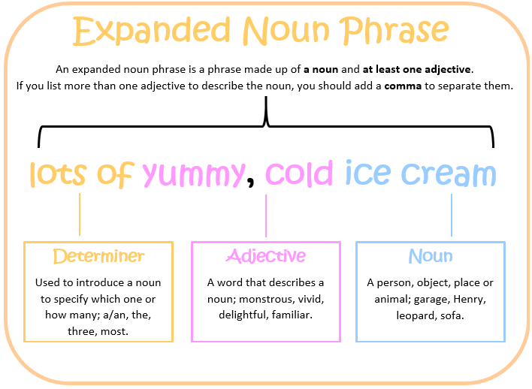
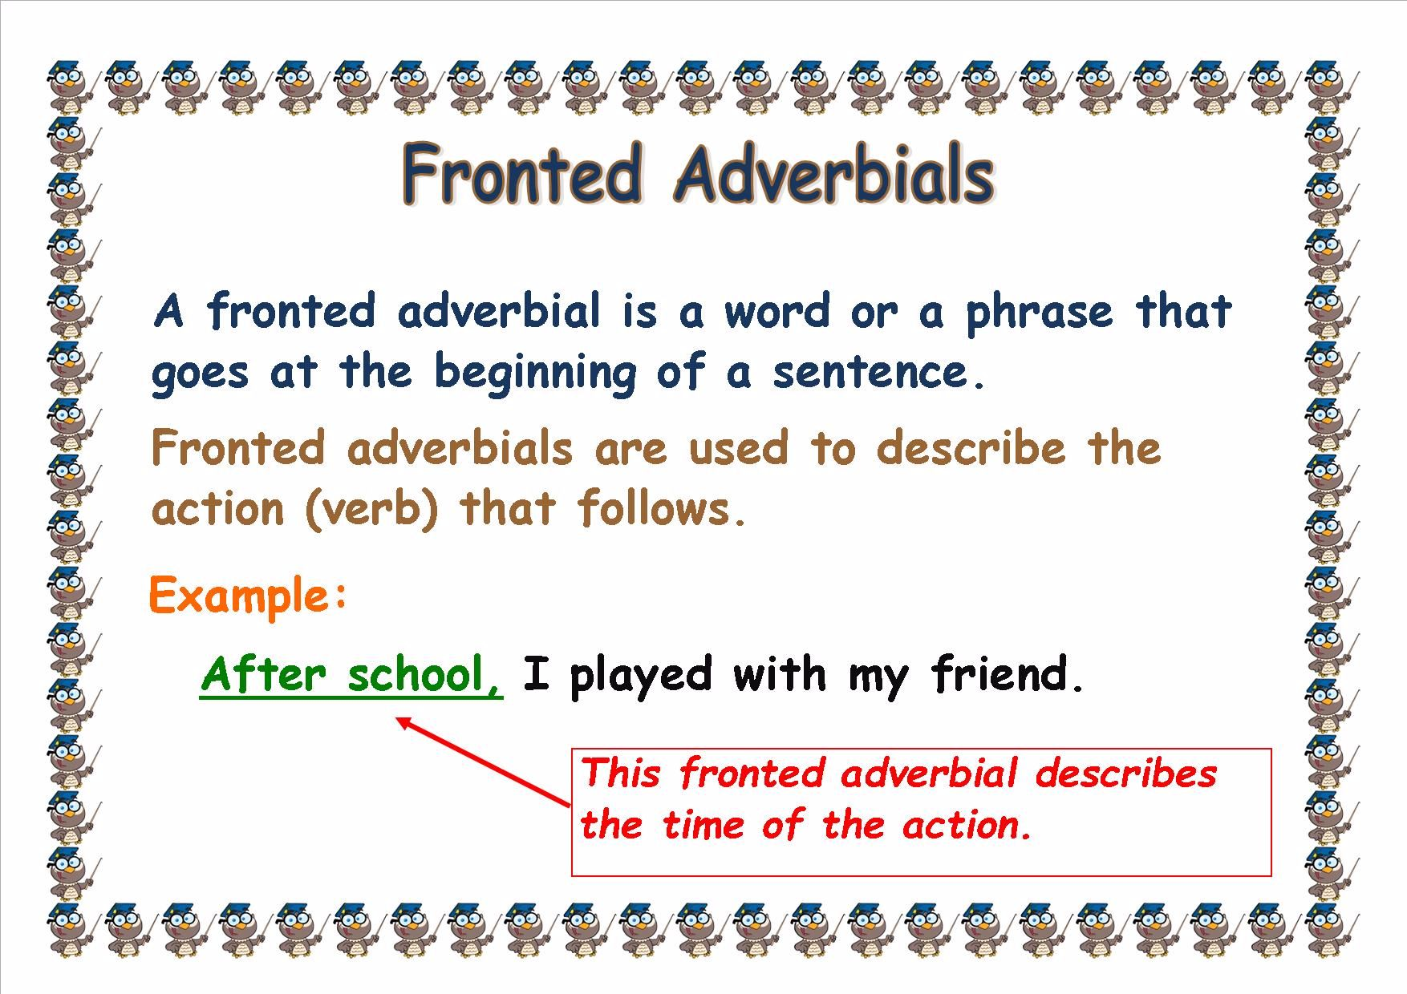
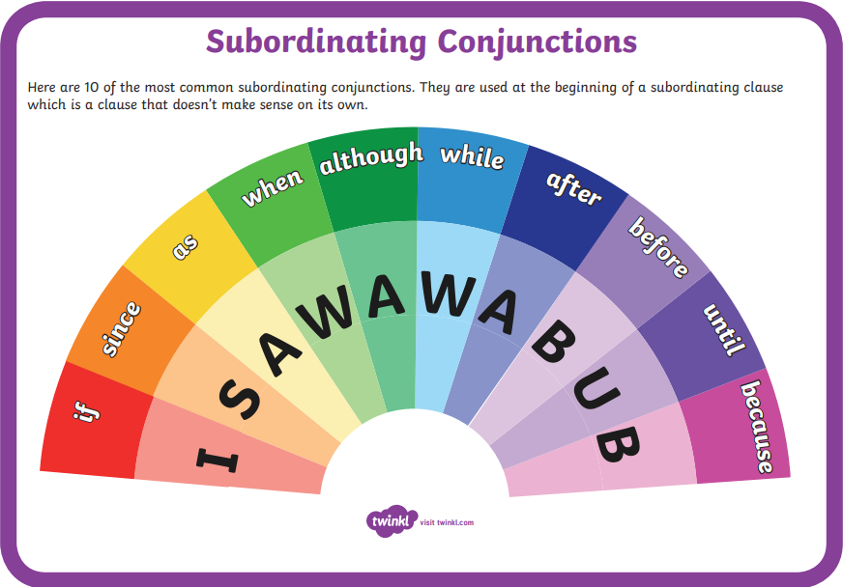
Let’s write the start of our class diary entry.
Try to use expanded noun phrases, conjunctions and fronted adverbials.
Make sure we are using the correct punctuation!

Slide 26
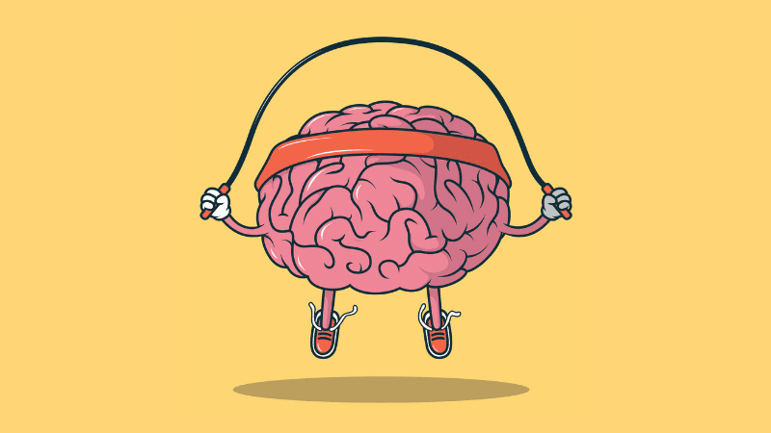
Activity:
Write your diary entry, using your plan to help you.
You have 30 minutes.
We will have a brain break after 15 minutes.

Slide 27
Friday 25th September 2020
LO: to write with purpose
C: The Heart and the Bottle

Slide 28

What am I looking for in your writing?

Slide 29
What am I looking for in your writing?
- correct punctuation
- sentences which make sense
- expanded noun phrases
- conjunctions
- fronted adverbials
- correct spelling

Slide 30

Read back over your work from last lesson.
Using the checklist, make any red pen edits that you can find in your work.
- correct punctuation
- sentences which make sense
- expanded noun phrases
- conjunctions
- fronted adverbials
- correct spelling

Slide 31
Read your partner’s work.
On post-it notes, write down any red pen edits your partner needs to do and stick the post-it note in their book.
Use the checklist to help you.
- correct punctuation
- sentences which make sense
- expanded noun phrases
- conjunctions
- fronted adverbials
- correct spelling

