Slide 1

Monday
Watch the video today up until the part where you pause for the 1st set of questions. Answer the questions on the PowerPoint for today.
https://vimeo.com/452198359

Slide 3

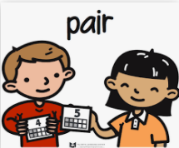
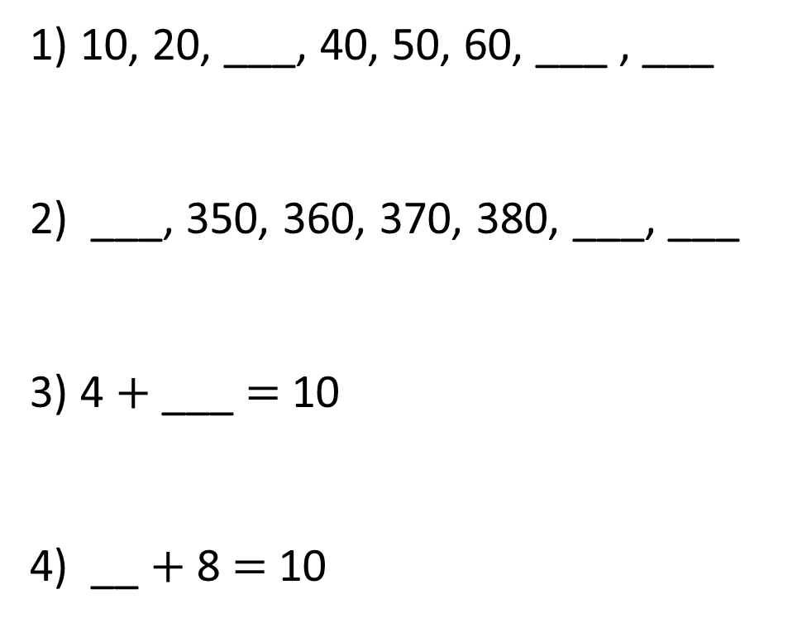
Let’s warm our brains!
1) 10, 20, ___, 40, 50, 60, ___ , ___
2) ___, 350, 360, 370, 380, ___, ___
3) 4 $+$ ___ $=$ 10
4) __ $+$ 8 $=$ 10

Slide 4
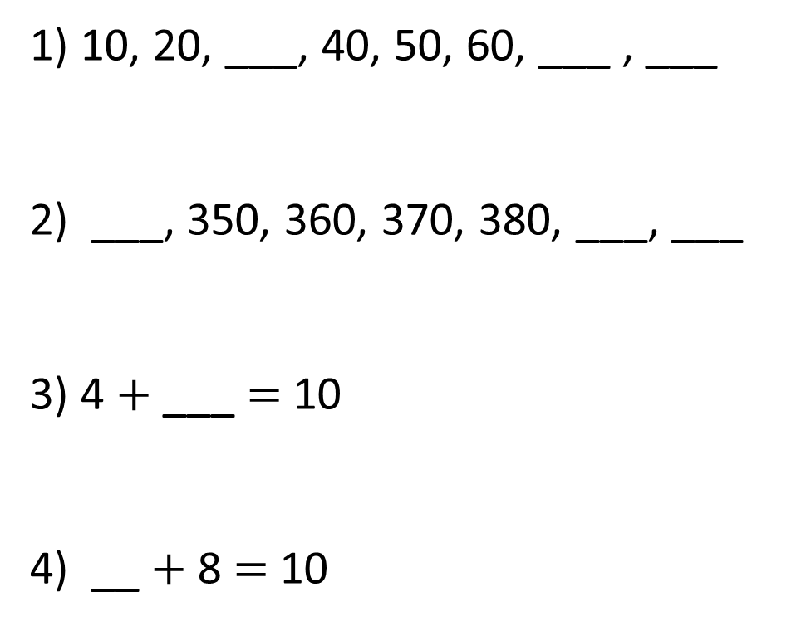
1) 10, 20, ___, 40, 50, 60, ___ , ___
2) ___, 350, 360, 370, 380, ___, ___
3) 4 $+$ ___ $=$ 10
4) __ $+$ 8 $=$ 10
30
70
80
340
390
400
6
2

Slide 6
Round 73 to the nearest 10
10
70
71
72
73
74
75
76
77
78
79
80
Things to think about:
- What two 10’s numbers does 73 sit between?
- What ‘interval’ is each line?

Slide 7
Round 73 to the nearest 10
3
7
70
71
72
73
74
75
76
77
78
79
80
73 is closer to 70 than 80
73 rounded to the nearest 10 is 70

Slide 8
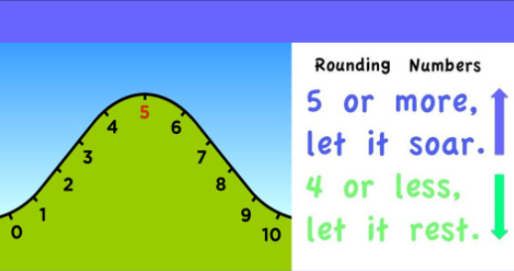
If the number ends in 1, 2, 3 or 4 we round down to the ten we just passed
If the number ends in 5, 6, 7, 8, or 9 we round up to the next 10.

Slide 9
Round 35 to the nearest 10
5
5
30
31
32
33
34
35
36
37
38
39
40
35 rounded to the nearest 10 is 40

Slide 10
Have a go at questions 1 & 2 on this PowerPoint.

Slide 11
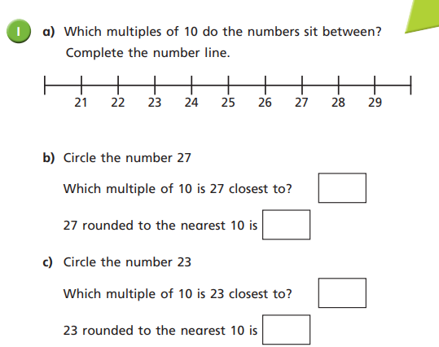
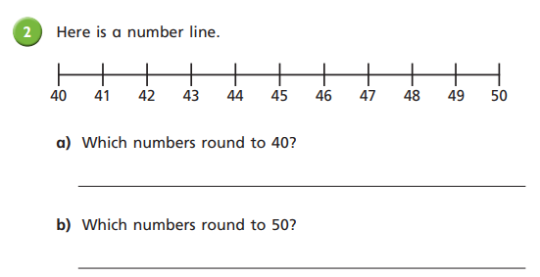

Slide 12
Tuesday
Re-watch the video today up until the part where you pause for the 1st set of questions. Answer the ‘task’ questions on the PowerPoint for today.
https://vimeo.com/452198359

Slide 14
Round 73 to the nearest 10
3
7
70
71
72
73
74
75
76
77
78
79
80
73 is closer to 70 than 80
73 rounded to the nearest 10 is 70

Slide 15
Round 78 to the nearest 10
8
2
70
71
72
73
74
75
76
77
78
79
80
78 is closer to 80 than 70
78 rounded to the nearest 10 is 80
Things to think about:
- What two 10’s numbers does 78 sit between?

Slide 16
Round 35 to the nearest 10
5
5
30
31
32
33
34
35
36
37
38
39
40
35 rounded to the nearest 10 is 40

Slide 17
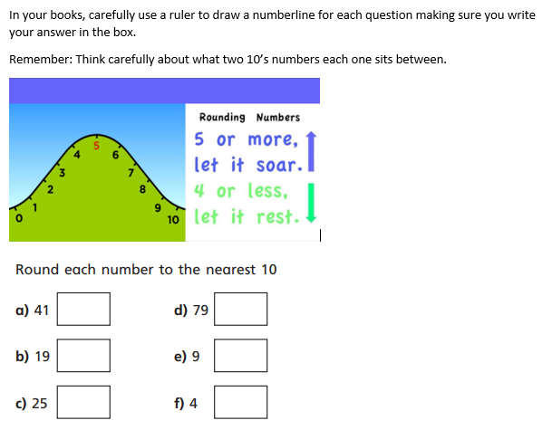
Task

Slide 18
Wednesday
Watch the second part of video today. Answer the questions on the PowerPoint for today.
https://vimeo.com/452198359

Slide 20
The same rules apply for rounding hundreds numbers to the nearest 10

Slide 21
Round 144 to the nearest 10
4
6
140
141
142
143
144
145
146
147
148
149
150
144 is closer to 140 than 150
144 rounded to the nearest 10 is 140

Slide 22
Which numbers round to 240 to the nearest 10?
235
236
237
238
239
240
241
242
243
244
245
5
6
7
8
9
1
2
3
4
What patterns do you notice when rounding to 10?

Slide 23
Let’s try rounding these numbers to the nearest
10 on the flip chart together…
173
128
356
745
** Teacher to model**
**Class discussion**

Slide 24
Have a go at questions 4 & 5

Slide 25
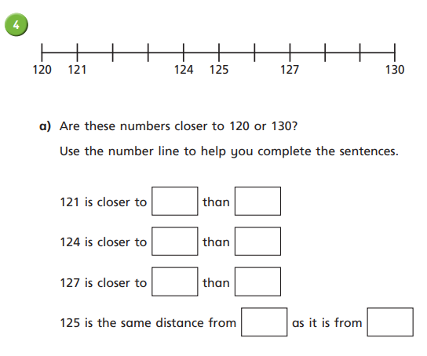

** Teacher to model answers**
**Class discussion**
Round these numbers to the nearest 10.
172
328
634

Slide 26
Thursday
Re- watch the second part of video today. Answer the ‘task’ questions on the PowerPoint for today.
https://vimeo.com/452198359

Slide 28
Remember, the same rules apply for rounding hundreds numbers to the nearest 10

Slide 29
Round 144 to the nearest 10
4
6
140
141
142
143
144
145
146
147
148
149
150
144 is closer to 140 than 150
144 rounded to the nearest 10 is 140

Slide 30
Which numbers round to 240 to the nearest 10?
235
236
237
238
239
240
241
242
243
244
245
5
6
7
8
9
1
2
3
4
What patterns do you notice when rounding to 10?

Slide 31
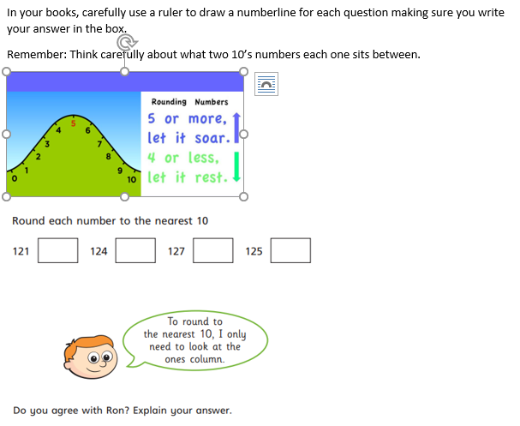

Slide 32
Friday

Slide 33
Round these numbers to the nearest 10
41
65
99
178
232
895

