Slide 1
Tuesday 23rd March 2021
L.O: To understand texts- vocabulary skills
C: Boy

Slide 2
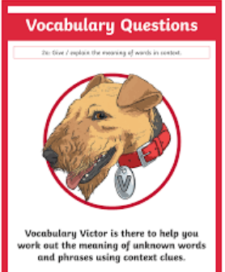
Today we are continuing to explore our new book! We are continuing to explore Roald’s time in Norway.
We are going to use our Vocabulary Victor skills to help us learn new words and how to apply them.

Slide 3
Starter: Game
Today we are going to learn lots of new words! Let’s start with this one…

Slide 4
Starter: Game
Toepoochers
“Oh no! I forgot to pack my toepoochers!”
What do you think toepoochers are? What word(s) can you see within the word? Could this word be a verb? A noun?

Slide 5
Starter: Game
Do you think this is a real word?
Toepoochers
“Oh no! I forgot to pack my toepoochers!”
What do you think toepoochers are? What word(s) can you see within the word? Could this word be a verb? A noun?

Slide 6
GAME TIME
Class read:
63-67
We are going to play a game to work out the meaning of the new vocabulary.
Benignly
Meteorologist
Raucous
Poach
Solemn
Tipsy

Slide 7
Benignly
“sitting in her rocking-chair, rocking away and smiling benignly”
A)angrily
B)swinging
C) harmlessly

Slide 8
Meteorologist
“he was an astrologer, a meteorologist and a speaker of ancient Greek”
A)someone who works with space
B)someone who works with the weather
C) someone who works with meat.

Slide 9
Raucous
“he [was]…totally overwhelmed… by the raucous rabble who were destroying his neat and polished home.”
A)noisy and troublesome
B)sneaky
C) fishermen

Slide 10
Poach
“the proper way to prepare fish like this is to poach it”
A)cook in liquid
B)burn
C) eat

Slide 11
Solemn
“It is a serious and solemn ceremony”
A)fun-packed
B)formal
C)large

Slide 12
Tipsy
“I always finished up as tipsy as a lord”
A)rich
B)tired
C)slightly drunk

Slide 13
Benignly
“sitting in her rocking-chair, rocking away and smiling benignly”
A)angrily
B)swinging
C) harmlessly

Slide 14
Meteorologist
“he was an astrologer, a meteorologist and a speaker of ancient Greek”
A)someone who works with space
B)someone who works with the weather
C) someone who works with meat.

Slide 15
Raucous
“he [was]…totally overwhelmed… by the raucous rabble who were destroying his neat and polished home.”
A)noisy and troublesome
B)sneaky
C) fishermen

Slide 16
Poach
“the proper way to prepare fish like this is to poach it”
A)cook in liquid
B)burn
C) eat

Slide 17
Solemn
“It is a serious and solemn ceremony”
A)fun-packed
B)formal
C)large

Slide 18
Tipsy
“I always finished up as tipsy as a lord”
A)rich
B)tired
C)slightly drunk

Slide 19

Red Pen Challenge:
:
Can you use one of the new words in a sentence?

