Slide 1
Part 1
LO: to describe the simple functions of the digestive system
C: Animals including humans

Slide 2
What did you learn about digestion last week?
https://www.bbc.co.uk/bitesize/clips/z7vygk7

Slide 3
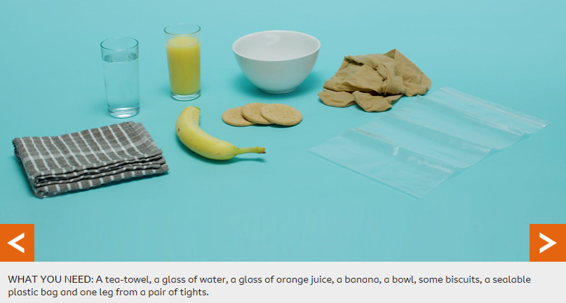
Watch: https://www.bbc.co.uk/bitesize/topics/zf339j6/articles/zrm48mn
Look through the pictures on the next slides – can you explain what is happening in each step?

Slide 4
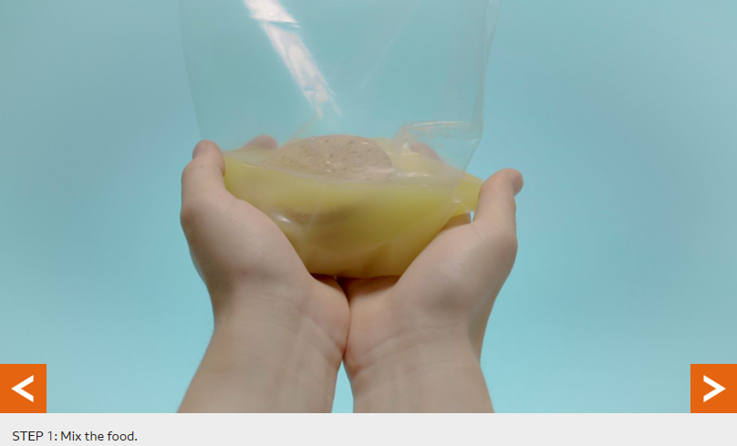

Slide 5
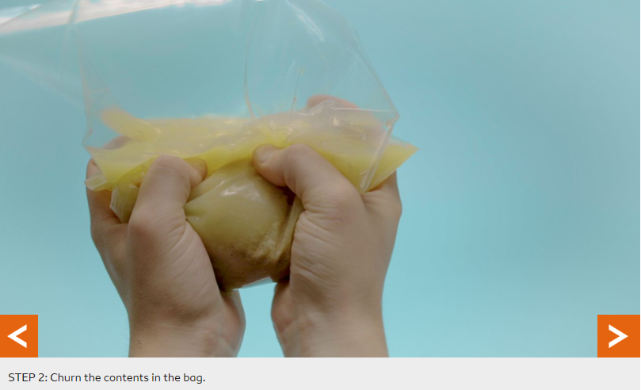

Slide 6
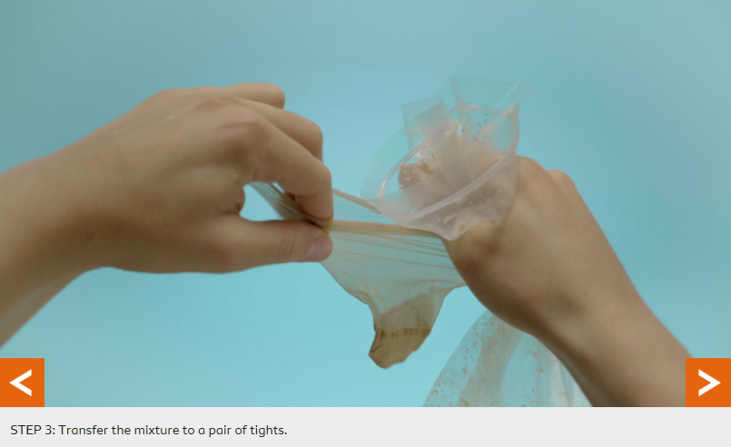

Slide 7
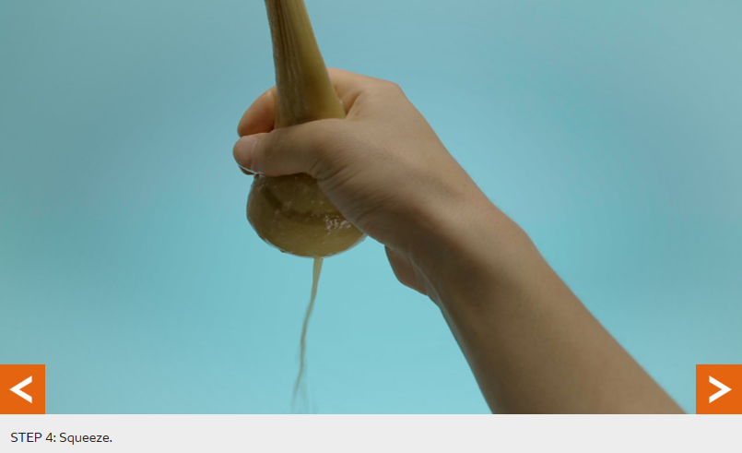

Slide 8
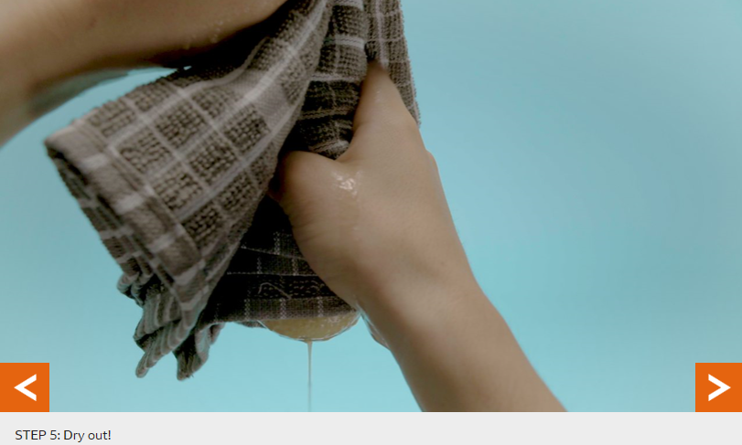

Slide 9
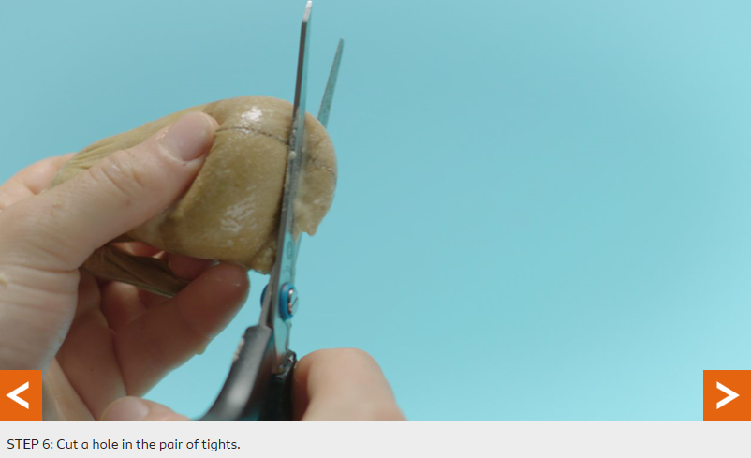

Slide 10
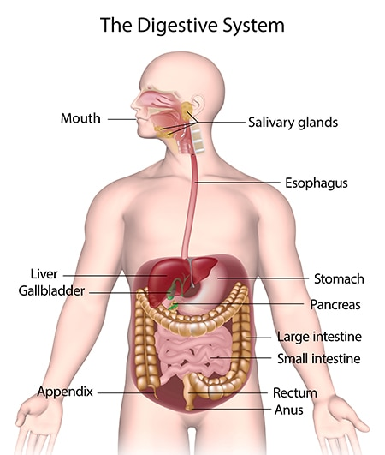
How does our body digest its food?
Red Pen: what would happen if we didn’t have one part of the digestive system? Explain your reasoning.

Slide 11
Part 2
LO: to describe the simple functions of the digestive system
C: Animals including humans

Slide 12
Can you explain what is happening in each picture?
Why does each part of the digestive system need to happen?

Slide 19

Paddling | Snorkelling | Diving
Match the photographs to the sentences about the digestive system. Red Pen: Why is digestion important? | Your pictures are in order. Write what is happening underneath each picture. Red Pen: What part of the digestive system is the most important? Explain your answer. | Your pictures are not in order. Order the photographs and write what is happening in each picture. Red Pen: How does breaking food up into smaller pieces aid digestion?

