Slide 1
Tuesday 23rd March 2021
L.O: To write with purpose.
C: Non-chronological reports

Slide 2
Just for a recap…
We are going to write our Non-Chronological Reports about our local area!
Today we are going to focus on how to write an introduction.

Slide 3
I have given you lots of different introductions of non-chronological reports.
What is the same? What is different?

Slide 4
A introduction of a Non-Chronological report gradually narrows down to help us get to the point of what we are writing about. A bit like setting the scene.

Slide 5
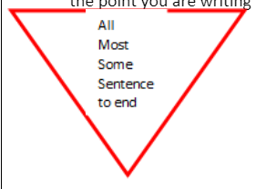
They follow the following pattern:
All/majority/lots of
Most/Many
Some/Few
One/A
Can you find this information in your knowledge organiser?

Slide 6
Let’s spot this structure in some examples:
Lots of people across the world like animals Many people enjoy seeing them in zoos. Some people even keep them as pets. One pet in particular that people like to keep is the common cat.

Slide 7
Let’s spot this structure in some examples:
All over the world children go to school. In most countries, children are able to wear their own clothes to school. However, in some countries, such as England, children wear a school uniform. In one school, Binfield Primary, children wear a red school uniform to school.

Slide 8
Can you spot the structure in one of the introductions in front of you?

Slide 9
Today, you are going to write your introduction about Binfield.
I will model writing an introduction about my home town!

Slide 10
Your Task:
Paddlers: to work with Teacher support to form a structured introduction using All…. Most…..Some… (Group write). Snorkellers: To write an introduction using the All…Most…Some… independently using the teacher’s model for support.
Divers: To use the All, Most, Some structure in a less prescriptive way. See Teacher’s model.

Slide 11

Red Pen Challenge:
We are going to BOOK on BOOK edit! Can you spot the ALL/MOST/SOME/ONE structure in your friend’s work?

