Slide 1
Friday 7th May 2021
L.O: To understand texts- comparison skills
C: Boy

Slide 2

Today we are going to learn about the headmaster at Repton!
We are going to use our comparison skills to help us compare the two headmasters!

Slide 3
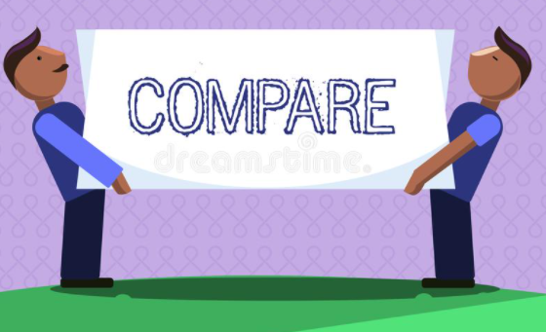
Starter:
Today we are going to exploring similarities and differences.
Can you begin by identifying similarities and differences between yourself and your partner?

Slide 4
Class Read
Class Read p.176-180
Whilst we are reading, think about the similarities and differences between the two headmasters.

Slide 5
Our task
Children to complete a Venn Diagram comparing the headmasters from St Peter’s and Repton.

Slide 6
Our task
Paddlers:
Complete your Venn Diagram with the Teacher.
Snorkellers:
Complete your Venn Diagram independently.
Divers:
Complete your Venn Diagram using evidence from the text.

Slide 7

Red Pen
Why do headmasters no longer act this way?

