Slide 1
Monday 14th December 2020
LO: to write with purpose.
C: Instructions

Slide 2
Instructions
What do you know about instructions?
Do you know how to write instructions?

Slide 3
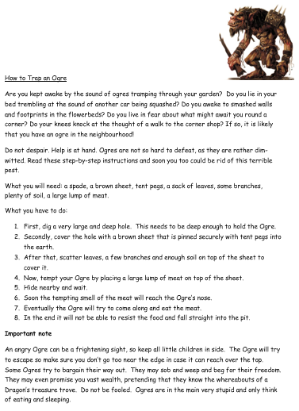
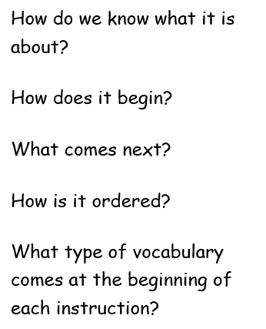

Slide 4

What are the features of writing instructions?

Slide 5
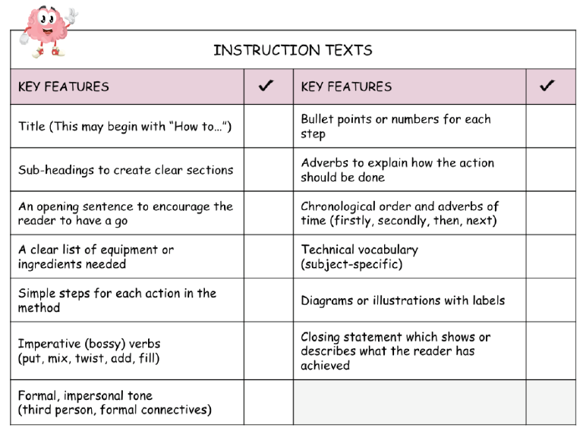

Slide 6
What did you notice about the instructions?
They all contain a verb.
An imperative (bossy) verb.
https://www.youtube.com/watch?v=oApd0goKJDM

Slide 7
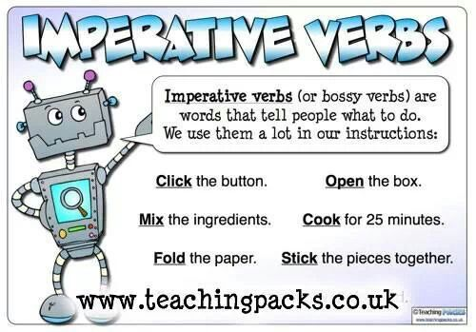

Slide 8
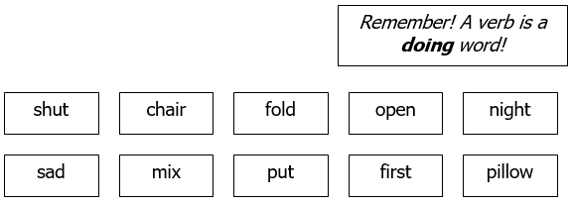
Activity
Activity 1: look at the words on the sheet – can you colour in the imperative verbs?
Activity 2: write sentences using the imperative verbs you have highlighted. Make sure you are writing in second person.
Red Pen: improve the instructions you have written using expanded noun phrases, conjunctions, time adverbials etc.
First, fold the fresh, clean clothes so they don’t become creased.

Slide 9
Tuesday 15th December 2020
LO: to write with purpose
C: Instructions

Slide 10
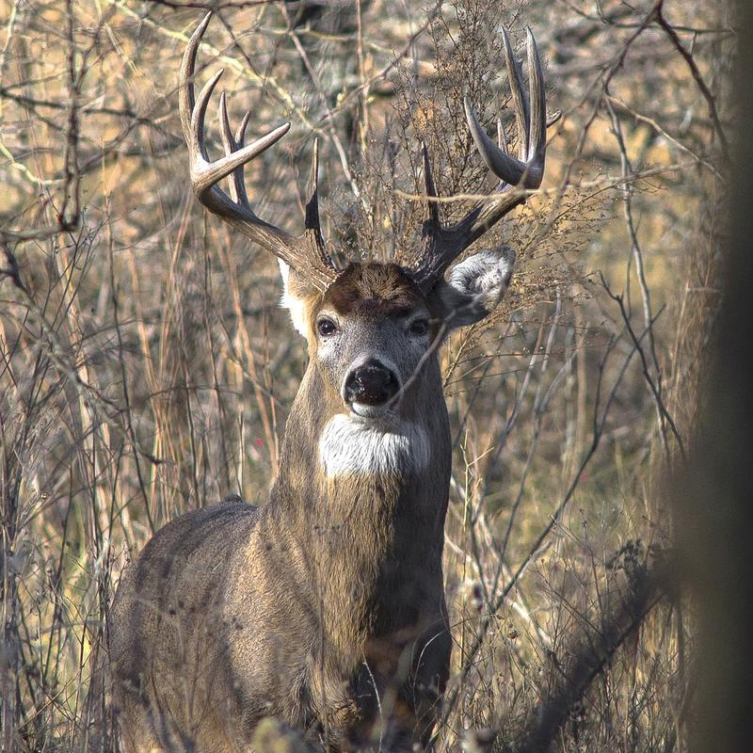
A reindeer has been spotted in the BOLE and Year 4 have been tasked with capturing it!
How could we capture the reindeer in the BOLE?
Create a bubble map of your ideas.

Slide 11
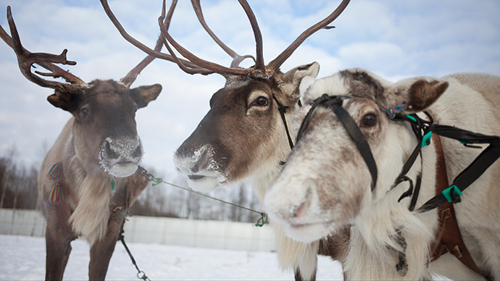
Choose ONE method for catching a reindeer.
Remember, you need to be clear about each step needed in the instructions.
Talk to an adult about your idea for catching a reindeer – does the adult understand what they have to do?
Write down your instructions on scrap paper as you talk to an adult to make sure you remember each step.

Slide 12

Today you are going to plan your instructions using this planning template:

Slide 13
For example:
Turn a large, deep container upside down.
Put a large lump of meat underneath the container
Prop it up with a sturdy, wooden stick.
Cover the container with leaves, soil and branches.

Slide 14

Paddling | Snorkelling | Diving
Plan your set of instructions for how to catch a reindeer. Red Pen: Annotate your plan with key words or phrases you would like to use in your writing, e.g. adjectives, time adverbials. | Plan your set of instructions for how to catch a reindeer. Red Pen: Annotate your plan with key words or phrases you would like to use in your writing, e.g. adjectives, time adverbials. | Plan a set of instructions for how to catch a reindeer. Red Pen: Annotate your plan with key words or phrases you would like to use in your writing, e.g. adjectives, time adverbials.

Slide 15
Wednesday 16th December 2020
LO: to write with purpose
C: Instructions

Slide 16
You are going to create your reindeer trap in the BOLE today!
Create your reindeer trap.
Share your instructions on how to catch the reindeer with an adult.
You must remember to use time adverbials, second person and imperative verbs in your verbal instructions.
Use the word mat for writing instructions to help you.

