Slide 1
PSHCE W.B 23.11.20

Slide 2
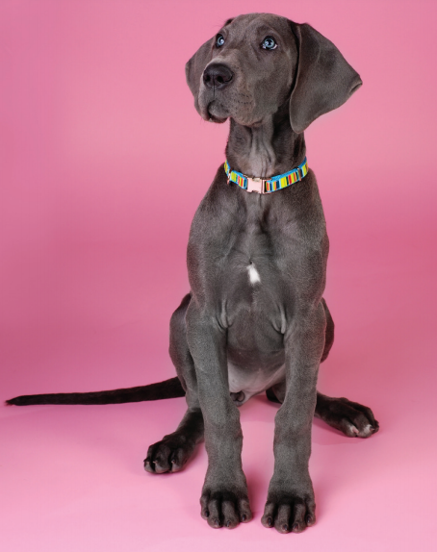
Write down 3 ideas on how you feel about this dog.

Slide 3
Write down 3 ideas on why you think you feel this way.

Slide 4
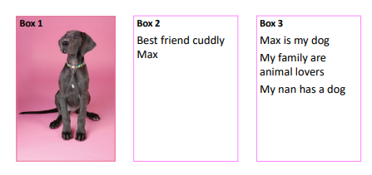
Fred wrote this about the dog…

Slide 5
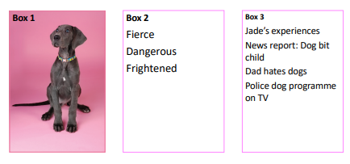
Jade wrote this:

Slide 6
We can see that both Max and Jade have had difference experiences with dogs and this has shaped how they feel about them.
This can often happen when we meet people for the first time. We may have different opinions of them because of our different experiences.

Slide 7
Repeat the same activity you did for the dog with the following examples:
Your favourite celebrity.
A person who lives on the streets.
Someone who has robbed a bank.
Your parents best friend.
How do you think your experiences have shaped your thoughts?

