Slide 1


Slide 2





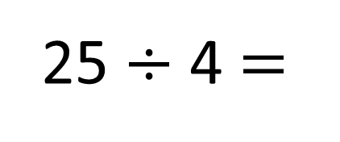
25 $÷$ 4 $=$
6 r 1
Have a think
$+$ 4
1
0
4
8
12
16
20
24
25
$−$ 4
0
1
5
9
13
17
21
25

Slide 4






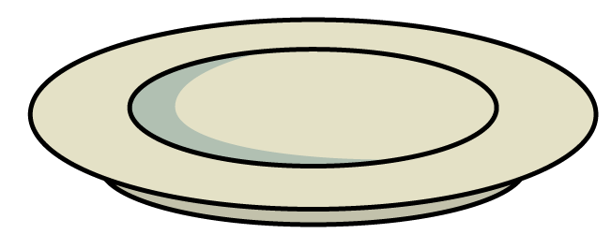
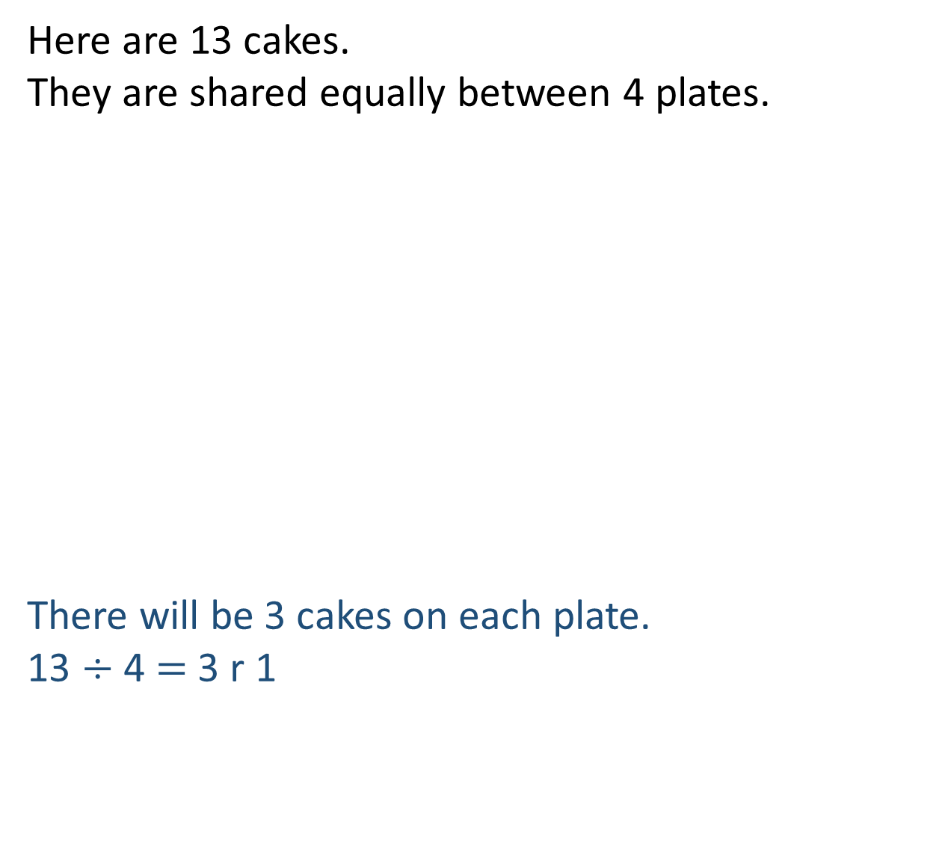
Here are 13 cakes.
They are shared equally between 4 plates.
There will be 3 cakes on each plate.
13 $÷$ 4 $=$ 3 r 1

Slide 5
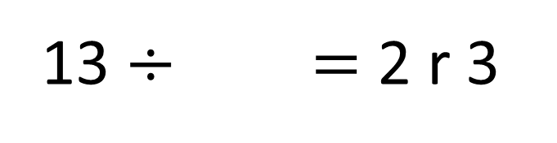
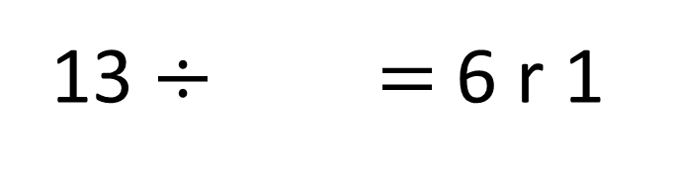
13 $÷$ $=$6 r 1
2
13 $÷$ $=$ 2 r 3
5
Have a think

Slide 6


73 ÷ 3 =
24
remainder 1
Tens | Ones

