Slide 1
LO: To identify that humans and some animals have skeletons for support, protection and movement.
C: Animals including humans

Slide 2
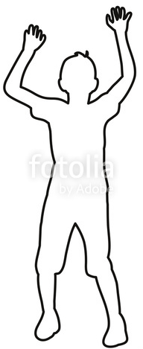
If you were going to create a new class member, what body parts would you need?
Where on the body would the body parts go?

Slide 3
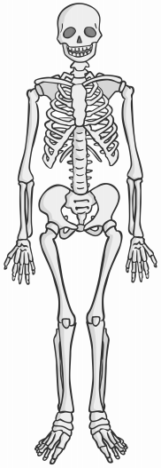
What is a skeleton?
A skeleton is made up of many bones.
Can you guess how many bones are in your body?
206!
What are bones like?
Bones are strong, light and rigid (they don’t bend)
Your skeleton is the rigid frame that holds your body up.

Slide 4
Why do we need a skeleton?
If we didn’t have a skeleton, you would be like this glove puppet – just a soft heap on the floor.
But with something rigid inside, it can hold itself up!
https://www.youtube.com/watch?v=e54m6XOpRgU

Slide 5
What else does our skeleton allow us to do?
Not only does our skeleton give us a shape, it always allows us to move.
Our skeleton is made up of many separate bones so that we can bend.
Imagine life with a back bone which was rigid rather than our backbone which is made up of many smaller joints which are held together but allow us to touch our toes!

Slide 6
What else does our skeleton allow us to do?
Skeletons also protect our bodies.
Look at our paper pupil – look at the soft organs it has.
These vital organs need to be protected!
Your skull protects your brain with a covering of hard bone.
Feel your rib cage - this protects your lungs and heart but has enough flexibility to rise and fall as we breathe.

Slide 7
Can you name the parts of the body?
Skull
Clavicle
Scapula
Ribcage
Humerus
Spine
Radius & Ulna
Pelvis
Carpels
Femur
Patella
Tibia and Fibula
Tarsels

Slide 8
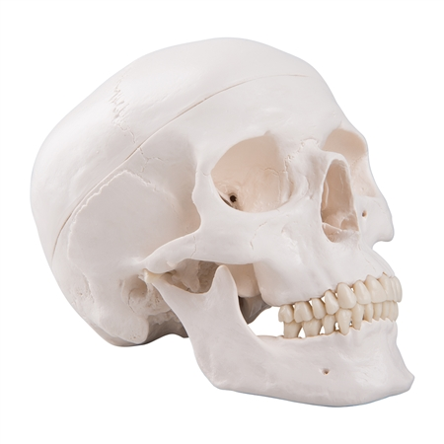
The skull
Skull
There are 29 bones altogether in the skull and jaw. Together, they protect the brain, eyes and ears.

Slide 9
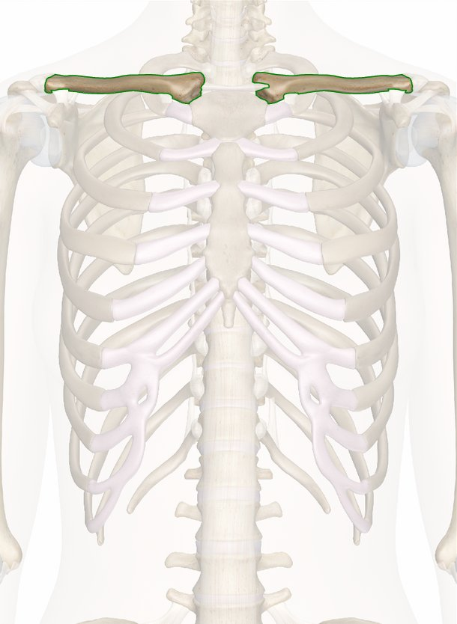
The clavicle
Clavicle
This is the collar bone, and joins the sternum (part of the chest) to the shoulder. They support the arms and transfer force from arms into the central skeleton.

Slide 10
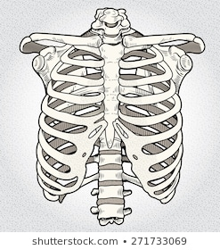
The ribcage
Ribcage
This protects the heart and lungs and other upper organs. There are 24 curved bones, and the sternum runs down the middle.

Slide 11
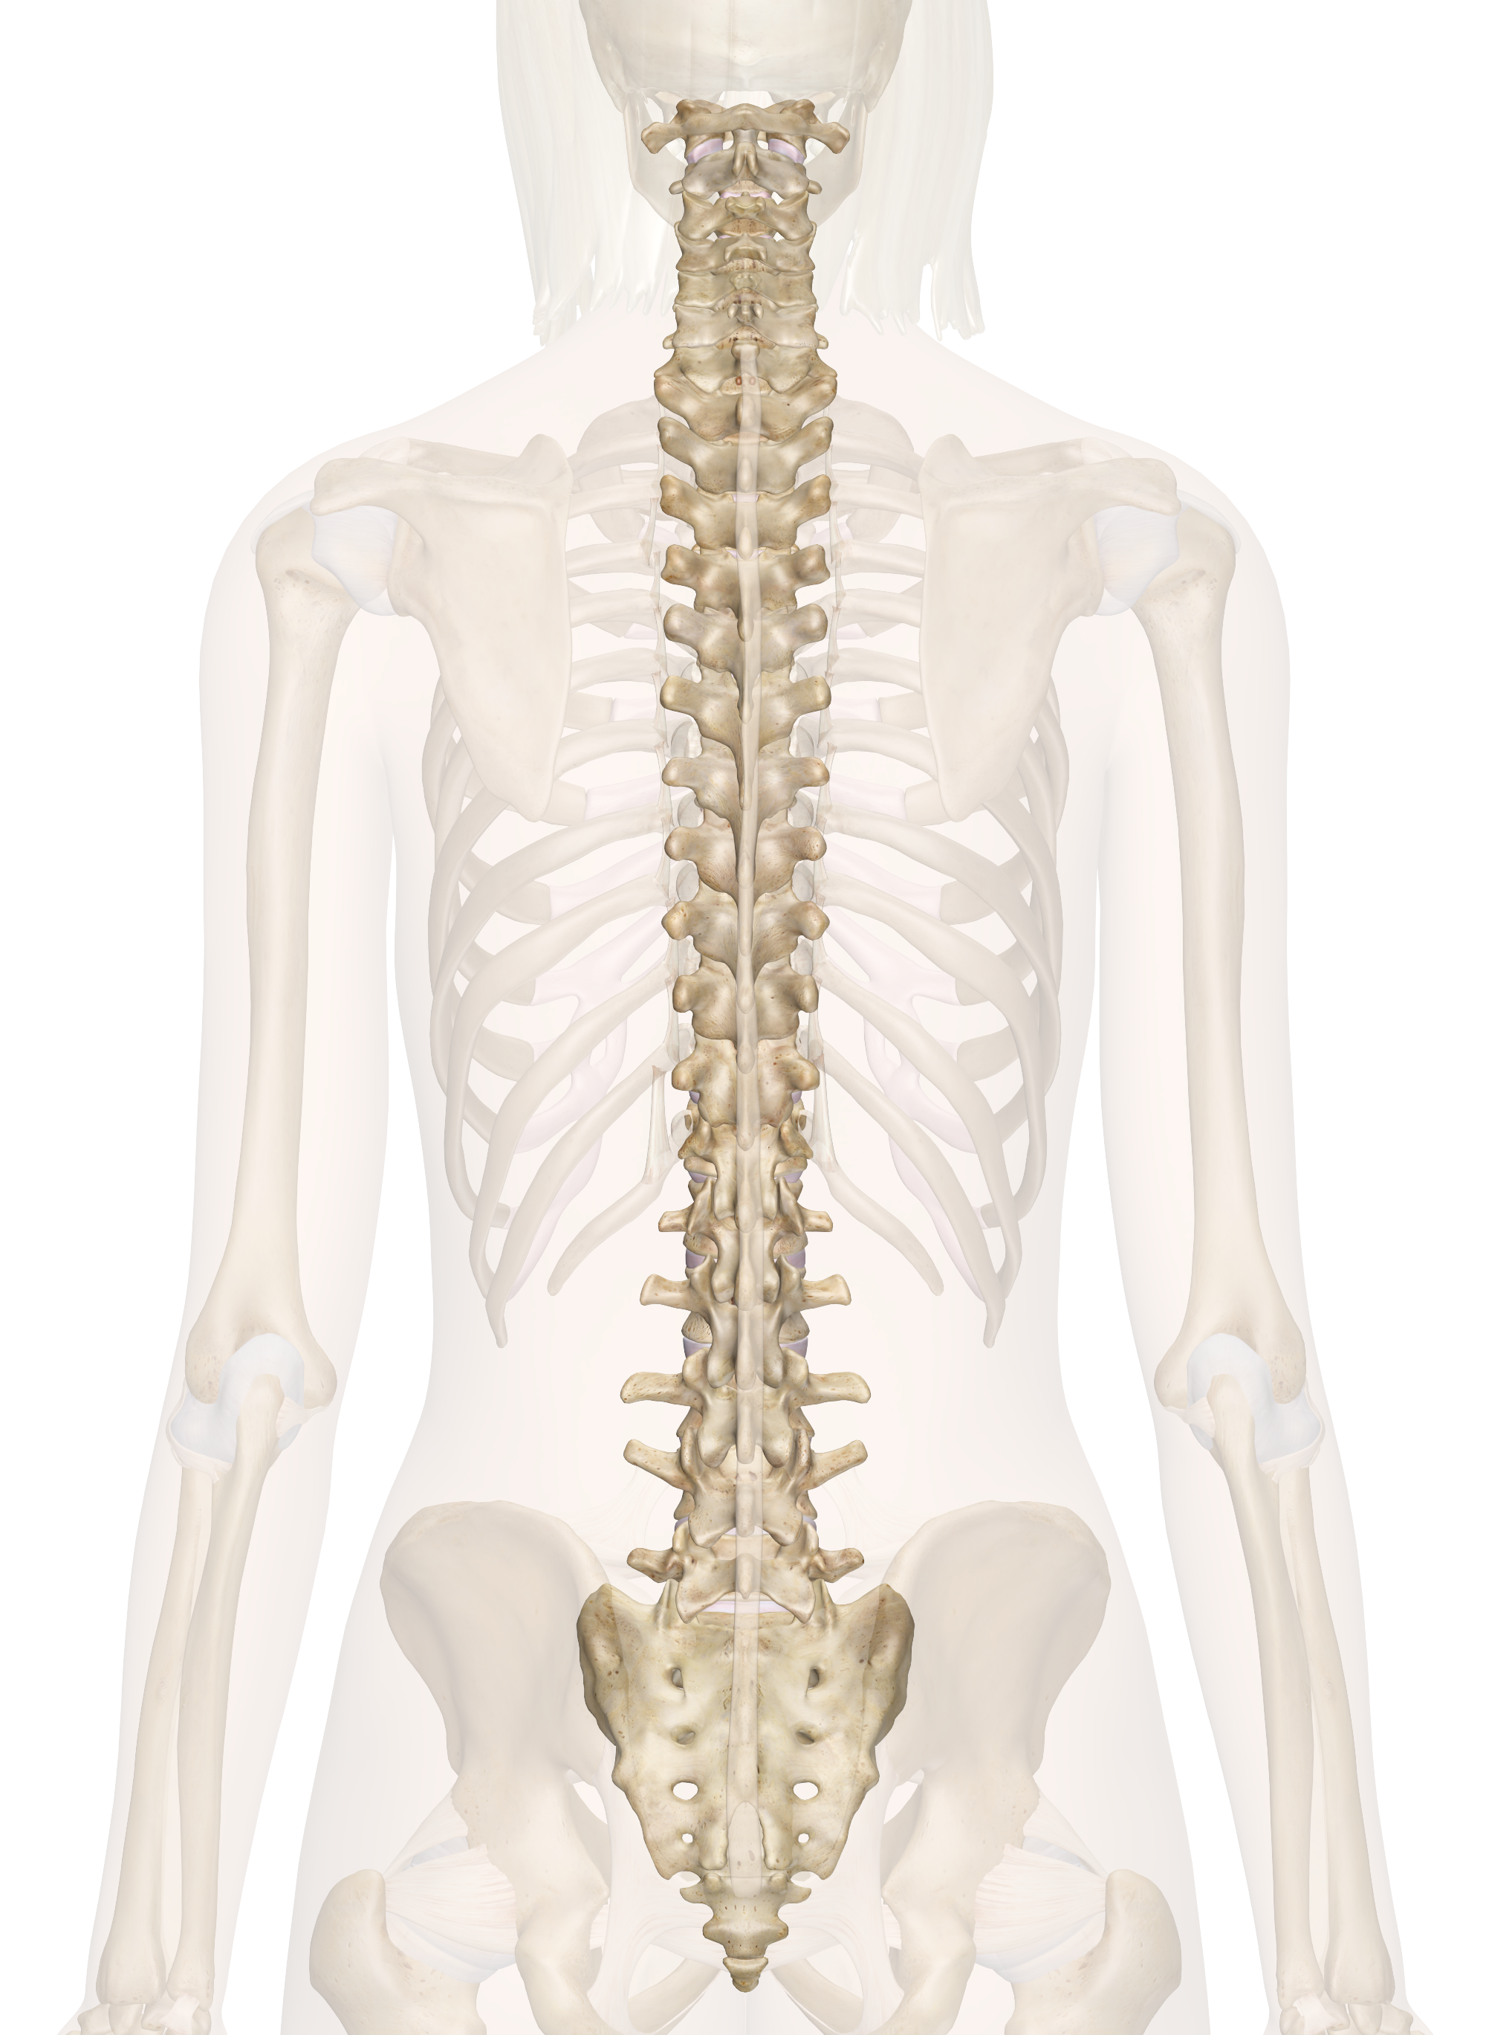
The spine
Spine
It is made up of 24 individual small bones (called vertebrae). Your spine supports your head and body. Each of the bones are linked by small joints which can move a little. Lots of small movements add up and let your spine bend a lot.

Slide 12
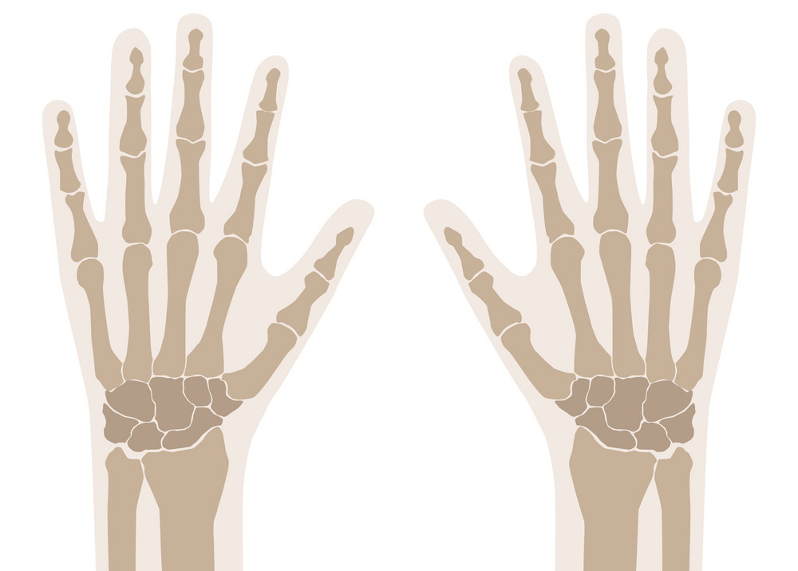
The hand bones
Hand bones
There are lots of bones in your hands. There are bones in your wrist (carpals), palms (metacarpals) and fingers (phalanges).

Slide 13
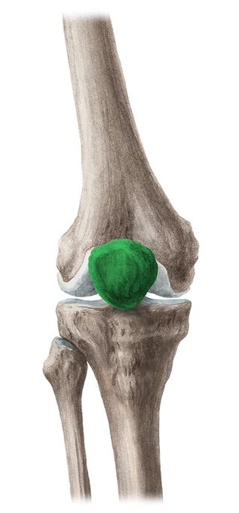
Patella
Patella
This is the bone in your kneecap. It is triangular shaped bone at the front of your knee joint. This protects the knee joint.

Slide 14
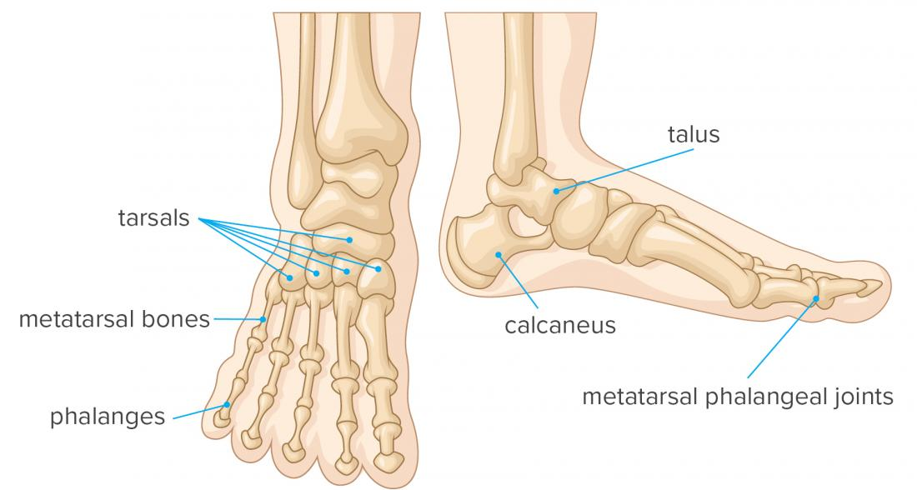
Foot bones
Foot bones
There are 26 bones in your foot. They can make an arch shape to support your body when you stand up.

Slide 15
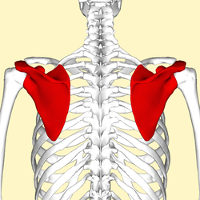
Scapula
Scapula
This is also known as the shoulder blade. It is a flat triangular bone that lies over the back of upper ribs. Helps with the movement of the arm and shoulder.

Slide 16
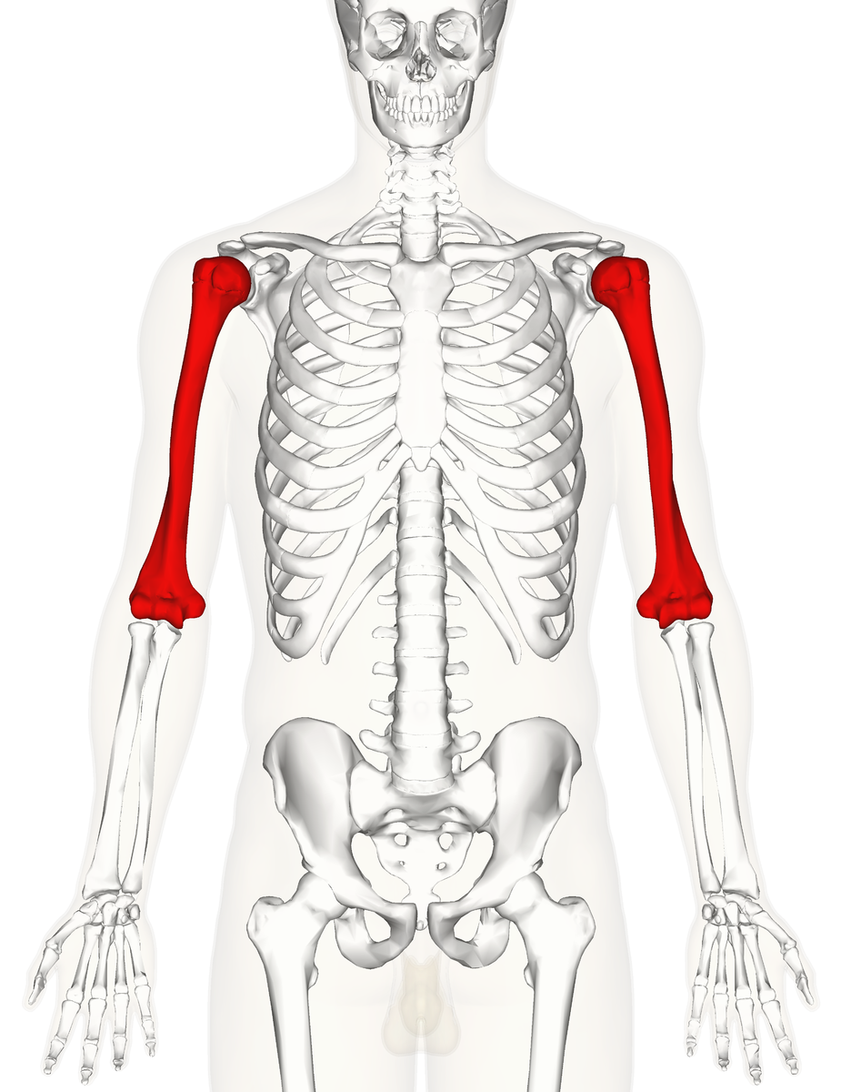
Humerus
Humerus
This is the bone in your upper arm. It is a long bone and goes between your shoulder and elbow joints.

Slide 17
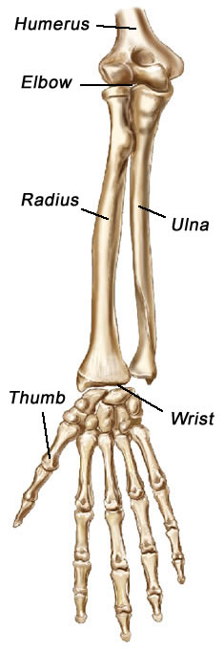
Radius and Ulna
Radius and Ulna
These are the bones in your lower arm. The radius is on the thumb side of your arm. The two bones swivel over each other when you twist your wrist.

Slide 18
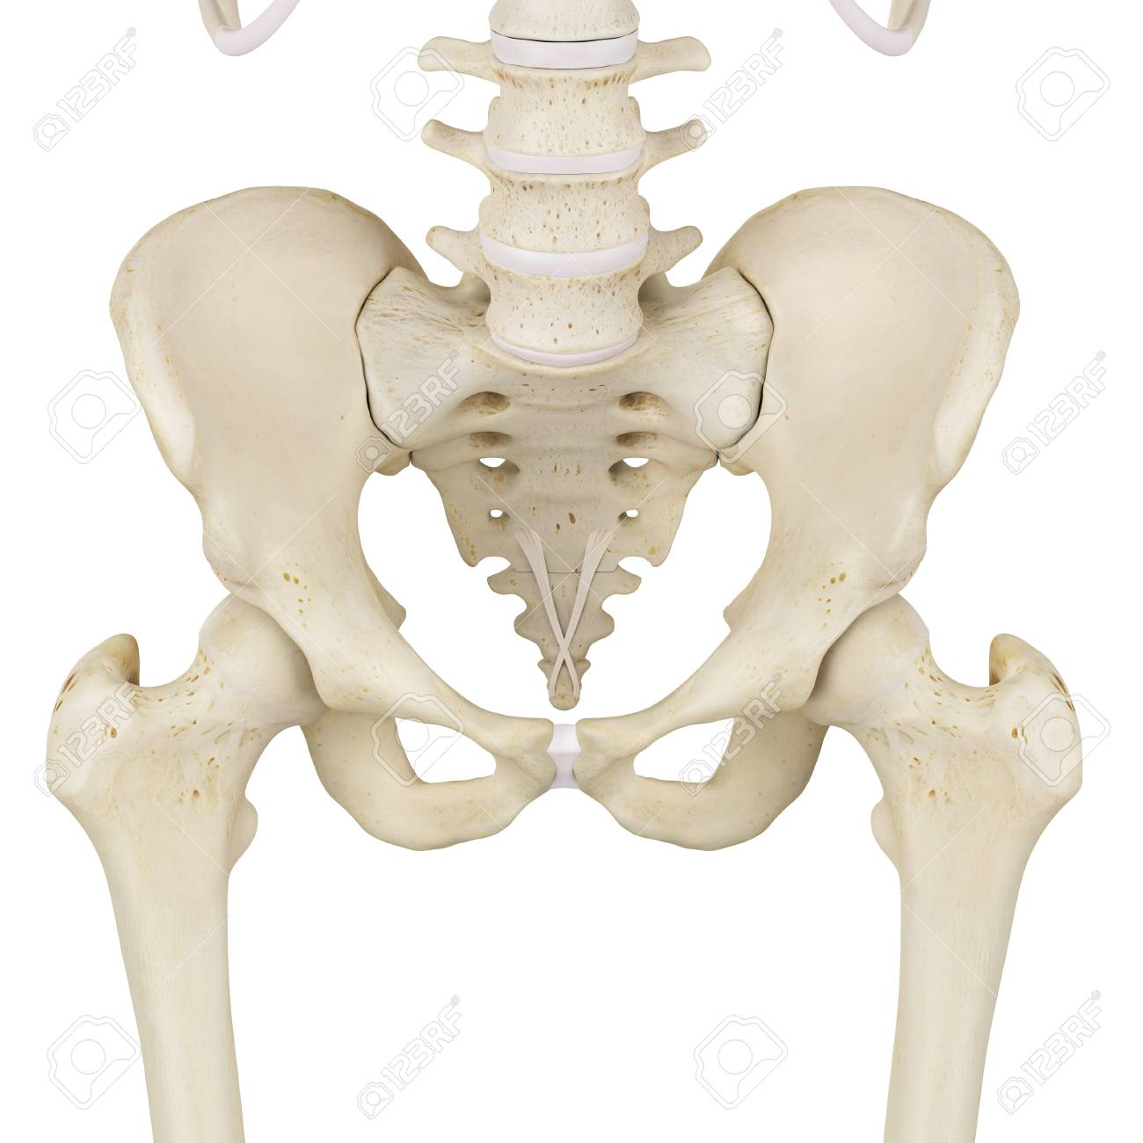
Pelvis
Pelvis
Your pelvis is shaped like a bowl. It holds all of the organs in the lower part of the body. It is a slightly moveable joint.

Slide 19
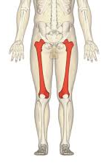
Femur
Femur
This is the thigh bone. It is the longest bone in the body and is one of the strongest. It helps to support your weight when you stand.

Slide 20
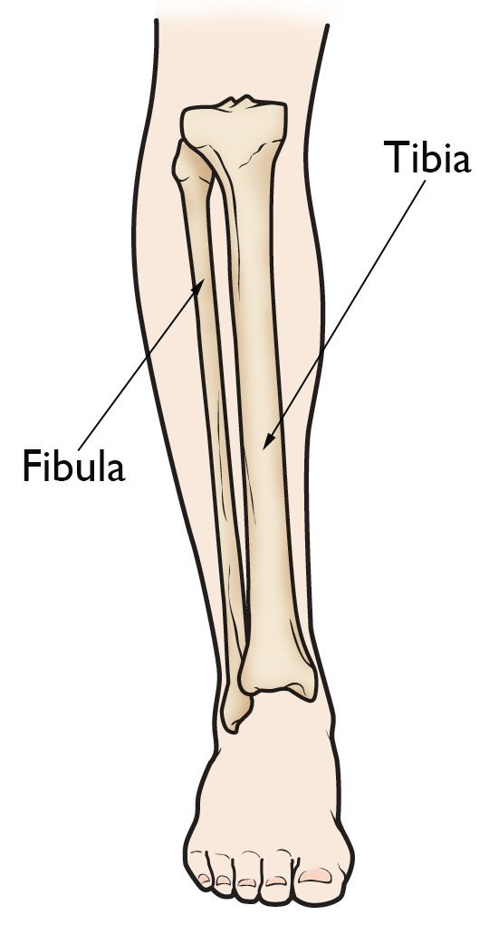
Tibia and Fibula
Tibia and Fibula
These bones are both in your lower leg. The tibia is the thicker shin bone, and the fibula is the slimmer bone. They both hold the lower leg muscles in place. Doesn’t give much support/ strength to the leg.

Slide 21
Do all animals have a skeleton inside?
No!
Many animals do not, like worms, jellyfish and flies.
All animals can be divided into 2 groups:
Vertebrates – animals with a backbone
Invertebrates – animals without a backbone
https://www.bbc.co.uk/bitesize/clips/ztfnvcw
https://www.bbc.co.uk/bitesize/clips/zmj8q6f

Slide 22
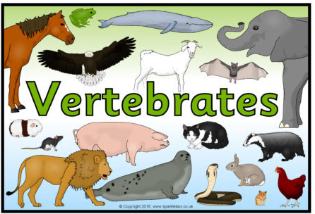
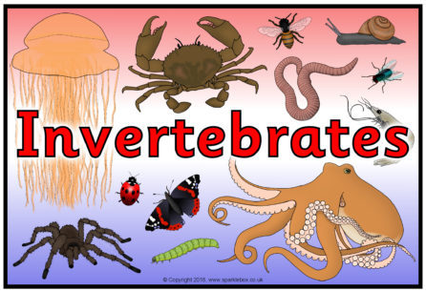

Slide 23
Vertebrate or Invertebrate?
Look at each animal picture and decide if you think it is a vertebrate (it has a backbone) or an invertebrate (it does not have a backbone).
There are 12 animals altogether.

Slide 24
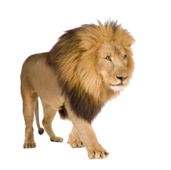
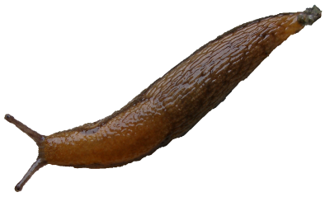
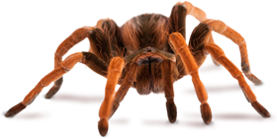

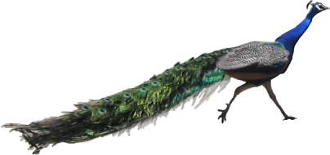
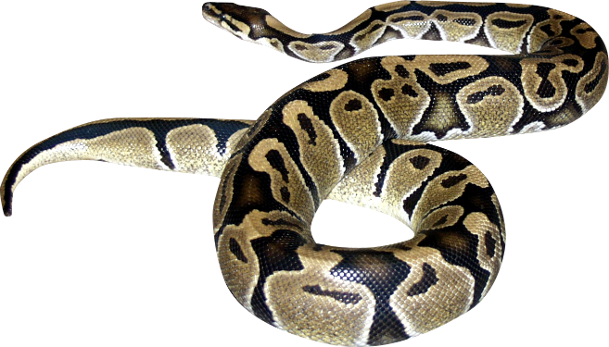
1. Tarantula
2. Lion
3. Slug
4. Cat
6. Python
5. Peacock

Slide 25
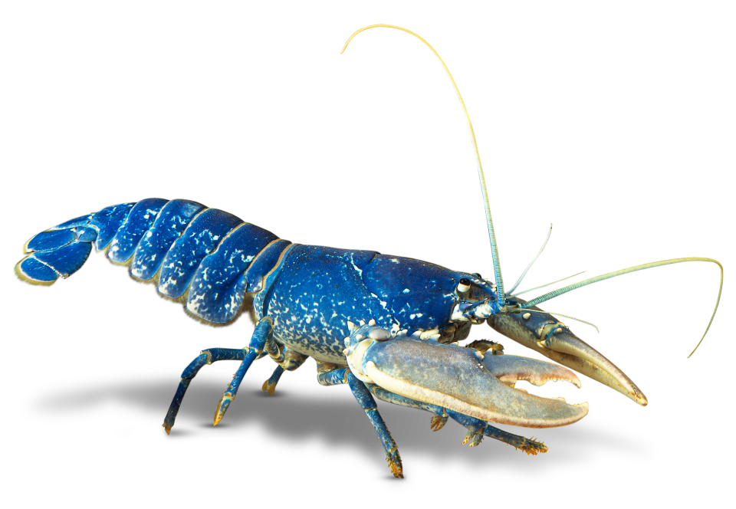
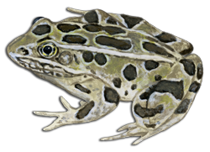
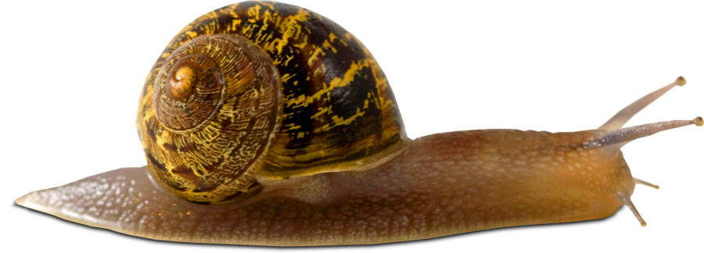
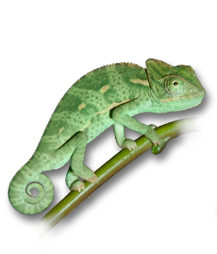
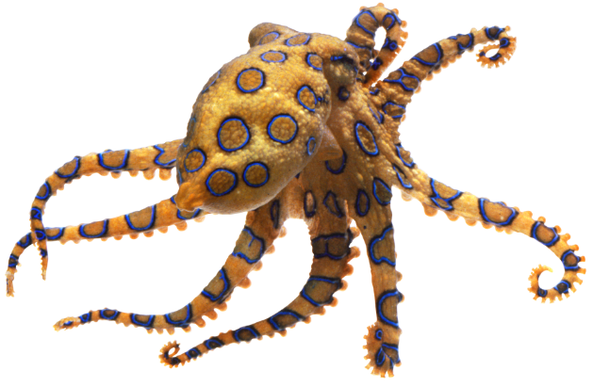
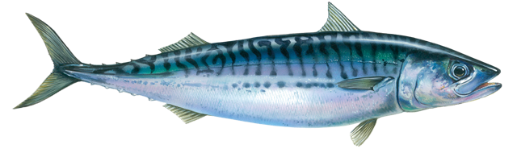
7. Lobster
8. Toad
9. Snail
10. Chameleon
11. Octopus
12. Mackerel

Slide 26
Let’s see how well you know your vertebrates from your invertebrates!
1. Tarantula
2. Lion
3. Slug
Invertebrate
Invertebrate
Vertebrate
4. Cat
6. python
5. Peacock
Vertebrate
Vertebrate
Vertebrate

Slide 27
7. Lobster
8. Toad
9. Snail
Invertebrate
Invertebrate
Vertebrate
10. Chameleon
11. Octopus
12. Mackerel
Vertebrate
Invertebrate
Vertebrate

Slide 28
Whole groups of animals can be classified as vertebrates or invertebrates.
For example, birds, mammals, reptiles, amphibians and typical fish are all….
Vertebrates
Which groups are invertebrates?
All insects, shell creatures like snails and shellfish, soft bodied creatures like jellyfish, squid, slugs and worms.

Slide 29

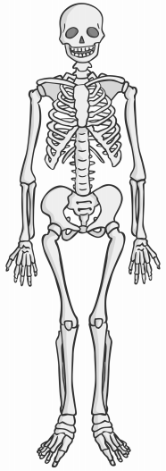
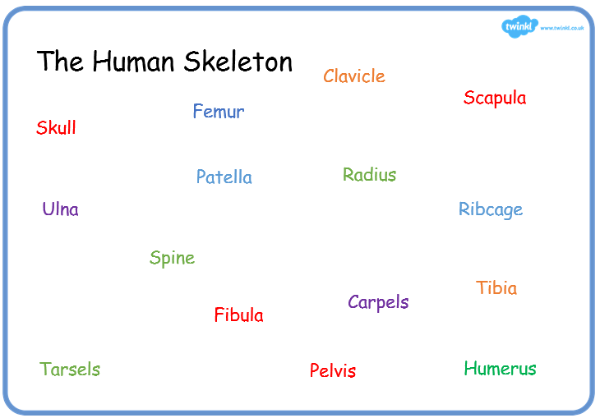
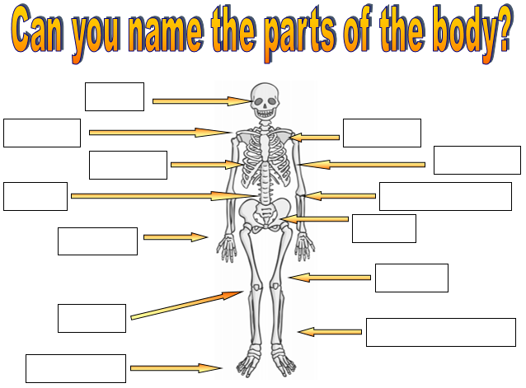
Paddling | Snorkelling | Diving
On your skeleton image; label and colour the bones that protect organs in the body. Red Pen: Why do our organs need protecting? | Create a large drawing of the human skeleton and label it using the word bank. Red Pen: Explain the different between a vertebrate and an invertebrate. | Complete the bone labelling sheet. Red Pen: How do some invertebrates protect their soft bodies? Is this a good form of protection? Explain your reasoning.

