Slide 1
Monday 23rd November 2020
LO: to write for purpose.
C: Newspaper Reports

Slide 2
Newspapers
Today we are going to look at features of newspaper articles.
Newspapers have a range of features that attract the reader.
Look at the examples of newspaper articles.
What do they look like?
How are they set out?
What is the same in each article?

Slide 3
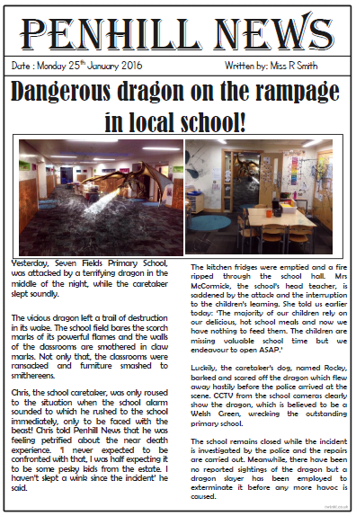
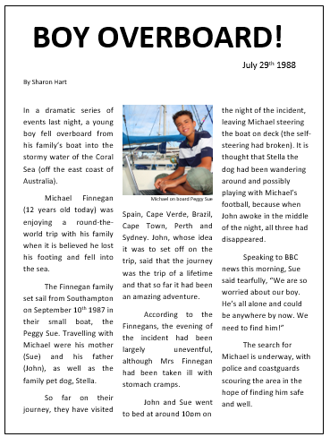

Slide 4

A newspaper report needs to…
Be about an interesting event;
Capture the reader’s attention;
Present factual information;
Be succinct and to the point;

Slide 5


The Essentials First
When the reader reads a newspaper report, they should be given the essential information first, so that they can decide if they wish to read more.
It is important that newspaper reports have the most important information coming first. This is called front-loading.

Slide 6
Structure of a newspaper report
Headline and byline
Lead
Body
Tail

Slide 7
Headline
Headline and byline
For a good headline, you need to:
Catch the reader’s attention so they want to read the rest of the report;
Sum up the story in a few words;
Use powerful and interesting language;
Write in the present tense – even if the report is about an event that has already happened;
Include alliteration or wit at times.
Lead
Body
Tail

Slide 8
Byline
Headline and byline
Lead
For a good byline, you need:
The writer’s name;
The writer’s speciality (for example, Sports reporter, Food correspondent, Crime editor, Deputy politic editor, Senior fashion reporter);
A link to the writer’s Twitter account (for example, @dgoodman).
Body
Tail

Slide 9
Lead
Headline and byline
For a good lead paragraph, you need to;
Make the paragraph short and snappy so that it briefly explains what has happened;
Ensure that, even if the reader stopped reading at this point, they would still know roughly what happened;
Use past tense in most cases;
Make sure the first paragraph answers as many of these six questions as you can –
Who? What? Where? Why? When? How?
Lead
Body
Tail

Slide 10
Body
For a good body section, you need to:
Add more information and detail to your lead paragraph;
Include background information, evidence, facts and quotes from people involved in or connected to the event/story;
Continue to write in order of importance, putting the most important information in the first few paragraphs of the body section.
Headline and byline
Lead
Body
Having quotes from witnesses or experts
will make your report more credible and interesting.
Tail
Be sure to use correct punctuation for quotes!

Slide 11
Tail
For a good tail section:
Give the reader the opportunity to gain additional information if they are particularly interested in the topic of the news report;
Include links to previous news reports or useful websites;
Include a final quote from a witness or expert that helps to sum up the story or that could hint at what might happen next.
Headline and byline
Lead
This ‘Tail’ information can be useful but is not always needed. It tends to be the least important information in the report.
Body
Tail

Slide 12
Example
headline
School Children Raise Funds for Local Charity
Frances Trackall, Education reporter
byline
A small group of Year 5 students from Arkwood Primary School have created a brilliant plan to raise money for a local charity that assists people in the community. Following a visit to the school from a charity representative, the students set out to create a way of raising much needed funds.
The students presented the fundraising idea to school principal Mrs Justine Knight, who saw great potential in the plan to sell produce from the school’s vegetable garden to local restaurants and, in turn, raise money for the local charity. She stated that ‘the children have displayed a true sense of community in their fundraising plan.’ Following a meeting with teachers, it is hoped that the students can begin to implement the four phase plan. ‘The school would support students wholly in the fund raising venture,’ Mrs Knight added.
The school plans to sell the garden produce to two local restaurants, beginning in early September. For more information on this fundraising plan, visit the Arkwood Primary School website (www.arkwood.sch.com).
lead
body
tail

Slide 13

Headlines
These are really important!
Would you read on if the headline was boring?

Slide 14

Headline!
Newspapers use headlines to grab your attention.
Headlines try to tell the story in as few words as possible.
Watery weather washes out Wales!
Driverless car ploughs through busy junction!’

Slide 15
Headlines!
Think of some possible headlines for the following news stories:
Noah finds a rock at the park that turns out to be a solid gold nugget.
Sienna finds a new species of cow on her holiday in Scotland.
Mrs Norman bakes a record breaking sausage roll for charity.

Slide 16
Headlines!
Gold nugget windfall for Winmill!
‘Moo’ving moment for cow girl!
Mighty meat treat for charity!

Slide 17
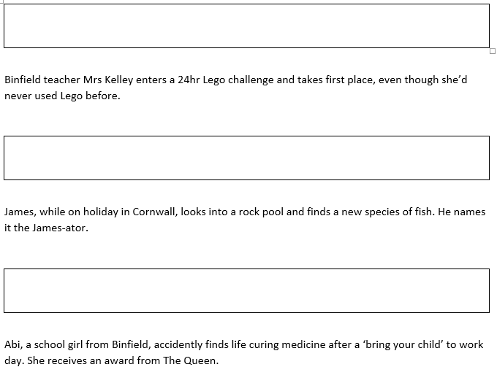
Activity
Look at the details of the news stories.
Write the headlines you have made up next to them.

Slide 18
Tuesday 24th November 2020
LO: to write for purpose.
C: Newspaper Reports

Slide 19

What is an adverbial?

Slide 20
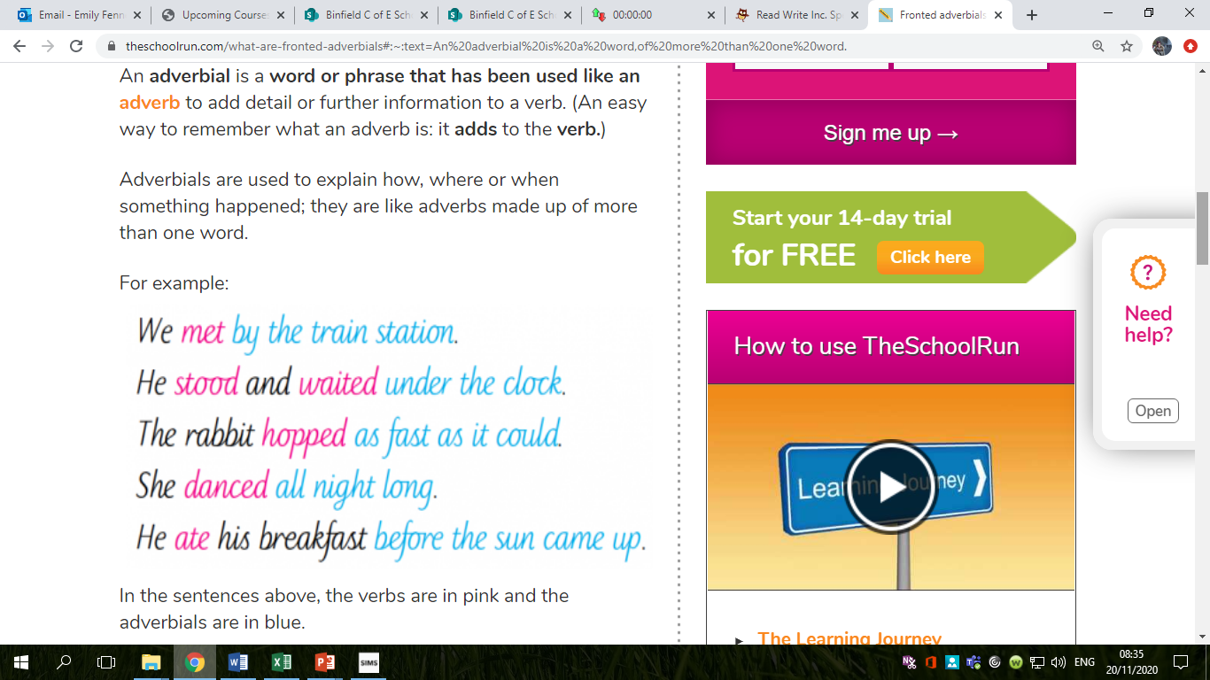

Slide 21
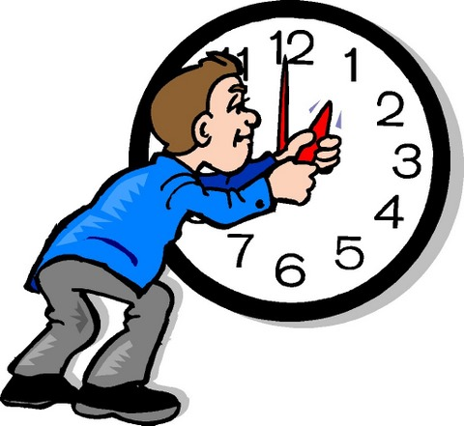
What is a time adverbial?
A time adverbial describes when, for how long, or how often a certain action/event has or will happen.
Robin Hood swindled the Sheriff of Nottingham yesterday.
Sarah is going to clean her house tomorrow.
Christmas is traditionally celebrated in December.
She stayed at her grandmother’s house all day.

Slide 22
Time Adverbials
Sometimes, you can even add them at the front!
Who can remember what that is called?
Yesterday, Robin Hood swindled the Sheriff of Nottingham.
Tomorrow, Sarah is going to clean her house.
In December, Christmas is traditionally celebrated.
However, sometimes they don’t quite work…
All day, she stayed at her grandmother’s house.

Slide 23
What might they look like in a newspaper report?
Late last night, there was an incident in Binfield park. An alien space craft, carrying strange purple men, was seen landing in the field. Before long, these peculiar purple men were seen playing on the slide and the swings and were reported by one eye witness as having the time of their lives. Tomorrow, alien investigators are expected to arrive to the scene and spend all day piecing together this puzzle.

Slide 24
Now it’s your turn…
What time adverbials can you think of linked to the Roman invasion that would work well in a newspaper report?

Slide 25
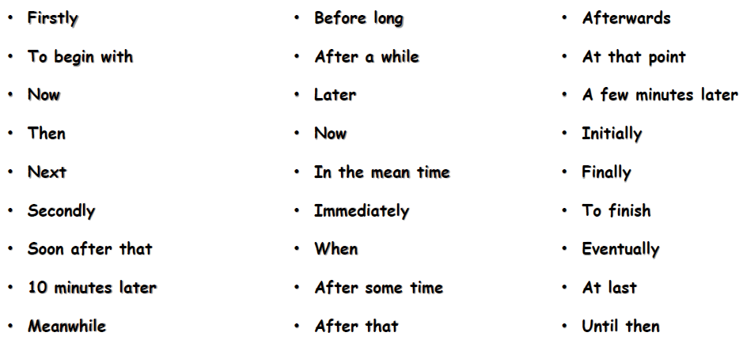
Time Adverbials

Slide 26
Activity
Paddling | Snorkelling | Diving
Think of some time adverbials for your newspaper report. Write some sentences about the Roman invasion with time adverbials that could be used in your report. | Think of some time adverbials for your newspaper report. Write at least 5 sentences about the Roman invasion with time adverbials that could be used in your report. | Think of some impressive time adverbials for your newspaper report (i.e. time adverbials you haven’t used before/time adverbials with more than one word). Write at least 6 sentences about the Roman invasion with time adverbials that could be used in your report.
Remember to use a comma after your time adverbial!

Slide 27
Wednesday 25th November 2020
LO: to write for purpose.
C: Newspaper Reports

Slide 28
Captions
When we look at newspapers there are often photos.
Under the photos there is writing that tells us what is happening in that picture.
These are called captions.

Slide 29
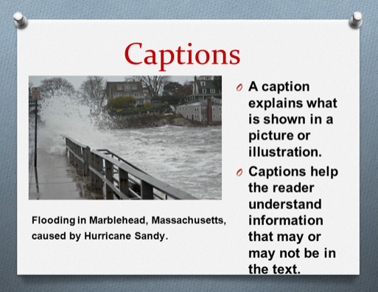

Slide 30
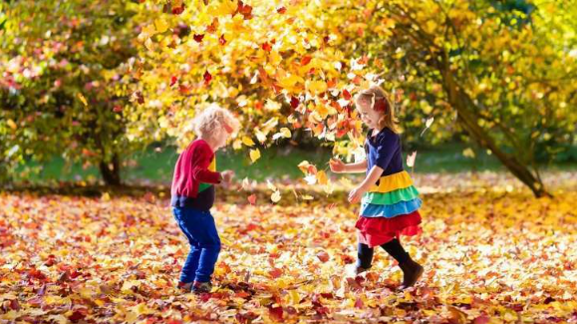
Can you caption this?
Remember, a caption just states what you can see.

Slide 31
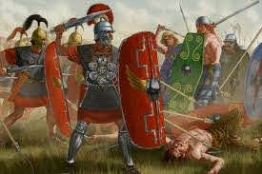
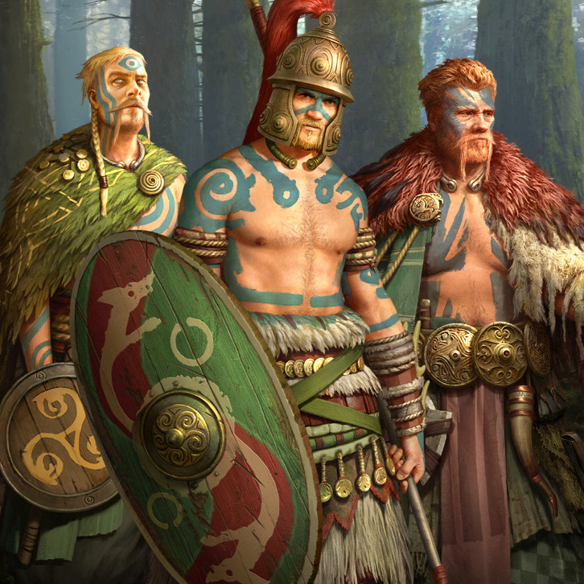
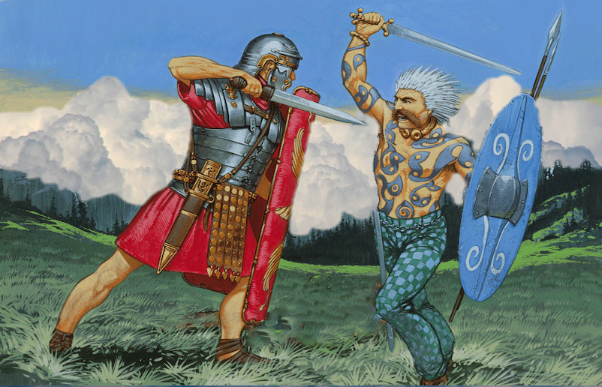
Think of some captions for these pictures.

Slide 32
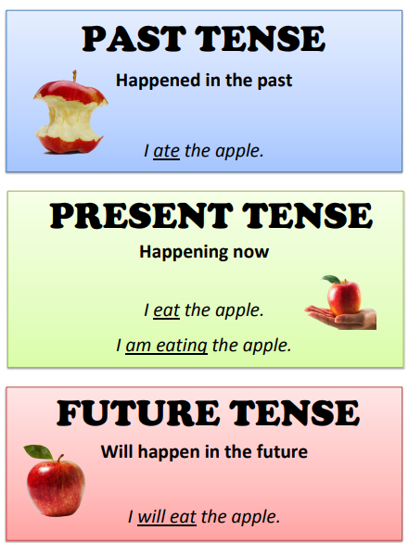
Tenses
Newspapers are written mainly in past tense .
The last paragraph tends to look towards the future and what will happen next.
https://www.bbc.co.uk/bitesize/topics/z88t97h/articles/z3dbg82
https://www.bbc.co.uk/bitesize/topics/z4hrt39/articles/z7t2vk7

Slide 33
Can you write the below verbs in past tense?
Make sure you set it out with 2 columns. I’ve done the first one for you…
Present tense | Past tense
Walk | Walked
Ask
Go
Run
Fight
Paddling – write one sentence using one of the words.
Snorkelling – write two sentences using two of the words and conjunctions.
Diving – write two sentences using two of the words, conjunctions and fronted adverbials.

Slide 34
Red Pen Marking
Mark your work – correct any mistakes (including spellings) and make sure you write SA next to your work.
Present tense | Past tense
Walk | Walked
Ask | Asked
Go | Went
Run | Ran
Fight | Fought

Slide 35
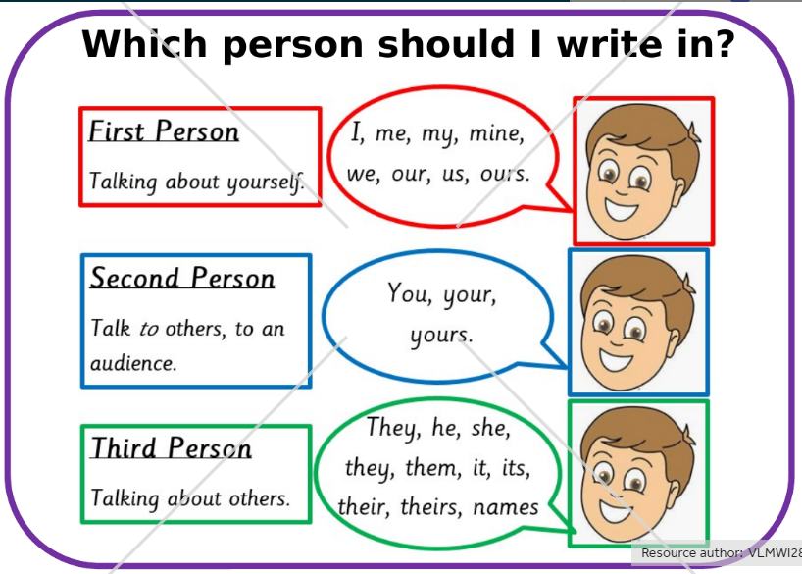
1st, 2nd or 3rd person.
Newspapers are written mainly in 3rd person.
https://www.bbc.co.uk/bitesize/topics/z88t97h/articles/zxdhsg8
https://www.bbc.co.uk/bitesize/clips/zt3nvcw

Slide 36
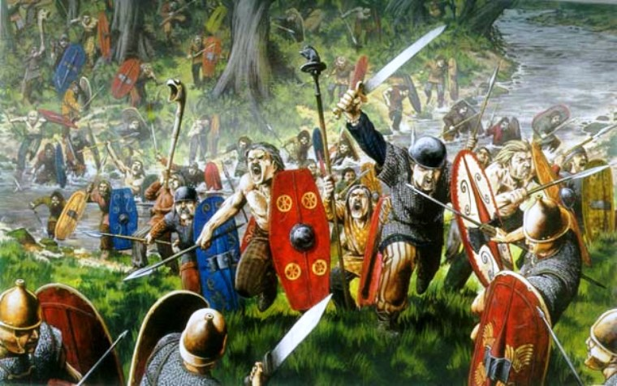
Write a sentence about the Roman invasion in 1st, 2nd or 3rd person.
1st – I (You are a Roman soldier invading).
2nd – You (You are talking to the Roman soldier and telling him what he did).
3rd – Him, He, Her, She, They (You are talking about what the Roman soldier did).
Write some more sentences if you are finished. Try to use conjunctions or fronted adverbials.

Slide 37
Thursday 26th November 2020
LO: to write for purpose.
C: Newspaper Reports

Slide 38
Who might have been at the Roman invasion?

Slide 39
Who might have been at the Roman invasion?
Roman Emperor
Roman soldier
Roman citizen
Celt soldier
Celt citizen

Slide 40

Think about the eyewitnesses from the Roman invasion.
What might they have said?
What would they have seen?
How would they have felt?

Slide 41
Quotes are short snippets of speech that has to be exactly what the eyewitness has said.
What might the eye witnesses have said about the Roman invasion?
Write what they might have said in a speech bubble.

Slide 42


“QUOTES”
Quotations tell us what has been said and who said it. They can help to tell the story by giving the reader the opinions of the people involved.
e.g. Class teacher for Year 4, Mrs Norman said “They are a lovely class of children and I really like teaching them.”
“It was the scariest moment of my life!” the 28 year old home owner told us.
“They’re lucky to be alive!” said Sam Fenton, (35) Chief Fire Officer for Greater Manchester Fire Service.
Are these quotes FACTS or OPINIONS?

Slide 43
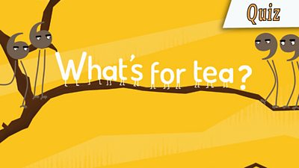
Quotes
We’re going to put our character’s bubble speech quotes into real quotes.
Remember the rules: https://www.youtube.com/watch?v=k7TZ7lyALjg&feature=emb_logo

Slide 44
Rules of speech – using inverted commas.
66 – open with a 66 (it sits above the 1st letter).
CAPITAL letter to start your first word.
Punctuation after what is said - ! ? . ,
99 – close speech (it sits above the punctuation)
Then you can write who said it (although this can be at the front sometimes).

Slide 45

Careful!
It’s not like a story when you write:
Cried the poor, injured soldier.
It’s more factual:
Eyewitness Caesar Augustus told us.
Stated the Emperor of Rome.
A Roman soldier reported.

Slide 46
Activity
Paddling | Snorkelling | Diving
Using the prompt sheet, write one quote for each eyewitness. | Using the prompt sheet, write at least one quote for each eyewitness. | Write two quotes for each eyewitness. Ensure your punctuation is correct!
Stated
Reported
Remarked
Commented
Claimed
Declared
Suggested

