Slide 1
Monday 9th November 2020
LO: Write with purpose.
To use imaginative description.
C: Roman Gods

Slide 2

Starter: Five Sentence Story
Once upon a time | One day | Unfortunately | Luckily | Finally
Create a story starting each sentence with the given connectives.
For example:
Once upon a time, there was a princess who lived in a tower.
One day, she climbed down the tower and escaped.
Unfortunately, the wicked king chased her.
Luckily, she grew wings and flew away.
Finally, she found a little village where everyone had wings.
You could create a story about ANYTHING!

Slide 3
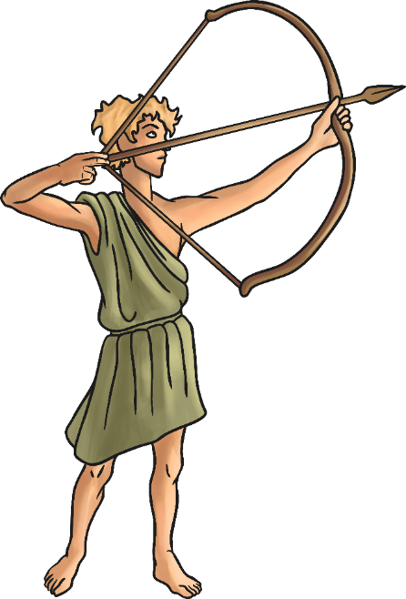
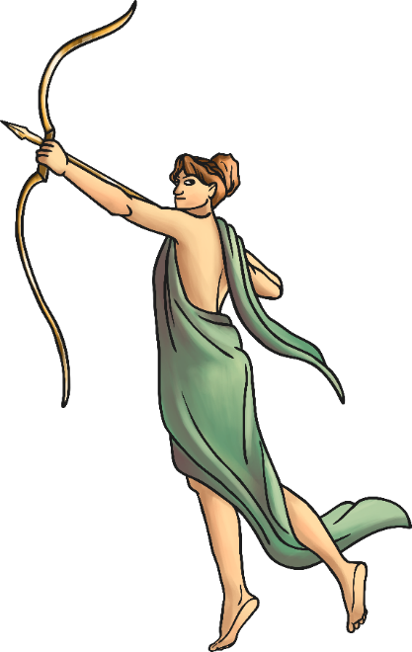
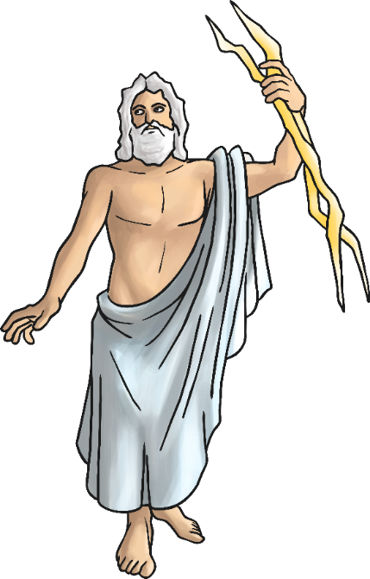
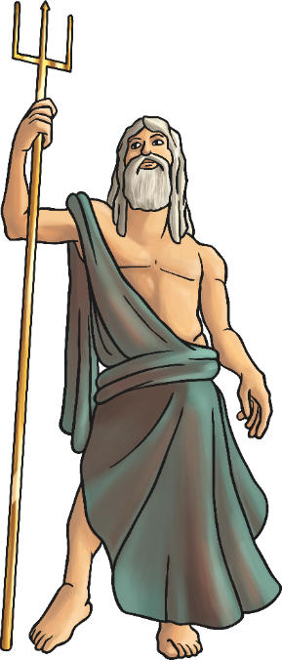
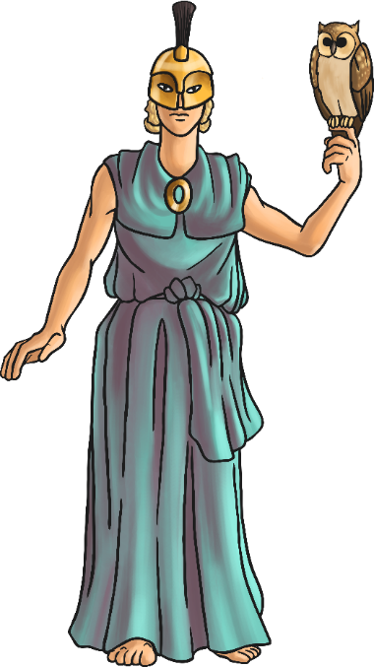
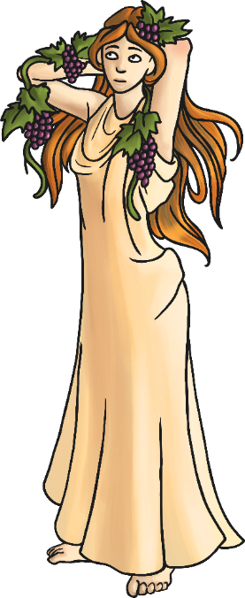
You are going to write your own Roman God story today!
Your story will have:
- a beginning
- a middle
- an end

Slide 4
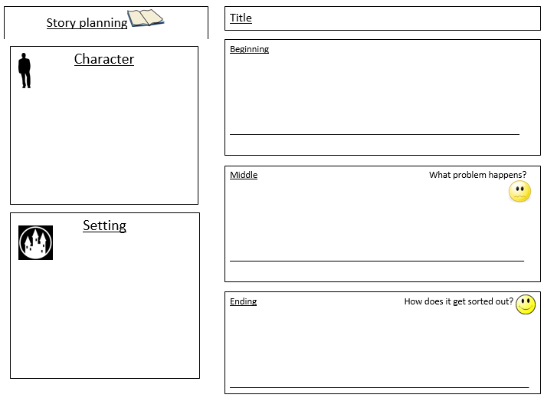
My story plan
Eddie was the God of Education – he helped children to learn.
Flew on a comfortable, hovering brain to watch children learning.
Looks: lightbulb above his head, bright, blue eyes, alphabet tunic, elephant-like ears.
Weapon: a sharpened, pointed pencil.
Eddie – the God of Education
An intelligent, thoughtful God.
He visited the Roman children in school to help them learn but they asked him a question that he couldn’t answer.
Eddie panicked and decided he couldn’t be the God of Education anymore because he didn’t know everything.
The growing, bustling city of Rome in Italy.
Eddie’s neat, tidy Roman house.
The busy, noisy school.
The children visited Eddie at his house and taught him that no one can know everything! We are all learning new things every day. The children and Eddie worked together to find the answer to the question and Eddie agreed to be the God of Education again.

Slide 5

What could happen in your story?
Jot down your thoughts and ideas on whiteboards.

Slide 6
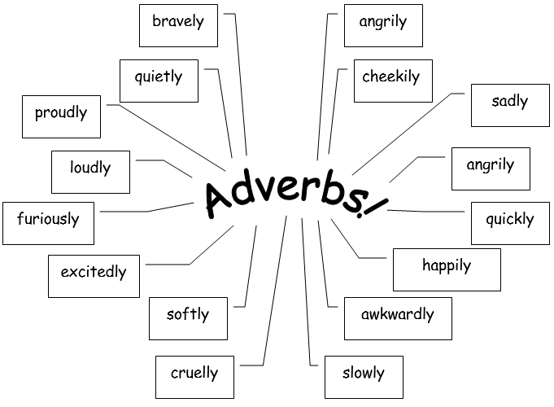
Activity: complete the planning template.
Red pen: annotate your plan with expanded noun phrases and adverbs that you could use in your story.

Slide 7
Tuesday 10th November 2020
LO: Write with purpose
Use imaginative description.
Use sentences appropriately.
C: Roman Gods

Slide 8
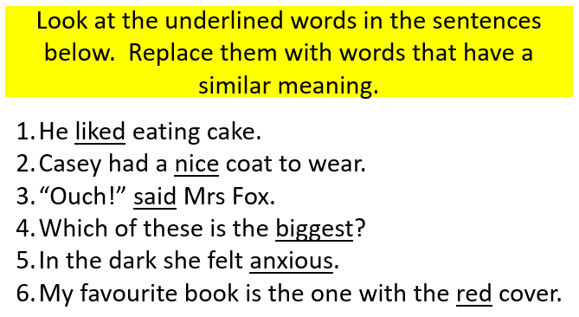
Starter: How many different words can you think of?

Slide 9
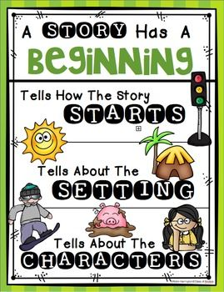
Today you are going to be writing the beginning of your story.
Your beginning should include:
- explaining who your God is
- describing your God
- describing what your God does

Slide 10

Example
More than two thousand years ago in a growing, bustling city called Rome, lived an intelligent, thoughtful God called Eddie. He was the God of Education, and it was his sole priority to ensure every small, uncertain child in the land learned something brand new each day. You would often see Eddie riding on a comfortable, hovering brain, so he could watch the young, innocent children learning in school.
Eddie was easily distinguishable by the bright, burning lightbulb which hovered above his head, and lit up, when he had a brilliant idea. He had bright, blue eyes which glowed with excitement, when he noticed dedicated, focused children learning. Because he had to listen carefully to everything that was going on, he had large, elephant-like ears which stuck out from his face. If you looked carefully at his smart, beige tunic, you would notice the letters of the alphabet sewn into the soft, delicate fabric.
Although he tried to use his knowledge as power, he did carry a towering, sharp pencil which he used as a deadly, frightening weapon. If anyone unkindly tried to stop children learning, he poked them angrily with the sharpened, pointed tip.

Slide 11

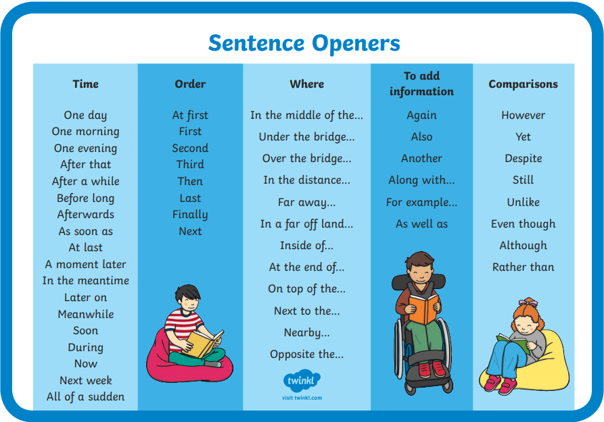
Look at the sentence starter word mat and create sentences for your stories which use these interesting sentence starters.

Slide 12
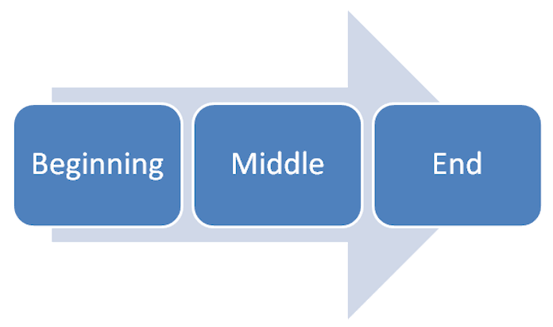
Activity
Write the beginning of your story.
Your beginning should include:
- explaining who your God is
- describing your God
- describing what your God does
Remember to include:
- correct punctuation
- expanded noun phrases
- conjunctions
Red Pen: use a thesaurus to improve the adjectives you have used.

Slide 13
Wednesday 11th November 2020
LO: Write with purpose
Use imaginative description.
Use sentences appropriately.
C: Roman Gods

Slide 14

Starter:
Spend 10 minutes looking back at your work from last lesson.
Use a red pen to make any corrections or improvements.

Slide 15

Today you are going to be writing the middle of your story.
Your middle should include:
- a problem occurring
- describing what the problem is
- describing how your God reacts to the problem
(e.g. his actions, feelings etc.)

Slide 16
Example
Early one morning, Eddie was noisily getting ready for his important, godly duties. He woke up as the warm, golden sun began to rise, and he quickly dressed in his lengthy, clean tunic. After his breakfast of juicy, red grapes, Eddie jumped excitedly on his pink, slimy brain, and flew rapidly to the local school. As soon as he arrived, a large, noisy crowd of excited, eager children surrounded him. He smiled broadly, as they shouted at him, desperate to share what they had been learning.
One small, nervous child tiptoed over to Eddie and timidly pulled at the bottom of his brand new, hand-stitched tunic. Without hesitation, Eddie kindly knelt down. “What is XXXVIII add XLVIII?” asked the little, brown-haired boy. Immediately, Eddie’s thick, dark brow furrowed, while the fragile, glass lightbulb above his head flickered uncertainly. He repeated the question over and over again, but his brilliant, clever mind was blank! His bright, blue eyes bulged nervously, as he desperately looked around for someone to help him. Unsure of what to do, he promptly turned and ran quickly back to his safe, quiet house.

Slide 17
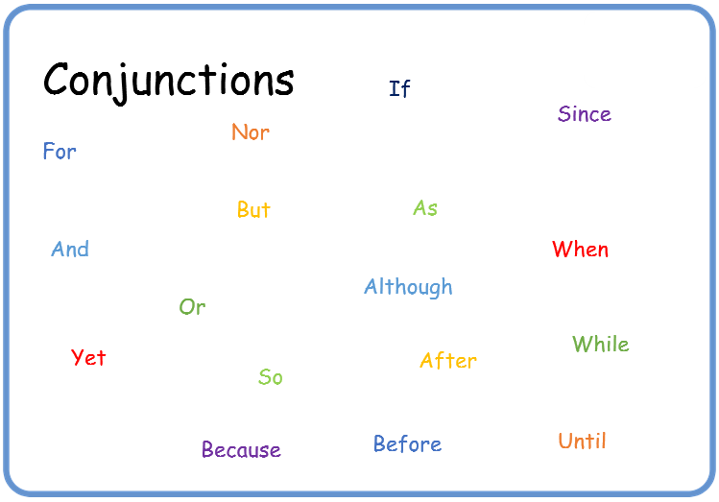
Look at the conjunction word mat and create sentences for your stories which use these conjunctions.

Slide 18
Activity
Write the middle of your story.
Your middle should include:
- a problem occurring
- describing what the problem is
- describing how your God reacts to the problem (e.g. his actions, feelings etc.)
Remember to include:
- correct punctuation
- expanded noun phrases
- conjunctions
Red Pen: use subordinate conjunctions at the start of a sentence.

Slide 19
Thursday 12th November 2020
LO: Write with purpose
Use imaginative description.
Use sentences appropriately.
C: Roman Gods

Slide 20
Starter:
Spend 10 minutes looking back at your work from last lesson.
Use a red pen to make your corrections and improvements.

Slide 21
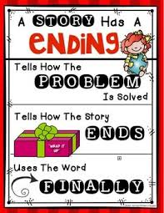
Today you are going to be writing the end of your story.
Your end should include:
- the problem being resolved
- describing how the problem is resolved
- describing how your God reacts to the solution
(e.g. his actions, feelings etc.)

Slide 22
Example
Thick, salty, wet tears fell from Eddie’s sad, dull, blue eyes, as he entered his familiar, comforting house. His usually bright, glowing lightbulb hovered darkly above his head. How could he be the God of Education if he couldn’t answer a simple question? Eddie repeated the many, confusing letters over and over again, but he still couldn’t work out the answer. He hung his head in shame.
As a gentle, quiet knock sounded on the door, Eddie jumped in surprise. He walked slowly and ashamedly to the towering, wooden front door, and opened it. To his surprise, there was a long, winding line of children queueing neatly one behind the other! “It doesn’t matter that you don’t know the answer Eddie!” They shouted happily. “We’ll work it out together!”
All of the kind, considered children bundled inside Eddie’s small, cramped house, and took out a piece of thick, yellow papyrus. Kindly, the considerate, caring children showed Eddie how to work out the difficult calculation. Afterwards, Eddie smiled happily, as he realised that no one can know everything, but we can always work things out together!

Slide 23

Prepositions
We can add information to our expanded noun phrases using prepositions.
What is a preposition?

Slide 24
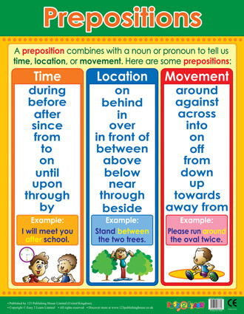

Slide 25
Look at the preposition word mat and create sentences for your stories which use prepositions to add information to your expanded noun phrases.
For example:
She wears a blue, patterned dress which almost touches the floor.
He gripped his deadly, pointed spear with a wooden handle.

Slide 26
Activity
Write the end of your story.
Your end should include:
- the problem being resolved
- describing how the problem is resolved
- describing how your God reacts to the solution (e.g. his actions, feelings etc.)
Remember to include:
- correct punctuation
- expanded noun phrases
- conjunctions
Red Pen: add extra information to your expanded noun phrases using prepositions.

