Slide 1
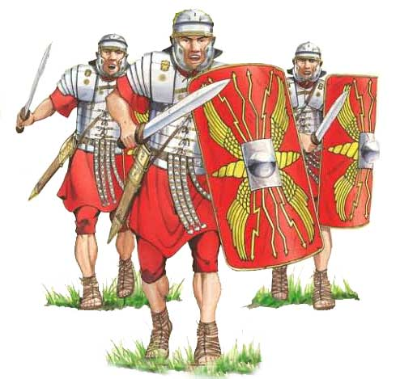
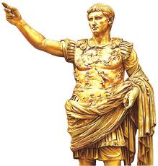
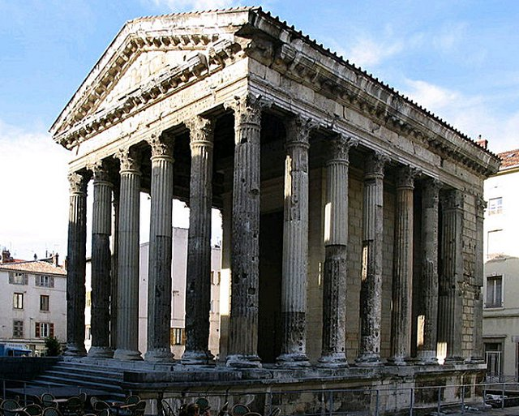
LO: Build an overview of world history.
Understand chronology.
C: Roman life.

Slide 2
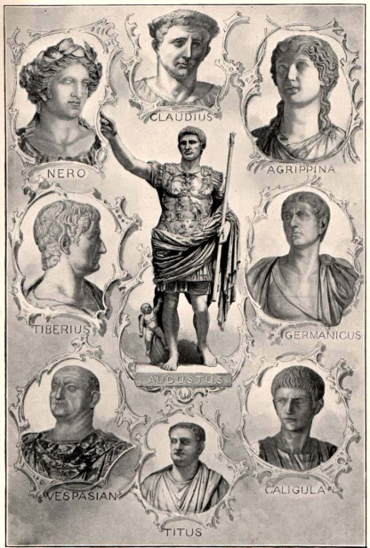
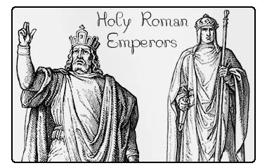
Roman Emperors
In the beginning Rome was ruled by kings. However, as the city’s power grew senators and army generals fought to control the lands.
Eventually one person took over, the Emperor.

Slide 3
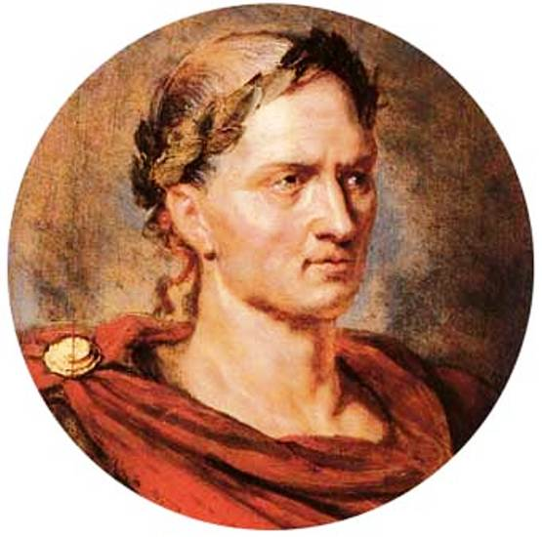
Roman Emperors
Many people thought the
famous Roman General Julias
Caesar would be the first Roman
Emperor.
Caesar was a powerful general.
He extended the Roman Empire through Europe and into Britain.
Unfortunately, Caesar was murdered by a group of people who did not like his decisions, so he didn’t not become emperor.

Slide 4
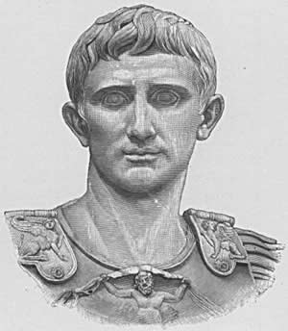
Roman Emperors
A few years after Caesars death in 27 BCE, his nephew Augustus Caesar became the first of 49 emperors of Rome.
Augustus ruled from 27 BCE to 14 BCE.

Slide 5
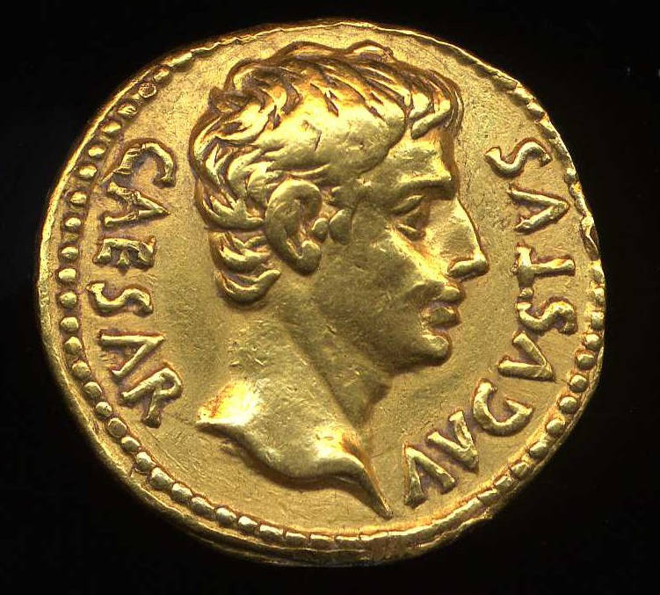
Roman Emperors
Roman emperors were very powerful and were in charge of all laws. The emperors head was stamped on Roman coins.
Emperors were worshipped like Gods. Temples were built in their honor all over the empire.

Slide 6
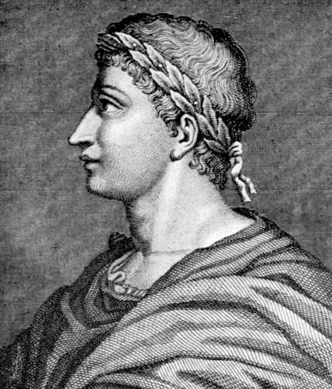
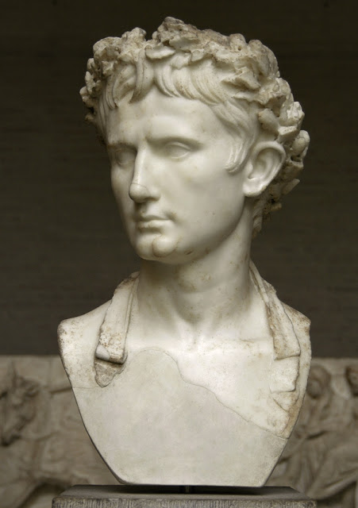
Roman Emperors
Emperors were not kings and they did not wear crowns. They wore wreaths made from Laurel to celebrate victory and power.

Slide 7
Task 1
Using the information we’ve just looked at, write a short paragraph about Roman Emperors.
What was their purpose?
Why were they so powerful?
How did people show their respect towards them?

Slide 8
Roman Life
What was life like for a Roman family?
Life for women in Roman times was often hard. The mother was less important than father in the family. The father had the power of life or death over everyone.
When a new baby was born it would be laid at its father's feet - if the father picked the baby up it would live, but if he ignored the baby it would be taken away to die.
Women were expected to run the home, cook meals, and raise children. If they were wealthy, women were lucky; they had slaves to do the work.
Many girls were married at the age of 14. Marriages were often arranged between families. A man could divorce his wife if she did not give birth to a son. Many women died young (in their 30s), because childbirth could be dangerous, and diseases were common. Now we have fantastic health care and Science to keep us safe and healthy.

Slide 9
Roman Life
If you were a rich family during the Roman Empire you would have had a slave.
Slaves were either born as slaves or were captives of war. They worked hard as household slaves or on farms or building sites. They were not paid for their work.
Slaves could be badly treated, but sometimes they were treated as members of the family.

Slide 10
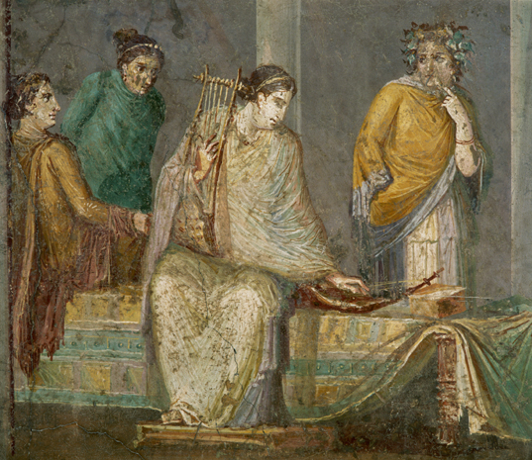
Roman Life

Slide 11
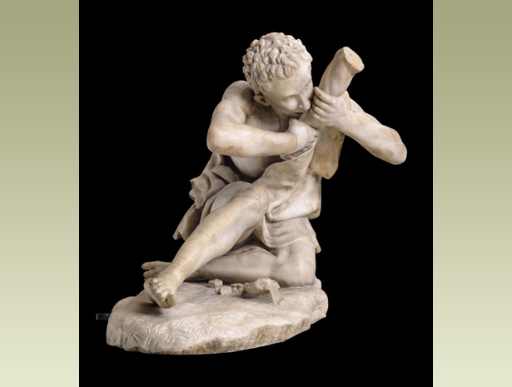
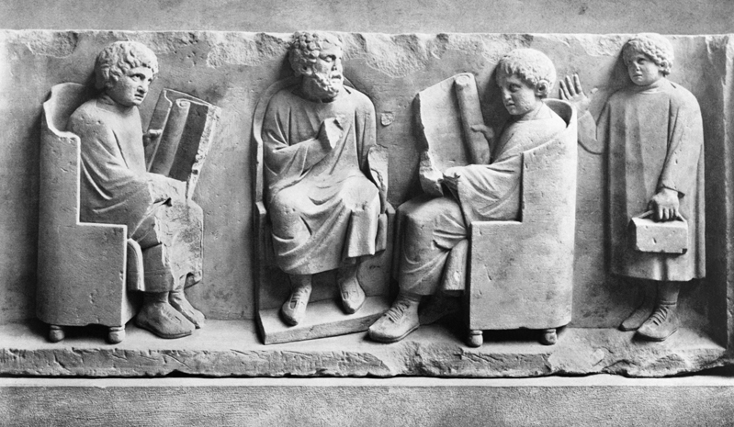
Roman Life
Did Romans go to school?
Most children in Roman times did not go to school. Only quite rich families could afford to pay a teacher. Most schools were in towns. Not many girls went to school, but some were taught at home by tutors, who were often educated slaves. Boys from rich families learned History, Maths, and Literature at school, to prepare them for jobs in the army or government.
In poor families, girls and boys had to work, helping their parents.

Slide 12
Roman Life
What did Romans eat?
Poor Romans ate bread, vegetable soup, and porridge. Meat was a luxury, unless they lived in the countryside and could go hunting or fishing.
Poor people's small homes had no kitchens. So they often took food round to the baker to cook in his oven. Many people bought takeaways, such as sausages or fried fish, from food-shops.
Rich Romans had food cooked at home in the kitchen by slaves. Most ate a light breakfast, and a snack at mid day - perhaps bread and cheese, or boiled eggs and salad. They ate dinner in late afternoon, with a starter, a meat course (such as hare, pig, beef, goat, chicken, fish or pigeon) followed by fruit or nuts. Ice cream was a treat. Lettuce was served at the end of a meal because Romans believed it helped you sleep.

Slide 13
Roman Life
What were Roman toys like?
Roman children had some toys very like ones we play with today - such as toy soldiers, rattles, balls, doll's houses, carts and pull-along animals on wheels.
Even poor children had board games using pebbles for counters and wooden dolls. Some dolls had moveable arms and legs. Roman children had ivory letters to practise their spellings with. Favourite Roman pets were dogs, birds and monkeys.

Slide 14
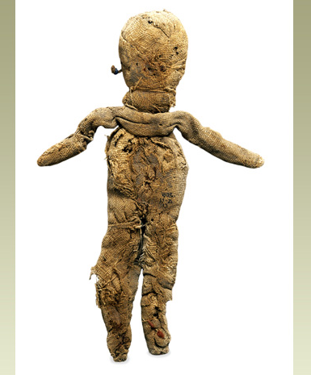
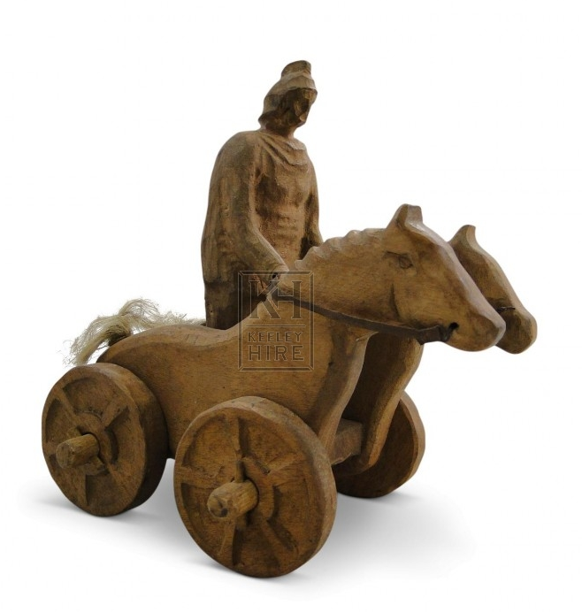
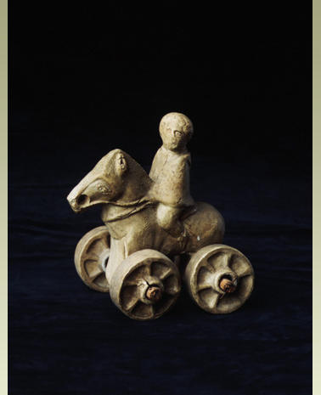
Roman Life

Slide 15
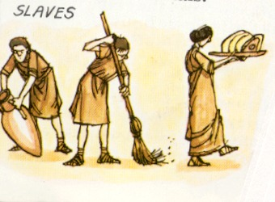
Roman Life

Slide 16
Task 2
Paddling | Snorkeling | Diving
With you parents talk about the comparisons between our lives and the lives of Romans. Would you like to live in Roman times? Explain your answer. | Divide you page into 4. Title each box as: family School food toys. Make comparisons between our lives and the lives of Romans. Were Roman times a good time to live? Explain your answers. | Write 4 paragraphs making comparisons between our lives and the lives of Romans. Title each paragraph as: family School Food toys. In your opinion, did the Romans live a good life?

