Slide 1


Slide 3
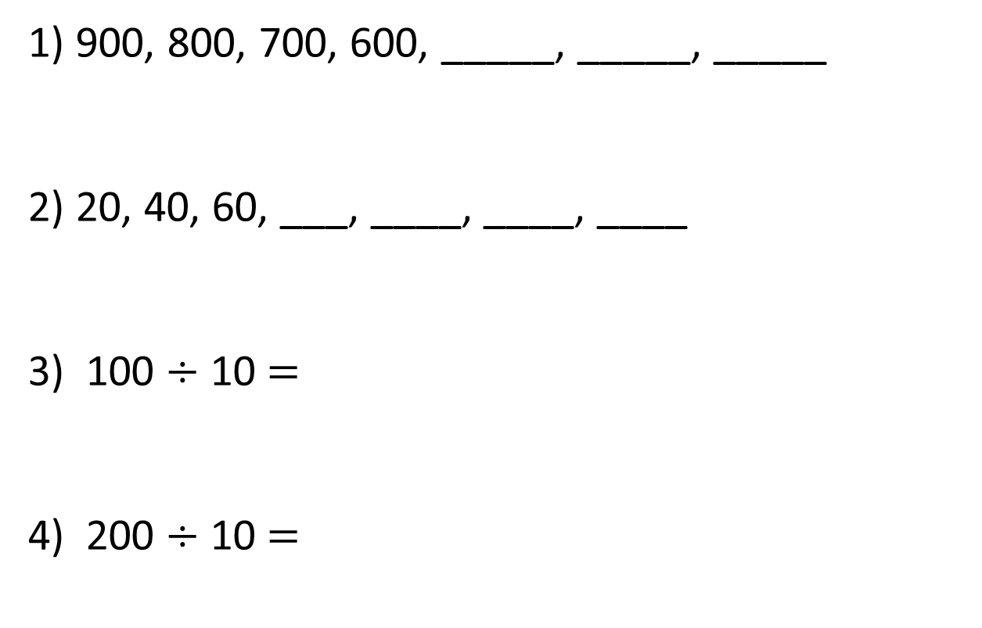
1) 900, 800, 700, 600, _____, _____, _____
2) 20, 40, 60, ___, ____, ____, ____
3) 100 $÷$ 10 $=$
4) 200 $÷$ 10 $=$

Slide 4
500
300
1) 900, 800, 700, 600, _____, _____, _____
2) 20, 40, 60, ___, ____, ____, ____
3) 100 $÷$ 10 $=$
4) 200 $÷$ 10 $=$
400
80
100
120
140
10
20

Slide 6
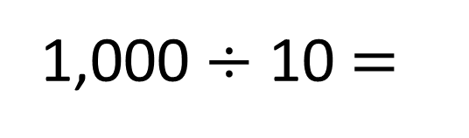
Complete the number line.
1,000
0
100
200
300
400
500
600
700
800
900
1,000
1,000 $÷$ 10 $=$
100

Slide 7
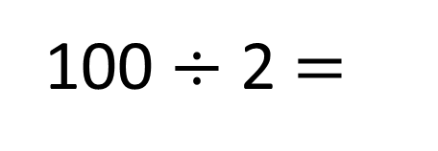
Write the missing numbers.
200
850
0
100
200
500
800
900
1,000
100 $÷$ 2 $=$
50

Slide 9
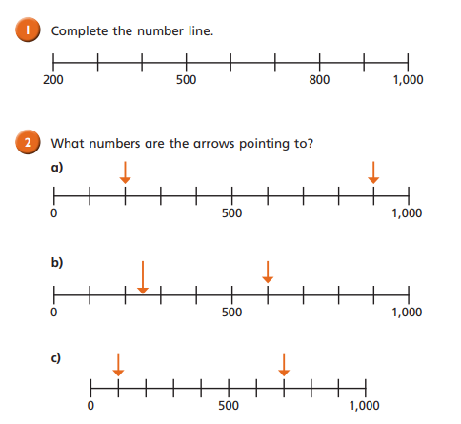

Slide 10
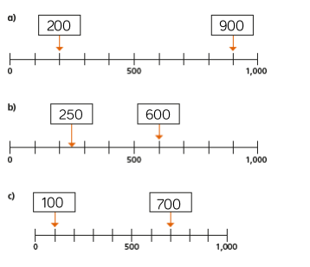

Slide 11
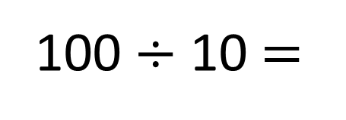
Complete the number line.
100
300
310
320
330
340
350
360
370
380
390
400
100 $÷$ 10 $=$
10

Slide 12
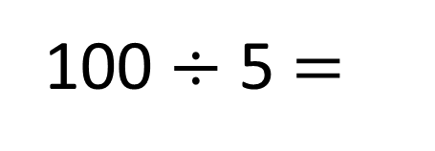
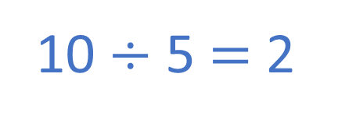
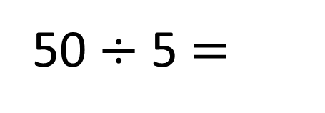
100
300
320
340
360
380
400
20
100 $÷$ 5 $=$
What’s different?
What’s the same?
10 $÷$ 5 $=$ 2
50
300
310
320
330
340
350
10
50 $÷$ 5 $=$

Slide 14
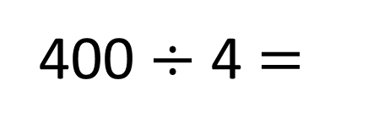
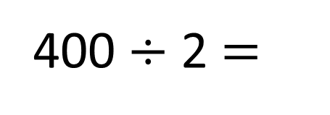
Estimate where 150 goes on the number line.
400
0
100
150
200
300
400
200
400 $÷$ 2 $=$
100
400 $÷$ 4 $=$

Slide 15
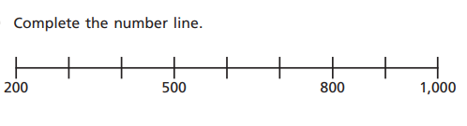
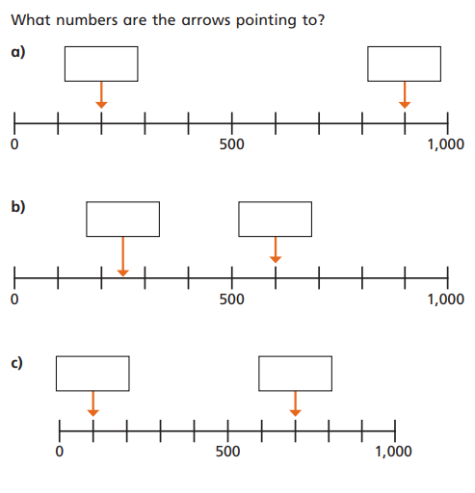
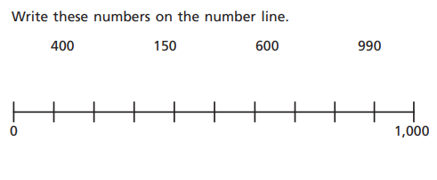
Task

